Slide 1

Of First Importance
“Christ died for our sins in accordance with the Scriptures, that he was buried, that he was raised on the third day in accordance with the Scriptures”
(1 Corinthians 15:3–4)
Notes:
Note that “in accordance with the Scriptures” is so important, it is repeated
Note His death is foundational
Note His burial is foundational
Note His resurrection is foundational

Slide 2
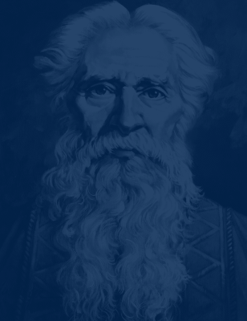
The Prophecy
Isaiah 53:4-11
Notes:
Notice this prophecy says that he will die (vv. 7-8)
That he was to be buried (v. 9)
That He Shall Thereafter See and His days would be prolonged (vv. 10-11)

Slide 3

The Death and Burial
Matthew 27:27-60
Notes:
He was stripped, mocked, beaten and spat upon
They crucified Him and watched Him die among wicked men
They buried Him in the tomb of a rich man

Slide 4
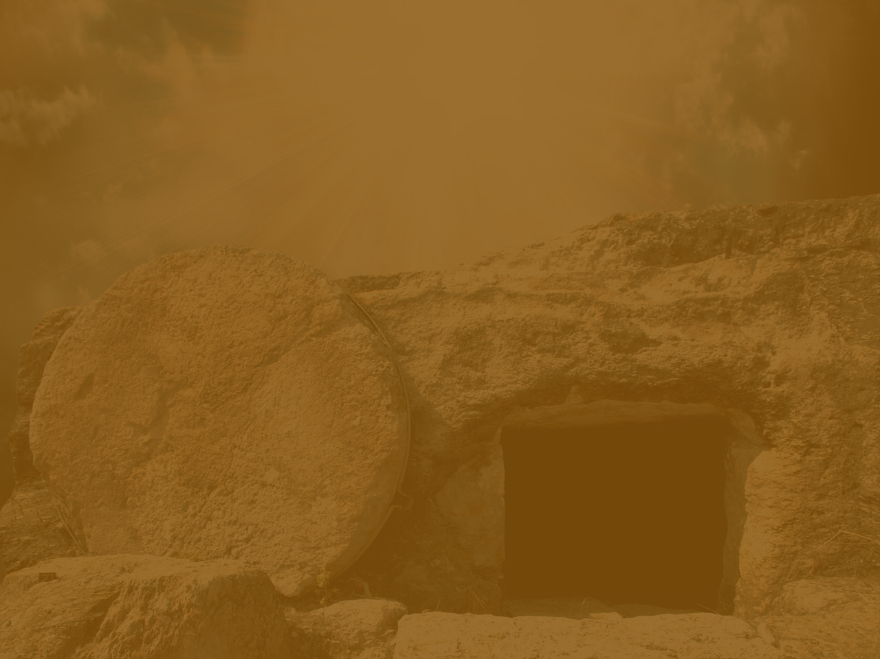
The Empty Tomb
Luke 23:54-24:12
Notes:
It was the First Day of the week, just like today (24:1)
His body, however, was no longer in the tomb that they had seen Him buried in (23:55, 24:3)
They were confused, scared, their story was doubted, it was confirmed by one who knew him well and he marveled at the fact of His resurrection. (24:4-5, 11, 12)

Slide 5

What Is The
?
Romans 1:1-4, 14-16
Notes:
Jesus was declared to be the Son of God in power… by his resurrection from the dead (v. 4)
Obligation to share this record with all nationalities, whether they are spiritually wise or not (v. 14)
This story is the power of God unto salvation to everyone who believes. (v. 16)

Slide 6

Do You Believe?
“Whoever believes and is baptized will be saved, but whoever does not believe will be condemned.” (Mark 16:16 ESV)
Notes:
Jesus was declared to be the Son of God in power… by his resurrection from the dead
Obligation to share this record with all nationalities, whether they are spiritually wise or not
This story is the power of God unto salvation to everyone who believes.

