Slide 1
Jesus Cares for all…
Here, he particularly singles out children.
You gotta be like a little child to enter the kingdom of Heaven.

Slide 2
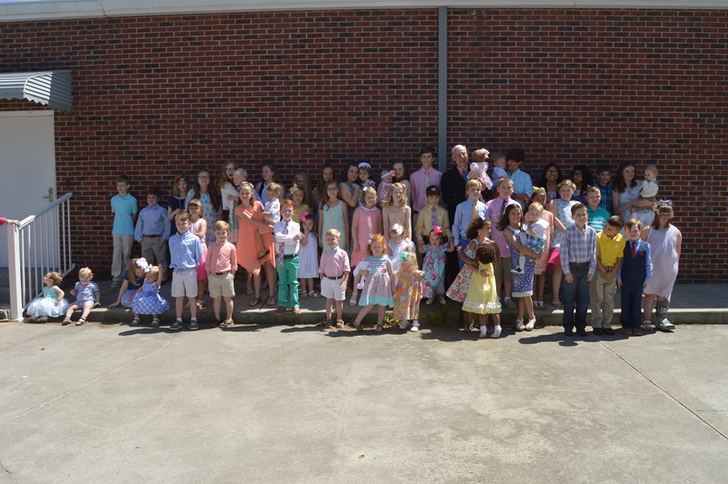

Slide 3
What will these children look like in 20 years from now?
What will these children be doing 20 years from now?
So much depends on us!
What is God’s plan for you children?

Slide 4
Matt 18:1-6 Who will be the greatest in the kingdom of heaven?

Slide 5
Matt. 18:1-6 At the same time came the disciples unto Jesus, saying, Who is the greatest in the kingdom of heaven?
² And Jesus called a little child unto him, and set him in the midst of them,
³ And said, Verily I say unto you, Except ye be converted, and become as little children, ye shall not enter into the kingdom of heaven.
⁴ Whosoever therefore shall humble himself as this little child, the same is greatest in the kingdom of heaven.
⁵ And whoso shall receive one such little child in my name receiveth me.
⁶ But whoso shall offend one of these little ones which believe in me, it were better for him that a millstone were hanged about his neck, and that he were drowned in the depth of the sea.

Slide 6
Matt. 19:13-15 Rebuking little children… Jesus does not have time for you? Wrong!
¹³ Then were there brought unto him little children, that he should put his hands on them, and pray: and the disciples rebuked them.
¹⁴ But Jesus said, Suffer little children, and forbid them not, to come unto me: for of such is the kingdom of heaven.
¹⁵ And he laid his hands on them, and departed thence.

Slide 7
And as children grow…
Regardless of your age, you are able to place your life in the hands of God and allow Him to work.

Slide 8
Jesus and Children..and as children keep growing..
How did Jesus react to young people?
What does God say about young people?
Psalm 119:9 Wherewithall shall a young man cleanse his ways?
By taking heed thereto according to thy word.

Slide 9
If a young man wants to live a clean life..
Where withall shall he cleanse his life?
By taking heed to his life in conformity
With God’s Word” (Psalm 119:9)
A young person needs the Word of God!

Slide 10
Examples of the value of Children and Young People
Little children can make you cry for the super dependence upon
their parents and their teachers/their helpers/grandparents/etc.
They cling to their parents!

Slide 11
Examples of Young People in the Bible
Young Lad with His lunch. In John 6:60
A large group had assembled and listened to Jesus.
(Young people need to listen to Jesus..Children need to feel
and understand their need for the perfect example for their life. We do not have to resort to something rather than the Word of God.
5,000 men ( with no mention of how many women and children there might have been in that group) . The problem that the multitude was hungry and that it was late in the day. Of course Christ already knew what He was planning to do.

Slide 12
1. Jesus asked Philip where they would get enough bread to feed the crowd.
2. Philip did not know, but doubted that it could be done with the limited resources they had.
3. Andrew sought for a solution. He found a young man with a meal of 5 loaves of barley bread and two small fish.
4. One young boy was very smart. He was prepared. The boy could have refused to give up his lunch.
5. He could have chosen to run away when the disciple approached him and asked if he would sacrifice his meal for Jesus.
6.Neither Andrew nor the boy knew what Christ would do, but this boy allowed the Lord to use his little gift.
7. He trusted Christ even though he did not know what the outcome would be.

Slide 13
Notice what Jesus did:
1. Jesus took the food and gave thanks to God for it.
2. He distribued the food to the disciples who took each piece they were given and started handing it out to the people around them.
3. Surprisingly there was plenty of food to go around.
4. When everyone had finished eating, the disciples gathered up the food fragments and brought them back to Jesus. In the end they gathered 12 baskets full of food.
Jesus’ instructions: John 6:10-13 .

Slide 14
This little boy demonstrated a huge lesson for us all:
We should be willing to hand over to the Lord anything that He requests from us.
We may not know what He will do with it, but if we trust Him with our possessions and our lives, then He will do something wonderful like He did with this little lunch. (..if only the young rich man had given up all his wealth. (Matt.19:16-22)
1. One great lesson we can all learn is that regardless of your age
We ought to be willing to trust the Lord with our possessions and our lives.
God can make something beautiful out of our lives, just like he did
By this young boy’s lunch and his willingness to give it all to the Lord!
By the way, when they picked up the the fragments, there were no
12 baskets with the fragments of the five barley loaves which remained over and above what had been eaten! God can do great things for little children!.

Slide 15
Example of the Little Maid of Israel
2 Kings 5, the story of Naaman being healed of leprosy by God.
One of the minor characters in the story is a little slave girl of whom we know almost nothing. However, the one thing we know about her is that she was concerned for the people around her that they would know the power of God.
She was concerned for others.
1. She was in a land that was not her home.
2. She was actually there against her will.
3. Yet, she still loved the people God had placed around her and was willing to share what she knew about the Lord with them.

Slide 16
4. When she learned about her master Naaman had leprosy, she willingly told him about God’s prophet Elisha and how that God worked through this man.
5. Naaman went to Elisha because he trusted what this little maid said.
6. Naaman, the captain of the host of the king of Syria, was a great man with his master, and honouralble, because by him the Lord had given deliverance unto Syria; he was also a mighty man in valour, but he was a leper.
7. And the Syrians had gone out by companies, and had brought away captive out of the land of Israel a little maid; and she waited on Naaman’s wife.

Slide 17
8. I know not how old she was, but evidently very young. “A little maid Who waited on Naaman’s wife.
9. She said unto her mistress (Naaman’s wife) Would God my lord were with the prophet that is in Samaria!for he would recover him of his leprosy.
2 Kings 5:1-3

Slide 18
We know nothing else about her but we know this young lady
Loved others and showed her concern for those who are less
Fortunate than we are…the diseased.
She obviously was a trustworthy and honest servant.

Slide 19
Daniel and His Friends
Shadrach,Meshach and Abednego ..young people…it is believed that they were cast into the fiery furnace when they were between 10 and 30 years old.
1. We don’t know precisely when Nebuchadnezzar built the statue that he wanted the people to worship, but it was sometime beween the 3rd and 23rd year of the Babylonian captivity..

Slide 20
2. It is believed that Shadrach, Meshach and Abednego were between 10 and 30 years old. They stood up for what they believed in.
a)They were offered food and drink that were against their traditional Jewish beliefs. ..Daniel 1..and later suffered.
b) It is believed that Daniel was about 80 years old when he was cast into the lion’s den.
3. The result of their decision to honor the Lordwith their eating habits was that God gave them knowledge and skill in learning and wisdom. (Daniel 1:17) And
Daniel was given an ability to understand dreams and visions which is basically what the rest of the book is about.

Slide 21
The New Testament is filled with teaching about young people.

Slide 22
Jesus Christ Himself: 12 years old in the temple.
Luke 2:41-52

Slide 23
Timothy..a beloved servant of the Lord.
2 Tim. 3:14-17

Slide 24
David and Goliath…when David was about 17 years old.
David: an obedient son.
From 1 Samuel 17:17-20 we learn about David:
1. About 17 years old when he faced Goliath
2. David was an obedient son to his dad.
3. David was a bracve soldier (verses 26-32)
4. Above all, Daid , as a young man fully trusted God. (v. 37,45-47)

Slide 25
Mary, the mother of Jesus.
A young woman..perhaps 17-20 years of age.

Slide 26
Joseph and Potiphar’s wife. Gen. 37: 36
Gen. 39:11-20

Slide 27
As Children grow into young people : Ways for Young people to Realize God’s plan for your life.

Slide 28
1. God had a plan for Jeremiah.
2. Jesus had a plan for his disciples. Matt. 4:19-20
“Follow Me (Jesus) and I will make you fishers of men.”
Immediately…they (Simon and Andrew left their nets and followed Him.”
3. God has a plan for your life and mine! How can we know that plan?
4. The Bible is chalked full of truth and wisdom on how we all can follow God’s plan for us.. Consider these truths from God’s Word:

Slide 29
1. Trust in God’s Judgment.
“For I know the plans I have for you, declares the Lord, plans for welfare and not for evil, to give you a future and a hope.” (Jerm. 29:11)
#1 First stepping stone in a believer’s life as a Christian.
God has a plan for us. Gal. 1:15

Slide 30
#2 As believers, we start by believing that He has everything in control and His sovereignty will guide us exactly where He wants us to go and what He wants us to do.
This sermon that I am preaching today is not by accident…this is God’s way of telling you he has a plan for you…
a) Be a preacher b)Plan to be an elder c) Plan to be a companion to people who are taking responsible jobs in the kingdom of God.

Slide 31
Whatever God has plans for you: ‘be about my Father’s business”
As Jesus said when he was about 12 years old!’
“I must be about my Father’s business”
If you find that you want to be
a) A nurse
b) A doctor
c)A caretaker…

Slide 32
Assess your skills:
1. Look at the skills you have been blessed with.
2. Moses. In Exodus 35:30-35 Moses spoke to Israel about specific men with specific skills that they were given by God to use for His glory
a)Music..
b) Caretaker
c) 17 year old girl …visited nursing home. She would comb the hair of ladies whose arms would not allow them to reach and do it. She
Would read letters and write letters for them to their loved ones. I will never forget that Nursing Home Experience.

Slide 33
B. What are you good at? What do you love to do? Assess your
Skills and then seek to fulfil what God has planned for you.

Slide 34
Pray a lot.
Prayer is the way to stay connected with God through open communication.
If you are searching to find what God’s plan is for you, young people, then pray and ask Him.
I John 5:14-15 “And this is the confidence that we have toward Him,that if we ask anything according to His will he hears us. And if we know that He hears us in whatever we ask, we know that we have the requests that we have asked of Him. “

Slide 35
When you pray that God’s will be done in your life, God will always show you your next step in his plan. I Thess. 5:17 pray without ceasing
.God yearns for a relationship with us. As we honor Him in prayer, he will guide us according to His will.

Slide 36
… Stay committed – in Love.
I Cor. 13:1-3 Love is the key. I John4:8 He that loveth not, knoweth not God, for God is love.” We can all be sure of one thing: God’s plan for us Involves love.”
God wants your Heart and Mind + Your Love..
Do what you do for God because He loves You…Matt.22:36-39
Love God with all. Your heart, your mind, your soul, your being! Whatever you do, in word or deed,do all in the name of the Lord…for that is the way that we Honor God.
God deserves to have us honor, Respect and Obey Him.

Slide 37
Answer When God calls

Slide 38
Any time that you see a need and you have the resources to provide,Answer the call!!!
a) If God has placed a burden on your heart to love children, consider adoption or choose teaching children.
b) If God has placed a burden on your heart to love old people,
Consider retirement homes ( sing for them, help them, visit them)
Go get groceries for them.. Remember Jesus said: (Matt.25:31-46) have done it unto me.
Even the giving of a cup of cold water..

Slide 39
Grocery store with their bags.
The lady that had an umbrella at Aldi’s…walked with Ann
To shelter her from the rain. Send cards, send a letter, send a text..
Matt. 25;35-40: help the hungry;thirsty;naked;sick;in prison;
When you do it unto one of these, you have done it unto me.
Even the giving of a cup of cold water..

Slide 40
Live a life worthy of your calling!

Slide 41
Be a Light to the World; Matt. 5:16
Be salt to the earth Matt. 5:13
Be a Beacon for others to see there is hope
Be a Reflector that demonstrates your closeness to Jesus..Others may see your good works and glorify
your Father which is in Heaven. (Matt. 5:16)
Be a Motivator that moves people to live closer to God.. Titus 2:11-14
Be a genuine Christian..not a hypocrite. Mtt.23:23

Slide 42
Be a loving person that moves others closer to God because of
you.
Be a humble, obedient and zealous child, young person; middle
Age and an older person..with being on ready for the Master’s business
As you prepare to leave this world.

Slide 43
Jesus Cares… for us all.

