Slide 1
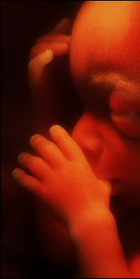
Shining light for the Innocents
Our epic struggle against the sin of abortion
Notes:
Is the abortion problem getting worse in America? What are the facts? What does the Bible say about abortion, and what can Christians do in this epic struggle to protect the lives of innocents?

Slide 2
Is the World Becoming More Evil all the Time?
It has long appeared so.
2 Timothy 3:13; Jeremiah 9:3-5; 2 Chron. 36:14
But at intervals in history, the Lord has put a stop to the progression of transgression!
2 Kings 24:3-4; Psalm 106:37-40

Slide 3
The Sin of Abortion
The Status of the Unborn in the Womb
Formed by God (Psalm 139:13-14)
Called “children” (Genesis 25:21-22)
Called “babies” (Luke 2:12, 16; 18:15)
Regarded as a human life (Exodus 21:22-25)
Taking the life of the innocent…
Is an abomination to God (Proverbs 6:17)
Is the opposite of justice and righteousness (Jeremiah 22:3)

Slide 4
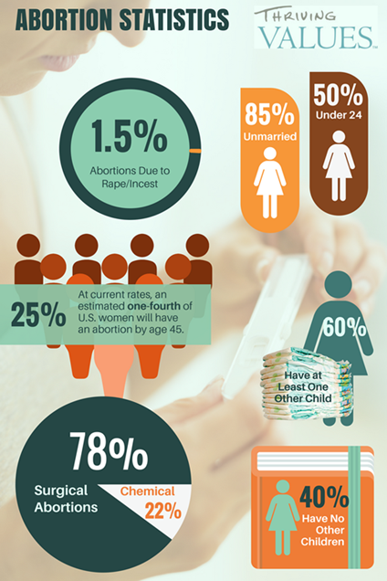
Is it getting worse?
In 2015, 638,169 legal abortions were reported to the CDC.
A 2% decrease from 2014
A 24% decrease from 2006-15
However, some states do not report. The actual number in 2015 was about 826,199.
The CDC also reports:
44% of women who had abortions in the U.S. had at least one previous abortion
85% were unmarried
25% of all women in U.S. will have an abortion.

Slide 5
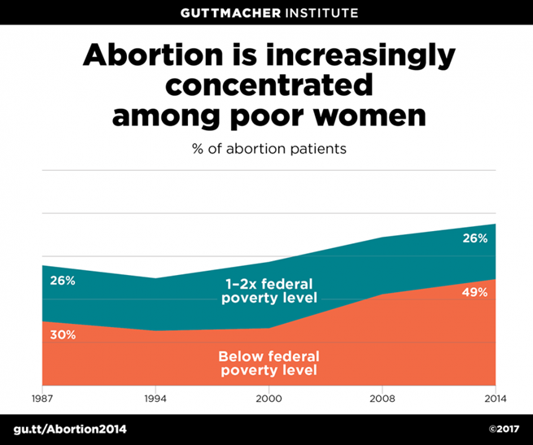
Is it getting worse?
Abortion rates are higher among poor women, who accounted for 49% of patients in 2014.
Will solving poverty solve abortion?
Zimbabwe has a lower abortion rate than New York (17.8 abortions per 1,000 vs. 29.6 per 1,000)
Abortion is not an economic problem, it’s a moral one!

Slide 6
Shining Light for the Innocents
Trust your King! (Psalm 72:1-5; Isaiah 10:1)
Pray! (1 Timothy 2:1-4)
Accept God’s deliverance and peace! (Galatians 1:3-4)
Do good and live God’s word! (Phil. 2:14-16)

