Slide 2
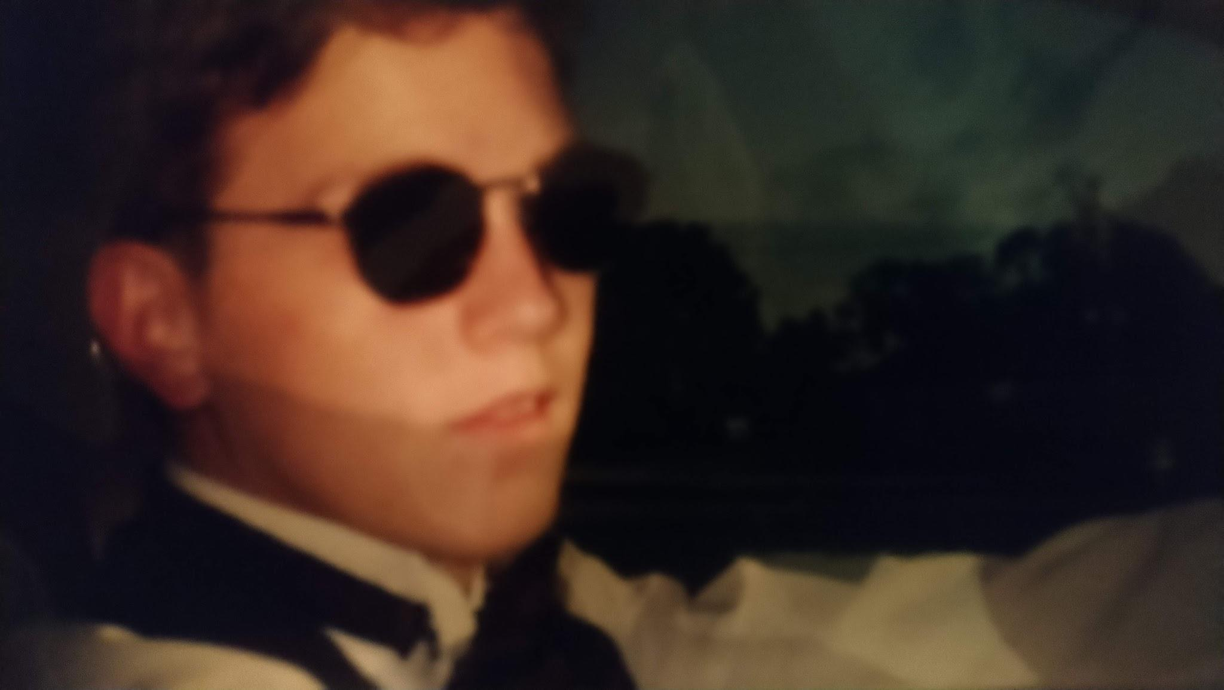
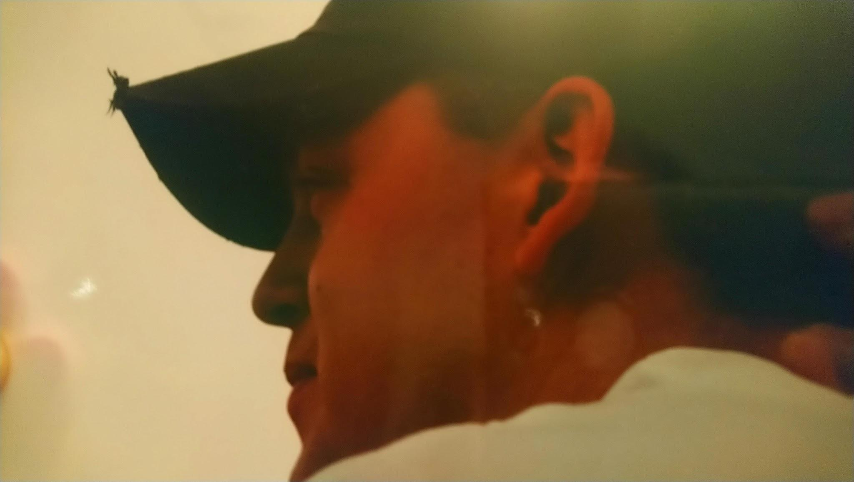
I Knew it All!
Except the answer to one Question.

Slide 3
Am I ready to become a Christian?
Looking at some stories of Salvation.

Slide 4
The Story of Cornelius: Acts 10:1-48
Now there was a man at Caesarea named Cornelius, a centurion of what was called the Italian cohort, a devout man and one who feared God with all his household… 1-2
So I sent for you immediately, and you have been kind enough to come. Now then, we are all here present before God to hear all that you have been commanded by the Lord.” 22
Surely no one can refuse the water for these to be baptized who have received the Holy Spirit just as we did, can he?” And he ordered them to be baptized in the name of Jesus Christ. Then they asked him to stay on for a few days. 47-48

Slide 5
Cornelius was a morale person
“A Devout man”
Vs. 1-2

Slide 6
Cornelius was seeking God
“I sent for you…”
Vs. 22

Slide 7
Baptism = Forgiveness = Change
Vs. 47

Slide 8
Once Cornelius realized he needed to be baptized he was
Acts 10:48

Slide 10
Galatians 3:25-28
But now that faith has come, we are no longer under a tutor. For you are all sons of God through faith in Christ Jesus. For all of you who were baptized into Christ have put on Christ. There is neither Jew nor Greek, there is neither slave nor free man, there is neither male nor female; for you are all one in Christ Jesus.

Slide 11
On the Way to Damascus: Acts 9:3-19
As he was traveling, it happened that he was approaching Damascus, and suddenly a light from heaven flashed around him; and he fell to the ground and heard a voice saying to him, “Saul, Saul, why are you persecuting Me?” And he said, “Who are You, Lord?” And He said, “I am Jesus whom you are persecuting… 3-5
Go, for he is a chosen instrument of Mine, to bear My name before the Gentiles and kings and the sons of Israel; 15
And immediately there fell from his eyes something like scales, and he regained his sight, and he got up and was baptized; and he took food and was strengthened. 18-19

Slide 12
God had a plan for Paul.

Slide 13
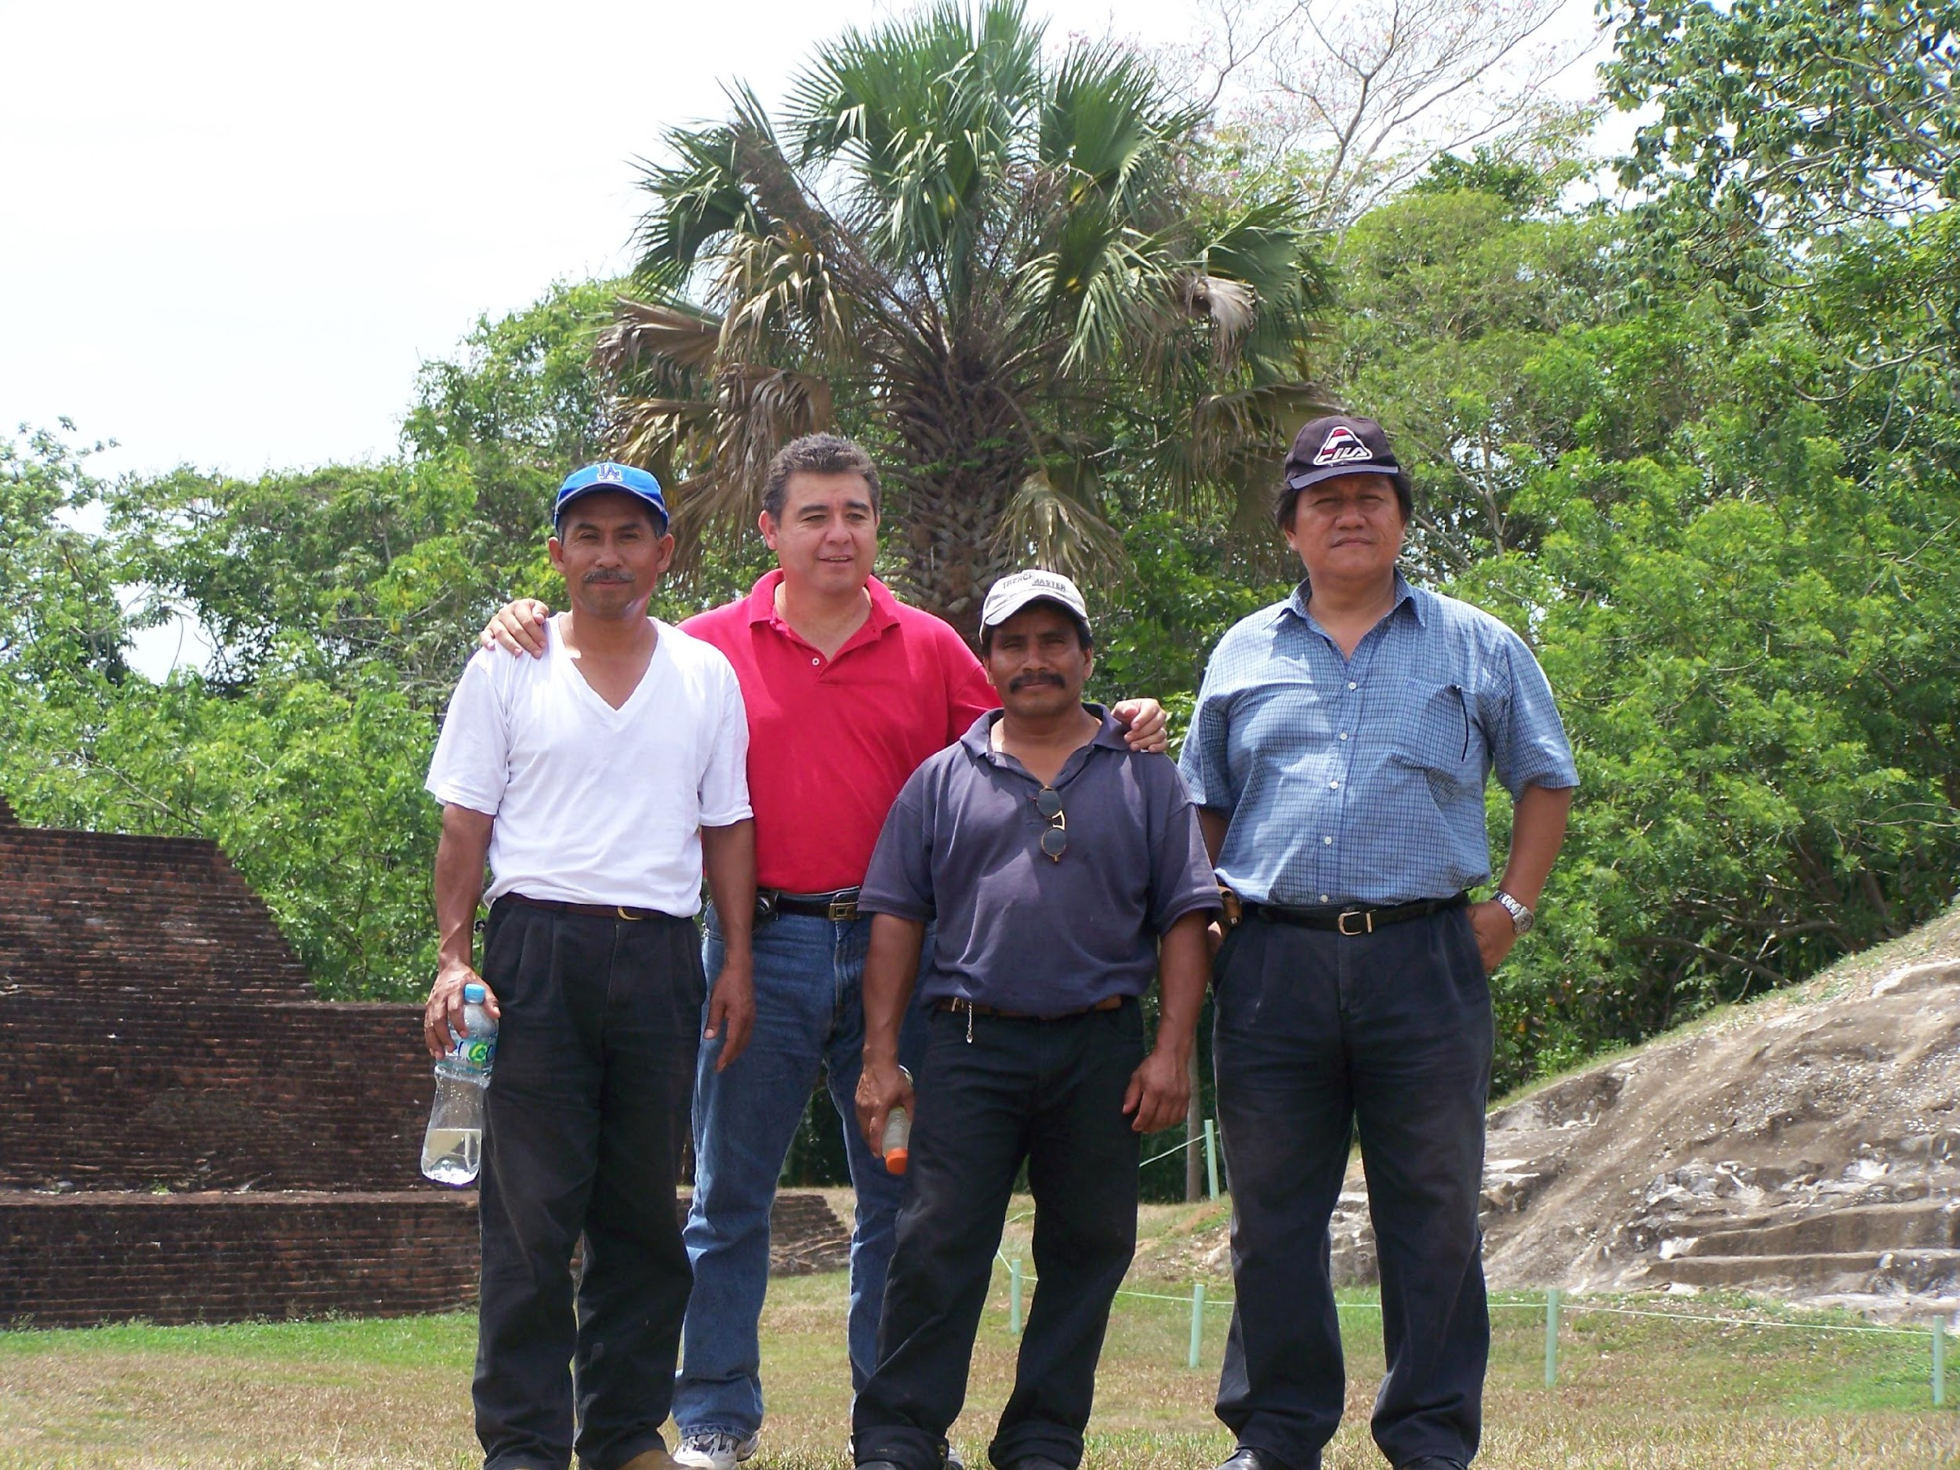

Slide 15
Paul recognized that God’s plan was bigger than his own plan.
Acts 9

Slide 16
On the way to Ethiopia: Acts 8:25-38
So he got up and went; and there was an Ethiopian eunuch, a court official of Candace, queen of the Ethiopians, who was in charge of all her treasure; and he had come to Jerusalem to worship, and he was returning and sitting in his chariot, and was reading the prophet Isaiah. Then the Spirit said to Philip, “Go up and join this chariot.” 27-29

Slide 17
On the way to Ethiopia: Acts 8:25-38
Philip ran up and heard him reading Isaiah the prophet, and said, “Do you understand what you are reading?” And he said, “Well, how could I, unless someone guides me?” And he invited Philip to come up and sit with him. 30-31
Then Philip opened his mouth, and beginning from this Scripture he preached Jesus to him. 35

Slide 18
On the way to Ethiopia: Acts 8:25-38
As they went along the road they came to some water; and the eunuch said, “Look! Water! What prevents me from being baptized?” And Philip said, “If you believe with all your heart, you may.” And he answered and said, “I believe that Jesus Christ is the Son of God.” And he ordered the chariot to stop; and they both went down into the water, Philip as well as the eunuch, and he baptized him. 36-38

Slide 19
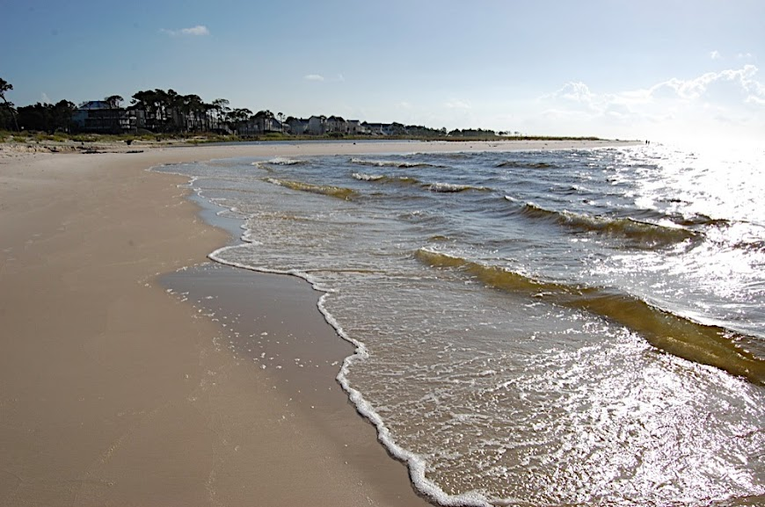
I have never been Baptized. Here is wate. What is stopping me?
“If you believe then we can baptize you now.” I believe.

Slide 20
Should I become a Christian?
Do I need to be baptized? Do I know enough? Am I old enough? Is it time? Is it tonight? Should I do it tonight? Should I be baptized for the remission of my sins now?

Slide 21
