Slide 1
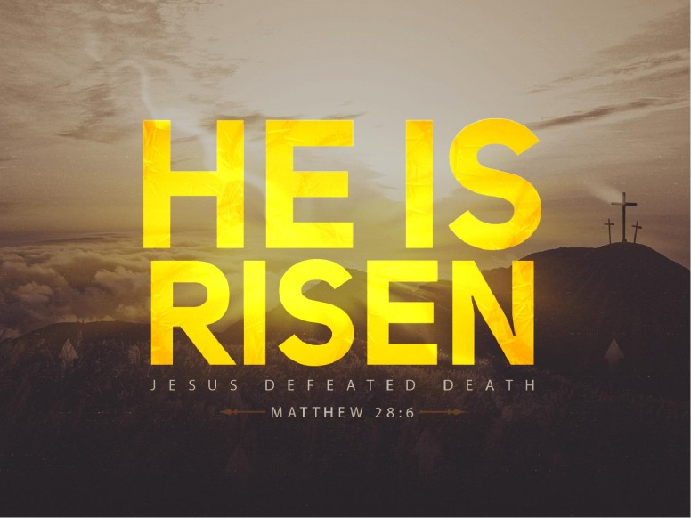

Slide 2
Luke 24:1 Now upon the first day of the week, very early in the morning, they came unto the sepulchre, bringing the spices which they had prepared, and certain others with them.
² And they found the stone rolled away from the sepulchre.
³ And they entered in, and found not the body of the Lord Jesus.
⁴ And it came to pass, as they were much perplexed thereabout, behold, two men stood by them in shining garments:
⁵ And as they were afraid, and bowed down their faces to the earth, they said unto them, Why seek ye the living among the dead?

Slide 3
⁶ He is not here, but is risen: remember how he spake unto you when he was yet in Galilee,
⁷ Saying, The Son of man must be delivered into the hands of sinful men, and be crucified, and the third day rise again.
⁸ And they remembered his words,
⁹ And returned from the sepulchre, and told all these things unto the eleven, and to all the rest.
¹⁰ It was Mary Magdalene and Joanna, and Mary the mother of James, and other women that were with them, which told these things unto the apostles.
¹¹ And their words seemed to them as idle tales, and they believed them not.

Slide 4
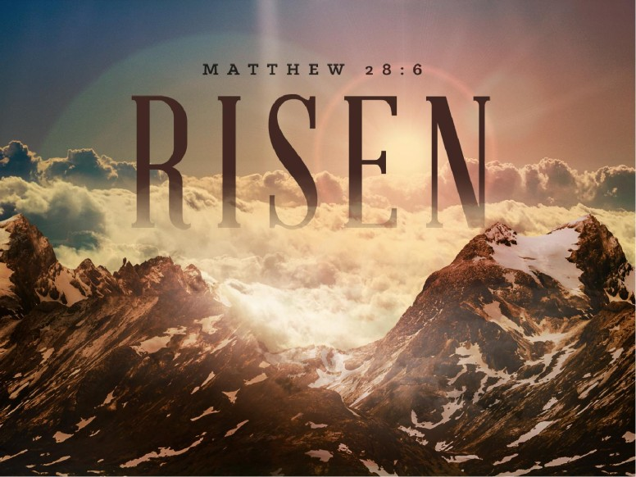

Slide 5
Do you believe that Jesus was
Raised up from the dead?
Do you believe in the Resurrection of Jesus
Christ from the dead?

Slide 6
The Convincing proof in the New Testament
Days…
The Appearances of Jesus after He was
Raised from the dead. People saw Him
Alive who had seen him dead!

Slide 7
The main reason the disciples believed in the resurrection of Jesus is that they saw Him alive after He was dead.
Jesus presented Himself alive on a number of different occasions to His followers.
We see them testifying, time and time again, to the fact they were eyewitnesses of His resurrection. This firsthand evidence of the disciples is a powerful argument for the resurrection of Christ. The disciples knew that He had risen because they saw Him with their own eyes

Slide 8
Look what Jesus said about His own
Resurrection from the dead

Slide 9
“ I am the Living One, I was dead, and behold I am alive for Ever and ever! And I hold the keys of death and Hades (Rev. 1:18)
Luke records Jesus’ saying: “Look at my hands and my feet. It is I myself! Touch me and see; a ghost does not have flesh and bones, as you see I have. (Luke 24:39)

Slide 10
The Various Appearances Of Jesus
Many different people saw Jesus after the resurrection. Some of the appearances were as follows

Slide 11
1. Mary Magdalene
The first appearance of Jesus was to Mary Magdalene.
John 20:14-16 ¹⁴ And when she had thus said, she turned herself back, and saw Jesus standing, and knew not that it was Jesus.
¹⁵ Jesus saith unto her, Woman, why weepest thou? whom seekest thou? She, supposing him to be the gardener, saith unto him, Sir, if thou have borne him hence, tell me where thou hast laid him, and I will take him away.
¹⁶ Jesus saith unto her, Mary. She turned herself, and saith unto him, Rabboni; which is to say, Master.

Slide 12
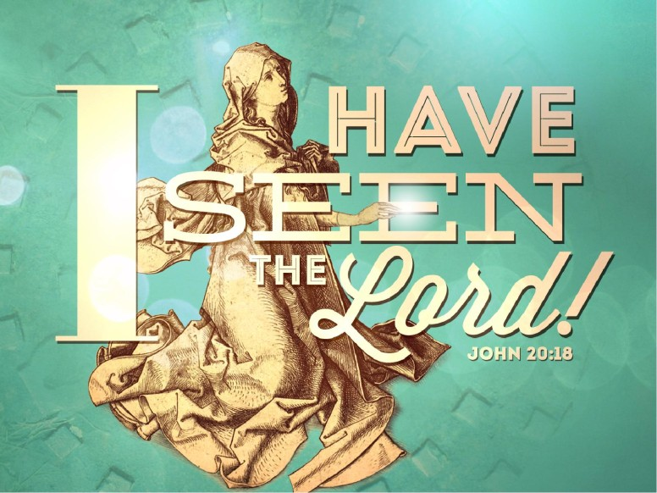

Slide 13
2. Mary the Mother of James, Salome, And Joanna

Slide 14
Mary The Mother Of James, Salome, And Joanna
Jesus also appeared to these three women. This happened
after the appearance to Mary Magdalene. After an angel told
them Jesus had risen, they were on their way to tell Jesus’ disciples when they met the risen Christ
Matthew 28:9 ⁹ And as they went to tell his disciples, behold, Jesus met them, saying, All hail. And they came and held
him by the feet, and worshipped him

Slide 15
3. Peter

Slide 16
Peter is the first person mentioned in Paul’s
List of witnesses, and is the first of the apostles
To see the risen Christ.
This was a private appearance to perhaps reassure him, since he had just denied His Lord. The gospels are completely silent as to the Details of this meeting.
Luke merely wrote:
The Lord is risen indeed, and has appeared to Simon!
Luke 24:34

Slide 17
4. Two Disciples On the Emmaus Road

Slide 18
Later, on the Sunday that Jesus arose from the grave,
Jesus Appeared to Cleopas and another disciple on the
Road to Emmaus.
Luke 24:13-16 ¹³ And, behold, two of them went that same day to a village called Emmaus, which was from Jerusalem about threescore furlongs. (about 6 to 7 miles)
¹⁴ And they talked together of all these things which had happened.
¹⁵ And it came to pass, that, while they communed together and reasoned, Jesus himself drew near, and went with them.
¹⁶ But their eyes were holden that they should not know him

Slide 19
^{Luke 24: 17-20} And he said unto them, What manner of communications are these that ye have one to another, as ye walk, and are sad?
¹⁸ And the one of them, whose name was Cleopas, answering said unto him, Art thou only a stranger in Jerusalem, and hast not known the things which are come to pass there in these days?
¹⁹ And he said unto them, What things? And they said unto him, Concerning Jesus of Nazareth, which was a prophet mighty in deed and word before God and all the people:
²⁰ And how the chief priests and our rulers delivered him to be condemned to death, and have crucified him.

Slide 20
^{Luke 24: 21} But we trusted that it had been he which should have redeemed Israel: and beside all this, to day is the third day since these things were done.
²² Yea, and certain women also of our company made us astonished, which were early at the sepulchre;
²³ And when they found not his body, they came, saying, that they had also seen a vision of angels, which said that he was alive.
²⁴ And certain of them which were with us went to the sepulchre, and found it even so as the women had said: but him they saw not.

Slide 21
²⁵ Then he said unto them, O fools, and slow of heart to believe all that the prophets have spoken:
²⁶ Ought not Christ to have suffered these things, and to enter into his glory?
²⁷ And beginning at Moses and all the prophets, he expounded unto them in all the scriptures the things concerning himself.
²⁸ And they drew nigh unto the village, whither they went: and he made as though he would have gone further.

Slide 22
²⁹ But they constrained him, saying, Abide with us: for it is toward evening, and the day is far spent. And he went in to tarry with them.
³⁰ And it came to pass, as he sat at meat with them, he took bread, and blessed it, and brake, and gave to them.
³¹ And their eyes were opened, and they knew him; and he vanished out of their sight.
³² And they said one to another, Did not our heart burn within us, while he talked with us by the way, and while he opened to us the scriptures?

Slide 23
^{Luke 24: 33} And they rose up the same hour, and returned to Jerusalem,(Returned to Jerusalem ..about 6-7 miles)) and found the eleven gathered together, and them that were with them, ³⁴ Saying, The Lord is risen indeed, and hath appeared to Simon.
³⁵ And they told what things were done in the way, and how he was known of them in breaking of bread.
³⁶ And as they thus spake, Jesus himself stood in the midst of them, and saith unto them, Peace be unto you.

Slide 24
5. The Disciples - Thomas Absent
This is the last of the 5 appearances of Jesus on
The first Sunday after His Resurrection. It took place
In the evening, probably in the upper room in which Jesus had Instituted the Lord’s Supper.
It is recorded in both Luke’s and John’s gospel, giving
Us two independent accounts as to what happened.

Slide 25
John wrote: John 20:19-20¹⁹
Then the same day at evening, being the first day of the week, when the doors were shut where the disciples were assembled for fear of the Jews, came Jesus and stood in the midst, and saith unto them, Peace be unto you.
²⁰ And when he had so said, he shewed unto them his hands and his side. Then were the disciples glad, when they saw the Lord.
John 20:24 ²⁴ But Thomas, one of the twelve, called Didymus, was not with them when Jesus came.

Slide 26
6. All the Disciples
Eight days later He appeared again—this time with Thomas
Present.
John 20:26-28 ²⁶ And after eight days again his disciples were within, and Thomas with them: then came Jesus, the doors being shut, and stood in the midst, and said, Peace be unto you. (Why was Thomas absent the first time?)
²⁷ Then saith he to Thomas, Reach hither thy finger, and behold my hands; and reach hither thy hand, and thrust it into my side: and be not faithless, but believing.
²⁸ And Thomas answered and said unto him, My Lord and my God

Slide 27
7 Disciples At The Sea of Galilee
Another appearance was to 7 disciples on the Sea of
Galilee. John 21:1-2
1 After these things Jesus shewed himself again to the disciples at the sea of Tiberias; and on this wise shewed he himself.
² There were together Simon Peter, and Thomas called Didymus, and Nathanael of Cana in Galilee, and the sons of Zebedee, and two other of his disciples.

Slide 28
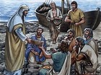

Slide 29
8. A Mountain In Galilee
There is also the account of Jesus appearing before
His 11 disciples in Galilee.
Matthew 28:16-17 ¹⁶ Then the eleven disciples went away into Galilee, into a mountain where Jesus had appointed them.
¹⁷ And when they saw him, they worshipped him:
but some doubted.

Slide 30
9. OVER 500 PEOPLE!
On another occasion, Jesus appeared to over 500
People at one time.
I Cor. 15:6 ⁶ After that, he was seen of above
five hundred brethren at once; of whom the greater
part remain unto this present, but some are fallen asleep.
“

Slide 31
10. James
The Bible also says that Jesus appeared to
His half-brother James.
I Cor.15:7
⁷ After that, he was seen of James; then of all the apostles

Slide 32
11. Saul
After Jesus’ ascension He appeared again-this time to
Saul of Tarsus.
Acts 9:3-5 ³ And as he journeyed, he came near Damascus: and suddenly there shined round about him a light from heaven:
⁴ And he fell to the earth, and heard a voice saying unto him, Saul, Saul, why persecutest thou me?
⁵ And he said, Who art thou, Lord? And the Lord said, I am Jesus whom thou persecutest: it is hard for thee to kick against the pricks.

Slide 33
,,These are the appearances of Jesus that the N.T.
Records. They caused His disciples to believe that
He had risen from the dead.
Accts 1:3 Luke says ^{3 “} To whom also he shewed himself
alive after his passion by many infallible proofs,
being seen of them forty days, and speaking of
the things pertaining to the kingdom of God:

Slide 34
The Bible says that Jesus made a number of
Appearances after His death. They were to a
Number of different people over a 40 day
Period. The Bible specifically says that on Sunday,
The First day of the Week, on the day that Jesus was
Raised up from the dead,

Slide 35
1. Jesus appeared to Mary Magdalene,
2. To the women that came to Jesus’ tomb
(Mary the Mother of James, Salome, and Joanna)
3. To Peter
4. To 2 disciples on the Emmaus road
5. He also appeared to the 11 Disciples with Thomas absent
All of these on the day in which He had
Risen from the dead!

Slide 36
These appearances convinced His disciples,
Beyond any doubt, that Jesus had risen from the dead!
Do they convince you?

Slide 37
Acts 4:33 And with great power gave the apostles witness of the resurrection of the Lord Jesus: and great grace was upon them all.
People WHO SAID THEY WITNESSED THE
LORD JESUS CHRIST BEING RAISED FROM
THE DEAD!
Do you believe them?

Slide 38
Acts 23:6 But when Paul perceived that the one part were Sadducees, and the other Pharisees, he cried out in the council, Men and brethren, I am a Pharisee, the son of a Pharisee: of the hope and resurrection of the dead I am called in question
Paul’s preaching was:
1. Hope
2. Resurrection of the dead!

Slide 39
Acts 24:21 Except it be for this one voice, that I cried standing among them, Touching the resurrection of the dead I am called in question by you this day.
Paul restates that truth:
“Touching the resurrection of the dead”..I am called in
Question by you this day.

Slide 40
Acts 17:18
“Then certain philosophers of the Epicureans, and of the Stoicks, encountered him. And some said, What will this babbler say? other some, He seemeth to be a setter forth of strange gods: because he preached unto them Jesus, and the resurrection.”
What did Paul (the babbler) preach?
Jesus, and the Resurrection!

Slide 41
Scriptures abound to prove that people believed in Jesus’ resurrection and preached it

Slide 42
1 Peter 1:3 - Blessed [be] the God and Father of our Lord Jesus Christ, which according to his abundant mercy hath begotten us again unto a lively hope by the resurrection of Jesus Christ from the dead,
Romans 10:9 - That if thou shalt confess with thy mouth the Lord Jesus, and shalt believe in thine heart that God hath raised him from the dead, thou shalt be saved.
John 11:25 - Jesus said unto her, I am the resurrection, and the life: he that believeth in me, though he were dead, yet shall he live:

Slide 43
Romans 8:11 - But if the Spirit of him that raised up Jesus from the dead dwell in you, he that raised up Christ from the dead shall also quicken your mortal bodies by his Spirit that dwelleth in you.
Romans 6:4 - Therefore we are buried with him by baptism into death: that like as Christ was raised up from the dead by the glory of the Father, even so we also should walk in newness of life.
Acts 17:31 - Because he hath appointed a day, in the which he will judge the world in righteousness by [that] man whom he hath ordained; [whereof] he hath given assurance unto all [men], in that he hath raised him from the dead.

Slide 44
^{I Cor. 15:1-4}
15 Moreover, brethren, I declare unto you the gospel which I preached unto you, which also ye have received, and wherein ye stand;
² By which also ye are saved, if ye keep in memory what I preached unto you, unless ye have believed in vain.
³ For I delivered unto you first of all that which I also received, how that Christ died for our sins according to the scriptures;
⁴ And that he was buried, and that he rose again the third day according to the scriptures:

Slide 45
Romans 8:34 - Who [is] he that condemneth? [It is] Christ that died, yea rather, that is risen again, who is even at the right hand of God, who also maketh intercession for us.

Slide 46
1 Corinthians 15:20 - But now is Christ risen from the dead, [and] become the firstfruits of them that slept.

Slide 47
Romans 14:9 - For to this end Christ both died, and rose, and revived, that he might be Lord both of the dead and living

Slide 48
Why does this day , The Lord’s Day, mean so much to us?:
1. It is the “Lord’s day”. It’s Sunday. It is the day that Jesus
was raised from the day.
2. It is the day upon which the early disciples
came together to ‘break bread’…remember the Lord. Acts 20:7
3. It is the day that God’s Son showed Himself ‘alive’…
“He is not here…he has risen!” Luke 24:1ff
4. It is the day of Jesus’ Resurrection. He appeared to so many!
Saul…Acts 9:6-9

Slide 49
.But, Why is the Resurrection so important?
1st., The resurrection witnesses to the immense power of God Himself
To believe in the resurrection is to believe in God. If God exists, and if He created the universe and has power over it, then He has power to raise the dead. AND He does !. Only He who created life can resurrect it after death, only He can reverse the hideousness that is death itself, and only He can remove the sting and gain the victory over the grave (1 Corinthians 15:54–55).
In resurrecting Jesus from the grave, God reminds us of His absolute sovereignty over life and death

Slide 50
2nd. The resurrection of Jesus Christ is also important because it validates who Jesus claimed to be, namely, the Son of God and Messiah.
According to Jesus, His resurrection was the “sign from heaven” that authenticated His ministry (Matthew 16:1–4)
The proof that He had authority over even the temple in Jerusalem (John 2:18–22).
The resurrection of Jesus Christ, attested to by hundreds of eyewitnesses (1 Corinthians 15:3–8), provides irrefutable proof that He is the Savior of the world.

Slide 51
3rd . It proves His sinless character and divine nature.
The Scriptures said God’s “Holy One” would never see corruption (Psalm 16:10),
and Jesus never saw corruption, even after He died ( Acts 13:32–37).
It was on the basis of the resurrection of Christ that Paul preached, “Through Jesus the forgiveness of sins is proclaimed to you.
Through him everyone who believes and obeys HIM is set free from every sin” (Acts 13:38–39).

Slide 52
4th It also validates the Old Testament prophecies that foretold of Jesus’ suffering and resurrection (Acts 17:2–3).
Christ’s resurrection also authenticated His own claims that He would be raised on the third day (Mark 8:31; 9:31; 10:34).
If Jesus Christ is not resurrected, then we have no hope that we will be, either.
In fact, apart from Christ’s resurrection, we have no Savior, no salvation, and no hope of eternal life.
As Paul said, our faith would be “useless,” the gospel would be altogether powerless, and our sins would remain unforgiven (1 Corinthians 15:14–19).

Slide 53

To Spend Eternity With God
That’s what I want. Isn’t it what you want?

Slide 54
Jesus said, “I am the resurrection and the life” (John 11:25), and in that statement claimed to be the source of both.
Jesus does more than give life; He is life, and that’s why death has no power over Him. Jesus confers His life on those who obey Him, so that we can share His triumph over death
(1 John 5:11–12).
We who believe in Jesus Christ and are faithful till death, will personally experience resurrection because, having the life Jesus gives, we have overcome death. When we are in Jesus, it is impossible for death to win (1 Corinthians 15:53–57).

Slide 55
#5 . The resurrection of Jesus Christ is important as a testimony to the resurrection of human beings, which is a basic tenet of the Christian faith.
Unlike other religions, Christianity possesses a Founder who transcends death and promises that His followers will do the same. Every other religion was founded by men or prophets whose end was the grave. As Christians, we know that Jesus became man, died for our sins, and was resurrected the third day. The grave could not hold Him.And it won’t hold us ! He lives, and so shall we..and He sits today at the right hand of the Father in heaven (Hebrews 10:12).

Slide 56

To Be forgiven
I Tim. 1:15

Slide 57
The Word of God guarantees the believer’s resurrection at the coming of Jesus Christ for His church . Such assurance results in a great song of triumph as Paul writes in
1 Corinthians 15:55, “Where, O death, is your victory? Where, O death, is your sting?” (cf. Hosea 13:14).

Slide 58
The importance of the resurrection of Christ has an impact on our service to the Lord now. Paul ends his discourse on resurrection with these words: ” (1 Corinthians 15:58).
Because we know we will be resurrected to new life, we can endure persecution and danger for Christ’s sake (verses 30–32), just as our Lord did.
Because of the resurrection of Jesus Christ, thousands of Christian martyrs through history have willingly traded their earthly lives for everlasting life and the promise of resurrection.

Slide 59
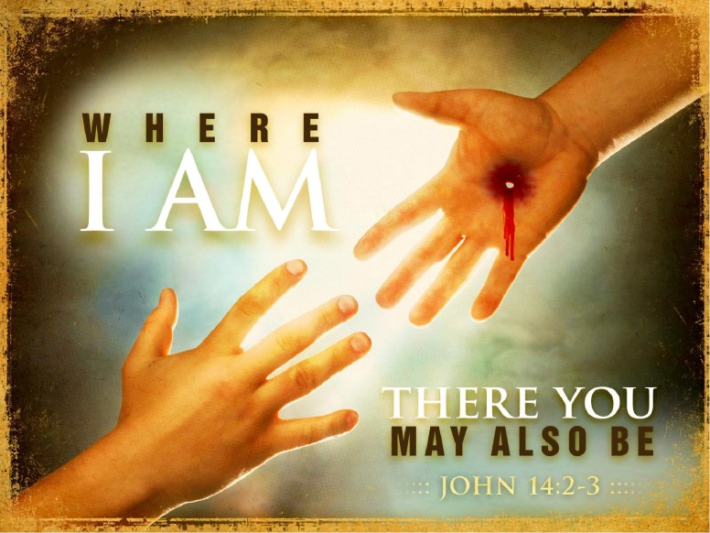

Slide 60
The resurrection is the triumphant and glorious victory for every faithful believer.
Jesus Christ died, was buried, and rose the third day according to the Scriptures (1 Corinthians 15:3–4). And He is coming again! (Why? To Raise the dead!) The dead in Christ will be raised up, and those who are alive at His coming will be changed and receive new, glorified bodies
(1 Thessalonians 4:13–18).

Slide 61
Why is the resurrection of Jesus Christ important?
It proves who Jesus is.
It demonstrates that God accepted Jesus’ sacrifice on behalf of sinners.
It shows that God has the power to raise us from the dead.
It guarantees that the bodies of those who believe in Christ and are faithful to Him, will not remain dead but will be resurrected unto eternal life.

Slide 62
The Resurrection | Changes Everything‎

Slide 63
THE FOUR WITNESSES AGREE
The four witnesses are Matthew, , Mark, Luke, and John
What do they say?
What do they ALL say?
What is their witness?

Slide 64
They said, and they all say, that Jesus of Nazareth is, was, and ever is a supernatural Person.
They say, and they all say, that he performed the greatest wonders ever seen on earth.
They say, and they all say, that he raised the dead to life again.
They say, and they all say, that he gave himself up to die in order to redeem people from sin.
They say, and they all say, that he was crucified and buried in the tomb of Joseph of Arimathea.
They say, and they all say, that he rose from the dead on the third day.
They say, and they all say, that he repeatedly appeared to his own group in his resurrection body.

Slide 65
They say, and they all say, that he commanded the gospel of salvation to be proclaimed to all people.
They say, and they all say, that he ascended to God and that all power in heaven and upon earth belongs to him.
They say, and they all say, that he is one with Almighty God.

Slide 66
They say, and they all say, that he alone can redeem human beings from the curse of sin.
They say, and they all say, that he shall judge all people on the last day.
They say, and they all say, that he is now enthroned with God in heaven.
They say, and they all say, that he loves and cares for his spiritual body, the church.
They say, and they all say, that he is the Christ promised in the Old Testament.
They say, and they all say, that his alone is the name through which people ought to pray.

Slide 67
They say, and they all say, that he is Lord and Saviour.
They say, and they all say, that the fate of every soul ever born on earth hinges on that soul's relationship with Jesus Christ.

Slide 68
And, what is OUR relationship with
Jesus Christ this morning?
John 5:28-29 ²⁸ Marvel not at this: for the hour is coming, in the which all that are in the graves shall hear his voice,
²⁹ And shall come forth; they that have done good, unto the resurrection of life; and they that have done evil, unto the resurrection of damnation.

Slide 69
Folks:

Slide 71
Let’s be sure that we are
Ready to be raised in the
Last day by Jesus Christ!

