Slide 1
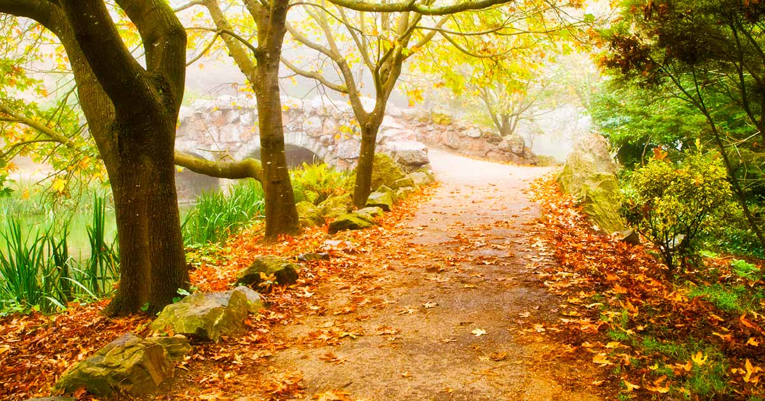
Let’s Walk In the Old Paths

Slide 2
Jeremiah 6:16
“Thus saith the LORD, Stand ye in the ways, and see, and ask for the old paths, where is the good way, and walk therein, and ye shall find rest for your souls. But they said, We will not walk therein.”

Slide 3
Condition of God’s people is not good.
. Jeremiah 6:13-16 ¹³ For from the least of them even unto the greatest of them every one is given to
covetousness;
and
from the prophet even unto the priest every one dealeth falsely

Slide 4
^{Verse 14}
They have healed also the hurt of the daughter of my people slightly, saying,
Peace, peace;
when there is no peace.

Slide 5
1. Some have peace because they live for entertainment and excitement, distracting them from higher things.
·
2. Some have peace because they tell themselves there is no God and therefore no accountability before Him.
·
3. Some have peace because they are ignorant of the things of God and need to be told the truth of their responsibility.
·4. Some have peace because they intend to do better later in life and such future wishes are enough to make them right.

Slide 6
^{Verse 15}
?? Were they ashamed when they had committed abomination?
nay, they were not at all ashamed,
neither could they blush:
therefore they shall fall among them that fall: at the time that I visit them they shall be cast down, saith the Lord.
(over 400 times ..in Jermeiah 147 and in Ezekiel 126)

Slide 7
·1, To benefit from the old paths, God told them to position themselves (stand in the ways).
· 2. To benefit from the old paths, God told them to look for the
Old paths (see).
· 3. To benefit from the old paths, God told them to ask for them, to desire them.
·4. To benefit from the old paths, God told them to see them as the good way.
· 5. To benefit from the old paths, God told them to walk in it – to actually obey and follow God as indicated by His word and work in days gone by.

Slide 8
Stand ye in the ways, and see…
Stand - Stop, Stand, Pause,..consider all the ways…
See: Observe; Pay attention to;
and
Ask for the old paths why the old paths?
(Where Is the Good way…) God’s ways are so much better
than ours. (Isa. 55:8,9 For my thoughts are not your thoughts
neither are my ways, your ways..
Walk therein..obey God (Heb.5:8,9)
And ye shall find rest for your souls..

Slide 9
But they said:
We will not walk therein

Slide 10
כה אמר יי
  for so says the LORD
עמדו על דרכים
  !stand! upon paths/ways
וראו ושאלו לנתבות עולם
  and-then !see! and !inquire! of eternal treadings/followings
אי זה דרך הטוב
  (about) which are good paths
ולכו בה
  and-then !proceed! of-them
ומצאו מרגוע לנפשכם
  and !find/discover! calmness of your breaths/souls
ויאמרו לא נלך
  and-then say-them not passive-walked-on
  = and then they say "not walked".

Slide 11
The Cry to ask for the Old Paths
Is it obsolete
or a Pressing Need?
Don’t we need to do the same today?

Slide 12
Why ask for the old, ancient paths? 1. They are Plain!Simple
and true!
1. The Old Paths are Plain! Simple, True
Jerm. 10:23; Prov. 14:12; Prov. 16:25
Illustration: Matt. 19:16-20 He needed to trust in God!
a) Do not lie. Rev. 21:8 ; Jas.3:14 Lie not against the truth
b) Do not steal. Eph. 4:28
c) Do not gossip..I Tim. 5:18
d) Pay your debts. Rom.13:8 Owe nothing to anyone except to love one another; for he who loves his neighbor has fulfilled the law
(Proverbs 22:7) The rich rules over the poor, And the borrower becomes the lender's slave.

Slide 13
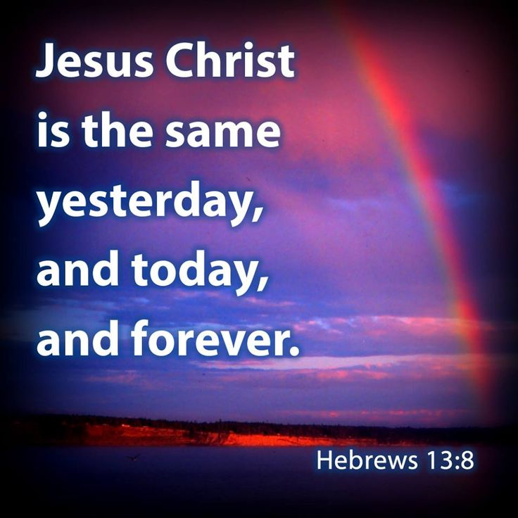

Slide 14
2. The Old Paths are unchanging. God does not change.
Isa. 55:8-9
Heb.13:8
He doesn’t tell you one thing today, and changes it
tomorrow!
Same Yesterday, Today, and Forever!
Hebrews 13:8 Jesus Christ the same yesterday, and to day, and for ever.

Slide 15
3. The Old Paths are paths of righteousness.
Peter told Cornelius: Acts 10:35-36
When you walk in the old paths, you are walking
In the light! I John 1:7
a) Your’re letting your light shine. Matt.5:16
b) You are doing what is right. I Tim.1:15;
c) The old paths lead you to a happy home with
loved ones, beautiful marriages, children blessed,
and you know you are right with God!
“It is well with my soul”…

Slide 16
4. The old paths produce plenty.
Some of the riches people that have ever lived in this
world were God’s people! Can you think of anyone
who had more than Abraham and Solomon?.
Phil. 4:19 MY GOD… But my God shall supply all your need according to his riches in glory by Christ Jesus.
The Old paths teach you to work! 2 Thess.3:10;
Matt. 6 :32,33 My Father knoweth what you have need of

Slide 17
5. The Old Paths give you rest.
And you shall find Rest for your souls. Jerm. 6:16
(Bring Christ your broken life)
The Old Paths lead us to the Prince of Peace.
I want my soul to be at peace with God.
Jesus said: Matt. 11:28-30 Come unto me and
I will give you rest.
Lord, what must I do?
Acts 2:37 People on the day of Pentecost

Slide 18
What did the people do that Jeremiah pleaded with to
Ask for the old paths and walk therein.??
They said:
WE WILL NOT WALK THEREIN!
We will not do it!

Slide 19
What really happened?
God said:
1. Jerm. 6:2 The daughter of Zion (a poetic
Name for Jerusalem) shall be cut off. And it
Was.
2. Jerm. 6 :3 She shall be encircled with tents. And she was.
3. Jerm. 6:4 The lengthening shadows mark the closing of the Day of God’s favor upon racial Israel.

Slide 20
4. Jerm. 6:5 Her palaces shall be destroyed. (and they were)
5. Jerm. 6:6 The military shall cast up a mound against her.
Happened just as God said it would.
6. Jerm.6:8 She shall be uninhabited, a desolation. And it was.
7. Jerm. 6 :9 The vine of Israel shall be stripped and gleaned
And it was.
8. Jerm. 6:11 The wrath of God shall be poured out upon her
Children, the young men, the husbands and wives, and even upon All the old people. It was!

Slide 21
9. Jerm. 6 :12 the houses, fields, wives of the people shall be
Taken away from them and given to the invaders. It happened!
10.Jerm. 6:25 the nation shall fall; it shall be cast down. It was.
11. Jerm. 6:19 God will bring evil upon her people. He did.
12. Jerm. 6:21 God will place stumblingblocks in their way;
Fathers and sons, friends and neighbors shall perish.(They did!)
13. Jerm. 6:24 The power of the defenders (Israel) shall be feeble, And anguish shall overwhelm them.(It was!)

Slide 22
14. Jerm. 6:25 The people will fear to go outside, for the sword of the enemy will be everywhere. ( True. .happened!)
15. Jerm. 6:26 They shall clothe themselves in sackcloth and
ashes, mourning as for an only son; destruction shall descend suddenly upon them. (Too late!)
People I have known…waited too late.

Slide 23
Some of you in this building today: I have begged you
To obey the gospel, you have heard some of the finest
Preaching by others, you know the way, but you have
Not been baptized. Why? Do you not believe that God
Means what He says? Mark 16:15,16
I don’t want you to be lost. Hell is terrible. Jesus died to
Keep you from having to be cast into the fiery furnace.
Why do you wait? Husband/wife/father/daughter/son…
Young and old…

Slide 24
Ask for the Old Paths,
where is the good way,
and walk therein…………….
and ye shall find rest for your souls!.
But……………………………………………………..they said,
We will not walk therein!
And God did what He said He would do!

Slide 25
Let’s Walk In the Old Paths

Slide 26
Conclusion:

Slide 27
1. Speak where the Bible speaks and remain silent where the bible is silent. I Pet.4:11
2. Love the brotherhood. I Pet. 2:17
3. Share what you have with others. Matt. 7:12
4. Stick Together. Acts 2:42
Give me the Old Time Religion..the Religion of Peter, Paul, and the Apostles!

Slide 28
Are you prepared to meet God today?

