Slide 1
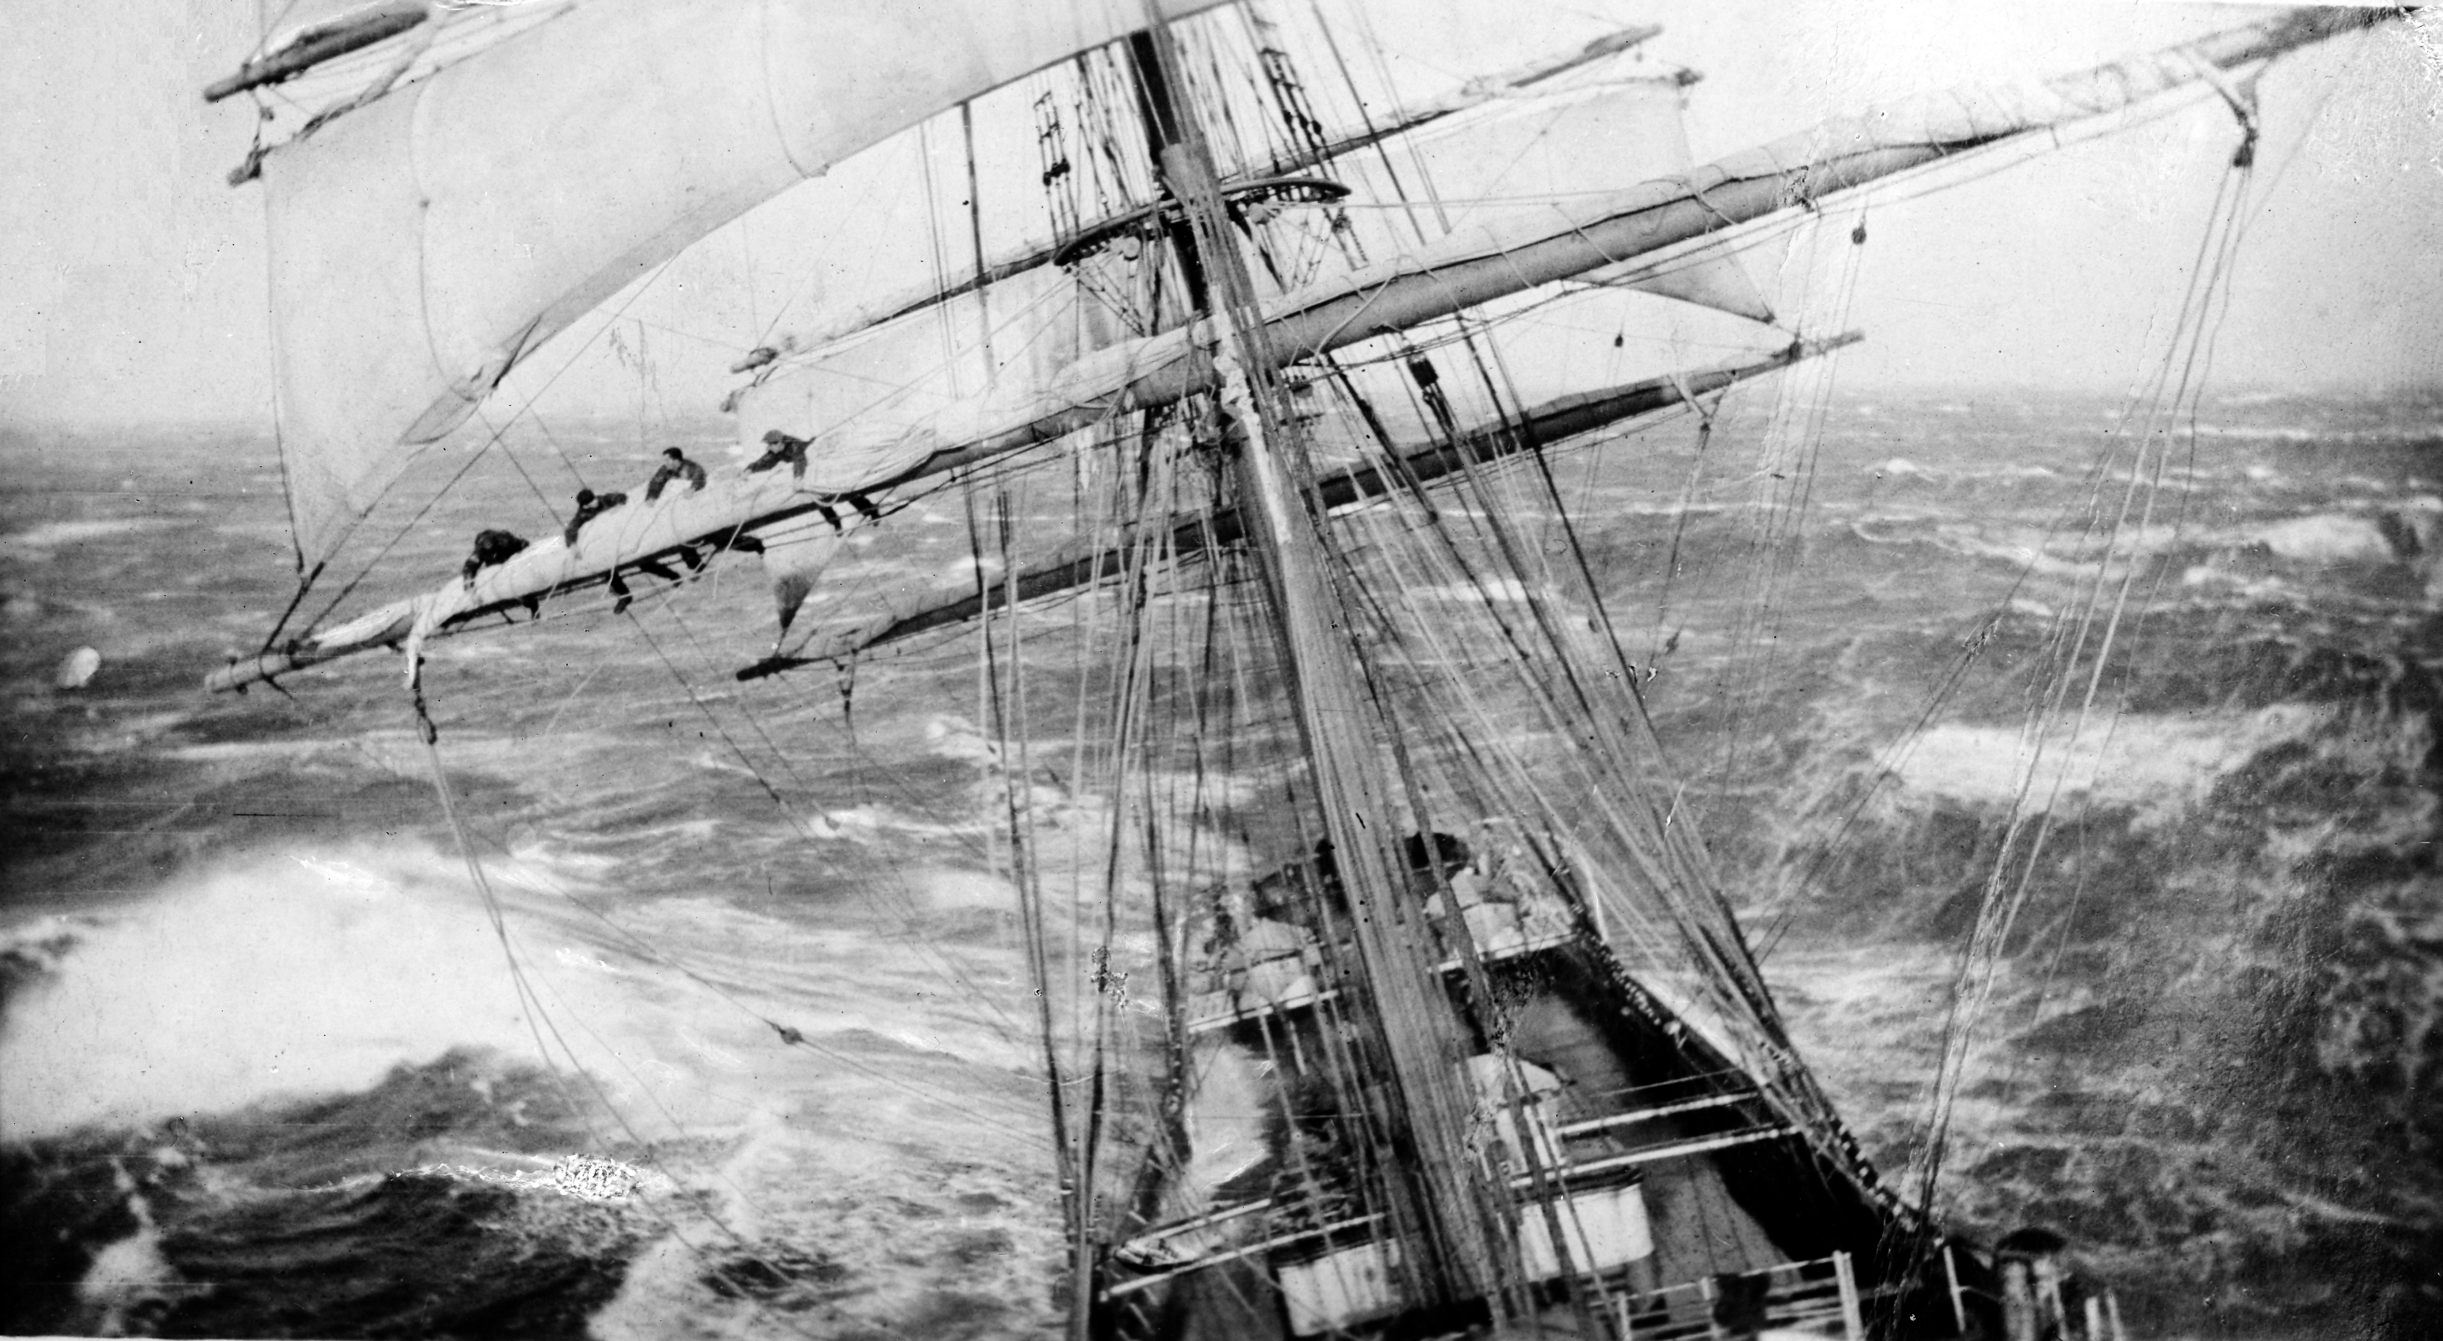
Being Calm
During the Storm
Acts 27
Notes:
Good evening!
Have you ever experienced something so devastating that is forever etched in your mind? Throughout history and throughout our lives, we have experiences that make lasting impressions on us. For some, the assassination of JFK, the tornadoes of ‘74, the spaceship Challenger blowing up, and 9/11 are just a few that come to mind from recent history. During those events, I’m sure you have a vivid recollection of where you were, who you were with, and how you felt.
More recently for me and several of you were the tornadoes of April 27, 2010, March 2 of 2011, and April 28 of 2014. The devastation of such events are not soon forgotten.
How do you remain calm in storms—especially the storms of life? Let’s take a look at a man who encountered many storms in his life and how he reacted during this storm.

Slide 2
Paul’s Storm
Acts 21: Paul seized by the Jews
Acts 22: Paul tells of his conversion & call to the Gentiles
Acts 23: Paul goes before the council & Jews vow to kill him
Acts 24: Paul before Felix; Left in prison 2 years
Notes:
The apostle Paul’s life could be characterized as one big storm. The troubles he had in life remind me of what Job said in Job 14:1 “Man that is born of a woman is of few days and full of trouble.”
Tonight let’s take a look at the events that unravel in Paul’s life starting with Acts 21.

Slide 3
Paul’s Storm
Acts 25: Paul before Festus; Jews still want to kill him; Appeals to Caesar
Acts 26: Paul before King Agrippa; Testifies of his conversion; Found nothing worthy of death
Acts 27: Sets sail to Rome: Encounters a storm
Notes:
In Chapter 27, Paul encounters an actual storm while as a prisoner headed to Rome. Let’s see how he reacts to this storm.

Slide 4
Caesarea to Fair Havens
Acts 27:1-8
  V. 1: Paul and other prisoners are delivered to Julius the centurion.
  V. 4: Winds are becoming contrary.
  V. 7: Slow sailing; Winds blowing against them.
  V. 8: Difficulty sailing
Notes:
Does this sound like a trip you would want to take?

Slide 5
Paul’s Warning
Acts 27:9-13
  V. 9: Sailing is now too dangerous
  V. 10: Paul’s warning:
  “Men, I perceive that this voyage will end with disaster and much loss, not only of the cargo and ship, but also our lives.”
  V. 11: Paul’s warning not heeded.
Notes:
Why don’t we heed warnings? When the tornado siren goes off, what do you do? I know what I do.
Not heeding warnings can be costly. “Remember Lot’s wife.” Luke 12:32

Slide 6
The Storm Begins
Acts 27:14-20
  V. 14: Tempestuous wind arose
  V. 15: Unable to sail against the wind, they are blown by the wind.
  V. 16-17: Secured the life boat and wrapped the boat with cables (ropes)
  V. 18: Tossed about; began lightening the ship
Notes:
When the storms in our lives happen, what do we do? Do we let the winds of life blow us in all directions? As a Christian, do we allow Satan to deceive us and toss us about?
Paul told the Ephesians in Ephesians 4:12-15
¹² For the perfecting of the saints, for the work of the ministry, for the edifying of the body of Christ:
¹³ Till we all come in the unity of the faith, and of the knowledge of the Son of God, unto a perfect man, unto the measure of the stature of the fulness of Christ:
¹⁴ That we henceforth be no more children, tossed to and fro, and carried about with every wind of doctrine, by the sleight of men, and cunning craftiness, whereby they lie in wait to deceive;
¹⁵ But speaking the truth in love, may grow up into him in all things, which is the head, even Christ:

Slide 7
The Storm Begins
Acts 27:14-20
  V. 19: Tacking (ship’s equipment) thrown overboard
  V. 20: Many days pass with no sight of the sun or stars; The storm is so bad,
  “all hope that we should be saved was then taken away.”
Notes:
The storm is so great that they conclude there is no hope!
What an awful feeling of having NO HOPE must be! No Hope—Do we feel that way about our lives sometimes? There’s no hope….we’ve sinned so that there’s nothing anyone can do to help you.
How great to serve the living God!
Peter said in 1 Peter 1:3-4 “³ Blessed be the God and Father of our Lord Jesus Christ, which according to his abundant mercy hath begotten us again unto a lively hope by the resurrection of Jesus Christ from the dead,
⁴ To an inheritance incorruptible, and undefiled, and that fadeth not away, reserved in heaven for you,”
For those of us in Christ, there is always hope!

Slide 8
Encouragement & Prophecy
Acts 27:21-26
  V. 21: Paul stands in the middle of them; You should have listened to my warning
  V. 22: “be of good cheer: for there shall be no loss of any man's life among you, but of the ship.”
  V. 23-24: Angel of God told me to “FEAR NOT!”
Notes:
How does Paul feel about this current state of hopelessness?
In verse 21….
In verse 22, Be of good cheer..
What’s there to cheer about? In our Christian life, it’s knowing where to have our faith!! In 1 Peter 1:5-7, ⁵ Who are kept by the power of God through faith unto salvation ready to be revealed in the last time.
⁶ Wherein ye greatly rejoice, though now for a season, if need be, ye are in heaviness through manifold temptations:
⁷ That the trial of your faith, being much more precious than of gold that perisheth, though it be tried with fire, might be found unto praise and honour and glory at the appearing of Jesus Christ:
How can you and I tell someone in the middle of a storm to Be of Good Cheer? James said in James 1:2-3 ² My brethren, count it all joy when ye fall into divers temptations;
³ Knowing this, that the trying of your faith worketh patience (steadfastness).
Paul could…..in verse 23-24….
How does Paul deal with a storm in his life—one that is life threatening?
Paul told the Corinthians in 1 Cor. 15:58, Therefore, my beloved brethren, be ye stedfast, unmoveable, always abounding in the work of the Lord, forasmuch as ye know that your labour is not in vain in the Lord.

Slide 9
Encouragement & Prophecy
Acts 27:21-26
  V. 25: “Wherefore, sirs,
  be of good cheer: for I believe God, that it shall be even as it was told me.”
  V. 26: However, we will wreck.
Notes:
Paul believed in God and His promises.
How can you and I believe in someone we haven’t seen?
Continuing with Peter’s words in 1 Peter 1:8-9, Peter says, “⁸ Whom having not seen, ye love; in whom, though now ye see him not, yet believing, ye rejoice with joy unspeakable and full of glory:
⁹ Receiving the end of your faith, even the salvation of your souls.”
We know that no matter what happens in this life—no matter what storm comes our way, that salvation comes to those who remain faithful to the Lord!
Our hope is built on nothing less
A shelter in the time of storm

Slide 10
The Shipwreck
Acts 27:27-44
  V. 27: 14 days adrift; Land is near!
  V. 29: 4 anchors cast; Wished for day to come
  V. 30-32: Sailors’ want to flee; Unless you stay in the ship, you won’t be saved.
Notes:
Don’t we have our own ideas on how to save ourselves.
What did Jesus say?
Acts 4:12 ¹² Neither is there salvation in any other: for there is none other name under heaven given among men, whereby we must be saved.

Slide 11
The Shipwreck
Acts 27:27-44
  V. 33-34: Paul encourages them to eat; Get strength—14 days without food! Not one hair will fall from anyone!
  V. 35: Took bread, gave thanks to God, & ate.
  V. 36: “Then were they all (276 souls) of good cheer…..”
Notes:
During storms of life, we need to feast upon the bread of life.
Jesus said in John 6:35, “I am the bread of life: he that cometh to me shall never hunger; and he that believeth on me shall never thirst.”
John 6:51, “⁵¹ I am the living bread which came down from heaven: if any man eat of this bread, he shall live for ever: and the bread that I will give is my flesh, which I will give for the life of the world.”
No wonder Paul, throughout all his storms, could have courage. No wonder Paul remained calm and had hope. He followed after the one who had the words of eternal life.
That’s why it is important for us to 2 Timothy 2:15 “¹⁵ Study to shew thyself approved unto God, a workman that needeth not to be ashamed, rightly dividing the word of truth.”
In John 8:31-32, “³¹ Then said Jesus to those Jews which believed on him, If ye continue in my word, then are ye my disciples indeed;
³² And ye shall know the truth, and the truth shall make you free.”

Slide 12
The Shipwreck
Acts 27:27-44
  V. 37-41: Ship lightened again; Run aground; Waves been to beat and destroy the boat
  42-44: Soldiers want to kill the prisoners, but Julius wants to save Paul; Swim or hold on to something—All escape safely to land!
Notes:
As the waves of life beat upon us, struggles with finances, struggles with children, struggles with our job, struggles with our marriage, struggles with our health, and struggles with trying to live a Christian life, we have to lighten the load and look to our hope—our anchor of the soul! We look to Jesus!
The Hebrew writer told us in Hebrews 12:1-2 “Wherefore seeing we also are compassed about with so great a cloud of witnesses, let us lay aside every weight, and the sin which doth so easily beset us, and let us run with patience the race that is set before us,
² Looking unto Jesus the author and finisher of our faith; who for the joy that was set before him endured the cross, despising the shame, and is set down at the right hand of the throne of God.”

Slide 13
When life becomes the biggest storm
And waters hard to wade:
The Savior’s love will keep you warm.
“It is I; be not afraid.”
John 6:20

Slide 14
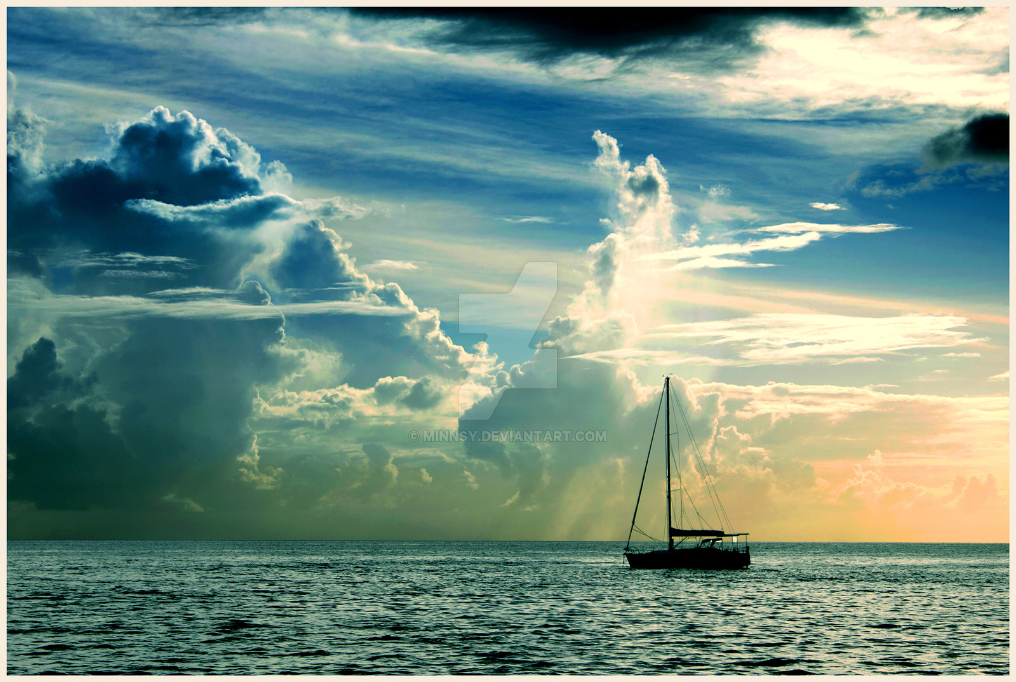
“Come unto me, all ye that labour and are heavy laden, and I will give you rest.”
Matthew 11:28

Slide 15
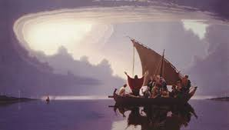
Peace, be still.
Mark 4:39
Notes:
Mark 4:39 And he arose, and rebuked the wind, and said unto the sea, Peace, be still. And the wind ceased, and there was a great calm.

Slide 16
Peace. It does not mean to be in a place where there is no noise, trouble or hard work. It means to be in the midst of those things and still be calm in your heart.
-Unknown
Notes:
You are safer with God in the middle of a storm than you are anywhere else without Him.
Are you in need of a calm from the storms and struggles of life? Then why not come to Jesus?
On April 28th, 2014, when the storm outside was raging and 50 plus family members were packed in a rather small storm shelter, kids crying, wind howling, Audrey said, say a prayer Matt. Faith of a child in the one who saves is precious!
Come to Jesus he will save you!

