Slide 1

Building Up The Church
Sermon # 1 Dec. 2, 2018
Eccl. 12:13-14
Let us hear the conclusion
Of the whole matter:

Slide 2
Fear God and
Keep his commandments; for this is the whole duty of man
For God shall bring every work into judgment,With every secret thing, whether it be good, or
Whether it be evil.

Slide 3
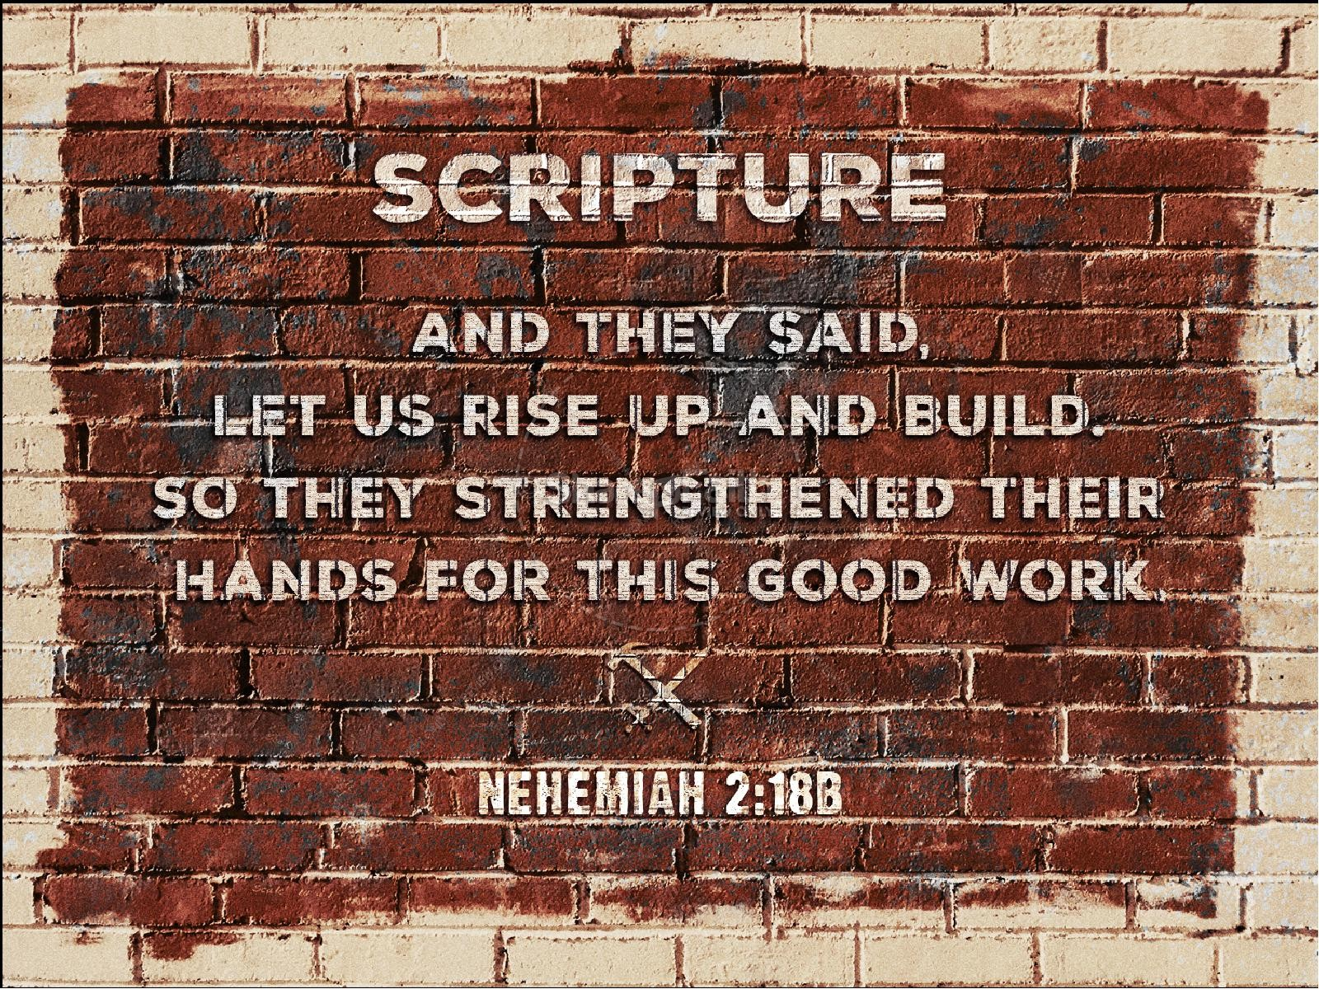

Slide 4
Then I told them of the hand of
My God which was good upon me.
As also the king’s words that he
had spoken unto me.
And they said,
Let us rise up and build.
So they strengthened their hands
for their good
Work. Neh. 2:18

Slide 5
First: God was Behind
The Building!
Nehemiah had instructions
from God!

Slide 6
Before we build, we listen to God.

Slide 7
What Nehemiah knew:
“Except the Lord build the
House, they labor in vain
that build it.” Psalm 127:1a

Slide 8
Nehemiah was successful…Nehemiah 2:18-and they built
The wall. Sure,a lot of obstacles..but God’s work is done when
Men seek Him for his guidance.
Noah was successful..Gen.6:22 why?²² Thus did Noah; according to all that God commanded him, so did he!
+++++++++++++++++++++++++++++++++++++++++++++++++
But not these people: People who sought to build a tower and a city. What was wrong with this? Gen.11:1-9
v.4 ⁴ And they said, Go to, let us build us a city and a tower, whose top may reach unto heaven; and let us make us a name, lest we be scattered abroad upon the face of the whole earth.”
Forgot God! “Let us do for us what we want for us!”

Slide 9
Genesis 11:1-9
1 And the whole earth was of one language, and of one speech.
² And it came to pass, as they journeyed from the east, that they found a plain in the land of Shinar; and they dwelt there.
³ And they said one to another, Go to, let us make brick, and burn them thoroughly. And they had brick for stone, and slime had they for morter.
⁴ And they said, Go to, let us build us a city and a tower, whose top may reach unto heaven; and let us make us a name, lest we be scattered abroad upon the face of the whole earth.
⁵ And the Lord came down to see the city and the tower, which the children of men builded.

Slide 10
⁶ And the Lord said, Behold, the people is one, and they have all one language; and this they begin to do: and now nothing will be restrained from them, which they have imagined to do.
⁷ Go to, let us go down, and there confound their language, that they may not understand one another's speech.
⁸ So the Lord scattered them abroad from thence upon the face of all the earth: and they left off to build the city.
⁹ Therefore is the name of it called Babel; because the Lord did there confound the language of all the earth: and from thence did the Lord scatter them abroad upon the face of all the earth.

Slide 11
What we build at O’Neal , should be what God wants,
It’s not for us and for us to glory in,
It is to be exactly what we learn from God that
He wants us to do in 2018 and 2019..
If we resist God’s way, we will lose.
If we abide in His Will, always asking His blessings
Upon us in our efforts, we will win. We will
‘always be saying, We will arise and build
For God!!

Slide 12
At God’s orders,”Let us rise and build”
And we must build on the rock, and not the sand!
Matt.7:21-28

Slide 13
Jesus promised to build the church..
and He did. Matt.16:18
God from the foundation of the world
had in His mind what He wanted to do- to
unite all men together in one body!
Colossians 1:26-27 ²⁶ Even the mystery which hath been hid from ages and from generations, but now is made manifest to his saints:²⁷ To whom God would make known what is the riches of the glory of this mystery among the Gentiles; which is Christ in you, the hope of glory:
In the church….
We need to Arise and let folks know this good News!!

Slide 14
The name on a sign does not make it
the ‘church of Christ’but the people in
the building, and what they do, does when
they are listening to God’s orders and does God’s
Work in God’s way!!
? ?
This is a CHURCH OF CHRIST
This is not a CHURCH OF CHRIST.

Slide 15
Did the old timer preachers make a mistake:
Speak where God speaks: “the churches of Christ salute
You.” Romans 16:16 Did Paul say that? Is that what God
Wanted said? Did God put it in the Bible.?
So many people want to say things about the church
Which are not said by God, but the things said by God
They don’t pay any attention too!. What a shame!

Slide 16
God wants the church of the Lord made known…
By name and by work!!
Listen to God through Paul:
Paul told the Corinthians:
..God wants the church to be built up…
“1 Corinthians 14:4 ⁴ He that speaketh in an unknown tongue edifieth himself; but he that prophesieth edifieth the church.
Edifieth: to be built up. “ The person who speaks in a language (supernaturally) builds up himself but the one who prophesies,
Builds up the church.”

Slide 17
I Cor. 14:12 ¹² Even so ye, forasmuch as ye are zealous of spiritual gifts, seek that ye may excel to the edifying of the church.
Look for ways to excel” in building up the church.!!”
I Cor. 14:26 Everything that is done , should be for the building up of the church!
Everything: We should be moved to work to
Build up the church. Are you doing that? Am I?

Slide 18
“Our duty is not to mold a church to our satisfaction,
but to learn the design of God and follow
His blueprint
to the best of our ability.”

Slide 19
Eph. 4:11,12 ¹¹ And he gave some, apostles; and some, prophets; and some, evangelists; and some, pastors and teachers; (Who? Why?)
¹² For the perfecting of the saints, for the work of the ministry, for the edifying (building up of the church) of the body of Christ:
This is it! God wants us to be ‘building up the church’:
and he tells us who and what to do !!!
1. For the perfecting of the saints
2. For the work of the ministry
3. For the edifying (building up of the church)
Simple but dynamic! Why? He is God!

Slide 20
Some Apostles: Given, used so long as God needed them.
Don’t need them today…we have their word to guide us!
Some Prophets: Given, used so long as God needed them.
Don’t need them today…we have God’s record of their work.
Some Pastors: (Pastors, Elders; Shepherds, Overseers,Presbyters;…We Need them today. We have them! Acts 14:23; I Tim. 3:1-6; Titus 1:5-8
Some Evangelists: Preachers; Ministers I Tim. 4:16;
..We need them; We have them today.
Some Teachers: Needs them today. We have them.
2 Tim. 2:2

Slide 21
The Men :
Some Apostles
Some Prophets;
Some Evangelists;
Some Pastors;
Some Teachers;
The Work.

Slide 22
The Work:
¹² For the perfecting of the saints, for the work of the ministry, for the edifying (building up of the church) of the body of Christ: This is it! God wants us to be ‘building up the church’: and he tells us how to do it!!!
1. For the perfecting of the saints
2. For the work of the ministry
3. For the edifying (building up of the church)
Simple but dynamic! Why? He is God!

Slide 23
1. For the perfecting of the saints (Edification) (Preparing the saints for service)
2. For the work of the ministry (Benevolence)(Providing for the needy saints.)
3. For the edifying (building up of the church)
(Evangelism. )(Proclaiming the gospel of Christ_ )

Slide 24
Don’t add to it. Rev.22:18
Don’t take away from it.
He knows what He wants and given the men through
Which
He will accomplish His work!

Slide 25
Conclusion for today:
Eccl. 12:13-14
Let us hear the conclusion
Of the whole matter:

Slide 26
Fear God and
Keep his commandments; for this is the whole duty of man
For God shall bring every work into judgment,With every secret thing, whether it be good, or
Whether it be evil.

