Slide 1
Counting Your Blessings

Slide 2
The Greatest Blessing that we have ,

Slide 3
JESUS CHRIST

Slide 4


Slide 5
John 3:9-21
⁹ Nicodemus answered and said unto him, How can these things be?
¹⁰ Jesus answered and said unto him, Art thou a master of Israel, and knowest not these things?
¹¹ Verily, verily, I say unto thee, We speak that we do know, and testify that we have seen; and ye receive not our witness.
¹² If I have told you earthly things, and ye believe not, how shall ye believe, if I tell you of heavenly things?

Slide 6
¹³ And no man hath ascended up to heaven, but he that came down from heaven, even the Son of man which is in heaven.
¹⁴ And as Moses lifted up the serpent in the wilderness, even so must the Son of man be lifted up:
¹⁵ That whosoever believeth in him should not perish, but have eternal life.
¹⁶ For God so loved the world, that he gave his only begotten Son, that whosoever believeth in him should not perish, but have everlasting life.
¹⁷ For God sent not his Son into the world to condemn the world; but that the world through him might be saved.

Slide 7
¹⁸ He that believeth on him is not condemned: but he that believeth not is condemned already, because he hath not believed in the name of the only begotten Son of God.
¹⁹ And this is the condemnation, that light is come into the world, and men loved darkness rather than light, because their deeds were evil.
²⁰ For every one that doeth evil hateth the light, neither cometh to the light, lest his deeds should be reproved.
²¹ But he that doeth truth cometh to the light, that his deeds may be made manifest, that they are wrought in God.

Slide 8
What would persuade you, today,
To hear Jesus, John 20:31,32
To believe in Jesus, John 8:24
To Repent and turn to Him, Luke 13:3
To Confess with your mouth that Jesus
Christ is the Son of God, Matt. 10:32-33
and
To Be Baptized for the remission
of your sins? I Pet. 3:21
What would persuade you, today, as an erring child of God, to Repent,( Acts 8:22 ); to Confess your sins (I John 1:9) and to Pray for God’s forgiveness? (James 5:16)

Slide 9
Go with me for a few minutes this morning

Slide 10
To ..CHRIST UPON THE CROSS
.We see Him, Hanging on a Cross, He hung there for about 6 hours,
What do we see?
It was the custom of those days that the accusation under which men were condemned should, in every case, be posted above their heads

Slide 11
Cf, John 19:19-22
We see what Matthew saw
Matthew: THIS IS JESUS THE KING OF THE JEWS
We see what Mark saw
Mark: THE KING OF THE JEWS
We see what Luke saw
Luke: THIS IS THE KING OF THE JEWS
We see what John saw.
John: JESUS OF NAZARETH THE KING OF THE JEWS
Thus,
THIS IS JESUS OF NAZARETH THE KING OF THE JEWS

Slide 12
As Jesus hung on the cross for about 6 hours…
3 hours there was the sun giving light
But then , at around noon, there are
3 hours of darkness upon the earth.
(Matt. 27:45 Now from the 6th hour there was darkness over all the land unto the 9th hour.”
And 7 sayings mentioned by him while on the cross..
During the hours ending at noon, the following events took place

Slide 13
1. The chief priests tried to get Pilate to change the inscription. John 19:21,22 “Then said the chief priests of the Jews to Pilate, Write not, The King of the Jews; but that he said, I am King of the Jews. V.22 Pilate answered, What I have written, I have written.”
2. The soldiers gambled for the Lord's garments. (Matt. 27:35-36)
“And they crucified him, and parted his garments, casting lots: that it might be fulfilled which was spoken by the prophet,’they parted my garments among them, and upon my vesture did they cast lots, and sitting down, they watched him there…”

Slide 14
3. The derision and scoffing by the Sanhedrin, the multitude, the soldiers, and the robbers Matt. 27:39-44 ³⁹ And they that passed by reviled him, wagging their heads,
⁴⁰ And saying, Thou that destroyest the temple, and buildest it in three days, save thyself. If thou be the Son of God, come down from the cross.
⁴¹ Likewise also the chief priests mocking him, with the scribes and elders, said,
⁴² He saved others; himself he cannot save. If he be the King of Israel, let him now come down from the cross, and we will believe him.
⁴³ He trusted in God; let him deliver him now, if he will have him: for he said, I am the Son of God.
⁴⁴ The thieves also, which were crucified with him, cast the same in his teeth.

Slide 15
The Three Hours of Darkness The sun was covered with darkness..
"And it was now about the sixth hour, and a darkness came over the whole land until the ninth hour, the sun's light failing" (Luke 23:44,45).
The Ripping of the Curtain (Veil) Lk. 23:44-45 And it was about the 6th hour ,And there was darkness over all the earth until the ninth hour, and the sun was darkened and the veil of the temple was rent in the midst.”
The Earthquake Matt. 27:54 Now when the centurian, and they that were with him, watching Jesus, saw the earthquake, and those things that were done, they feared greatly, saying, Truly this was the Son of God.

Slide 16
The Opening of the graves Matt. 27:52 And the graves were opened, and many bodies of the saints which slept arose, and came out of the graves after his resurrection, and went into the holy city and appeared unto many.

Slide 17
Christ upon the Cross….

Slide 18
1. "Father forgive them, for they know not what they do" (Luke 23:34).
Forgiveness. Our attitude must always be on like Christ..
Forgive others who sin against us.
Cf. Acts 2:36-38. Some of the first ones in the church!
Cf. Acts 7:60 Stephen forgave his killers…Saul…cf. what
He had to do. Acts 22:16

Slide 19
2. "Verily, I say unto thee, Today shalt thou be with me in paradise" (Luke 23:43).
Christ had the power to forgive sin. Mark 2:9,10
“..but that ye may know that the Son of man hath power on earth to forgive sins, he said to the sick of the palsy, I say unto thee, Arise, and take up thy bed, and go thy way into thine house.”
John 8:10-11 Woman, where are those thine accusers? Hath no man condemned thee? She said No man, Lord. And Jesus said
Neither do I condemn thee: go, and sin no more.”
Today, thou shalt be with me in Paradise.
Cf.

Slide 20
3. "Woman, behold thy son ... Behold thy mother" (John 19:26,27).

Slide 21
4. "My God, my God, why hast thou forsaken me?" (Matthew 27:46).

Slide 22
IV. "My God, my God, why hast thou forsaken me?“( Matt. 27:46)
Selected notes: The awful depths of those words are What sorrow flows from that pleading cry! What can it truly mean?
Should men believe that God forsook Christ on the cross? If so, why? Was it that he could not physically die until that occurred?.
Some believe Christ was quoting Psalms 22 which has these exact words in its first verse. If that was the case, it would have been in perfect keeping with the constant example of his whole life in meeting every crisis with a quotation from the Holy Scriptures.
"It is written; it is written; and again it is written" (Matthew 4:4-7). In support of this view is the remarkable number of specific prophecies relative to the crucifixion which are contained in Psalms 22, and which were at that very moment being fulfilled so graphically before all.

Slide 23
5. "I thirst!" (John 19:28).

Slide 24
V. "I thirst.“ John 19:28
The last three utterances are shorter, possibly due to the Saviour's ebbing life (Matthew 26:29).
What a paradox is this scene! He who upholds all things by the word of his power (Hebrews 1:3) is here himself upheld upon the rude and torturing beams of the cross.
He who changed eighty gallons of water into wine is here athirst!
He who is the Prince of Life must taste death for every man! The thirst was prophesied in Psalms 22:15

Slide 26
6. "It is finished" (John 19:30).

Slide 27
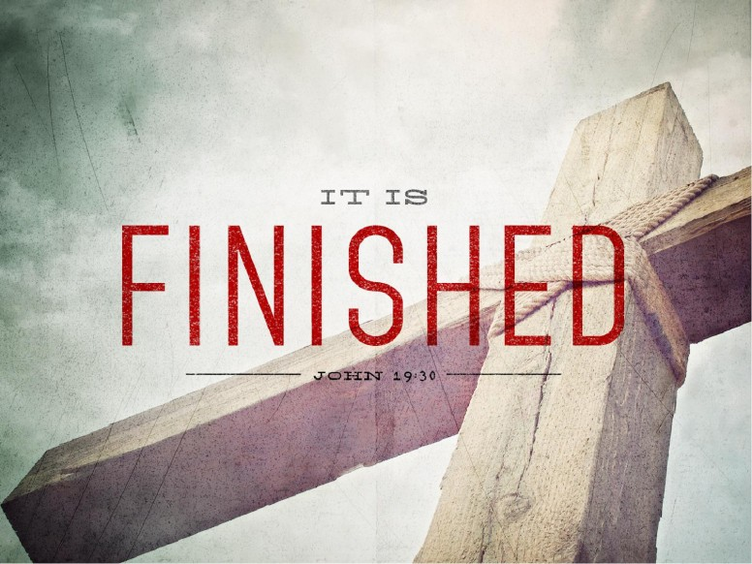

Slide 28
VI. "It is finished.“ What was finished?
1. The law of Moses (Colossians 2:14-16),
2. The Sabbath institution (Amos 8:5-9),
3. The works of his personal ministry,
4. The power of Satan (Hebrews 2:14),
5. The atonement for the sins of the whole world (Hebrews 9:26),
6. The purchase price for the church (Acts 20:28),
and
7. The remission of sins prior to Calvary, as well as the remission of whatever sins will be remitted for all eternity - these are among the things finished that day on the cross of Christ.

Slide 29
The finished work of Jesus leaves ample place for
Others to take up the cross daily and follow him.
Other hands must do his work;
Other lips must preach his word;
and
Other hearts must warm to his great love.
Indeed, "it is finished"; but man's work is before him.
"Save yourselves from this crooked generation!“Acts 2:40 “Work out your own salvation with fear and trembling!“Phil.2:12

Slide 30
7. "Father, into thy hands I commend my spirit" (Luke 23:46).

Slide 31
VII. "Father, into thy hands I commend my spirit.“Lk.23:46
What an argument for immortality is this!
In a moment the body of Christ would fail, but that would not be the end. He made an appointment for the Father to take his spirit, and did so with the calm assurance of one who might make an appointment to meet a friend after lunch.
Man has a body, but he is a soul. No wonder Paul said that Jesus "brought life and immortality to light through the gospel" (2 Timothy 1:10).
Selected Quote: “ Happy are the followers of Jesus, who, as the end nears, may feel the Father's nearness as did Jesus, and commend their souls to his eternal safekeeping. This last utterance is synchronized with the major thesis of Christianity involving the immortality of the soul and man's spiritual nature and accountability to God for all his deeds.”

Slide 32
The 7 Sayings from Christ from the Cross These were:
1. “Father forgive them, for they know not what they do. Lk.23:34
2. “Verily, I say unto thee, Today shalt thou be with me in
Paradise.” Luke 23:43
3. “Woman, behold thy son.behold thy mother. John 19:26,27
4. “My God, my God, why hast thou forsaken me?” Matt. 27:46
5. “I thirst!” John 19:28
6. “It is finished” John 19:30
7. “Father,into thy hands I commend my spirit. Lk.23:46

Slide 33
Count Your Many Blessings….
But at the top of the list, always and forever put
JESUS CHRIST, THE SON OF GOD,
If you can’t count Him first on your list…this is your invitation
To put him there by your obeying the gospel or being restored
Today.

