Slide 2
Forget me not

Slide 3
IDOLATRY
S
2
God warned Israel about serving foreign gods.
Deuteronomy 8:19 It shall come about if you ever forget the Lord your God and go after other gods and serve them and worship them, I testify against you today that you will surely perish. 20 Like the nations that the Lord makes to perish before you, so you shall perish; because you would not listen to the voice of the Lord your God.

Slide 4
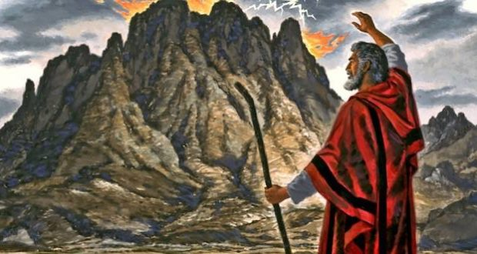
Exodus 32:7-10
Then the Lord spoke to Moses, “Go down at once, for your people, whom you brought up from the land of Egypt, have corrupted themselves. They have quickly turned aside from the way which I commanded them. They have made for themselves a molten calf, and have worshiped it and have sacrificed to it and said, ‘This is your god, O Israel, who brought you up from the land of Egypt!’” The Lord said to Moses, “I have seen this people, and behold, they are an obstinate people. Now then let Me alone, that My anger may burn against them and that I may destroy them; and I will make of you a great nation.”

Slide 5
They made a calf in Horeb
And worshiped a molten image.
Thus they exchanged their glory
For the image of an ox that eats grass.
They forgot God their Savior,
Who had done great things in Egypt,
Psalms 106:19-21

Slide 6
Their stubbornness lead them to forget God.

Slide 7
God’s people have always needed a reminder
“Know, then, it is not because of your righteousness that the Lord your God is giving you this good land to possess, for you are a stubborn people. Remember, do not forget how you provoked the Lord your God to wrath in the wilderness; from the day that you left the land of Egypt until you arrived at this place, you have been rebellious against the Lord. Deuteronomy 9:6-7

Slide 8
It seems people have always been forgetful
Then the Lord God took the man and put him into the garden of Eden to cultivate it and keep it. The Lord God commanded the man, saying, “From any tree of the garden you may eat freely; but from the tree of the knowledge of good and evil you shall not eat, for in the day that you eat from it you will surely die.” Genesis 2:15
When the woman saw that the tree was good for food, and that it was a delight to the eyes, and that the tree was desirable to make one wise, she took from its fruit and ate; and she gave also to her husband with her, and he ate. Genesis 3:6

Slide 9
God has always reminded his people
So watch yourselves, that you do not forget the covenant of the Lord your God which He made with you... Deut. 4:23
The covenant that I have made with you, you shall not forget, nor shall you fear other gods. II Kings 17:38
Thus the sons of Israel did not remember the LORD their God, who had delivered them from the hands of all their enemies on every side; Judges 8:34

Slide 10
God has always reminded his people
How often they rebelled against Him in the wilderness And grieved Him in the desert! Again and again they tempted God,And pained the Holy One of Israel.They did not remember His power,The day when He redeemed them from the adversary, When He performed His signs in Egypt... Psalms 78:40-43
Bless the LORD, O my soul, And forget none of His benefits; Psalms 103:2
The wicked will return to Sheol, Even all the nations who forget God. Psalms 9:17

Slide 11
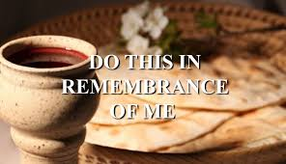

Slide 12
That is the beauty of the Gospel and God’s church.
For I received from the Lord that which I also delivered to you, that the Lord Jesus in the night in which He was betrayed took bread; and when He had given thanks, He broke it and said, “This is My body, which is for you; do this in remembrance of Me.” In the same way He took the cup also after supper, saying, “This cup is the new covenant in My blood; do this, as often as you drink it, in remembrance of Me.” For as often as you eat this bread and drink the cup, you proclaim the Lord’s death until He comes.
I Corinthians 11:23-26

Slide 13
Hebrews 10:23-25
Let us hold fast the confession of our hope without wavering, for He who promised is faithful; and let us consider how to stimulate one another to love and good deeds, not forsaking our own assembling together, as is the habit of some, but encouraging one another; and all the more as you see the day drawing near.

Slide 14
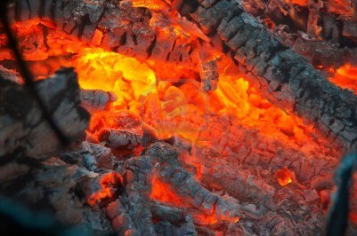

Slide 15
Forgetting happens a little a time.
Their deeds will not allow them To return to their God. For a spirit of harlotry is within them, And they have forgotten the LORD. Hosea 5:4

Slide 16
What do we forget?

Slide 17
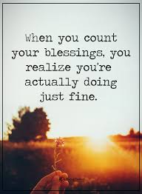
We forget how blessed we are
But I have received everything in full and have an abundance; I am amply supplied, having received from Epaphroditus what you have sent, a fragrant aroma, an acceptable sacrifice, well-pleasing to God. And my God will supply all your needs according to His riches in glory in Christ Jesus. Phillipians 4:18-19

Slide 18
Lord Forgive me when I whine
I stopped to buy some candy. The lad who sold it had such charm.
I talked with him. He seemed so glad. If I were late, it'd do no harm.
And as I left, he said to me, "I thank you. You have been so kind.
It's nice to talk with folks like you. You see," he said, "I'm blind."
Oh Lord! Forgive me when I whine.
I have two eyes. The world is mine.
Today, upon a bus, I saw a girl with golden hair,
I envied her....she seemed so sweet....and wished I were as fair.
When suddenly she rose to leave, I saw her hobble down the aisle.
She had one leg and wore a crutch; but as she passed....a smile.
Oh Lord! Forgive me when I whine.
I have two legs. This world is mine

Slide 19
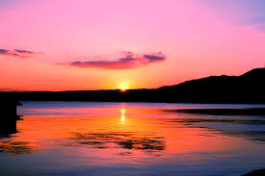
Lord Forgive me when I whine
Later while walking down the street, I saw a child with eyes of blue.
He stood and watched the others play.He Seemed to know not what to do
I stopped a moment,When I said, "Why don't you join the others, Dear?"
He looked ahead without a word, and then I knew he could not hear.
Oh Lord! Forgive me when I whine.
I have two ears. This world is mine.
With feet to take me where I'd go, with eyes to see the sunset's glow,
with ears to hear what I would know....
Oh Lord forgive me when I whine.
I am blessed indeed. The world is mine!

Slide 20
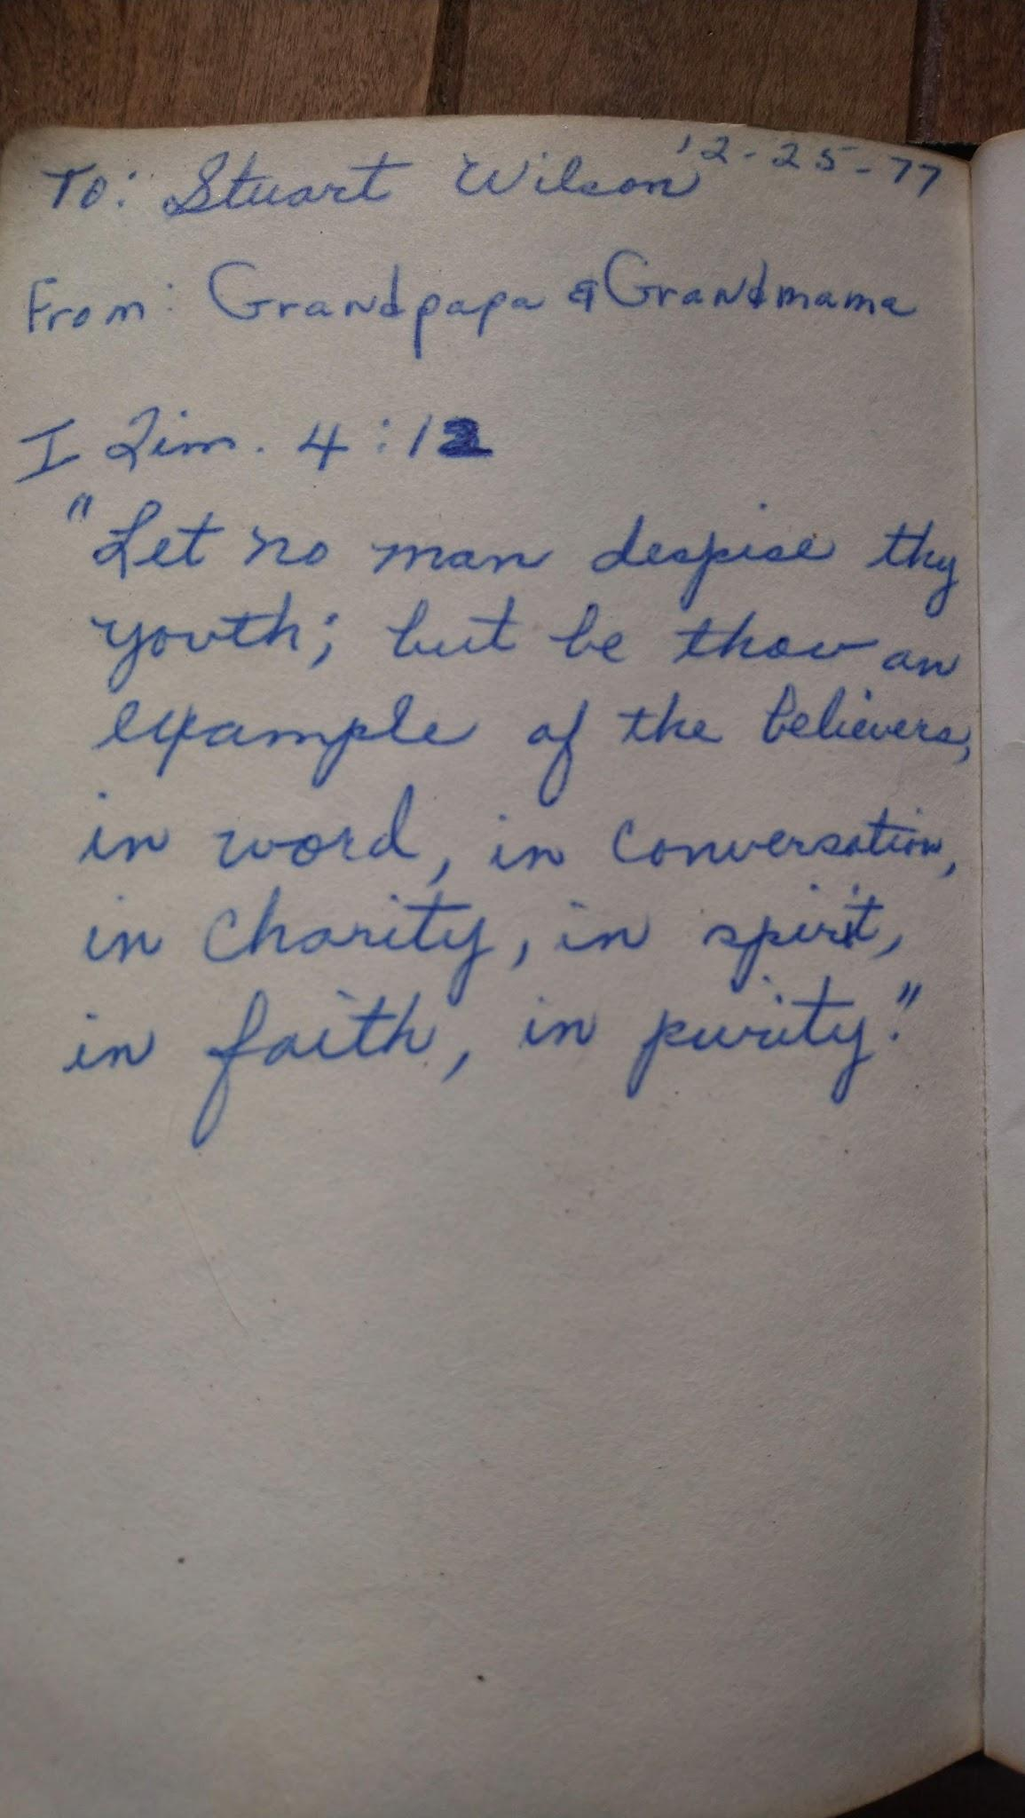
We forget what we are capable of
Let no man despise thy youth; but be thou an example of the believers, in word, in conversation, in charity, in spirit, in faith, in purity.Till I come, give attendance to reading, to exhortation, to doctrine. Neglect not the gift that is in thee… Timothy 4:12-14 KJV

Slide 21
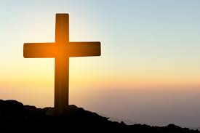
We forget how much we are loved
For while we were still helpless, at the right time Christ died for the ungodly. For one will hardly die for a righteous man; though perhaps for the good man someone would dare even to die. But God demonstrates His own love toward us, in that while we were yet sinners, Christ died for us. Romans 5:6-8

Slide 22
We Forget how much we are loved
Yet it is I who taught Ephraim to walk, I took them in My arms; But they did not know that I healed them. I led them with cords of a man, with bonds of love, And I became to them as one who lifts the yoke from their jaws; And I bent down and fed them. Hosea 11:3-4
How can I give you up, O Ephraim? How can I surrender you, O Israel?...I will not execute My fierce anger; I will not destroy Ephraim again. For I am God and not man, the Holy One in your midst, And I will not come in wrath. Hosea 11:9

Slide 23
We forget about how much we have to lose
If we miss heaven, we’ve missed it all

Slide 24
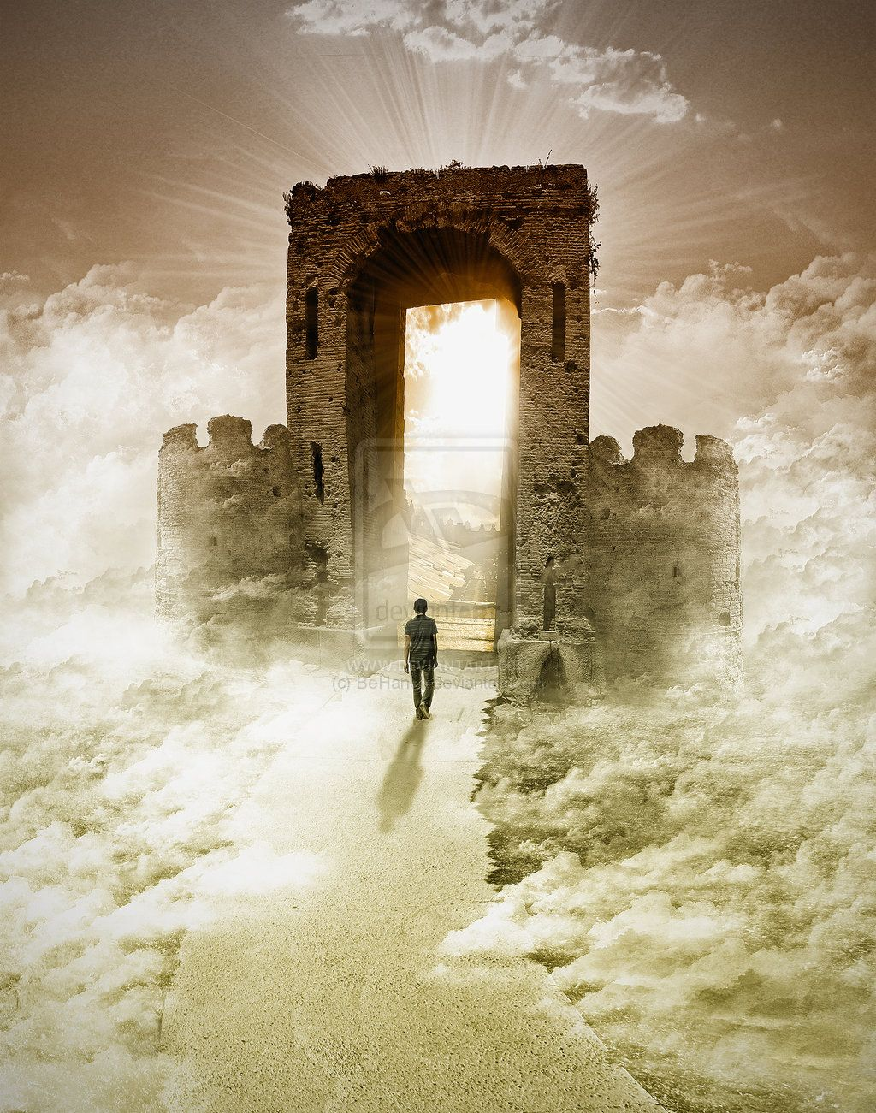
The Watcher: By Margaret Widdemer
She always leaned to watch for us, Anxious if we were late, In winter by the window, In summer by the gate.
And though we mocked her tenderly, Who had such foolish care, The long way home would seem more safe Because she waited there.
Her thoughts were all so full of us, She never could forget! And so I think that where she is She must be watching yet.
Waiting till we come home to her, Anxious if we are late, Watching from Heaven’s window, Leaning on Heaven’s gate.

