Slide 1
GENEROSITY -
THE BLESSED LIFE

Slide 2
Generosity Defined:
the quality of being kind and generous, a giver,
to share and to sacrifice..giving beyond means.
synonyms: liberality · benevolence · · charity · · · big-heartedness · · unselfishness · self-sacrifice ·
2 Cor. 9:7 God loveth a cheerful giver!
Are you a Giver? What kind of giver?
A Generous Giver—Give, Give, Give!

Slide 3
2Corinthians 8:1-5 Moreover, brethren, we do you to wit of the grace of God bestowed on the churches of Macedonia;
² How that in a great trial of affliction the abundance of their joy and their deep poverty abounded unto the riches of their liberality.
³ For to their power, I bear record, yea, and beyond their power they were willing of themselves;
⁴ Praying us with much intreaty that we would receive the gift, and take upon us the fellowship of the ministering to the saints.
⁵ And this they did, not as we hoped, but, and unto us by the will of God# 1 first gave their own selves to the Lord and unto Us by the will of God.

Slide 4
Scripture after Scripture
Example after Example

Slide 5
Before one can be considered as a generous giver,
What does he/she do first?
First Give Yourself To the Lord….

Slide 6
Acts 20:35 - I have shewed you all things, how that so labouring ye ought to support the weak, and to remember the words of the Lord Jesus, how he said, It is more blessed to give than to receive
Remember this! The best , the blessed
Thing, is to give better than receiving!!!!!
But---do you believe that?

Slide 7
Luke 6:38 - Give, and it shall be given unto you; good measure, pressed down, and shaken together, and running over, shall men give into your bosom. For with the same measure that ye mete withal it shall be measured to you again

Slide 8
Proverbs 19:17 - He that hath pity upon the poor lendeth unto the LORD; and that which he hath given will he pay him again.
What a fantastic plan!!!!!!

Slide 9
Matthew 6:19-21
¹⁹ Lay not up for yourselves treasures upon earth, where moth and rust doth corrupt, and where thieves break through and steal:
²⁰ But lay up for yourselves treasures in heaven, where neither moth nor rust doth corrupt, and where thieves do not break through nor steal:
²¹ For where your treasure is, there will your heart be also
Where is your heart?????

Slide 10
1 Timothy 6:17-19
¹⁷ Charge them that are rich in this world, that they be not highminded, nor trust in uncertain riches, but in the living God, who giveth us richly all things to enjoy;
¹⁸ That they do good, that they be rich in good works, ready to distribute, willing to communicate;
¹⁹ Laying up in store for themselves a good foundation against the time to come, that they may lay hold on eternal life.

Slide 11
1 John 3:17 - But whoso hath this world's good, and seeth his brother have need, and shutteth up his bowels [of compassion] from him, how dwelleth the love of God in him?
You have and can help…but you won’t!!!
(how dwelleth the love of God in you??)

Slide 12
2 Corinthians 9:6 - But this [I say], He which soweth sparingly shall reap also sparingly; and he which soweth bountifully shall reap also bountifully.
How are you and I sowing? Sparingly?
Bountifully?

Slide 13
THE POOR WIDOW WHO GAVE EVERYTHING
THAT SHE HAD!!

Slide 14
Luke 20:45-47 ⁴⁵ Then in the audience of all the people he said unto his disciples,
⁴⁶ Beware of the scribes, which desire to walk in long robes, and love greetings in the markets, and the highest seats in the synagogues, and the chief rooms at feasts;
⁴⁷ Which devour widows' houses, and for a shew make long prayers: the same shall receive greater damnation

Slide 15
Luke 21:1-4
And he looked up, and saw the rich men casting their gifts into the treasury.
² And he saw also a certain poor widow(not named) casting in thither two mites.(2 very small copper coins)
³ And he said, Of a truth I say unto you, that this poor widow hath cast in more than they all (She gave the most!) :
⁴ For all these have of their abundance cast in unto the offerings of God: but she of her penury([poverty) hath cast in all the living that she had.(her livelihood).

Slide 16
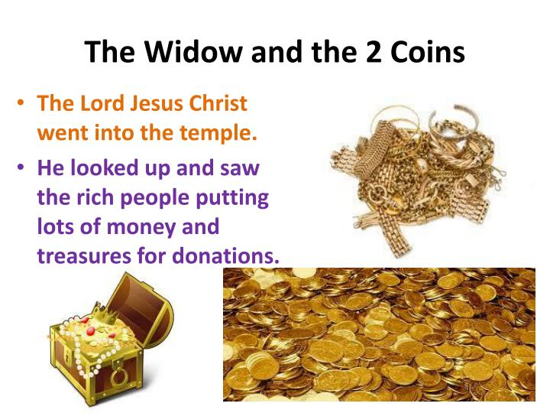

Slide 17
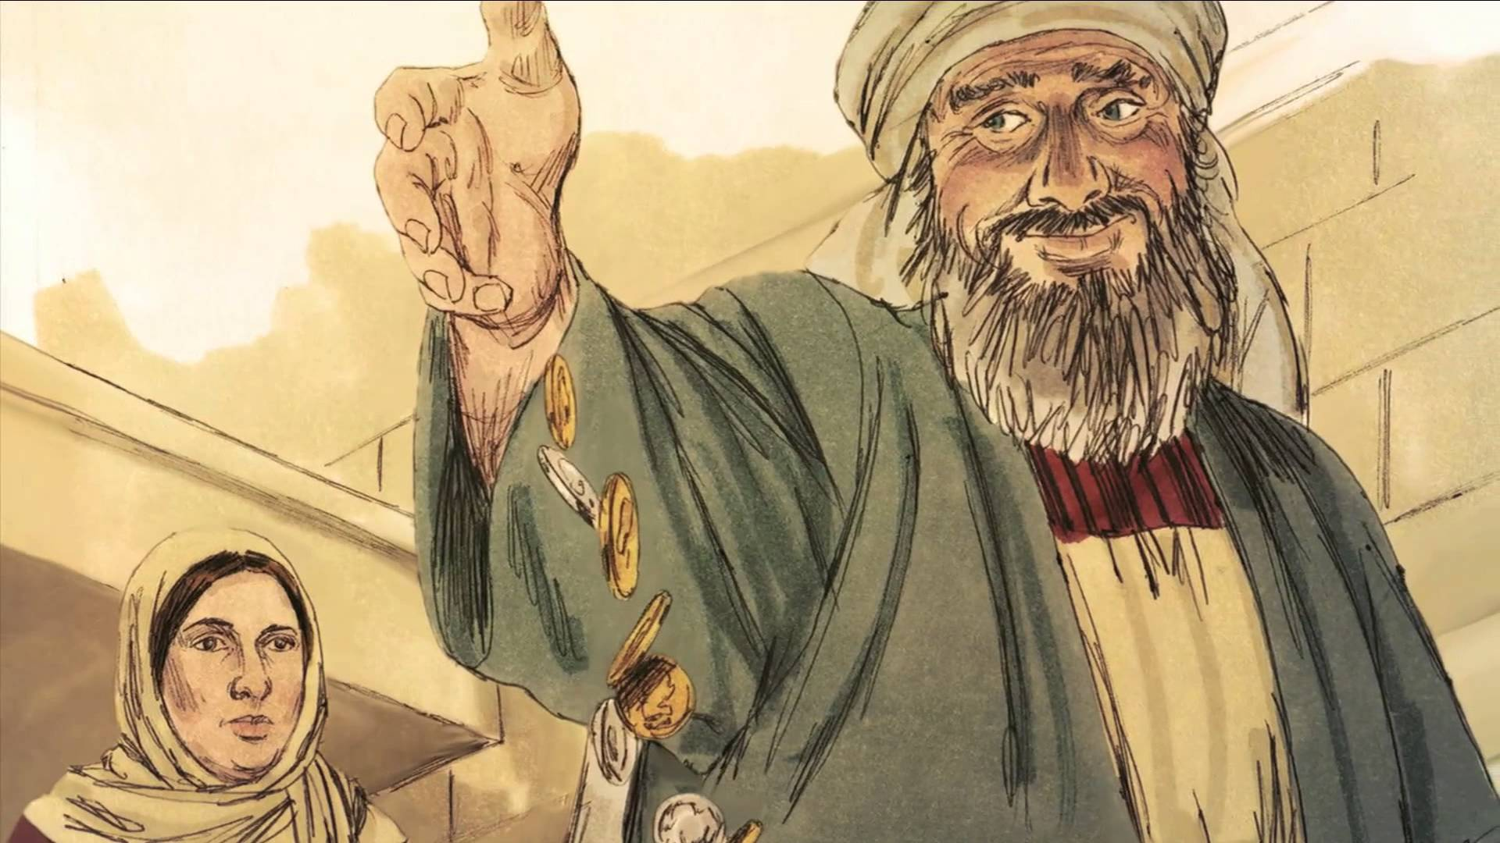

Slide 18
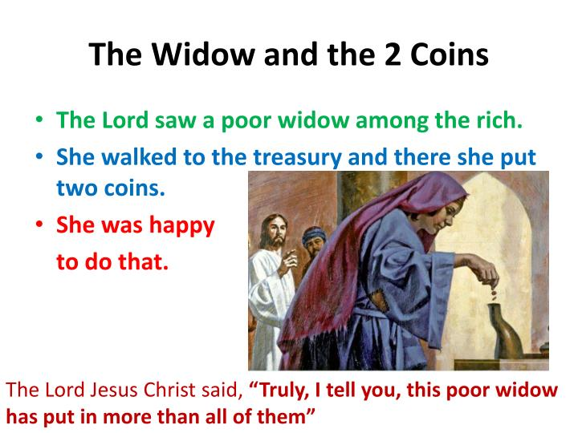

Slide 19
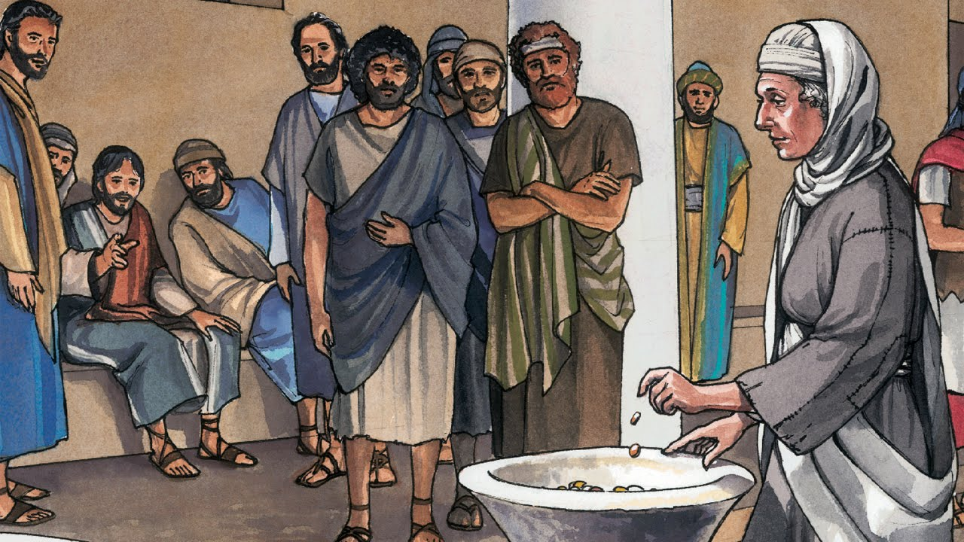

Slide 20
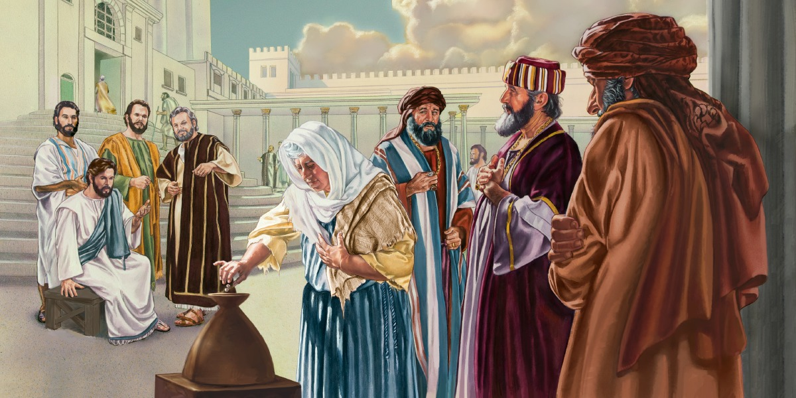

Slide 21
1. Why was a woman in the temple?
2. Why would this woman possess a true heart of faith,
Devotion and sacrifice?
3. Is each individual responsible to give to God?
4. What does it mean to truly be God dependent?
5. What is the connection between liberal giving and a
Heart devoted to God?

Slide 22
The Widow Who Gave All
Luke 20:45—21:4

Slide 23
Matt. 5:3 “Blessed are the poor in spirit, for theirs
Is the kingdom of heaven.”

Slide 24
Focus:
Discipleship requires a heart devoted to the
Lord. Such a heart changes how we see the
Things of the world.”
This world is not my home…….!

Slide 25
Christianity is a way of life.

Slide 26
In this lesson, we examine the outward manifestation Of a devoted heart.

Slide 27
Money and Material Things

Slide 28
Bob Russell told a story of a rich man who was determined
To take his wealth with him. He told his wife to get all his
Money together, put it in a sack, and then hang the sack
From the rafters in the attic. He said, “When my spirit is
Caught up to heaven, I’ll grab the sack on my way.” Well he
Eventually died, and the woman raced to the attic, only to
Find the money still there. She said, “I knew I should have
Put the sack in the basement.”

Slide 29
Out of 38 parables that Jesus told,16 deal with money
In some form or other..
If you add the times that heaven and hell are mentioned,
It comes to fewer times than money is mentioned.
The New Testament says 5 times as much about money,
Than it does about prayer.
There are 500 or so verses on prayer and faith combined,
But there are 2000 verses dealing with money and possessions.

Slide 30
Luke captured a stream of events in Jesus’ ministry
That concerned money and material things.

Slide 31
Luke 19:44-48 The Cleansing of the Temple
Luke 19:45-48 ⁴⁵ And he went into the temple, and began to cast out them that sold therein, and them that bought;
⁴⁶ Saying unto them, It is written, My house is the house of prayer: but ye have made it a den of thieves

Slide 32
Luke 20:20-26 Roman Taxes

Slide 33
Luke 20:20-26 ²⁰ And they watched him, and sent forth spies, which should feign themselves just men, that they might take hold of his words, that so they might deliver him unto the power and authority of the governor.²¹ And they asked him, saying, Master, we know that thou sayest and teachest rightly, neither acceptest thou the person of any, but teachest the way of God truly:²² Is it lawful for us to give tribute unto Caesar, or no?²³ But he perceived their craftiness, and said unto them, Why tempt ye me?²⁴ Shew me a penny. Whose image and superscription hath it? They answered and said, Caesar's.
²⁵ And he said unto them, Render therefore unto Caesar the things which be Caesar's, and unto God the things which be God's.
²⁶ And they could not take hold of his words before the people: and they marvelled at his answer, and held their peace.

Slide 34
The authorities over the temple allowed merchants to sell their wares in the section of the temple set aside for Gentiles. --
This was a violation of the very
nature of the temple’s purpose. (Isa. 56:7)
Isaiah 56:7 ⁷ Even them will I bring to my holy mountain, and make them joyful in my house of prayer: their burnt offerings and their sacrifices shall be accepted upon mine altar; for mine house shall be called an house of prayer for all people.

Slide 35
The Temple Treasury

Slide 36
The inner area of the Temple contained three courts. The easternmost court was the Court of the Women, and it contained the Temple treasury where people donated their money (Mk 12:41-44).
Three gates led into this court, one on the north, one on the south, and a third on the east. This third gate on the east side is almost certainly the "Beautiful Gate" that was mention in (Acts 3). A fourth gate, which was much larger and ornate led from the Court of the Women west into the Court of Israel (women could proceed no further), which was elevated 15 steps higher than the Court of Women

Slide 37
Court of the women - Wikipedia
https://en.wikipedia.org/wiki/Court_of_the_women
The court of the women (Hebrew: עזרת הנשים ‬ Ezrat HaNashim or עזרת נשים ‬ Ezrat Nashim) was the outer forecourt of the Temples in Jerusalem into which women were permitted to enter. The Jewish temple included a specific section (court)For women. The Court of the Women was where the temple Treasury was located. There were 13 trumpet-shaped Contribution chests designated for various purposes. The giver would place monies into the appropriate chest. The size and shape of these chests, allowed one to know by sound how much was Placed into it.

Slide 38
The 13 Contribution Chests (Trumpets) According to the Mishnah (Middoth 2,5) the Women's Court was just over 200 feet square between bounding lines. Each court on the outside was 60 feet square. The colonnade ran around the court, and within it, against the wall, the thirteen chests, or 'trumpets,' for charitable contributions were placed.
These thirteen chests were narrow at the mouth and wide at the bottom, shaped like trumpets. There were actually eleven treasure chests of the Temple for the voluntary offerings of money, and then also two at the Gate of Susan, for the half-shekel tax.
Their specific objects were carefully marked on them. Nine were for the receipt of what was legally due by worshippers; the other four for strictly voluntary gifts

Slide 39
As a whole, the Jewish nation seethed with indignation
Over paying tribute to Rome. Taxation imposed by the Roman Government was a bitter reminder of the Jew’s subjugation to
A pagan nation. This issue eventually led to Jewish rebellion
And the destruction of Jerusalem in 70 A.D.

Slide 40
The Scriptures are replete with warning and castigation
Concerning the proper treatment of widows. Both Old
And New Testament scripture provide instruction for the
Proper care of widows.
Poverty was often the lot of Widows.
A woman without a husband or a son who would
support her would be left to destitution and therefore
In need of a network of assistance. Luke captured Jesus’
Interaction with widows to emphasize the Lord’s compassion
for them and his indignation against their abusers.

Slide 41
Anna, 84 years old - departed not from the temple…served God With fastings and prayers night and day..
Luke 2:36-38 ³⁶ And there was one Anna, a prophetess, the daughter of Phanuel, of the tribe of Aser: she was of a great age, and had lived with an husband seven years from her virginity;
³⁷ And she was a widow of about fourscore and four years, which departed not from the temple, but served God with fastings and prayers night and day.
³⁸ And she coming in that instant gave thanks likewise unto the Lord, and spake of him to all them that looked for redemption in Jerusalem.

Slide 42
Luke 4:25-26 NKJV Widow of Zarephath
²⁵ But I tell you truly, many widows were in Israel in the days of Elijah, when the heaven was shut up three years and six months, and there was a great famine throughout all the land; ²⁶ but to none of them was Elijah sent except to Zarephath, in the region of Sidon, to a woman who was a widow.

Slide 43
Luke 7:11-15 Widow’s son dead…
¹¹ And it came to pass the day after, that he went into a city called Nain; and many of his disciples went with him, and much people.
¹² Now when he came nigh to the gate of the city, behold, there was a dead man carried out, the only son of his mother, and she was a widow: and much people of the city was with her.
¹³ And when the Lord saw her, he had compassion on her, and said unto her, Weep not.
¹⁴ And he came and touched the bier: and they that bare him stood still. And he said, Young man, I say unto thee, Arise.
¹⁵ And he that was dead sat up, and began to speak. And he delivered him to his mother.

Slide 44
Luke 18:1-5 The Persistent Widow
1 And he spake a parable unto them to this end, that men ought always to pray, and not to faint;
² Saying, There was in a city a judge, which feared not God, neither regarded man:
³ And there was a widow in that city; and she came unto him, saying, Avenge me of mine adversary.
⁴ And he would not for a while: but afterward he said within himself, Though I fear not God, nor regard man;
⁵ Yet because this widow troubleth me, I will avenge her, lest by her continual coming she weary me.

Slide 45
The Poor Widow of our Story tonight
Luke 21:1-4
21 And he looked up, and saw the rich men casting their gifts into the treasury.
² And he saw also a certain poor widow casting in thither two mites.(2 copper coins)
³ And he said, Of a truth I say unto you, that this poor widow hath cast in more than they all:
⁴ For all these have of their abundance cast in unto the offerings of God: but she of her penury hath cast in all the living that she had.

Slide 46
As we read Luke’s Gospel, we find that the religious
Leaders had been troubled by Jesus’ ministry since it’s
Beginning. They wanted to kill Jesus when He made His
Bold declarations in the synagogue (Luke 4:16-30). They
Spared no energies in looking for opportunities to capture
Him. In this text, we see them continue this effort.

Slide 47
The Sadducees were a sect of the Jews that denied
That there would be a resurrection of the dead. They were
Also more focused on good political standing. They
Differed from the Pharisees in that they were more
Materialistically driven and politically centered. With such
Fixation on the things of time, it is of little wonder that they
Did not believe in the resurrection.
Matt. 22:23 ²³ The same day came to him the Sadducees, which say that there is no resurrection, and asked him,
Acts 23:8
⁸ For the Sadducees say that there is no resurrection, neither angel, nor spirit: but the Pharisees confess both.

Slide 48
The Scribes: Jesus gave a solemn warning about the scribes He called them glory-seeking hypocrites.
(Luke 20:45-47).
He also said that they abused widows,
And this was of particular concern to the Lord in this study
Context. (Luke 20:47) God’s warnings against such abuse
Were embodied in Jesus as He judged these offenses.

Slide 49
Ex. 22:22 Ye shall not afflict any widow or fatherless child

Slide 50
Deut. 10:17-18
¹⁷ For the Lord your God is God of gods, and Lord of lords, a great God, a mighty, and a terrible, which regardeth not persons, nor taketh reward:
¹⁸ He doth execute the judgment of the fatherless and widow, and loveth the stranger, in giving him food and raiment.

Slide 51
Psalms 68:5
⁵ A father of the fatherless, and a judge of the widows, is God in his holy habitation

Slide 52
Prov. 15:25
²⁵ The Lord will destroy the house of the proud: but he will establish the border of the widow

Slide 53
Jesus watched as various persons went to the
Treasury boxes to make their contribution. This
Must have unnerved some who were well aware
Of His condemnation of their practices. When
He saw the widow go to the boxes to give, He
Paid particular attention to her. Commenting on
what she gave, Jesus taught His disciples what true
Giving is all about.

Slide 54
Application: Bringing it Home –
True giving!.
This widow whom Jesus observed was serious about her
Contribution. Unlike some of the others, she did not give
Into the treasury for show. She did not allow potential
Onlookers of her meager means to impact her giving. She,
In spite of her poverty, simply gave what she had. Doubtless,
she depended upon the Lord to care for her needs in some
fashion .

Slide 55
Giving of our means to the Lord is really a solemn matter.
It is a test of our faith in God to supply all of our needs.
(Phil. 4:19 ¹⁹ But my God shall supply all your need according to his riches in glory by Christ Jesus.) It reveals our heart for the continuance of the mission Of God through the church.
Sadly, some professing Christians Have really missed what giving is all about. Christians have been known to think of their contribution as a measure of pride. These often take advantage of any opportunity to let others know Of their superior giving. Some give with the thought of currying Favor with the leadership of the local congregation.

Slide 56
Others consider their giving as justification for having say
Or control concerning the agenda and direction of the
Local church. Such thoughts reveal a satanically influenced
Mind. (1) We are not to give for show,
(2) We are not to give for prestige,
(3) We are not to give for Power.
True giving never has an ulterior motive.

Slide 57
In a sense, our giving is really paying-it-forward. In making
Our offering to the Lord, we are actually providing funds that can assist the needy saints inside the body of Christ.
The Money given is to ensure that we can meet the needs of those who genuinely require our help.
Remember the widows !!
Acts 6:1-6.

Slide 58
Acts 6:1 And in those days, when the number of the disciples was multiplied, there arose a murmuring of the Grecians against the Hebrews, because their widows were neglected in the daily ministration.² Then the twelve called the multitude of the disciples unto them, and said, It is not reason that we should leave the word of God, and serve tables.³ Wherefore, brethren, look ye out among you seven men of honest report, full of the Holy Ghost and wisdom, whom we may appoint over this business.⁴ But we will give ourselves continually to prayer, and to the ministry of the word.⁵ And the saying pleased the whole multitude: and they chose Stephen, a man full of faith and of the Holy Ghost, and Philip, and Prochorus, and Nicanor, and Timon, and Parmenas, and Nicolas a proselyte of Antioch:⁶ Whom they set before the apostles: and when they had prayed, they laid their hands on them

Slide 59
Our giving should always be done with a mind toward steward-Ship. A good steward recognizes that he is not the owner of the Possessions. Rather, he is tending to the proper use and care Of that to which he has been entrusted. Whatever our income it is ultimately sourced in God.
( Deut. 8:1-18) WeAre called to manage it well, using it to sustain our needs and to live our lives. All of this is done after we put our offering aside. It is really an amazing thing to be able to serve as a conduit of God’s blessings to others in need.

Slide 60
Deut. 8:1-18
“Warnings against
Disobedience; The
Blessings of obedience”

Slide 61
1 All the commandments which I command thee this day shall ye observe to do, that ye may live, and multiply, and go in and possess the land which the Lord sware unto your fathers.
² And thou shalt remember all the way which the Lord thy God led thee these forty years in the wilderness, to humble thee, and to prove thee, to know what was in thine heart, whether thou wouldest keep his commandments, or no.
³ And he humbled thee, and suffered thee to hunger, and fed thee with manna, which thou knewest not, neither did thy fathers know; that he might make thee know that man doth not live by bread only, but by every word that proceedeth out of the mouth of the Lord doth man live.

Slide 62
⁴ Thy raiment waxed not old upon thee, neither did thy foot swell, these forty years.
⁵ Thou shalt also consider in thine heart, that, as a man chasteneth his son, so the Lord thy God chasteneth thee.
⁶ Therefore thou shalt keep the commandments of the Lord thy God, to walk in his ways, and to fear him.

Slide 63
⁷ For the Lord thy God bringeth thee into a good land, a land of brooks of water, of fountains and depths that spring out of valleys and hills;
⁸ A land of wheat, and barley, and vines, and fig trees, and pomegranates; a land of oil olive, and honey;
⁹ A land wherein thou shalt eat bread without scarceness, thou shalt not lack any thing in it; a land whose stones are iron, and out of whose hills thou mayest dig brass.
¹⁰ When thou hast eaten and art full, then thou shalt bless the Lord thy God for the good land which he hath given thee.

Slide 64
¹¹ Beware that thou forget not the Lord thy God, in not keeping his commandments, and his judgments, and his statutes, which I command thee this day:
¹² Lest when thou hast eaten and art full, and hast built goodly houses, and dwelt therein;
¹³ And when thy herds and thy flocks multiply, and thy silver and thy gold is multiplied, and all that thou hast is multiplied;
¹⁴ Then thine heart be lifted up, and thou forget the Lord thy God, which brought thee forth out of the land of Egypt, from the house of bondage;

Slide 65
¹⁵ Who led thee through that great and terrible wilderness, wherein were fiery serpents, and scorpions, and drought, where there was no water; who brought thee forth water out of the rock of flint;
¹⁶ Who fed thee in the wilderness with manna, which thy fathers knew not, that he might humble thee, and that he might prove thee, to do thee good at thy latter end;
¹⁷ And thou say in thine heart, My power and the might of mine hand hath gotten me this wealth.
¹⁸ But thou shalt remember the Lord thy God: for it is he that giveth thee power to get wealth, that he may establish his covenant which he sware unto thy fathers, as it is this day.

Slide 66
True Devotion
The widow gave with complete devotion to the Lord.
One does not give all that he has without a heart for the
Person or cause. The widow’s being
God – dependent and
God – devoted
prompted her action.
Matt. 6:33 ; I Pet.2:21

Slide 67
As children of God, we realize that we can depend on the Lord for
All things.

Slide 68
We are not told the hardships that this widow had endured
before coming to make her contribution, but we can imagine
that they were significant.
1) Perhaps she, was like the widow
Zarephath in Elijah[‘s day, was down to her final meal. (
I Kings 17:7-6)
2) Like Naomi of old, she may have already
Lost her husband and her sons (Ruth 1:4-5) .Whatever the case, It did not stop her from giving all she had.

Slide 69
We should never allow the circumstances of our lives to
Eclipse our devotion to the Lord. There are some who
Lose their faith in the midst of trial. These cannot imagine
How a loving God can allow them to fall into such dire
Circumstances.
This can result in a bitterness that stifles
Generosity .
When a heart is truly turned to God, no
Hardship, no tough circumstances, and no unjust experiences Can smother generosity

Slide 70
..Eve succumbed to such a theology by accepting satanic
Thoughts that God was holding her back from the better
Things of life. (Gen. 3:1-6)
… Job’s theology was rocked when he encountered the enormous amount of tragic Circumstances. He began to question God’s fairness (Job 31),And the Lord had to confront him to show him his folly.
…Naomi found herself in the same struggle with her view of God.(Ruth 1:20) We cannot give sanction to any such thoughts that question God’s love, goodness , or fairness.

Slide 71
It is possible to allow Tough times in life to desensitize us to the needs of others.
There can be people who are in dire need of our help, but our Personal struggles can result in our shutting our hearts to
Their condition. In such cases, the Scriptures would question
The genuineness of our love for our spiritual family.
(I John 3:17; Gal. 2: 10). This is the exact opposite of the spirit that the Lord Calls us to have fostered within us.

Slide 72
The Place of Generosity
Generosity does not begin with out wallets and purses.
It Begins in our hearts. When we function from this perspective, we are less likely to hold back in giving our offering to the Lord as we have been directed. Our giving will be liberal, and Our spirit will be admirable (2 Cor. 8:1-5)
The Poor Widow had something – 2 mites-
She Gave It All To The Lord!!)
Ananias and Sapphira (cf. Acts 5:1-6
Remember Young Rich Ruler. Matt. 19:16ff

Slide 73
One basica warning:
Generosity does not eliminate the need for exercising
Wisdom.
This is true of churches and individuals. There
Are times when people and groups seek assistance from churches,
but this assistance becomes the enabling of poor stewardship
Or even of irresponsible behavior.

Slide 74
Individual Christians can also be called upon to support poor stewardship or behavior. At times, we are told that if we truly love as Jesus commands, we will not Refuse these requests.
However, generosity is not to be exercised
Apart from good stewardship. At times we will be forced to help others see the need for taking on their own responsibilities rather than simply depending on others to do so.
(Gal. 6:5 Every man shall bear his own burdens.
( 2 Thess. 3:10-12 If a man does not work,neither
Shall he eat!

Slide 75
The beautiful picture of an outwardly poor and destitute
Widow is contrasted with well-to-do among the God-worshippers.
However, the contrast is really presented favorably toward
One whom society considered unfavorably. The condition of
Her heart far outweighed the heart condition of many others
At the temple.
This is yet another instance of the Lord’s showing us how we
Really look in God’s sight. ( I Sam. 16:7)
Matt Taylor’s verse this week for the children…

Slide 76
1 Samuel 16:7 King James Version (KJV)
⁷ But the Lord said unto Samuel, Look not on his countenance, or on the height of his stature; because I have refused him: for the Lord seeth not as man seeth; for man looketh on the outward appearance, but the Lord looketh on the heart.
We need to get our HEART right, and then we will
Become generous givers!!! Give your heart to God—FIRST!
REMEMBER: The Poor Widow that gave all!

