Slide 1
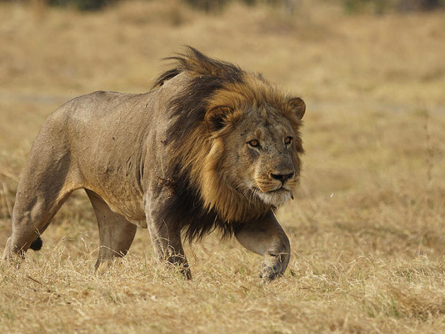
How the Devil Wins a Christian
Notes:
Does anyone here tonight want to lose to Satan? How many of us woke up this morning and said today is the day I lose? God—today’s not your day. My heart belongs to Satan. Satan 1—God 0.
We many not say it, but our actions oftentimes speak louder than our words.
Another question: Is it possible for Satan to win Christian? Once I’m His, can I fall away?

Slide 2
Can We Fall from Grace?
Galatians 5:4
4 Christ is become of no effect unto you, whosoever of you are justified by the law; ye are fallen from grace.
Notes:
In Galatians 5:1, Paul tells the Galatian brethren to “Stand fast therefore in the liberty wherewith Christ hath made us free, and be not entangled again with the yoke of bondage.” He called them “children of God” in chapter 4, so they were definitely Christians he was warning. Paul clarifies to them whether or not someone should be circumcised. He tells them if they continued in the old law—law of bondage—then they were debtors in vs. 3 to do the whole law. He goes on to tell them in vs. 4……
Since our salvation is by grace (gift of God) (Eph. 2:8) and all “spiritual blessings” are “in Christ” (Eph. 1:3) then a child of God who falls “from grace” and is “severed from Christ” is lost if they remain in that condition.

Slide 3
Name Blotted Out
Names are written in the book of life. Luke 10:20, Phil. 4:3
Names not written were cast into the lake of fire. Rev. 20:14-15
Jesus promised in Rev. 3:5 that whoever overcomes will not have his name blotted out of the book of life. So…..what happens if you don’t overcome?
Ex. 32:33 And the Lord said unto Moses, Whosoever hath sinned against me, him will I blot out of my book.
Notes:
One’s name can be blotted out of God’s book of life.
Those who have their names written in the book of life are God’s children. (cf. Luke 10:20; Phil. 4:3). In the judgment those whose names are “not written in the book of life” will be cast into the lake of fire. (Rev. 20:14,15)
Jesus promised: “He that overcometh…I will not blot out his name out of the book of life” (Rev. 3:5). If he does not overcome then his name will be blotted out of the book of life. “Blot out” here is from the same Greek word as in Acts 3:19, exaleipho (ex-al-i'-fo); from NT:1537 and NT:218; to smear out, i.e. obliterate (erase, tears,): KJV - blot out, wipe away.
Ex 32:33
And the LORD said unto Moses, Whosoever hath sinned against me, him will I blot out of my book. (KJV)
Question: How can a name be blotted out/erased from the book of life unless it had first been there?

Slide 4
2 Peter 2:20-22
20 For if after they have escaped the pollutions of the world through the knowledge of the Lord and Saviour Jesus Christ, they are again entangled therein, and overcome, the latter end is worse with them than the beginning.
21 For it had been better for them not to have known the way of righteousness, than, after they have known it, to turn from the holy commandment delivered unto them.
22 But it is happened unto them according to the true proverb, The dog is turned to his own vomit again; and the sow that was washed to her wallowing in the mire.
Notes:
2 Peter 2 gives a very vivid picture of some people who had been delivered (redeemed, saved) from sin but go back into sin and are lost. This demonstrates that a once saved child of God can be lost.

Slide 5
1 John 5:19-21
19 And we know that we are of God, and the whole world lieth in wickedness.
20 And we know that the Son of God is come, and hath given us an understanding, that we may know him that is true, and we are in him that is true, even in his Son Jesus Christ. This is the true God, and eternal life.
21 Little children, keep yourselves from idols. Amen.
Notes:
Another thought: The devil isn’t trying to win people who aren’t Christians. People who don’t belong to Christ already belong to Satan.
Satan’s sole mission is to find ways to win over Christians. Look what John said in 1 John 5:19-21:

Slide 6
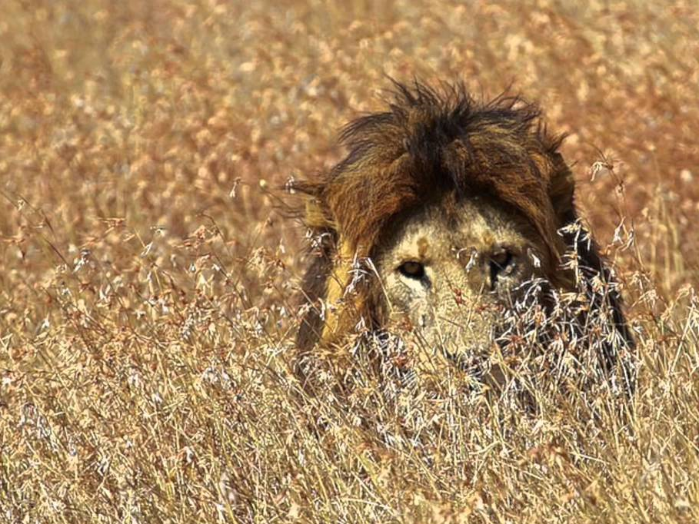
John 14:30
30 Hereafter I will not talk much with you: for the prince of this world cometh, and hath nothing in me.
Notes:
We know Satan is called the prince of the world. As he walks about in this world seeing whom he may devour, he does so sneakingly.

Slide 7
Sly Old Fox
Notes:
What do the kids sing? The Devil is a Sly old Fox.
He’s in our midst and we aren’t even aware of it.

Slide 8
Notes:
The Devil loves when we become filled with pride. He knows what will happen. Proverbs 16:18. Pride makes us an easy target. We are relying on self and not God. He sees our weakness and that’s when he strikes.

Slide 9
Fallen Saints
Ananias & Sapphira
Acts 5
Simon
Acts 8
Hymenaeus & Alexander
1 Timothy 1:20
Demas
2 Timothy 4:10
Diotrephes & other elders
3 John 1:9
Notes:
Just like Satan devoured these saints:
Ananias & Sapphira—because of their lies and greed
Simon because of his desire to make gain from the Holy Spirit
In 1 Timothy 1:18-20, Hymenaeus and Alexander shipwrecked their faith
Demas—loved the world more
Diotrephes & other elders: will not listen

Slide 10
Could this happen to me?
Notes:
1 Peter 5:8 Be sober, be vigilant; because your adversary the devil, as a roaring lion, walketh about, seeking whom he may devour:
He doesn’t go after the entire congregation just as the lion doesn’t go after the entire herd. Satan goes after one Christian at a time. He looks for the most vulnerable one—which is usually weaker and is not staying with the group—he’s looking for someone whose faith is weak and who is inactive in the kingdom of God.
Want Satan to pick you off—then don’t do anything. Stop caring. Stop studying. Stop praying. Stop singing. Stop loving and respecting others like you should. We make it too easy for him.

Slide 11
1 Corinthians 9:27
27 But I keep under my body, and bring it into subjection: lest that by any means, when I have preached to others, I myself should be a castaway. KJV
27 But I discipline my body and bring it into subjection, lest, when I have preached to others, I myself should become disqualified. NKJ
27 I discipline my body like an athlete, training it to do what it should. Otherwise, I fear that after preaching to others I myself might be disqualified. NLT
Notes:
Look what the apostle Paul did daily: 1 Corinthians 9:27

Slide 12
Ways the Devils Wins

Slide 13
Distractions
2 Corinthians 2:11
11 Lest Satan should get an advantage of us: for we are not ignorant of his devices.
Notes:
How does the Devil distract us?
You see the devil loves it when Christians get to many things going on in their life and they get to busy to spend any time with God. Think about your own lives and the amount of time you spend running from one place to other or
how much time you spend watching TV, YouTube, Netflix, or
How much time we spend on social media or
How much time we work around the house and

Slide 14
Distractions
Notes:
Compare that time to how much time you spend with God by either praying or studying his word or by being a doer of his word?
If we were a pie chart and we compared how we use our time—how big would the pie be that is spent on God?
How many times do we allow distractions to keep up from attending worship service and Bible class? When we allow the things of this world to distract from serving God on daily basis the Devil is getting closer and closer to wining you over to his side.

Slide 15
Are Our Priorities Straight?
1 Corinthians 10:13
13 There hath no temptation taken you but such as is common to man: but God is faithful, who will not suffer you to be tempted above that ye are able; but will with the temptation also make a way to escape, that ye may be able to bear it.

Slide 16
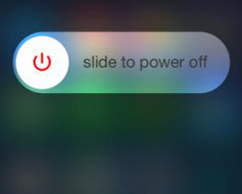
Way of Escape
Notes:
We learn that God will not allow a Christian to be tempted beyond what they are capable of handling and God will always provide away of escape for the Christians.
But on the same hand the devil will also provide a way for corruption. For instance when Jonah of the OT tried to run from God there just happened to be a boat available for him sail away.
When Adam and Eve sinned in the Garden the devil provided them with an excuse.
When the Christian today doesn’t want assembly with the saints, give to the lord, or fulfill their Christian duties the devil will make a way available for you to avoid these things and he certainly will provide you with the excuse you need to justify the sins you get involved in because he wants you to feel good about rebelling against God.

Slide 17
Boredom
Notes:
Another way the devil wins the Christian is through Boredom.
One thing that is important for us to learn about life is that we cannot maintain the same excitement level everyday because life many times is mundane & ordinary.
This why we look forward to vacations, entertaining events or hobbies we may have because we want to do something a little different.
Many times people can understand this concept when it comes to everyday life but they don’t learn to apply to their Christianity. Some Christians who were on fire for the Lord—full of zeal—enthusiastic—had a passion for serving Christ—would lift the roof with their singing—ready to convert the world---wake up to find themselves like a flame that is about the go out. That zeal is gone. They began to go through the motions. They stop serving the Lord. The devil wins another Christian.

Slide 18
Stir the Fire & Refuel
Mark 6:31 And He said to them, "Come aside by yourselves to a deserted place and rest a while." For there were many coming and going, and they did not even have time to eat.
32 So they departed to a deserted place in the boat by themselves.
Notes:
As Christians we must learn that there will be ups and downs in our Christianity just like there is ups and downs in regular lives. But we must to never give up on Christianity during low times.
There will be times when our flame gets a little low but just don’t let it go out.
We must learn what works for us and motivates to stir the fire now and again to keep it burning strong.
Jesus understood this,
Mark 6:31 And He said to them, "Come aside by yourselves to a deserted place and rest a while." For there were many coming and going, and they did not even have time to eat. 32 So they departed to a deserted place in the boat by themselves.

Slide 19
Galatians 6:9-10
9 And let us not be weary in well doing: for in due season we shall reap, if we faint not.
10 As we have therefore opportunity, let us do good unto all men, especially unto them who are of the household of faith.
Notes:
As Christians we must learn that there will be ups and downs in our Christianity just like there is ups and downs in regular lives. But we must to never give up on Christianity during low times.
There will be times when our flame gets a little low but just don’t let it go out.
We must learn what works for us and motivates to stir the fire now and again to keep it burning strong.
Jesus understood this,
Mark 6:31 And He said to them, "Come aside by yourselves to a deserted place and rest a while." For there were many coming and going, and they did not even have time to eat. 32 So they departed to a deserted place in the boat by themselves.
So even if we are in the middle of recharging ourselves and someone needs a helping hand we cannot say I’m sorry I cant help your right now because I am on vacation from the Lord.
So if you get to the point in your Christian life where you feel bored with God’s word or doing good works or attending the church services let it be a warning sign to you that you are well on your way to being won by the devil.

Slide 20
Remember your WHY!

Slide 21
Other Christians
Galatians 2:11-13
11 Now when Peter had come to Antioch, I withstood him to his face, because he was to be blamed;
12 for before certain men came from James, he would eat with the Gentiles; but when they came, he withdrew and separated himself, fearing those who were of the circumcision.
13 And the rest of the Jews also played the hypocrite with him, so that even Barnabas was carried away with their hypocrisy.
Notes:
Another way the devil wins Christians is through other Christians.
This how many Christians fall away from the church completely. They will put a lot of faith and trust in other Christians and when they see them doing things they should not be doing or when the fall away then that influences the Christian to fall away as well.
You see the devil just loves it when Christians base there faithfulness on another Christian because he knows that no matter how faithful a person is they can and will sin against God and when they do, they become a power tool for the devil as their behavior will most likely win him so more souls.
A great example of what I am talking about can be found in, Galatians 2:11-13

Slide 22
What kind of example am I being today? Am I working for the devil or against him?
Notes:
Again this shows just how powerful you can be as a bad example and why the devil loves using you in this situation to win other Christians to his side. The devil has won far too many Christians to his side because they made another Christian their example instead of allowing Jesus to be their example.
This is why I believe it very important that we watch how we live our lives and the example that we are making.
We need to ask ourselves on a daily basis, What kind of example am I being today? Am I working for the devil or against him?

Slide 23
Notes:
If we don’t’ want to be won by the devil then we must learn to look to the example of the great cloud of witnesses that didn’t get distracted, that didn’t get bored, that didn’t leave a bad example.

Slide 24
Hebrews 12:1-3
1 Wherefore seeing we also are compassed about with so great a cloud of witnesses, let us lay aside every weight, and the sin which doth so easily beset us, and let us run with patience the race that is set before us,
2 Looking unto Jesus the author and finisher of our faith; who for the joy that was set before him endured the cross, despising the shame, and is set down at the right hand of the throne of God.
3 For consider him that endured such contradiction of sinners against himself, lest ye be wearied and faint in your minds.

Slide 25
Notes:
Let us look unto JESUS! He authored our faith and he will finish our faith. He endured the cross so we can endure this world. He is on the right hand of God—why is he there?
Making intercession of us! Saving His sheep!

Slide 26
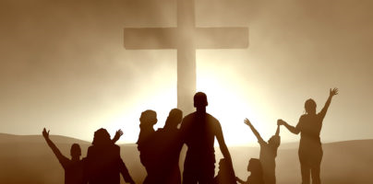
Romans 8:33-34
33 Who shall lay any thing to the charge of God's elect? It is God that justifieth.
34 Who is he that condemneth? It is Christ that died, yea rather, that is risen again, who is even at the right hand of God, who also maketh intercession for us.

Slide 27
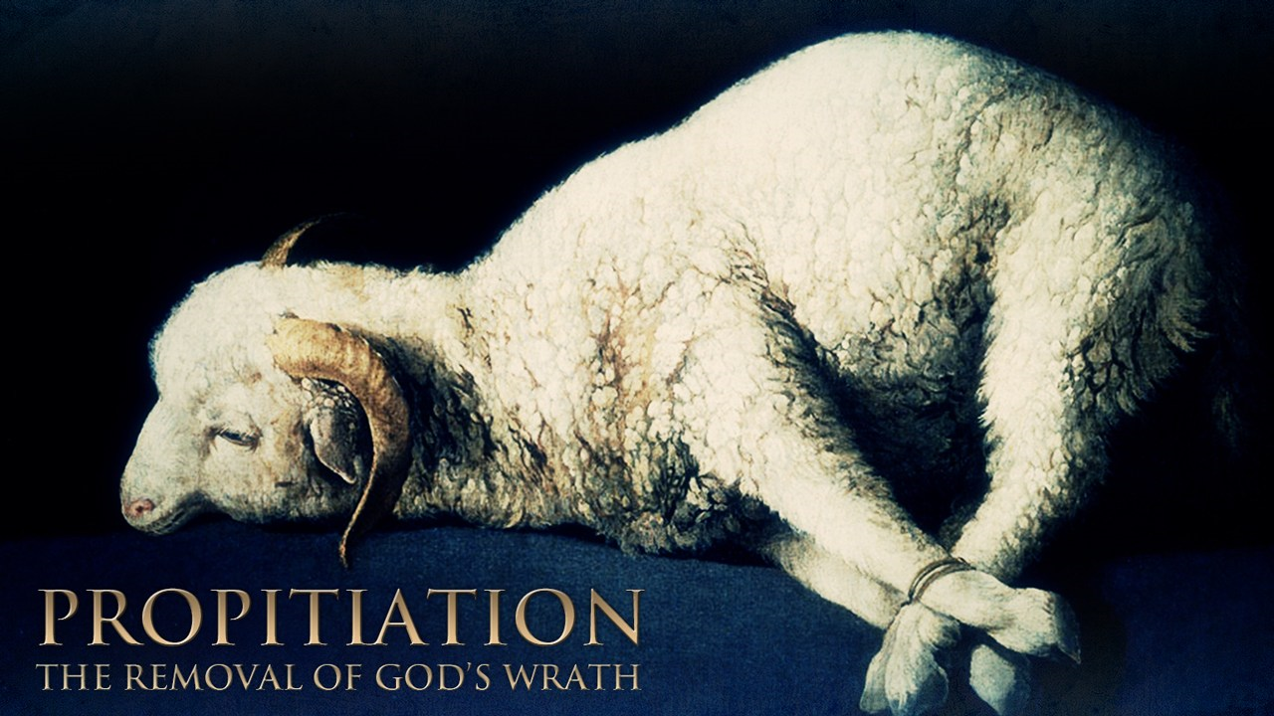
1 John 2:2
My little children, these things write I unto you, that ye sin not. And if any man sin, we have an advocate with the Father, Jesus Christ the righteous:
2 And he is the propitiation for our sins: and not for ours only, but also for the sins of the whole world.

Slide 28
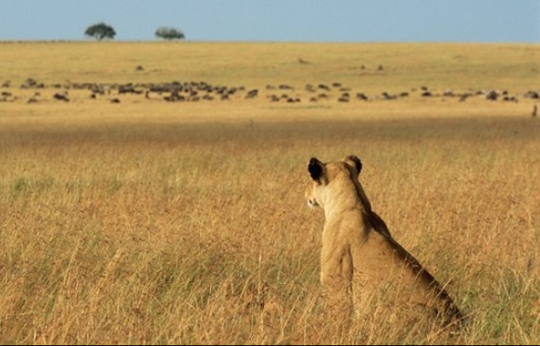
Notes:
Tonight, don’t be unaware that the devil is seeking us—one at a time. He’s out there and waiting to see who is distracted, who is bored, and who has his faith in another Christian.
Tonight don’t let the devil win you! If you have fallen into sin, get rid of it, by confessing your faults. We will be glad to pray for you.
It may be that you are the devil’s because you aren’t Christian yet. Be born again into the family of God. Come out of the watery grave of baptism and into the new life of a Christian.
If you are subject to the Lord’s invitation, please come as we stand and sing.

