Slide 1

O’neal church of Christ, Athens, Alabama Dec. 17, 2017

Slide 2
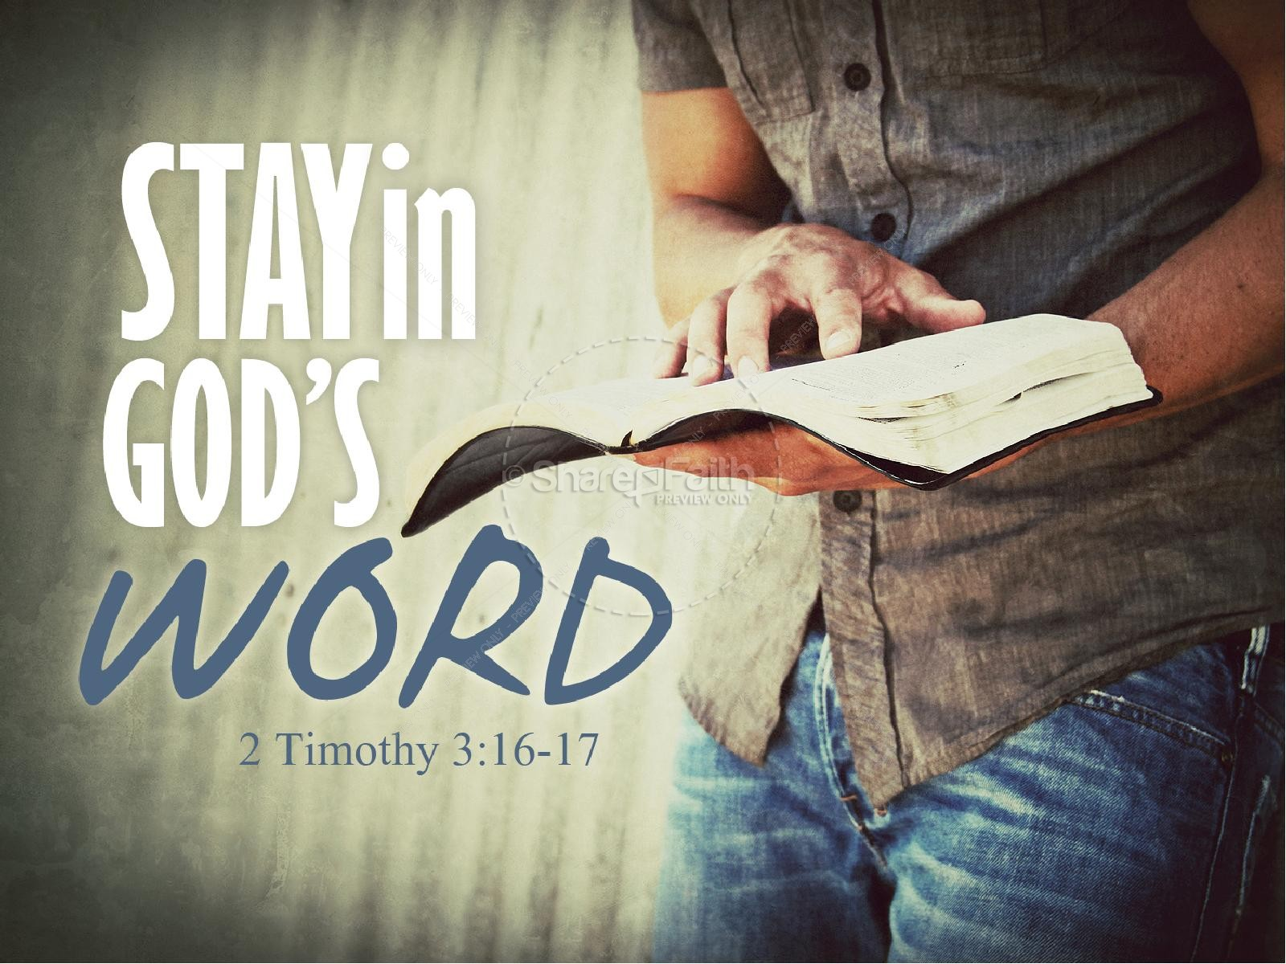

Slide 3


Slide 4
IT IS CERTAIN..
I Tim 6:6-10

Slide 5
1 Timothy 6:6-10⁶ But godliness with contentment is great gain.
⁷ For we brought nothing into this world, and it is certain we can carry nothing out.
⁸ And having food and raiment let us be therewith content.
⁹ But they that will be rich fall into temptation and a snare, and into many foolish and hurtful lusts, which drown men in destruction and perdition.
¹⁰ For the love of money is the root of all evil: which while some coveted after, they have erred from the faith, and pierced themselves through with many sorrows.

Slide 6
From this text we learn there are some
Things that are for sure…for certain.
“known for sure”
“established without a doubt”
“no guessing”
“no argument about it”
IT IS CERTAIN

Slide 7
Elders are warned: It is Certain! Acts 20:28
Preachers are warned: It is Certain!
I Tim.4:16
Members are warned: It is Certain!
Acts 20:31 ³¹So be on your guard! Remember that for three years I never stopped warning each of you night and day with tears.

Slide 8
Dangers Confronting the
Church
Acts 20:28-31

Slide 9
Acts 20:28-31
²⁸ Take heed therefore unto yourselves, and to all the flock, over the which the Holy Ghost hath made you overseers, to feed the church of God, which he hath purchased with his own blood.
²⁹ For I know this, that after my departing shall grievous wolves enter in among you, not sparing the flock.
³⁰ Also of your own selves shall men arise, speaking perverse things, to draw away disciples after them.
³¹ Therefore watch, and remember, that by the space of three years I ceased not to warn every one night and day with tears.

Slide 10
^{Eph. 6:10-20} Finally, my brethren, be strong in the Lord, and in the power of his might.¹¹ Put on the whole armour of God, that ye may be able to stand against the wiles of the devil.¹² For we wrestle not against flesh and blood, but against principalities, against powers, against the rulers of the darkness of this world, against spiritual wickedness in high places.¹³ Wherefore take unto you the whole armour of God, that ye may be able to withstand in the evil day, and having done all, to stand.¹⁴ Stand therefore, having your loins girt about with truth, and having on the breastplate of righteousness;¹⁵ And your feet shod with the preparation of the gospel of peace;¹⁶ Above all, taking the shield of faith, wherewith ye shall be able to quench all the fiery darts of the wicked.¹⁷ And take the helmet of salvation, and the sword of the Spirit, which is the word of God:

Slide 11
¹⁸Praying always with all prayer and supplication in the Spirit, and watching thereunto with all perseverance and supplication for all saints;
¹⁹ And for me, that utterance may be given unto me, that I may open my mouth boldly, to make known the mystery of the gospel,
²⁰ For which I am an ambassador in bonds: that therein I may speak boldly, as I ought to speak.

Slide 12
Let us observe a few things together from
God’s Word that He says are certain

Slide 14
IT IS CERTAIN…
Ignorance OF GOD’S
WORD ..
LEADS TO DESTRUCTION

Slide 15
Hosea 4:6 My people are destroyed for lack of knowledge: because thou hast rejected knowledge, I will also reject thee, that thou shalt be no priest to me: seeing thou hast forgotten the law of thy God, I will also forget thy children.
John 6:45 It is written in the prophets, And they shall be all taught of God. Every man therefore that hath heard, and hath learned of the Father, cometh unto me.

Slide 16
2 Tim. 2:15 Study to shew thyself approved unto God, a workman that needeth not to be ashamed, rightly dividing the word of truth.
Col. 1:9 For this cause we also, since the day we heard it, do not cease to pray for you, and to desire that ye might be filled with the knowledge of his will in all wisdom and spiritual understanding;

Slide 17
^{Acts 17:22-34} Then Paul stood in the midst of Mars' hill, and said, Ye men of Athens, I perceive that in all things ye are too superstitious.²³ For as I passed by, and beheld your devotions, I found an altar with this inscription, To The Unknown God.
Whom therefore ye ignorantly worship, him declare I unto you.²⁴ God that made the world and all things therein, seeing that he is Lord of heaven and earth,
(1.) dwelleth not in temples made with hands;25
(2)neither is worshipped with men's hands, as though he needed any thing, seeing he giveth to all life, and breath, and all things;²⁶
(3) and hath made of one blood all nations of men for to dwell on all the face of the earth, and
(4)hath determined the times before appointed, and the bounds of their habitation;²⁷ That they should seek the Lord, if haply they might feel after him, and find him,
(5) though he be not far from every one of us:
(6) 28for in him we live, and move, and have our being; as certain also of your own poets have said, For we are also his offspring.

Slide 18
²⁹ Forasmuch then as we are the offspring of God, we ought (6) not to think that the Godhead is like unto gold, or silver, or stone, graven by art and man's device.³⁰ And the times of this ignorance God winked at; but now commandeth all men every where to repent:
³¹ Because he hath appointed a day, in the which he will judge the world in righteousness by that man whom he hath ordained; whereof he hath given assurance unto all men, in that he hath raised him from the dead.³² And when they heard of the resurrection of the dead, some mocked: and others said, We will hear thee again of this matter.³³ So Paul departed from among them.³⁴ Howbeit certain men clave unto him, and believed: among the which was Dionysius the Areopagite, and a woman named Damaris, and others with them.

Slide 19
IT IS CERTAIN…
IF WE NEGLECT
THE THINGS WE HAVE HEARD..
WE WILL DRIFT AWAY..
Heb. 2:1-4 2 Therefore we ought to give the more earnest heed to the things which we have heard, lest at any time we should let them slip.
² For if the word spoken by angels was stedfast, and every transgression and disobedience received a just recompence of reward;
³ How shall we escape, if we neglect so great salvation; which at the first began to be spoken by the Lord, and was confirmed unto us by them that heard him;
⁴ God also bearing them witness, both with signs and wonders, and with divers miracles, and gifts of the Holy Ghost, according to his own will?

Slide 20
We will allow Worldliness to control us!

Slide 21
I John 2:15-17
¹⁵ Love not the world, neither the things that are in the world. If any man love the world, the love of the Father is not in him.
¹⁶ For all that is in the world, the lust of the flesh, and the lust of the eyes, and the pride of life, is not of the Father, but is of the world.
¹⁷ And the world passeth away, and the lust thereof: but he that doeth the will of God abideth for ever.
2 Tim. 4:10
¹⁰ For Demas hath forsaken me, having loved this present world, and is departed unto Thessalonica; Crescens to Galatia, Titus unto Dalmatia.

Slide 22
James 1:27 Pure religion and undefiled before God and the Father is this, To visit the fatherless and widows in their affliction, and to keep himself unspotted from the world.
Gal. 5:19-21 Now the works of the flesh are manifest, which are these; Adultery, fornication, uncleanness, lasciviousness,
²⁰ Idolatry, witchcraft, hatred, variance, emulations, wrath, strife, seditions, heresies,
²¹ Envyings, murders, drunkenness, revellings, and such like: of the which I tell you before, as I have also told you in time past, that they which do such things shall not inherit the kingdom of God.

Slide 23
IT IS CERTAIN…
That ERROR of God’s Ways, will lead us to
Being rejected: accursed.

Slide 24


Slide 25
Gal. 1:8-9 But though we, or an angel from heaven, preach any other gospel unto you than that which we have preached unto you, let him be accursed.⁹ As we said before, so say I now again, if any man preach any other gospel unto you than that ye have received, let him be accursed.
Gal. 2:11-14
¹¹ But when Peter was come to Antioch, I withstood him to the face, because he was to be blamed.¹² For before that certain came from James, he did eat with the Gentiles: but when they were come, he withdrew and separated himself, fearing them which were of the circumcision.¹³ And the other Jews dissembled likewise with him; insomuch that Barnabas also was carried away with their dissimulation.¹⁴ But when I saw that they walked not uprightly according to the truth of the gospel, I said unto Peter before them all, If thou, being a Jew, livest after the manner of Gentiles, and not as do the Jews, why compellest thou the Gentiles to live as do the Jews?

Slide 26
Matt. 6:1-4 Take heed that ye do not your alms before men, to be seen of them: otherwise ye have no reward of your Father which is in heaven.
² Therefore when thou doest thine alms, do not sound a trumpet before thee, as the hypocrites do in the synagogues and in the streets, that they may have glory of men. Verily I say unto you, They have their reward.
³ But when thou doest alms, let not thy left hand know what thy right hand doeth:
⁴ That thine alms may be in secret: and thy Father which seeth in secret himself shall reward thee openly.

Slide 27
IT IS CERTAIN…
We must never Compromise

Slide 28
Eph. 5:11
And have no fellowship with the unfruitful works of darkness, but rather reprove them.
Gal. 2:11-12 ¹¹ But when Peter was come to Antioch, I withstood him to the face, because he was to be blamed.
¹² For before that certain came from James, he did eat with the Gentiles: but when they were come, he withdrew and separated himself,
(why did Peter do this?) fearing them which were of the circumcision.

Slide 29
Jude 3 ³ Beloved, when I gave all diligence to write unto you of the common salvation, it was needful for me to write unto you, and exhort you that ye should earnestly contend for the faith which was once delivered unto the saints.
Phil. 1:27 ²⁷ Only let your conversation be as it becometh the gospel of Christ: that whether I come and see you, or else be absent, I may hear of your affairs, that ye stand fast in one spirit, with one mind striving together for the faith of the gospel;

Slide 30
Luke 8:14 ¹⁴ And that which fell among thorns are they, which, when they have heard, go forth, and are choked with cares and riches and pleasures of this life, and bring no fruit to perfection.
I Tim. 6:6-10 ⁶ But godliness with contentment is great gain.
⁷ For we brought nothing into this world, and it is certain we can carry nothing out.⁸ And having food and raiment let us be therewith content.⁹ But they that will be rich fall into temptation and a snare, and into many foolish and hurtful lusts, which drown men in destruction and perdition.¹⁰ For the love of money is the root of all evil: which while some coveted after, they have erred from the faith, and pierced themselves through with many sorrows.

Slide 31
Rev. 3:14-18 ¹⁴ And unto the angel of the church of the Laodiceans write; These things saith the Amen, the faithful and true witness, the beginning of the creation of God;¹⁵ I know thy works, that thou art neither cold nor hot: I would thou wert cold or hot.¹⁶ So then because thou art lukewarm, and neither cold nor hot, I will spue thee out of my mouth.
¹⁷ Because thou sayest, I am rich, and increased with goods, and have need of nothing; and knowest not that thou art wretched, and miserable, and poor, and blind, and naked:
¹⁸ I counsel thee to buy of me gold tried in the fire, that thou mayest be rich; and white raiment, that thou mayest be clothed, and that the shame of thy nakedness do not appear; and anoint thine eyes with eyesalve, that thou mayest see.

Slide 32
IT IS CERTAIN…
If We don’t live for Him; we will not live
with Him.
Matt. 12:30
³⁰ He that is not with me is against me; and he that gathereth not with me scattereth abroad.

Slide 33
2 Tim. 1:13 ¹³ Hold fast the form of sound words, which thou hast heard of me, in faith and love which is in Christ Jesus.
  2 Tim. 2:12 ¹² If we suffer, we shall also reign with him: if we deny him, he also will deny us:
2 Tim. 3:16-17 ¹⁶ All scripture is given by inspiration of God, and is profitable for doctrine, for reproof, for correction, for instruction in righteousness:
¹⁷ That the man of God may be perfect, thoroughly furnished unto all good works

Slide 34
IT IS CERTAIN…
If we are faithful to Him,
We will live with Him
forever.

Slide 35


Slide 36
Rev. 2:10
Rev. 14:13
Psalm 116:15
Matt. 11:28-30

Slide 37
IT IS CERTAIN THAT HEAVEN WILL BE FOR
THE FAITHful
IT IS CERTAIN THAT HELL WILL BE FOR THE
LOST.
Be Saved Today!

Slide 38
I Cor. 10:12
¹² Wherefore let him that thinketh he standeth take heed lest he fall
I Tim. 4:1-3
4 Now the Spirit speaketh expressly, that in the latter times some shall depart from the faith, giving heed to seducing spirits, and doctrines of devils;
² Speaking lies in hypocrisy; having their conscience seared with a hot iron;
³ Forbidding to marry, and commanding to abstain from meats, which God hath created to be received with thanksgiving of them which believe and know the truth.

Slide 39
Heb. 3:12-13
¹² Take heed, brethren, lest there be in any of you an evil heart of unbelief, in departing from the living God.
¹³ But exhort one another daily, while it is called To day; lest any of you be hardened through the deceitfulness of sin.
2 Tim. 4:3-4 ³ For the time will come when they will not endure sound doctrine; but after their own lusts shall they heap to themselves teachers, having itching ears;
⁴ And they shall turn away their ears from the truth, and shall be turned unto fables.

