Slide 1
Jesus forgives the sinful woman
Luke 7:36-50

Slide 2
Luke 7:36-50 (NKJV)
A Sinful Woman Forgiven
36 Then one of the Pharisees asked Him to eat with him. And He went to the Pharisee’s house, and sat down to eat. 37 And behold, a woman in the city who was a sinner, when she knew that Jesus sat at the table in the Pharisee’s house, brought an alabaster flask of fragrant oil, 38 and stood at His feet behind Him weeping; and she began to wash His feet with her tears, and wiped them with the hair of her head; and she kissed His feet and anointed them with the fragrant oil. 39 Now when the Pharisee who had invited Him saw this, he spoke to himself, saying, “This Man, if He were a prophet, would know who and what manner of woman this is who is touching Him, for she is a sinner.”

Slide 3
40 And Jesus answered and said to him, “Simon, I have something to say to you.” So he said, “Teacher, say it.” 41 “There was a certain creditor who had two debtors. One owed five hundred denarii, and the other fifty. 42 And when they had nothing with which to repay, he freely forgave them both. Tell Me, therefore, which of them will love him more?” 43 Simon answered and said, “I suppose the one whom he forgave more.” And He said to him, “You have rightly judged.” 44 Then He turned to the woman and said to Simon, “Do you see this woman? I entered your house; you gave Me no water for My feet, but she has washed My feet with her tears and wiped them with the hair of her head.

Slide 4
45 You gave Me no kiss, but this woman has not ceased to kiss My feet since the time I came in. 46 You did not anoint My head with oil, but this woman has anointed My feet with fragrant oil. 47 Therefore I say to you, her sins, which are many, are forgiven, for she loved much. But to whom little is forgiven, the same loves little.” 48 Then He said to her, “Your sins are forgiven.” 49 And those who sat at the table with Him began to say to themselves, “Who is this who even forgives sins?” 50 Then He said to the woman, “Your faith has saved you. Go in peace.”

Slide 5
Luke 7:36
36 Then one of the Pharisees asked Him to eat with him. And He went to the Pharisee’s house, and sat down to eat.

Slide 6
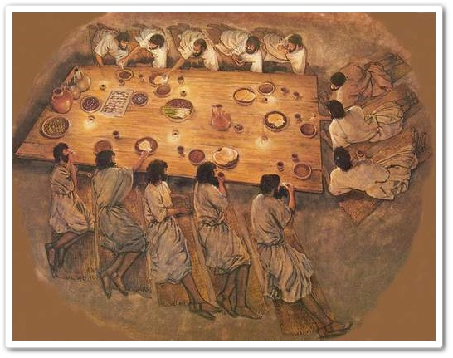

Slide 7
Luke 7:37
37 And behold, a woman in the city who was a sinner, when she knew that Jesus sat at the table in the Pharisee’s house, brought an alabaster flask of fragrant oil,

Slide 8
Luke 7:38
38 and stood at His feet behind Him weeping; and she began to wash His feet with her tears, and wiped them with the hair of her head; and she kissed His feet and anointed them with the fragrant oil.

Slide 9
Luke 7:39
39 Now when the Pharisee who had invited Him saw this, he spoke to himself, saying, “This Man, if He were a prophet, would know who and what manner of woman this is who is touching Him, for she is a sinner.”

Slide 10
Luke 7:40
40 And Jesus answered and said to him, “Simon, I have something to say to you.” So he said, “Teacher, say it.”

Slide 11
Luke 7: 41-42
41 “There was a certain creditor who had two debtors. One owed five hundred denarii, and the other fifty. 42 And when they had nothing with which to repay, he freely forgave them both. Tell Me, therefore, which of them will love him more?”

Slide 12
Luke 7:43
43 Simon answered and said, “I suppose the one whom he forgave more.” And He said to him, “You have rightly judged.”

Slide 13
Luke 7:44-46
44 Then He turned to the woman and said to Simon, “Do you see this woman? I entered your house; you gave Me no water for My feet, but she has washed My feet with her tears and wiped them with the hair of her head. 45 You gave Me no kiss, but this woman has not ceased to kiss My feet since the time I came in. 46 You did not anoint My head with oil, but this woman has anointed My feet with fragrant oil.

Slide 14
Luke 7:47-48
47 Therefore I say to you, her sins, which are many, are forgiven, for she loved much. But to whom little is forgiven, the same loves little.” 48 Then He said to her, “Your sins are forgiven.”

Slide 15
Luke 7:49
49 And those who sat at the table with Him began to say to themselves, “Who is this who even forgives sins?”

