Slide 1
Kneel at the Cross

Slide 2


Slide 3
^{Matt. 10: 38} And he that taketh not his cross, and followeth after me, is not worthy of me.

Slide 4
Psalm 95:
1 O come, let us sing unto the Lord: let us make a joyful noise to the rock of our salvation.
² Let us come before his presence with thanksgiving, and make a joyful noise unto him with psalms.
³ For the Lord is a great God, and a great King above all gods.
⁴ In his hand are the deep places of the earth: the strength of the hills is his also.
⁵ The sea is his, and he made it: and his hands formed the dry land.
⁶ O come, let us worship and bow down: let us kneel before the Lord our maker

Slide 5
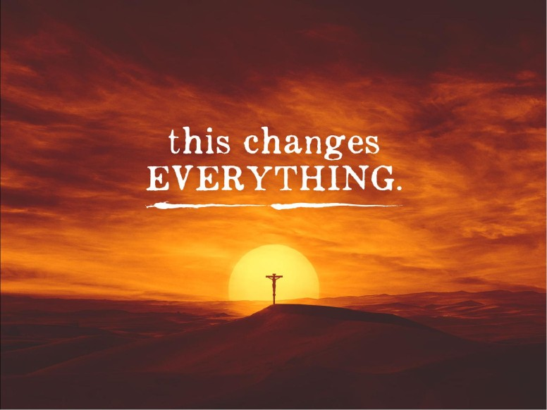

Slide 6
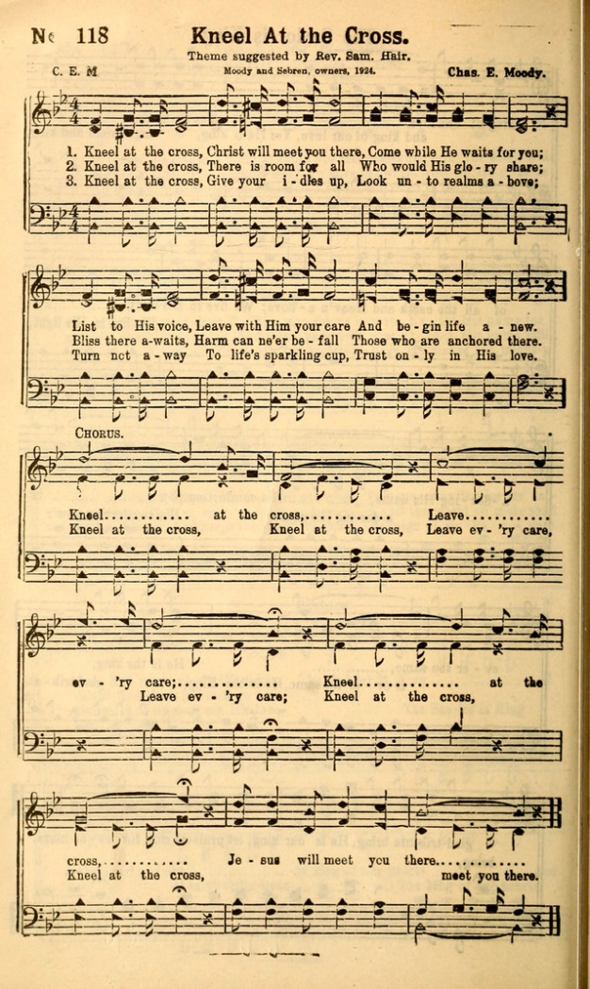

Slide 7
Kneel at the Cross
Kneel at the cross, Christ will meet you there
He intercedes for you
Lift up your voice, Leave with Him your care
And begin life a new.
Chorus
Kneel at the cross, kneel at the cross
Leave every care, leave every care
Kneel at the cross, kneel at the cross
Jesus will meet you there

Slide 8
Kneel at the cross, there's room for all (Mtt.11:28-30 ‘all”)
Who will his glory share
Bliss there awaits, harm can never be fall
Those who are anchored there
Kneel at the cross, give your idols up
Look unto realms above
Turn not away, to life's sparkling cup
Trust only in His love
by Charles E. Moody, 1924

Slide 9


Slide 10
,”Oh come let us worship and bow down; let us kneel before the Lord our Maker” (Ps. 95:6).

Slide 11
What people in the Bible did when they
Prayed to God.

Slide 12
1. Some Stood to pray
Gen. 18:22²² And the men turned their faces from thence, and went toward Sodom: but Abraham stood yet before the Lord
I Sam. 1:26 1 ²⁶ And she said, Oh my lord, as thy soul liveth, my lord, I am the woman that stood by thee here, praying unto the Lord.
Lk. 18:13¹³ And the publican, standing afar off, would not lift up so much as his eyes unto heaven, but smote upon his breast, saying, God be merciful to me a sinner.

Slide 13
2. Bowed their heads–especially in worship
Gen. 24:26 ²⁶ And the man bowed down his head, and worshipped the Lord.
Exod. 4:31 Exodus 4:31 King James Version (KJV)
³¹ And the people believed: and when they heard that the Lord had visited the children of Israel, and that he had looked upon their affliction, then they bowed their heads and worshipped.
12:27 ²⁷ That ye shall say, It is the sacrifice of the Lord's passover, who passed over the houses of the children of Israel in Egypt, when he smote the Egyptians, and delivered our houses. And the people bowed the head and worshipped.

Slide 14
3. Sat down and wept…mourned,fasted,and prayed
Nehemiah 1:4 ⁴ And it came to pass, when I heard these words, that I sat down and wept, and mourned certain days, and fasted, and prayed before the God of heaven,

Slide 15
4. Prayed while lying in bed
Ps. 63:6
⁶ When I remember thee upon my bed, and meditate on thee in the night watches.

Slide 16
5. Some fell face down, prostrate before the Lord
Num. 16:22
²² And they fell upon their faces, and said, O God, the God of the spirits of all flesh, shall one man sin, and wilt thou be wroth with all the congregation?
Josh. 5:14
¹⁴ And he said, Nay; but as captain of the host of the Lord am I now come. And Joshua fell on his face to the earth, and did worship, and said unto him, What saith my Lord unto his servant?

Slide 17
6. Another option is kneeling
I Kg. 8:54⁵⁴ And it was so, that when Solomon had made an end of praying all this prayer and supplication unto the Lord, he arose from before the altar of the Lord, from kneeling on his knees with his hands spread up to heaven

Slide 18
Daniel 6:10
¹⁰ Now when Daniel knew that the writing was signed, he went into his house; and his windows being open in his chamber toward Jerusalem, he kneeled upon his knees three times a day, and prayed, and gave thanks before his God, as he did aforetime.

Slide 19
Luke 22:41
⁴¹ And he was withdrawn from them about a stone's cast, and kneeled down, and prayed,

Slide 20
Acts 9:40
⁴⁰ But Peter put them all forth, and kneeled down, and prayed; and turning him to the body said, Tabitha, arise. And she opened her eyes: and when she saw Peter, she sat up.

Slide 21
Mat 10:38 And he that taketh not his cross, and followeth after me, is not worthy of me.
Mat 16:24 Then said Jesus unto his disciples, If any man will come after me, let him deny himself, and take up his cross, and follow me.
Mat 27:32 And as they came out, they found a man of Cyrene, Simon by name: him they compelled to bear his cross.

Slide 22
Mat 27:40 And saying, Thou that destroyest the temple, and buildest it in three days, save thyself. If thou be the Son of God, come down from the cross.
Mat 27:42 He saved others; himself he cannot save. If he be the King of Israel, let him now come down from the cross, and we will believe him.
Mar 8:34 And when he had called the people unto him with his disciples also, he said unto them, Whosoever will come after me, let him deny himself, and take up his cross, and follow me.

Slide 23
Mar 10:21 Then Jesus beholding him loved him, and said unto him, One thing thou lackest: go thy way, sell whatsoever thou hast, and give to the poor, and thou shalt have treasure in heaven: and come, take up the cross, and follow me.
Mar 15:21 And they compel one Simon a Cyrenian, who passed by, coming out of the country, the father of Alexander and Rufus, to bear his cross.
Mar 15:30 Save thyself, and come down from the cross.

Slide 24
Mar 15:32 Let Christ the King of Israel descend now from the cross, that we may see and believe. And they that were crucified with him reviled him.
Luk 9:23 And he said to them all, If any man will come after me, let him deny himself, and take up his cross daily, and follow me.
Luk 14:27 And whosoever doth not bear his cross, and come after me, cannot be my disciple.

Slide 25
Luk 23:26 And as they led him away, they laid hold upon one Simon, a Cyrenian, coming out of the country, and on him they laid the cross, that he might bear it after Jesus.
Joh 19:17 And he bearing his cross went forth into a place called the place of a skull, which is called in the Hebrew Golgotha:
Joh 19:19 And Pilate wrote a title, and put it on the cross. And the writing was JESUS OF NAZARETH THE KING OF THE JEWS.

Slide 26
Joh 19:25 Now there stood by the cross of Jesus his mother, and his mother's sister, Mary the wife of Cleophas, and Mary Magdalene.
Joh 19:31 The Jews therefore, because it was the preparation, that the bodies should not remain upon the cross on the sabbath day, (for that sabbath day was an high day,) besought Pilate that their legs might be broken, and that they might be taken away.
1 Cor 1:17 For Christ sent me not to baptize, but to preach the gospel: not with wisdom of words, lest the cross of Christ should be made of none effect.

Slide 27
1 Cor 1:18 For the preaching of the cross is to them that perish foolishness; but unto us which are saved it is the power of God.
Gal 5:11 And I, brethren, if I yet preach circumcision, why do I yet suffer persecution? Then is the offence of the cross ceased.
Gal 6:12 As many as desire to make a fair shew in the flesh, they constrain you to be circumcised; only lest they should suffer persecution for the cross of Christ.

Slide 28
Gal 6:14 But God forbid that I should glory, save in the cross of our Lord Jesus Christ, by whom the world is crucified unto me, and I unto the world.
Eph 2:16 And that he might reconcile both unto God in one body by the cross, having slain the enmity thereby:
Phi 2:8 And being found in fashion as a man, he humbled himself, and became obedient unto death, even the death of the cross.

Slide 29
Phi 3:18 (For many walk, of whom I have told you often, and now tell you even weeping, that they are the enemies of the cross of Christ:
Col 1:20 And, having made peace through the blood of his cross, by him to reconcile all things unto himself; by him, I say, whether they be things in earth, or things in heaven.
Col 2:14 Blotting out the handwriting of ordinances that was against us, which was contrary to us, and took it out of the way, nailing it to his cross;

Slide 30
Heb 12:2 Looking unto Jesus the author and finisher of our faith; who for the joy that was set before him endured the cross, despising the shame, and is set down at the right hand of the throne of God.

Slide 31
Are we willing to Kneel at the Cross
and then go forth and take the message
to others?

Slide 32


Slide 33
^{Matt. 10:}
And a man's foes shall be they of his own household.
³⁷ He that loveth father or mother more than me is not worthy of me: and he that loveth son or daughter more than me is not worthy of me.
³⁸ And he that taketh not his cross, and followeth after me, is not worthy of me.
³⁹ He that findeth his life shall lose it: and he that loseth his life for my sake shall find it.

Slide 34
⁴⁰ He that receiveth you receiveth me, and he that receiveth me receiveth him that sent me.
⁴¹ He that receiveth a prophet in the name of a prophet shall receive a prophet's reward; and he that receiveth a righteous man in the name of a righteous man shall receive a righteous man's reward.
⁴² And whosoever shall give to drink unto one of these little ones a cup of cold water only in the name of a disciple, verily I say unto you, he shall in no wise lose his reward.

Slide 35
Remember the words of this Song: Kneel at the Cross
Kneel at the cross, Christ will meet you there
He intercedes for you
Lift up your voice, Leave with Him your care
And begin life a new.
Chorus
Kneel at the cross, kneel at the cross
Leave every care, leave every care
Kneel at the cross, kneel at the cross
Jesus will meet you there

Slide 36
Kneel at the cross, there's room for all (Mtt.11:28-30 ‘all”)
Who will his glory share
Bliss there awaits, harm can never be fall
Those who are anchored there
Kneel at the cross, give your idols up
Look unto realms above
Turn not away, to life's sparkling cup
Trust only in His love
by Charles E. Moody, 1924

Slide 37


