Slide 1
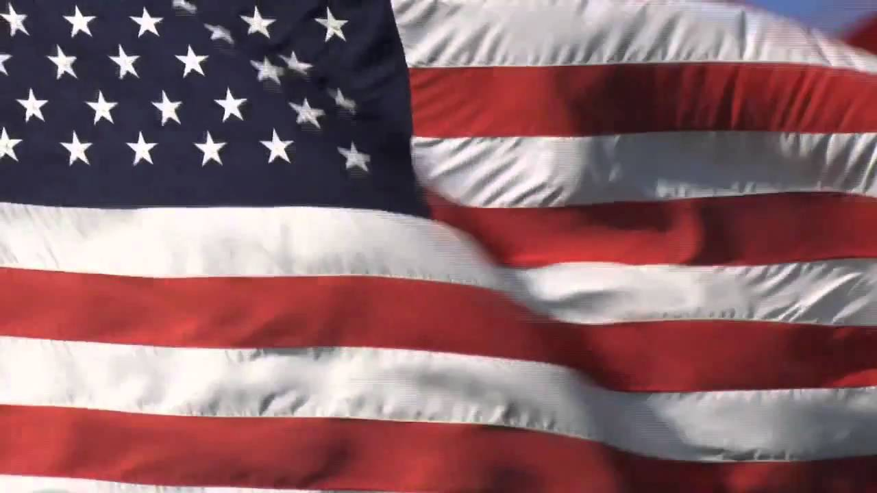
Lest we forget

Slide 2
Let us be thankful today for all those who paid with their lives for the freedom that we have.

Slide 3
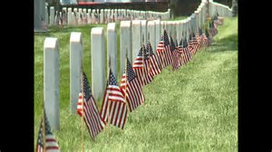

Slide 4
God of our fathers, known of old
Lord of our far-flung battle line,
Beneath whose awful hand we hold
Dominion over palm and pine—
Lord God of Hosts, be with us yet,
Lest we forget—lest we forget!

Slide 5
Deuteronomy 4:7-9⁷ For what nation is there so great, who hath God so nigh unto them, as the Lord our God is in all things that we call upon him for?
⁸ And what nation is there so great, that hath statutes and judgments so righteous as all this law, which I set before you this day?
⁹ Only take heed to thyself, and keep thy soul diligently, lest thou forget the things which thine eyes have seen, and lest they depart from thy heart all the days of thy life: but teach them thy sons, and thy sons' sons;

Slide 6
Lest we forget: Let us pray for our Nation, and
For those who are directing the affairs of men.

Slide 7
But today, I want to use this statement with reference to

Slide 8
Jesus our Lord

Slide 9
Song: Do you know my Jesus?

Slide 10
Do you know JESUS?
Matt. 7:21-23 ²¹ Not every one that saith unto me, Lord, Lord, shall enter into the kingdom of heaven; but he that doeth the will of my Father which is in heaven.
²² Many will say to me in that day, Lord, Lord, have we not prophesied in thy name? and in thy name have cast out devils? and in thy name done many wonderful works?
²³ And then will I profess unto them, I never knew you: depart from me, ye that work iniquity.

Slide 11
Jesus instituted the Lord’s Supper,
So that we might remember Him.

Slide 12
Jesus Christ , our Lord, God’s Son said:
This
Do
In
Remembrance
of
ME

Slide 13
Luke 22:19
And he took bread, and gave thanks, and brake it, and gave unto them, saying, This is my body which is given for you: this do in remembrance of me.

Slide 14
1 Corinthians 11:24
And when he had given thanks, he brake it, and said,
Take, eat: this is my body, which is broken for you:
this do in remembrance of me.

Slide 15
1 Corinthians 11:25
After the same manner also he took the cup, when he had supped, saying, this cup is the new testament in my blood: this do ye, as oft as ye drink it, in remembrance of me.

Slide 16
Lest we forget:
WHO HE IS! Matt. 1:21-23
²¹ And she shall bring forth a son, and thou shalt call his name Jesus: for he shall save his people from their sins.
²² Now all this was done, that it might be fulfilled which was spoken of the Lord by the prophet, saying,
²³ Behold, a virgin shall be with child, and shall bring forth a son, and they shall call his name Emmanuel, which being interpreted is, God with us.
Isa. 7:14
Isa. 8:8

Slide 17
Is the Name of Jesus important?

Slide 18
In Luke 1:31 an angel tells Mary to name her child Jesus,
And, behold, thou shalt conceive in thy womb, and bring forth a son, and shalt call his name Jesus.
and in Matthew 1:21 an angel tells Joseph to name the child Jesus.
²¹ And she shall bring forth a son, and thou shalt call his name Jesus: for he shall save his people from their sins.

Slide 19
There are some 198 different names and titles of Jesus in the Bible as listed in Cruden's Concordance, first published in 1737, and continuously in print ever since. The first index of the book (following the royal dedications and author's preface) is entitled "A collection of the Names and Titles given to Jesus Christ", with 198 names listed, each accompanied by a biblical reference

Slide 20
Lest we forget:
Jesus has all authority in Heaven and in earth.
Matt. 28:18-20 ¹⁸ And Jesus came and spake unto them, saying, All power is given unto me in heaven and in earth.
¹⁹ Go ye therefore, and teach all nations, baptizing them in the name of the Father, and of the Son, and of the Holy Ghost:
²⁰ Teaching them to observe all things whatsoever I have commanded you: and, lo, I am with you always, even unto the end of the world. Amen.

Slide 21
Lest we Forget: Every single thing that we do in Jesus’ name, Must be done in Jesus name!.
Giving a ‘thus saith the Lord” for everything.
Singing:Col.3:16 not playing an instrument of music
Eating the Lord’s Supper: Acts 20:7 On Sunday, the
Lord’s day…not on Wednesday!
Giving of our prosperity..on Sunday, I Cor. 16:1-2
not another day of the week.
Praying in the ‘name of Jesus’ .Col. 3:17.not in the name of Mary, or one of the apostles.
Preaching..the Gospel…Mk.16:15-16 what God says not what man says!

Slide 22
Jesus, “Son of God”
The relationship of Jesus with God…Jesus is God’s Son!
Jesus uses the term “my Father” as a direct and unequivocal assertion of
his sonship.
Consider:

Slide 23
Matt. 11:27 ²⁷ All things are delivered unto me of my Father: and no man knoweth the Son, but the Father; neither knoweth any man the Father, save the Son, and he to whomsoever the Son will reveal him.

Slide 24
John 5:23
That all men should honour the Son, even as they honour the Father. He that honoureth not the Son honoureth not the Father which hath sent him.

Slide 25
John 5:26
For as the Father hath life in himself; so hath he given to the Son to have life in himself;

Slide 26
Even at the age of 12, Jesus refers to God as His Father:
Luke 2:49 I must be about my Father’s business…
In ‘his Father’s house’ (John 14:1-6)
John 2:16 In the cleansing of the temple
And God refers to Jesus as His Son:
1. At Jesus’ baptism: Mtt. 3:13-17
2. At the transfiguration. Matt. 17:1-5

Slide 27
Is His Name Important??

Slide 28
Philippians 2:8-12⁸ And being found in fashion as a man, he humbled himself, and became obedient unto death, even the death of the cross.
⁹ Wherefore God also hath highly exalted him, and given him a name which is above every name:
¹⁰ That at the name of Jesus every knee should bow, of things in heaven, and things in earth, and things under the earth;
¹¹ And that every tongue should confess that Jesus Christ is Lord, to the glory of God the Father.
¹² Wherefore, my beloved, as ye have always obeyed, not as in my presence only, but now much more in my absence, work out your own salvation with fear and trembling.
¹³ For it is God which worketh in you both to will and to do of his good pleasure

Slide 29
After the Crucifixion of Jesus the early Church
did repeat his messages, and
focused on him, and
proclaimed him,
:
the proclaimer became the proclaimed
The use of the name of Jesus in petitions is stressed in John 16:23 when Jesus states: "If you ask the Father anything in my name he will give it you."

Slide 30
Christ (Messiah…the Anointed One)
Jesus is Lord ..appears over 700 times in NT.
Lord over all

Slide 31
Luke 5:5-8⁵ And Simon answering said unto him, Master, we have toiled all the night, and have taken nothing: nevertheless at thy word I will let down the net.
⁶ And when they had this done, they inclosed a great multitude of fishes: and their net brake.
⁷ And they beckoned unto their partners, which were in the other ship, that they should come and help them. And they came, and filled both the ships, so that they began to sink.
⁸ When Simon Peter saw it, he fell down at Jesus' knees, saying, Depart from me; for I am a sinful man, O Lord.

Slide 32
Logos . The Word…Jesus Christ!
John 1:1-18 calls Jesus the Logos ("the Word" )
The identification of Jesus as the Logos which became Incarnate appears only at the beginning of the Gospel of John and the term Logos/Word is used only in two other times by John in 1 John 1:1 and Revelation 19:13. It appears nowhere else in the New Testament

Slide 33
Lest We Forget:
JESUS IS OUR ONLY SAVIOUR…(Acts4:12).
JESUS IS TO BE RESPECTED, AND HIS AUTHORITY PREACHED AND OBEYED!
Heb. 5:8,9

Slide 34
Lamb of God
Light of the world
King of The Jews
Rabbi

Slide 35
Lest we Forget
If Christians can be called by denominational names,
Which do not honor Christ, why does the Bible
call early disciples Christians?:..
Acts 11:26; Acts 26:28; I Pet 4:16

Slide 36
Lest we forget!!
Old Time Religion, practiced by people who truly
Walked by the authority of Jesus Christ,
is a religion that has weathered the times…
It is relevant to our times.

Slide 37
Lest we forget: Our homes are not at rest.
People are practicing ‘living together’ without marriage
“marriage between same sex couples”
“husband NOT the head of the wife”
“some men want to look like women”; and “some women want to
look like men”
And look what some mothers do:
Illustration:
Have we forgotten? Do we not remember what God says?
Or does it not matter to us anymore?.”

Slide 38
Lest we forget!
Who will Remember Jesus?
Who will Remember the truth about the church?
Who will Remember the home as God designed it?
Who will Remember a nation built on “In God we Trust”?

Slide 39
May we Never Forget:
Jerm. 6:16 Ask for the Old Paths..and walk
therein. But they said: We will not walk
therein!
Many in the church like that today!
Let us remember: Prov. 14:34
Righteousness exalteth a nation, but sin is a
reproach to any people.!

Slide 40
Lest we forget…
Elders…listen to the Great Shepherd of the Sheep.
Deacons…Be busy…do your work for the Lord.
Preachers. Preach the Word of God.
Teachers: Teach the Word of God.
Christians..Stand up for Jesus…do His will.
Lest we forget, lest we forget!

Slide 41
Lest we forget

