Slide 1

You Mothers at O’Neal are Very Special. We thank God for you.

Slide 2

All Mothers;
All Women
At O’Neal 2017

Slide 3
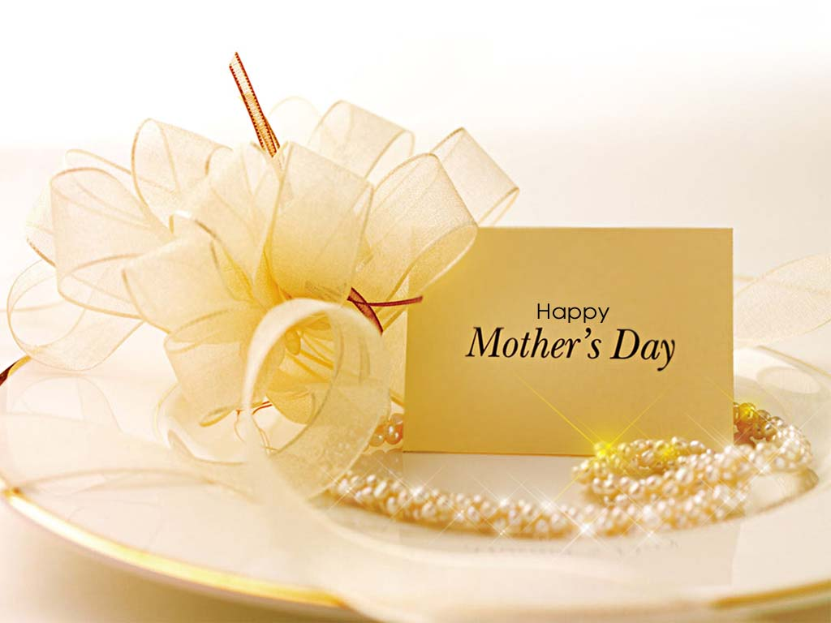
We love you! O’Neal church of Christ May 14,2017

Slide 4
She Hath Done What She
Could
Mark 14:3-9

Slide 5
Mark 14:3-9
³ And being in Bethany in the house of Simon the leper,(Where) as he sat at meat,(doing what?) there came a woman having an alabaster box of ointment of spikenard very precious;(About a year’s wages)(how much?) and she brake the box, and poured it on his head.
⁴ And there were some that had indignation within themselves, and said, Why was this waste (Judas,) of the ointment made?
⁵ For it might have been sold for more than three hundred pence, and have been given to the poor. And they murmured against her. (Not uncommon to get criticism)

Slide 6
⁶ And Jesus said, Let her alone; why trouble ye her? she hath wrought a good work on me.(What does Jesus call
Her actions?”)
⁷ For ye have the poor with you always, and whensoever ye will ye may do them good: but me ye have not always. (A huge truth stated!!)
⁸ She hath done what she could:
( Matt. 25:14-30) 5 Talents: 2 Talents;
1 talent )
she is come aforehand to anoint my body to the burying.
⁹ Verily I say unto you, Wheresoever this gospel shall be preached throughout the whole world, this also that she hath done shall be spoken of for a memorial of her.
And we are fulfilling that today!

Slide 7
Abraham Lincoln:
All that I am or ever hope to be, I owe to my angel Mother

Slide 8
George Washington
My mother was the most beautiful woman I ever saw. All I am I owe to my mother. I attribute all my success in life to the moral, intellectual and physical education I received from her.

Slide 9
Some women marry, have husbands and have children
A man to be an Elder is required to be married
And have faithful children.
I Tim.3:1-7
I Pet. 5:1-4

Slide 10
Some women have husbands; but no children
Hannah wanted a child so badly. (I Samuel 1)
She prayed and God heard her prayer. She conceived
A male child (Samuel)

Slide 11
Some couples who have no children will adopt children

Slide 12
Some women are foster mothers for other women’s children

Slide 13
Some women are unmarried but give their lives to serving others…

Slide 14
Some women are women who, like Rufus mother’ ,was a mother to Paul!
Romans 16:13
Greet Rufus, the one chosen by the Lord, and his mother, who has been a mother to me, too.

Slide 15
Most of the women in this audience fall into the category of a married woman with children..

Slide 16
Happy Mother’s Day to ALL mothers and
Women who have been mothers to others.

Slide 17
God’s Women today do so much in the
Service of the Lord.. And,
Prov. 31:10-31 (v. 28.. “her children rise up and call
Her blessed.”

Slide 18
1. They are commended and praised because they
Love their children.
..Older women are to teach the younger women
to love their children…Paul said in writing to
Titus : “That the older women ..”may teach the younger women to be sober, to love their husbands, to love their children”
Titus 2:4 We have so many mothers here who show so
Much love for their children.
And Mentioned 2 in particular in the Bible:

Slide 19
Just like in the Bible, we have the example of
Lois (grandmother) Eunice (Mother)
2 Timothy 1:5⁵ When I call to remembrance the unfeigned faith that is in thee, which dwelt first in thy grandmother Lois, and thy mother Eunice; and I am persuaded that in thee also.
We have so many wonderful grandmothers and mothers right
here at O’Neal who truly love their children and show it.
I love you Mom!

Slide 20
Godly women are praised because
they have taught and raised up their
children to fear God.
Mothers who have sat at night and read
to their children the Bible and Bible stories.
a) Just think of all the days and nights that
your good mother talked to you about God
b) Just like Lois and Eunice, who had strong
faith in God, so Paul said he was persuaded that
it was in Timothy!

Slide 21
2 Timothy 1:12
For the which cause I also suffer these things: nevertheless I am not ashamed: for I know whom I have believed, and am persuaded that he is able to keep that which I have committed unto him against that day.

Slide 22
3. Godly Mothers are to be commended for living
A good life before their children, demonstrating how
Much they love Jesus Christ.
A good mother not only tells her children about
Jesus , but demonstrates to them that He is to her
The most important thing in life.
a) She worships with her children. (Heb.10:25;
Psalm 122:1;

Slide 23
b) She prays with her children.
“If I could hear my mother, pray again.”
So many of these children here at O’Neal who
hear their mothers praying for them.
Pray, Pray,Pray I Thess. 5:17
God’s people have been called upon to pray
A lot , and mothers at O’Neal have prayed and shown
Their children how important it is to pray.
Ill. M.J. hardly ever closes a prayer without praying
For little Eli Williams who has been sick with cancer for
Some years now.

Slide 24
So many mothers at O’Neal have been
Given so many talents: Some
5 talents; 2 talents, and 1 talent
Matt. 25:14-30
And we see them using what God has
Given them to do the work of God.
1. Priscilla and Aquila ..Acts 18:2
2. Mary , Mark 14:3-9

Slide 25
No Wonder God Loves Mothers! And we do too!

Slide 26
Standing by our side when we have done a wrong, not
To uphold us in our wrong doing, but rather to stand to show
Us we are still loved and she will help you through whatever
You find yourself in.

Slide 27
Loving your daddy, respecting your daddy,
And giving your daddy his rightful place
In life.
Eph. 5:22-25 Wives, submit yourselves unto your own husbands

Slide 28
Many mothers are in this hero hall of fame today:
They have, as did Mary, done what they could.
They are not perfect,
Our grandson found a framed picture at our
Thrift store….and he asked me if he could have
it to give to his mother.
Here is what it said:

Slide 29
“If I didn’t have you for a mother
I’d choose you as a friend.”

Slide 30
She hath done what she could
Jesus was most grateful for Mary, who took precious ointment and poured it on his head and feet preparing him for his oncoming crucifixion and death.
The ointment was very expensive…300 pence…about a year’s wages.
I read a poem on Wed. night about how most of us give the Lord our left overs…Not so with Mary…She gave her best!

Slide 31
Let’s do what we can,
Praying God to help us to be
The kind of people that He wants
Us to be and lead others to
Jesus Christ. (Heb. 12:1-2)

Slide 32
All Mothers;
All Women
At O’Neal 2017

Slide 33
Are you a Christian? If not, why not?
Hear the Word of God. Rom. 10:17
Believe in Jesus as the Christ. John 8:24
Repent . Acts 17:30-31
Confess Jesus. Matt. 10:32,33
Be baptized. I Pet. 3:21
Are you a faithful Christian? If not, why not?
Repent. Acts 8:22; Confess & pray James. 5:16

Slide 34
This invitation is to all. Won’t you come and
Make your life right with God this morning.

