Slide 2
How do you know God is real?
Because the Bible says so.
Now we have received, not the spirit of the world, but the Spirit who is from God, so that we may know the things freely given to us by God, which things we also speak, not in words taught by human wisdom, but in those taught by the Spirit, combining spiritual thoughts with spiritual words. I Corinthians 2:12-13
Because I was raised to believe this way.
For I am mindful of the sincere faith within you, which first dwelt in your grandmother Lois and your mother Eunice, and I am sure that it is in you as well. I Timothy 1:5

Slide 3
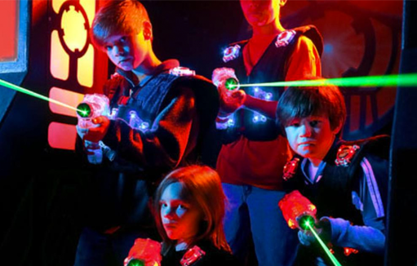

Slide 4
Not without witness
Acts 14:15-18

Slide 6
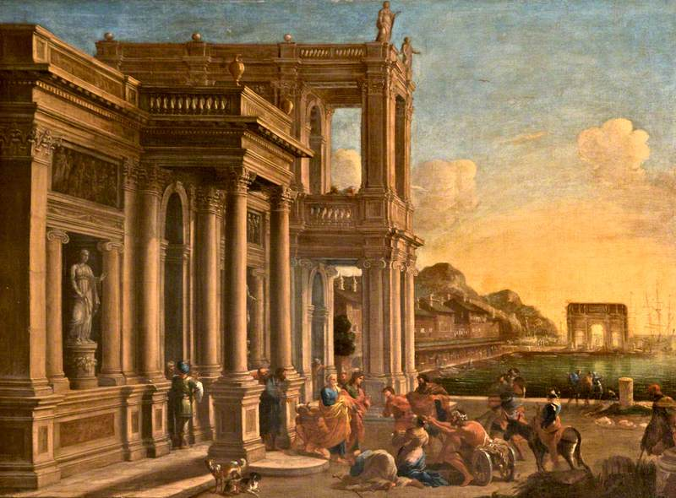
At Lystra
... Men, why are you doing these things? We are also men of the same nature as you, and preach the gospel to you that you should turn from these vain things to a living God, who made the heaven and the earth and the sea and all that is in them. In the generations gone by He permitted all the nations to go their own ways; and yet He did not leave Himself without witness, in that He did good and gave you rains from heaven and fruitful seasons, satisfying your hearts with food and gladness. Acts 14:15-18

Slide 7
What witness did God leave?
Now faith is the assurance of things hoped for, the conviction of things not seen. Hebrews 11:1

Slide 8
Who was Erastus?
He is only mentioned 3 times in the Bible:
Gaius, host to me and to the whole church, greets you. Erastus, the city treasurer greets you, and Quartus, the brother. Romans 16:23
And having sent into Macedonia two of those who ministered to him, Timothy and Erastus, he himself stayed in Asia for a while. Acts 19: 22
Erastus remained at Corinth, but Trophimus I left sick at Miletus. II Timothy 4:20

Slide 9
The Erastus Stone
Discovered in the ancient city of Corinth. It names a city official who made it possible to build the theater. RASTVUS translates to Erastus.

Slide 10
Who was Baruch?
Then Jeremiah called Baruch the son of Neriah, and Baruch wrote on a scroll at the dictation of Jeremiah all the words of the Lord which He had spoken to him. Jeremiah commanded Baruch, saying, “I am restricted; I cannot go into the house of the Lord. So you go and read from the scroll which you have written at my dictation the words of the Lord to the people in the Lord’s house on a fast day. And also you shall read them to all the people of Judah who come from their cities. Jeremiah 36:4-6

Slide 11
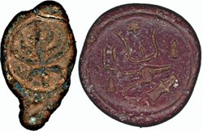
What is a Bulla?
A clay seal used to seal a scroll. Usually stamped with the name of the author.
In 1975 over 250 bulla were discovered in the remains of an ancient library which had burned. The fire had baked the clay bulla. Most of these were sold to collectors. But when they were studied the found something remarkable.

Slide 12
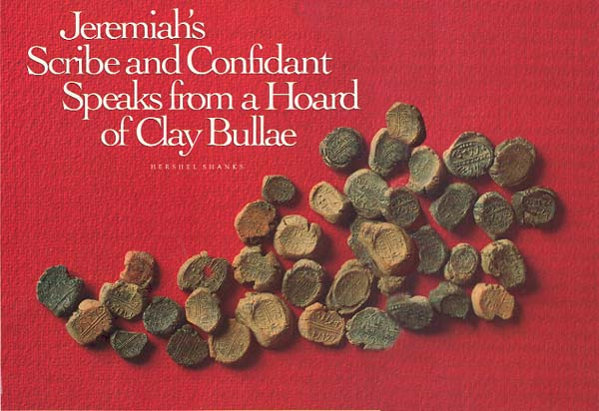

Slide 13
Scientific foreknowledge

Slide 14
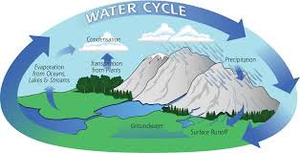
The hydrologic cycle
All the rivers flow into the sea, Yet the sea is not full. To the place where the rivers flow, There they flow again. Ecclesiastes 1:7
He wraps up the waters in His clouds, And the cloud does not burst under them. Job 26:8
The One who builds His upper chambers in the heavens, And has founded His vaulted dome over the earth, He who calls for the waters of the sea, And pours them out on the face of the earth, The Lord is His name. Amos 9:6

Slide 15
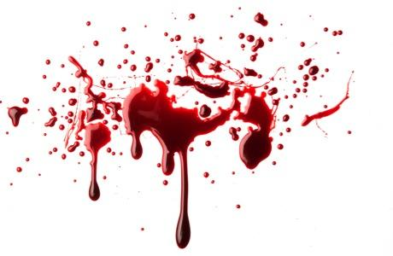
How does the Bible view blood?
For the life of the flesh is in the blood, and I have given it to you on the altar to make atonement for your souls; for it is the blood by reason of the life that makes atonement.’ Leviticus 17: 11
And every male among you who is eight days old shall be circumcised throughout your generations, a servant who is born in the house or who is bought with money from any foreigner, who is not of your descendants. Genesis 17:12

Slide 16
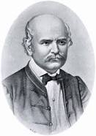
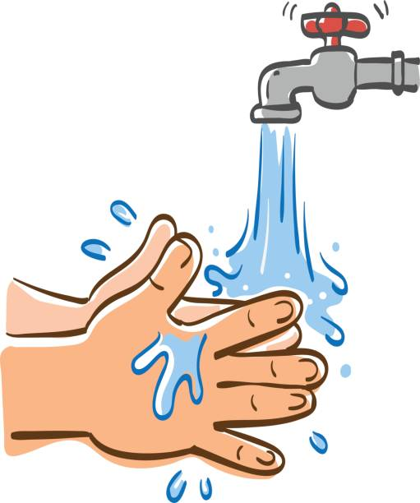
Ignaz Semmelweis
Began the practice of hand washing in 1847
Death rates dropped to 1%
No other doctor believe him and he was ostracized.
He was driven mad and committed at age 47 after he had a nervous breakdown. He died shortly after.

Slide 17
The Ashes of the Red Heifer.
Then the heifer shall be burned in his sight; its hide and its flesh and its blood, with its refuse, shall be burned. The priest shall take cedar wood and hyssop and scarlet wool and cast it into the midst of the burning heifer. The priest shall then wash his clothes and bathe his body in water, and afterward come into the camp, but the priest shall be unclean until evening. The one who burns it shall also wash his clothes in water and bathe his body in water, and shall be unclean until evening. Now a man who is clean shall gather up the ashes of the heifer and deposit them outside the camp in a clean place, and the congregation of the sons of Israel shall keep it as water to remove impurity; it is purification from sin. Numbers 19: 5-9

Slide 18
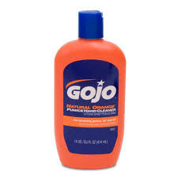
What if physicians in the 1800’s had used soap?

Slide 19
This lesson has not explained “How” to become a Christian. But rather “Why” .
Because the events in the Bible took place, it’s words are true and God is alive:
Hear: Rom. 10:17
Believe: Heb. 11:6
Repent: Acts 2:38
Confess: Rom. 10:10
Be Baptized: Acts 2:38

Slide 20
