Slide 1
Notes:
In a world full of darkness, God said in Genesis 1:3, Let there be light, and there was light.

Slide 2
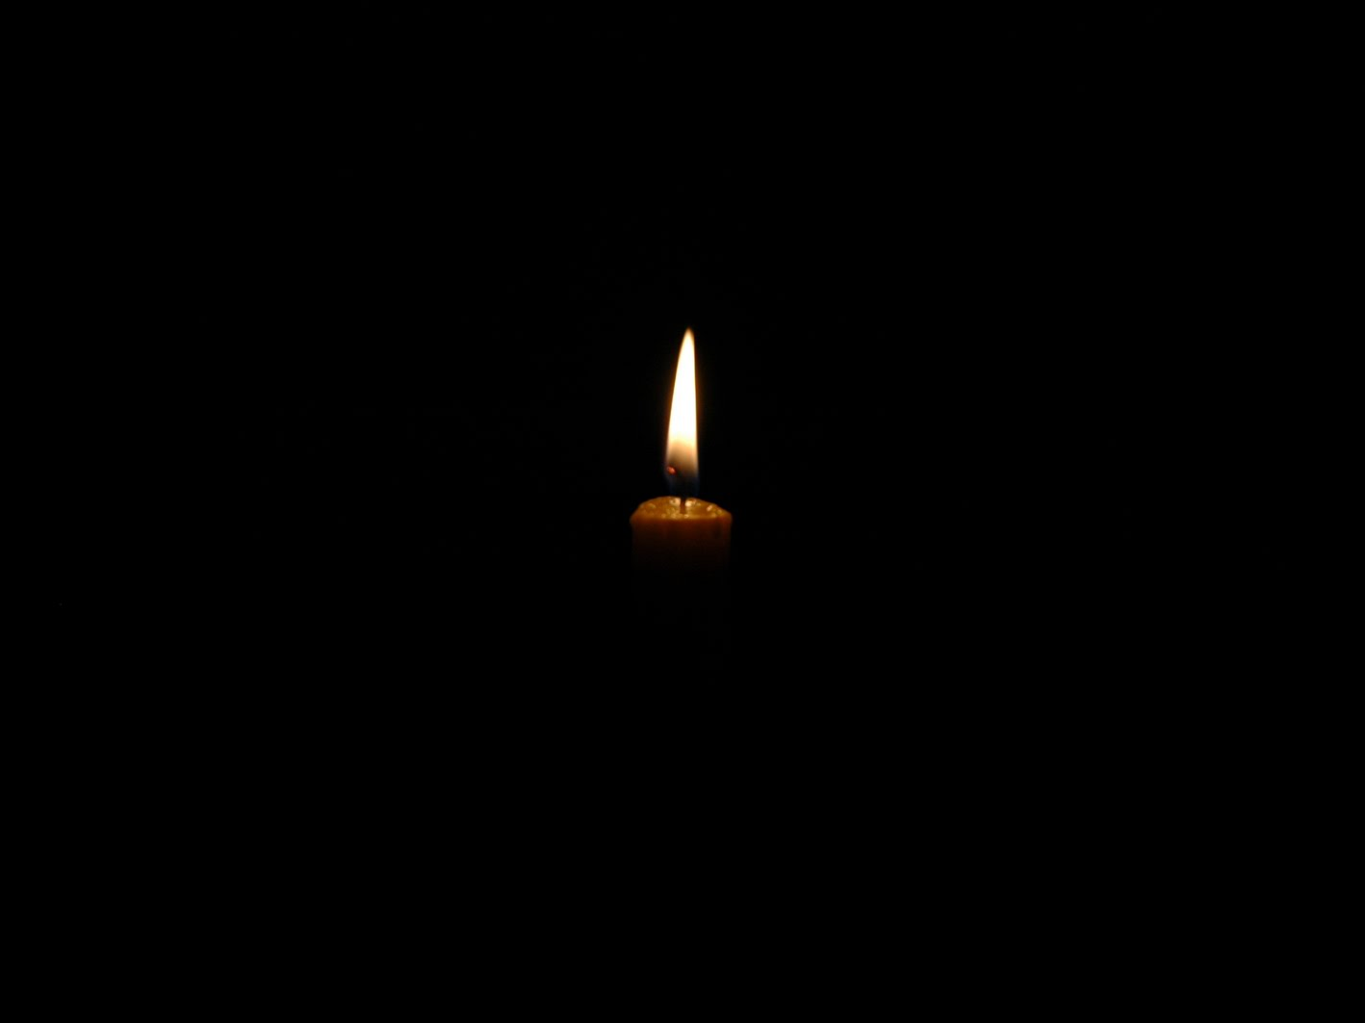
Notes:
Genesis 1:4 And God saw the light, that it was good….
I know God was referring to the Day and the Night, but let’s think about ourselves for a moment.
When he examines our hearts, when he examines Matt’s life, does He see my light and that is good? Does He see me as a light in the darkness?
And if He does, is my light significant? Does it really matter if my light shines or not?
Think about this quote for a moment.

Slide 3
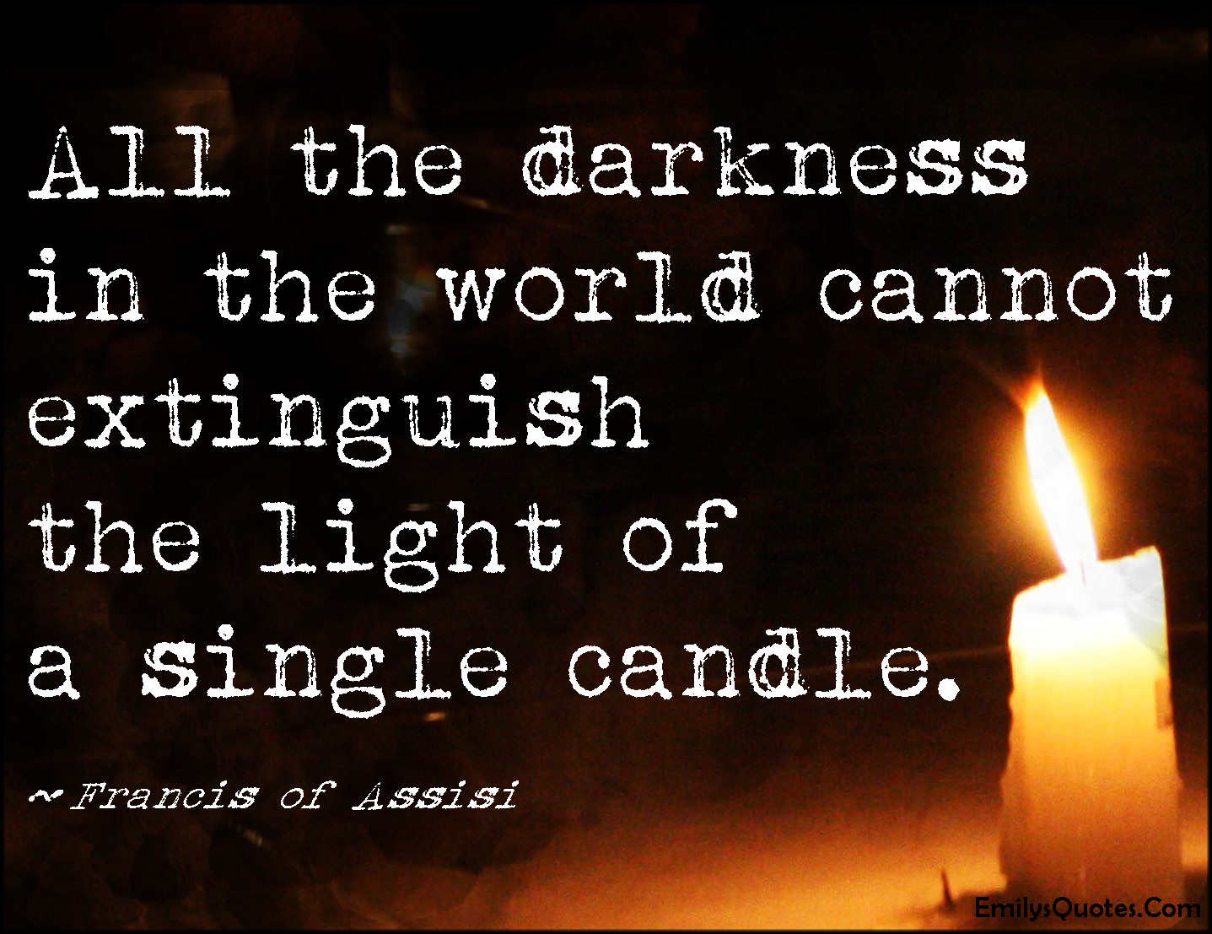
Notes:
Is your light significant?

Slide 4
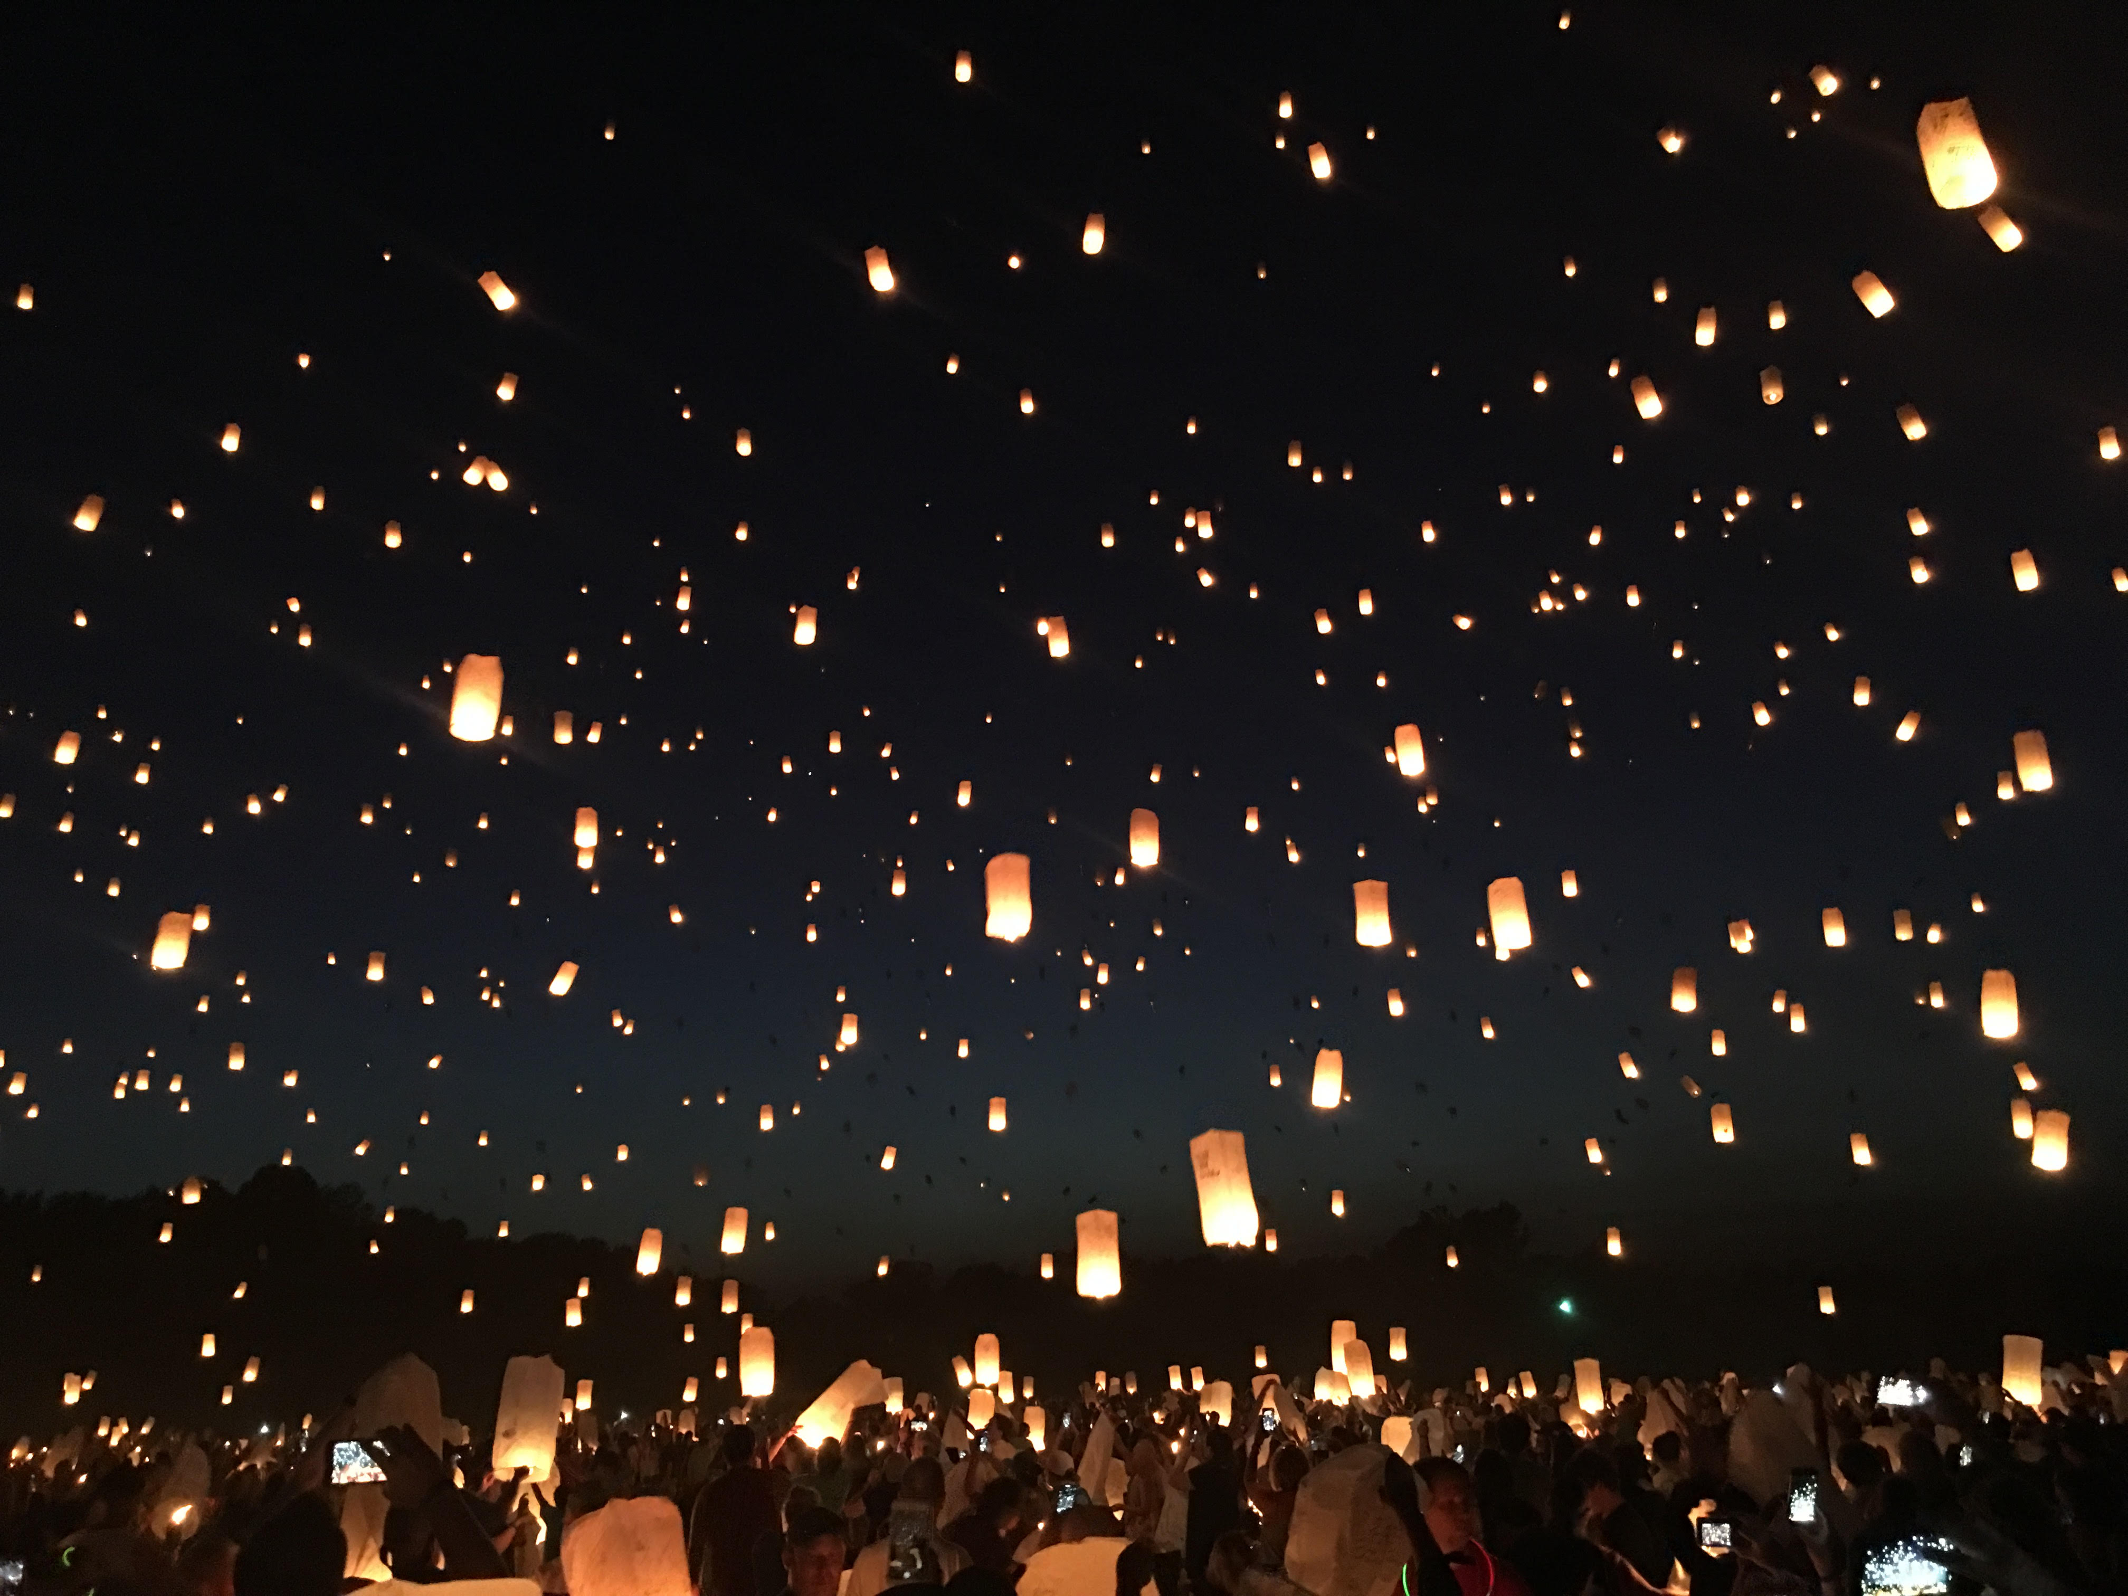
Notes:
Can you imagine what the darkness of the world would look like if each Christian let our light shine?
If each Christian realized they are significant….we would drive out the darkness of this world.

Slide 5
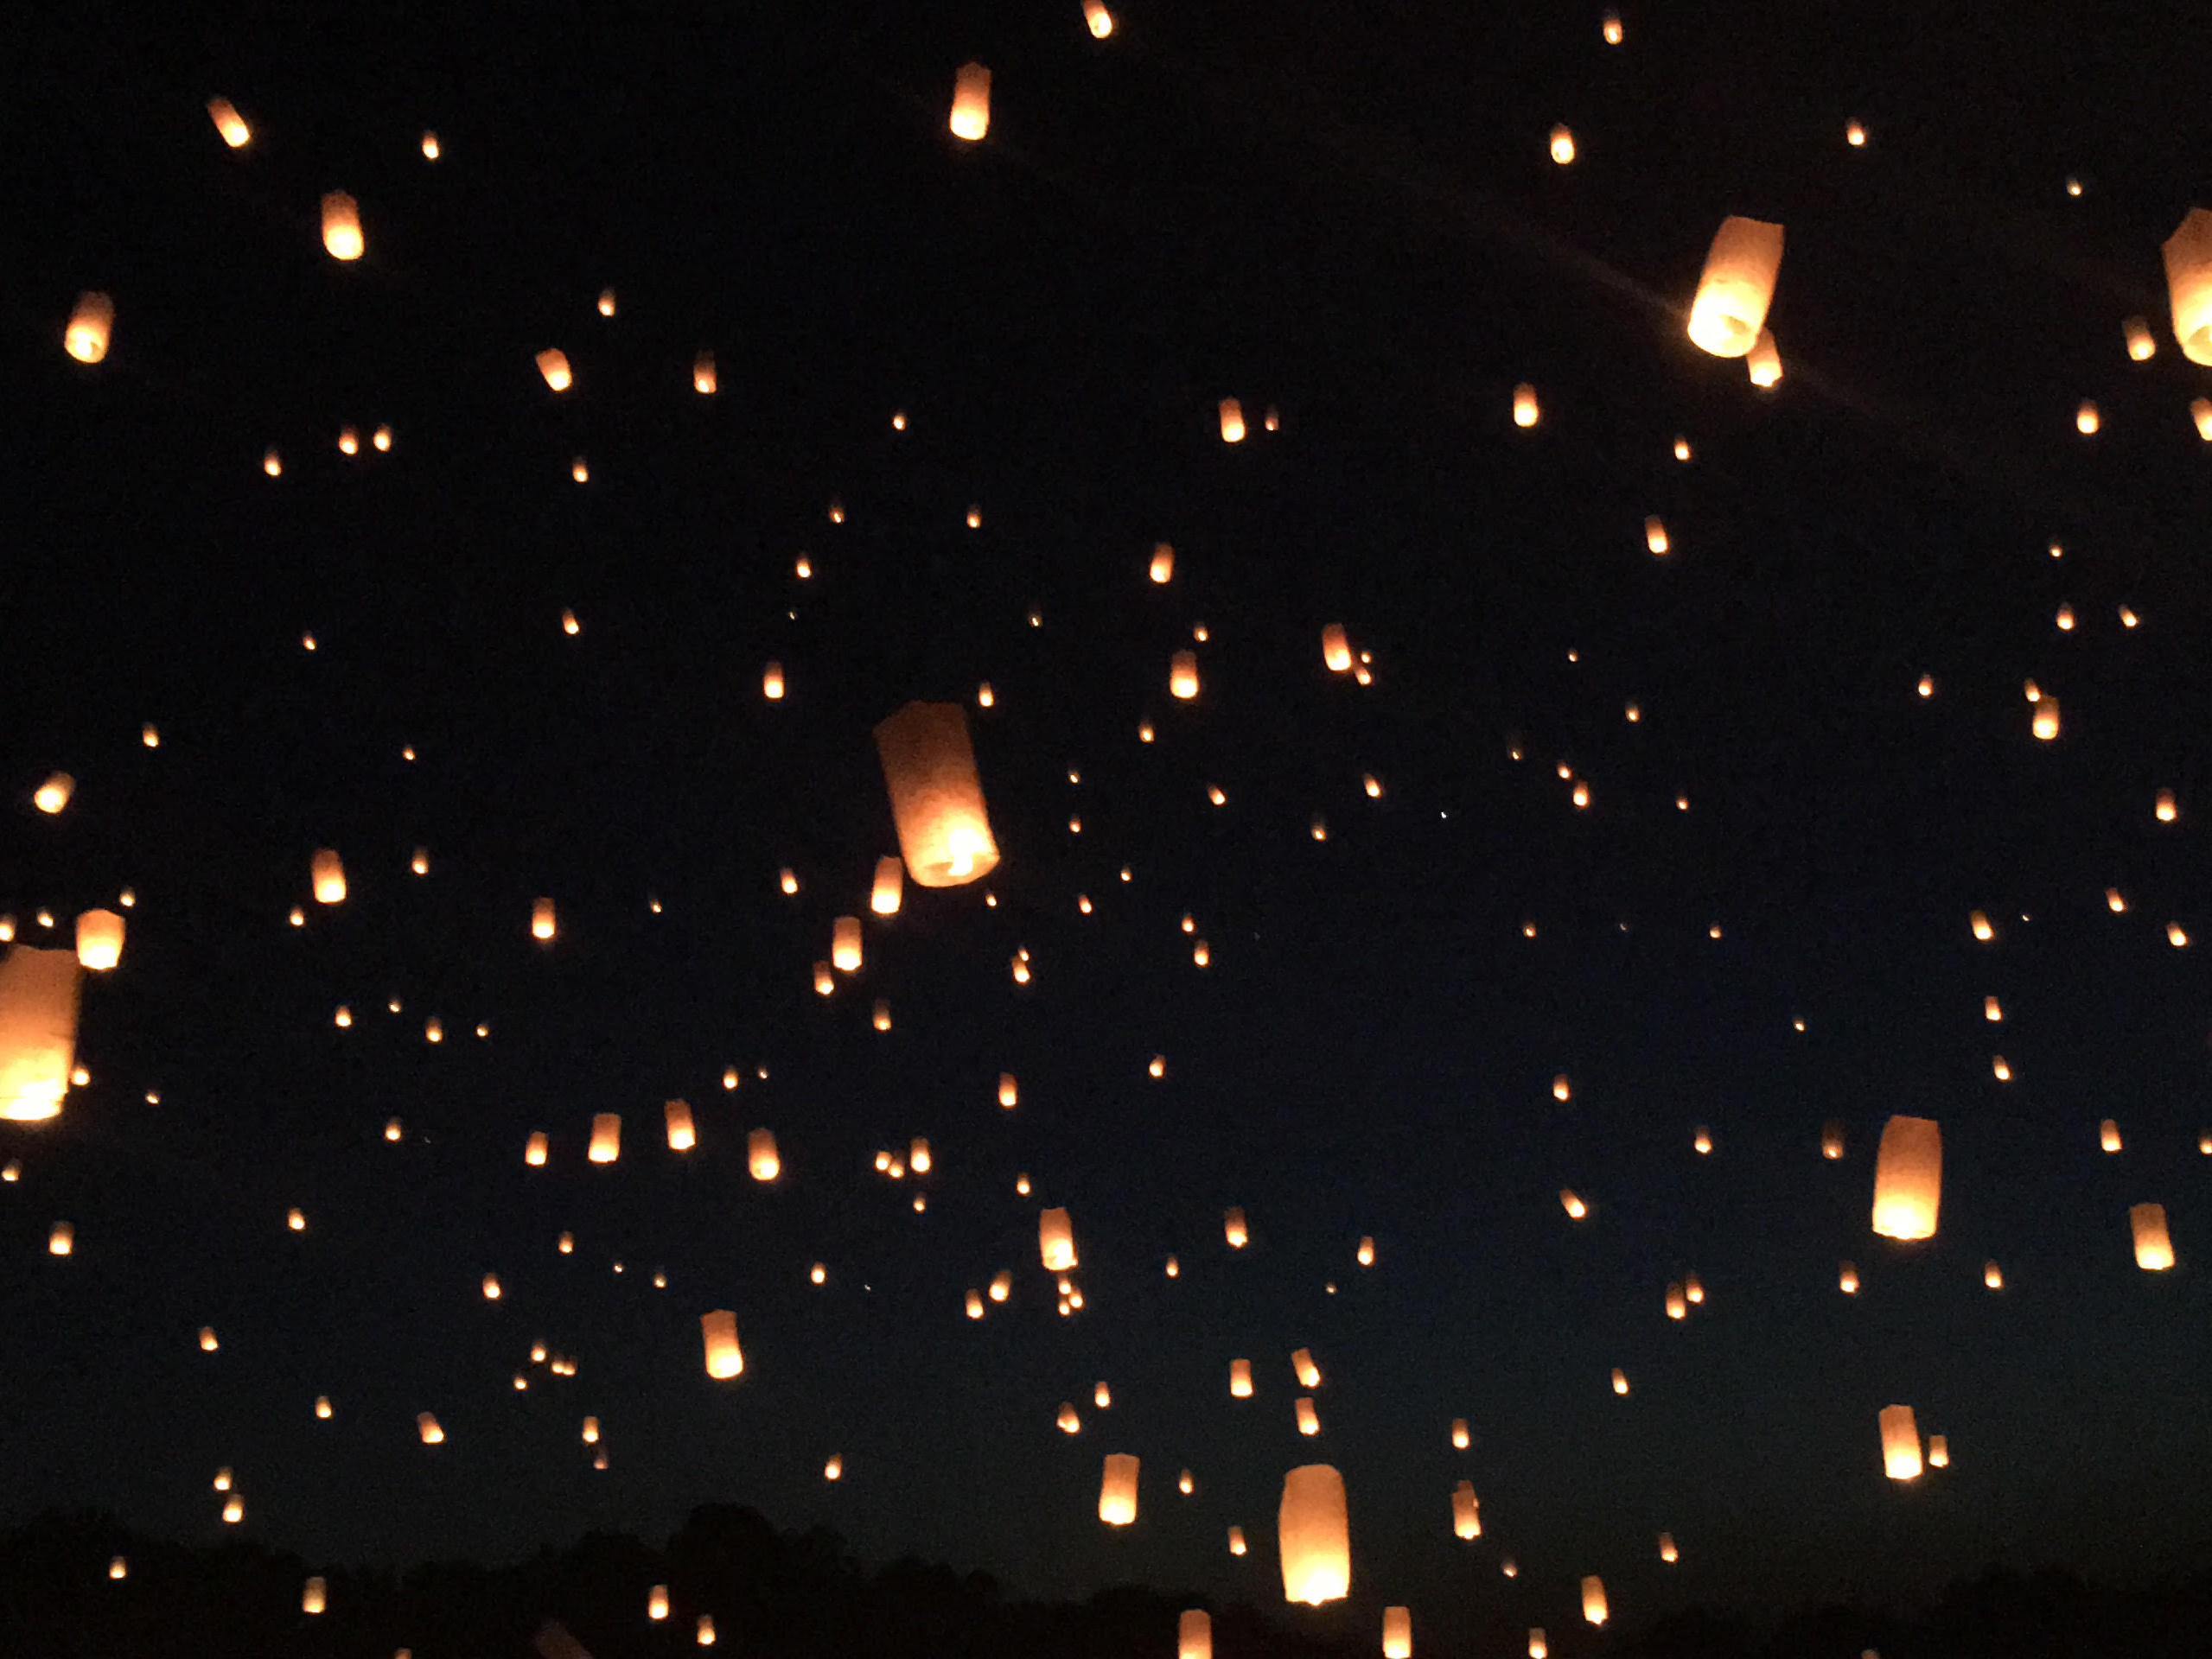

Slide 6
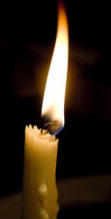
This Little Light of Mine
Notes:
Don’t think that your light, your life, your influence is insignificant.
What can I do?
How can I help?
Who am I?
You never know who may be watching you.
You never know whom you may be influencing.
Jesus said, You are the light of the world!

Slide 7
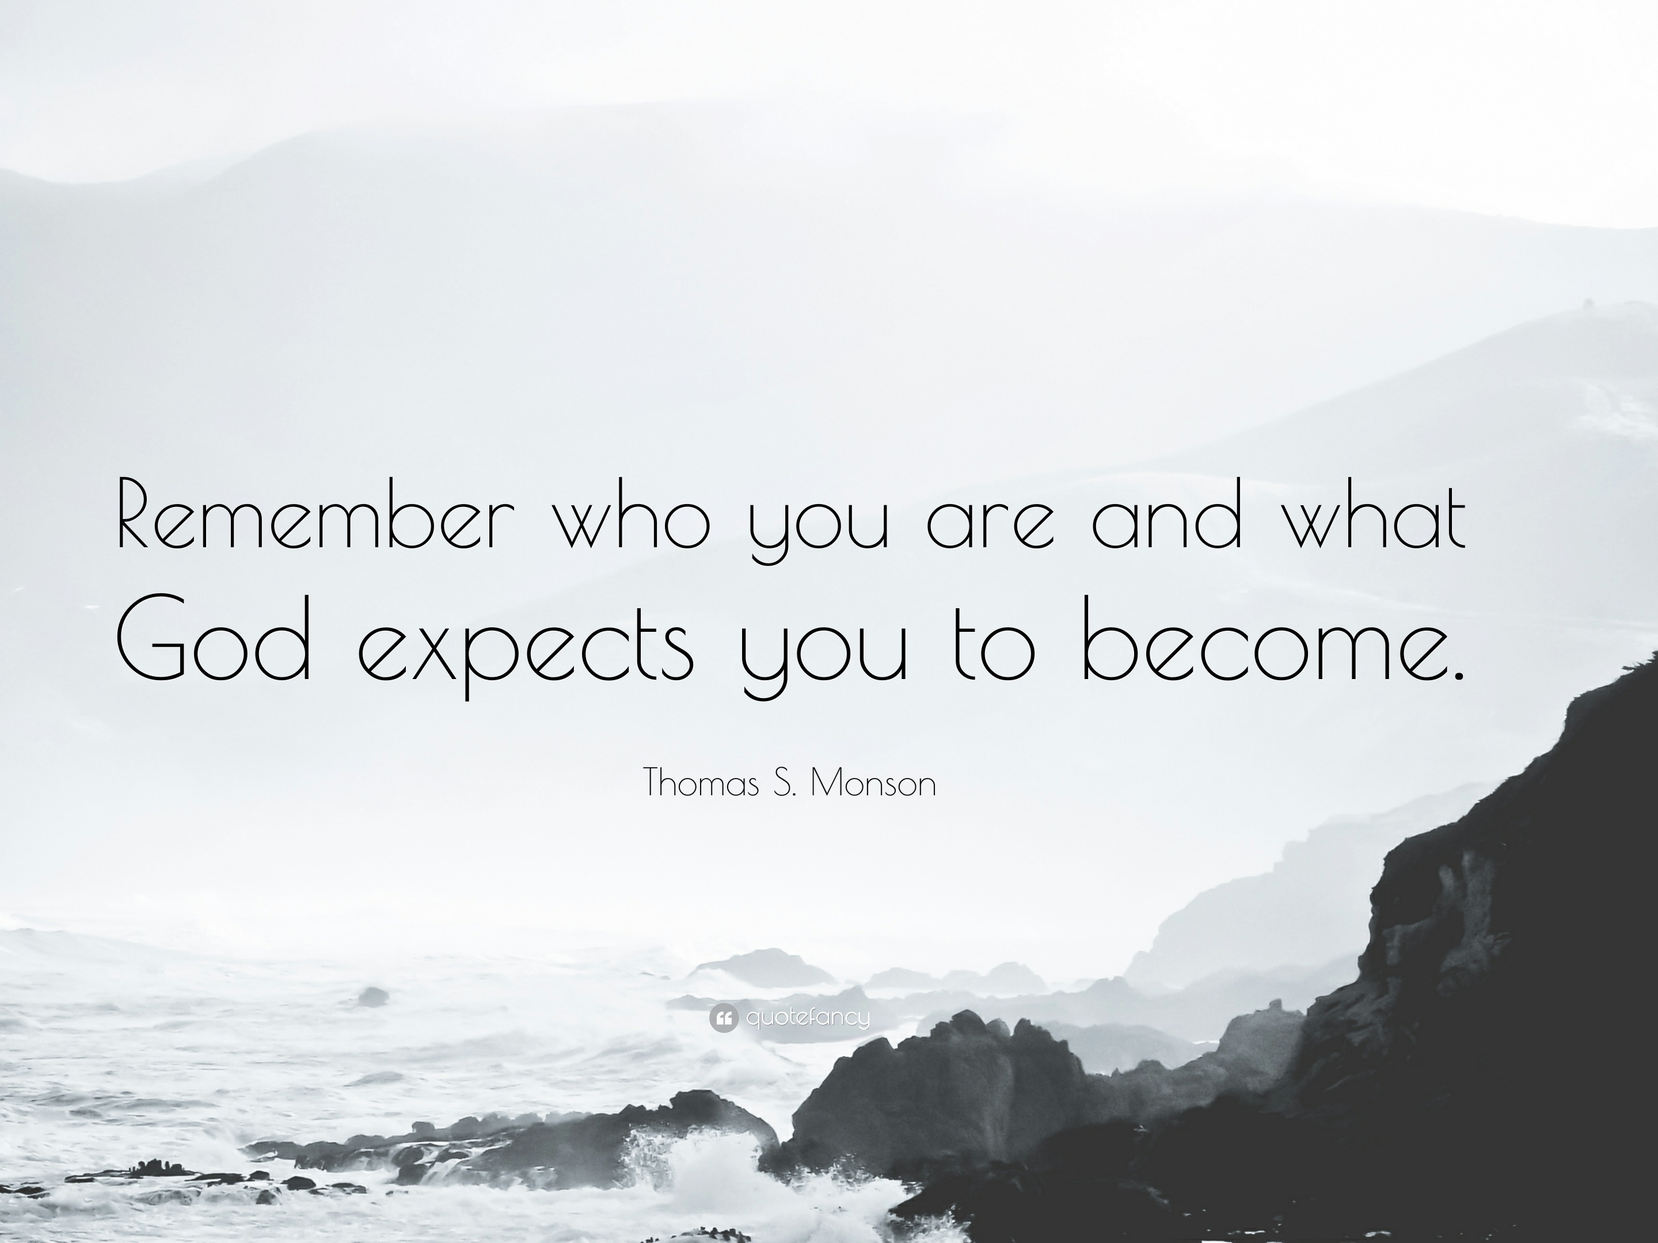
Notes:
Lion King
Born to be a king NOT a bug eater
Simba’s father’s message: Remember Who You Are
As Christians, we have to remember who we are.
We are…..the Light of the World!

Slide 8


Slide 9
Remember Who You Are
The Light of the World
Matthew 5:14-16
  ¹⁴ You are the light of the world. A city that is set on a hill cannot be hidden.
  ¹⁵ Nor do they light a lamp and put it under a basket, but on a lampstand, and it gives light to all who are in the house.
  ¹⁶ Let your light so shine before men, that they may see your good works and glorify your Father in heaven.

Slide 10
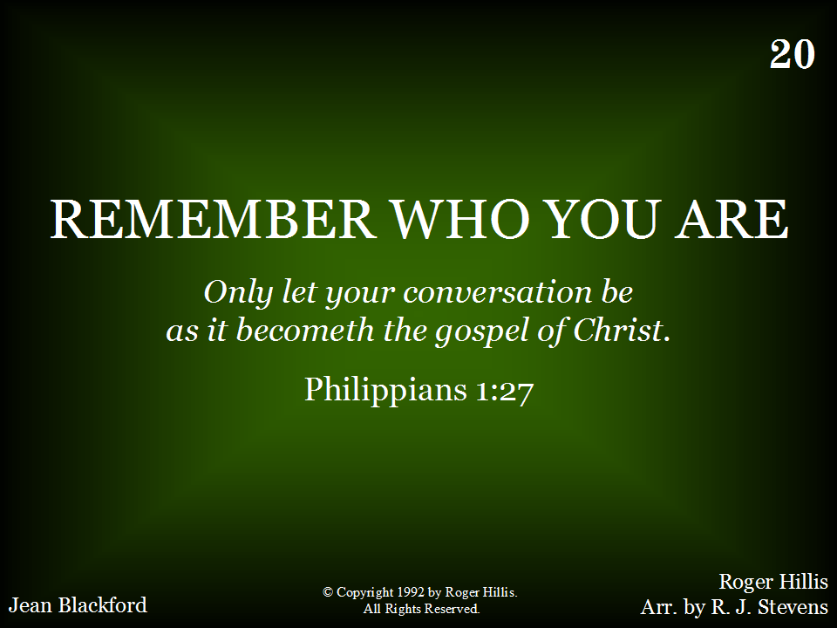
020 - Remember Who You Are - Title

Slide 11
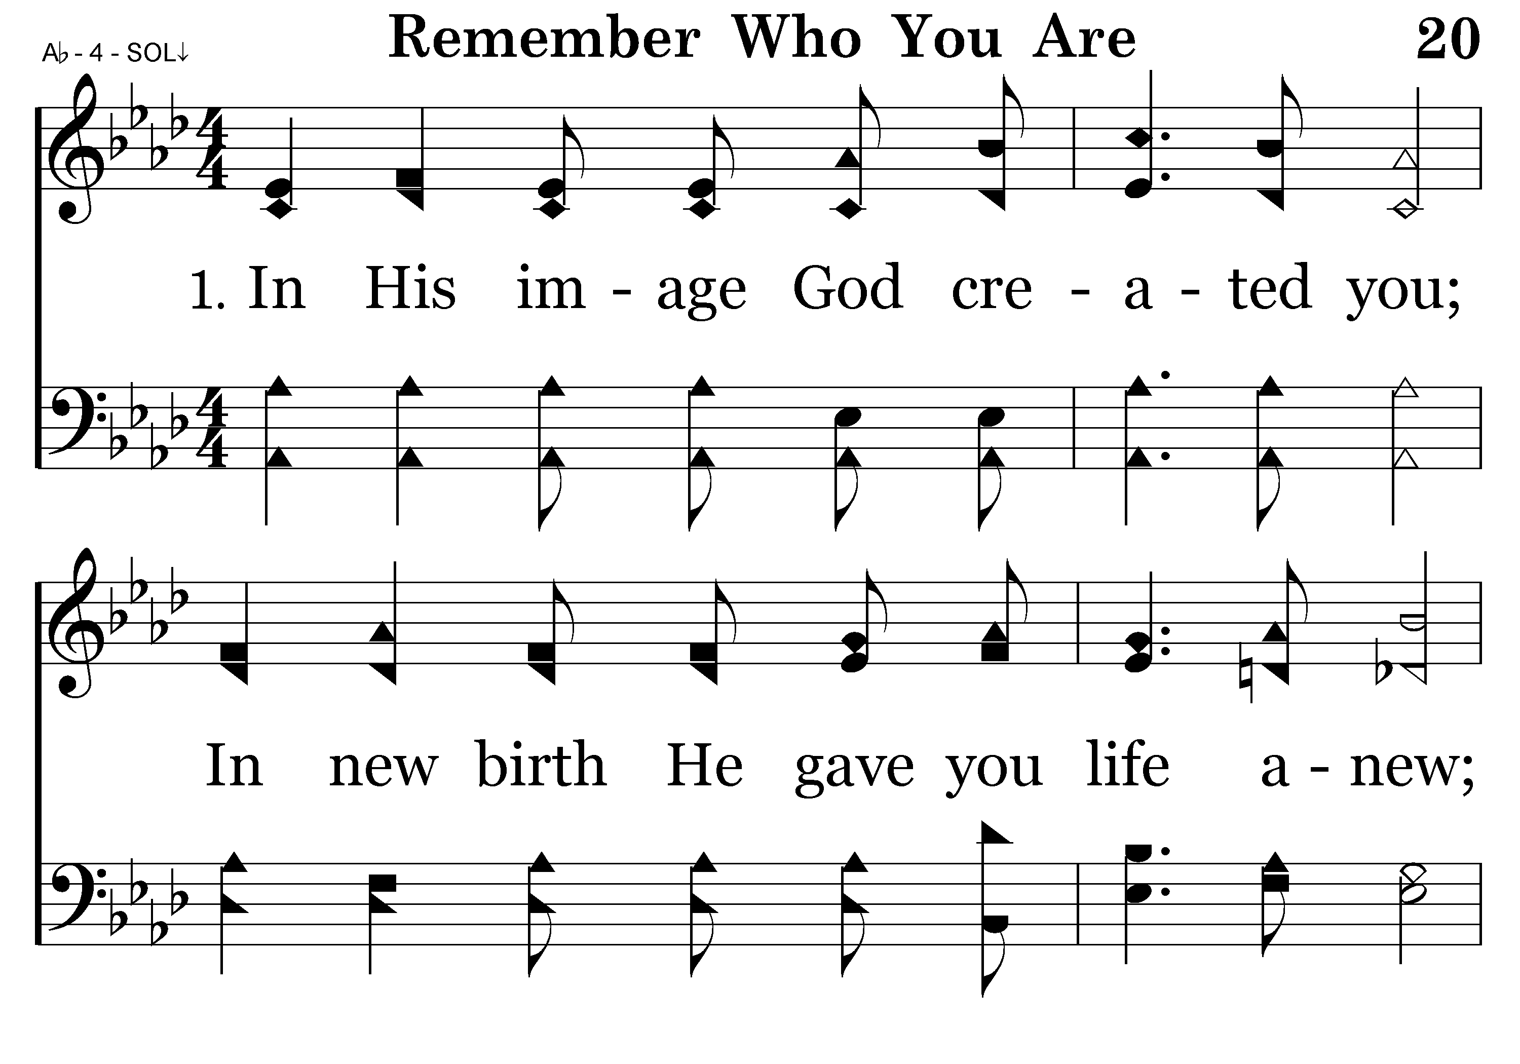
020 - Remember Who You Are - 1.1

Slide 12
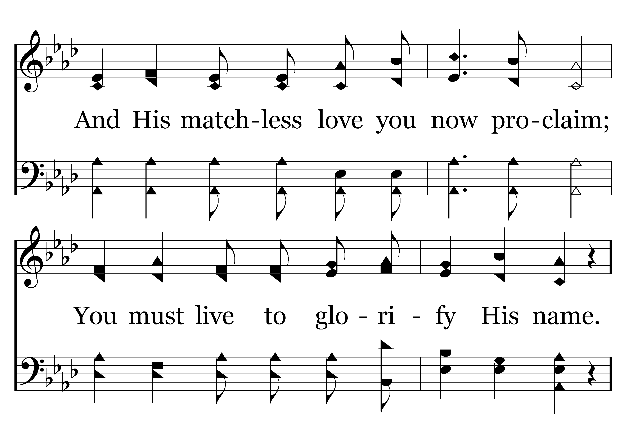
020 - Remember Who You Are - 1.2

Slide 13
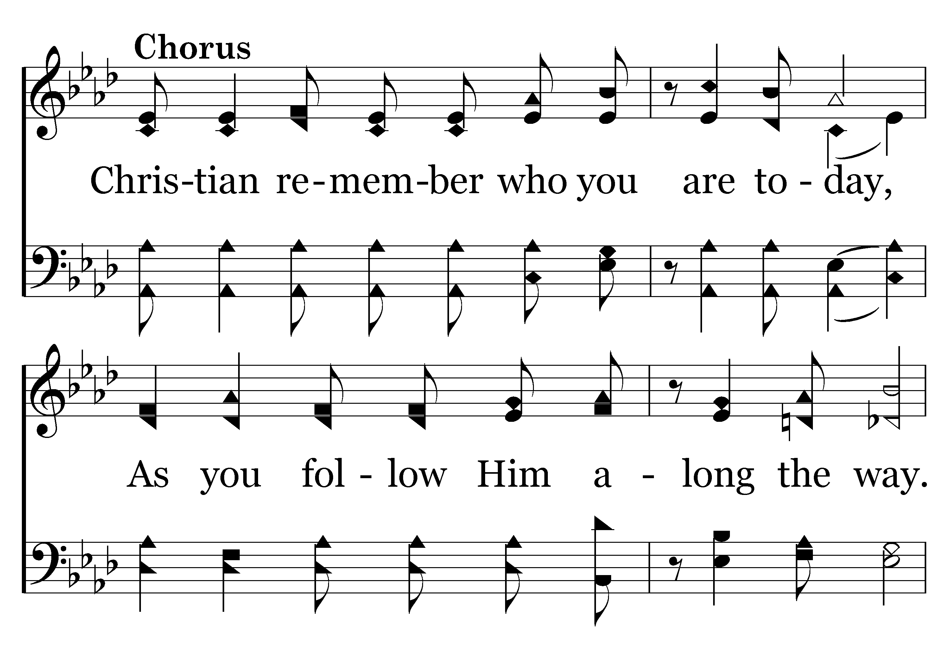
020 - Remember Who You Are - C.1

Slide 14
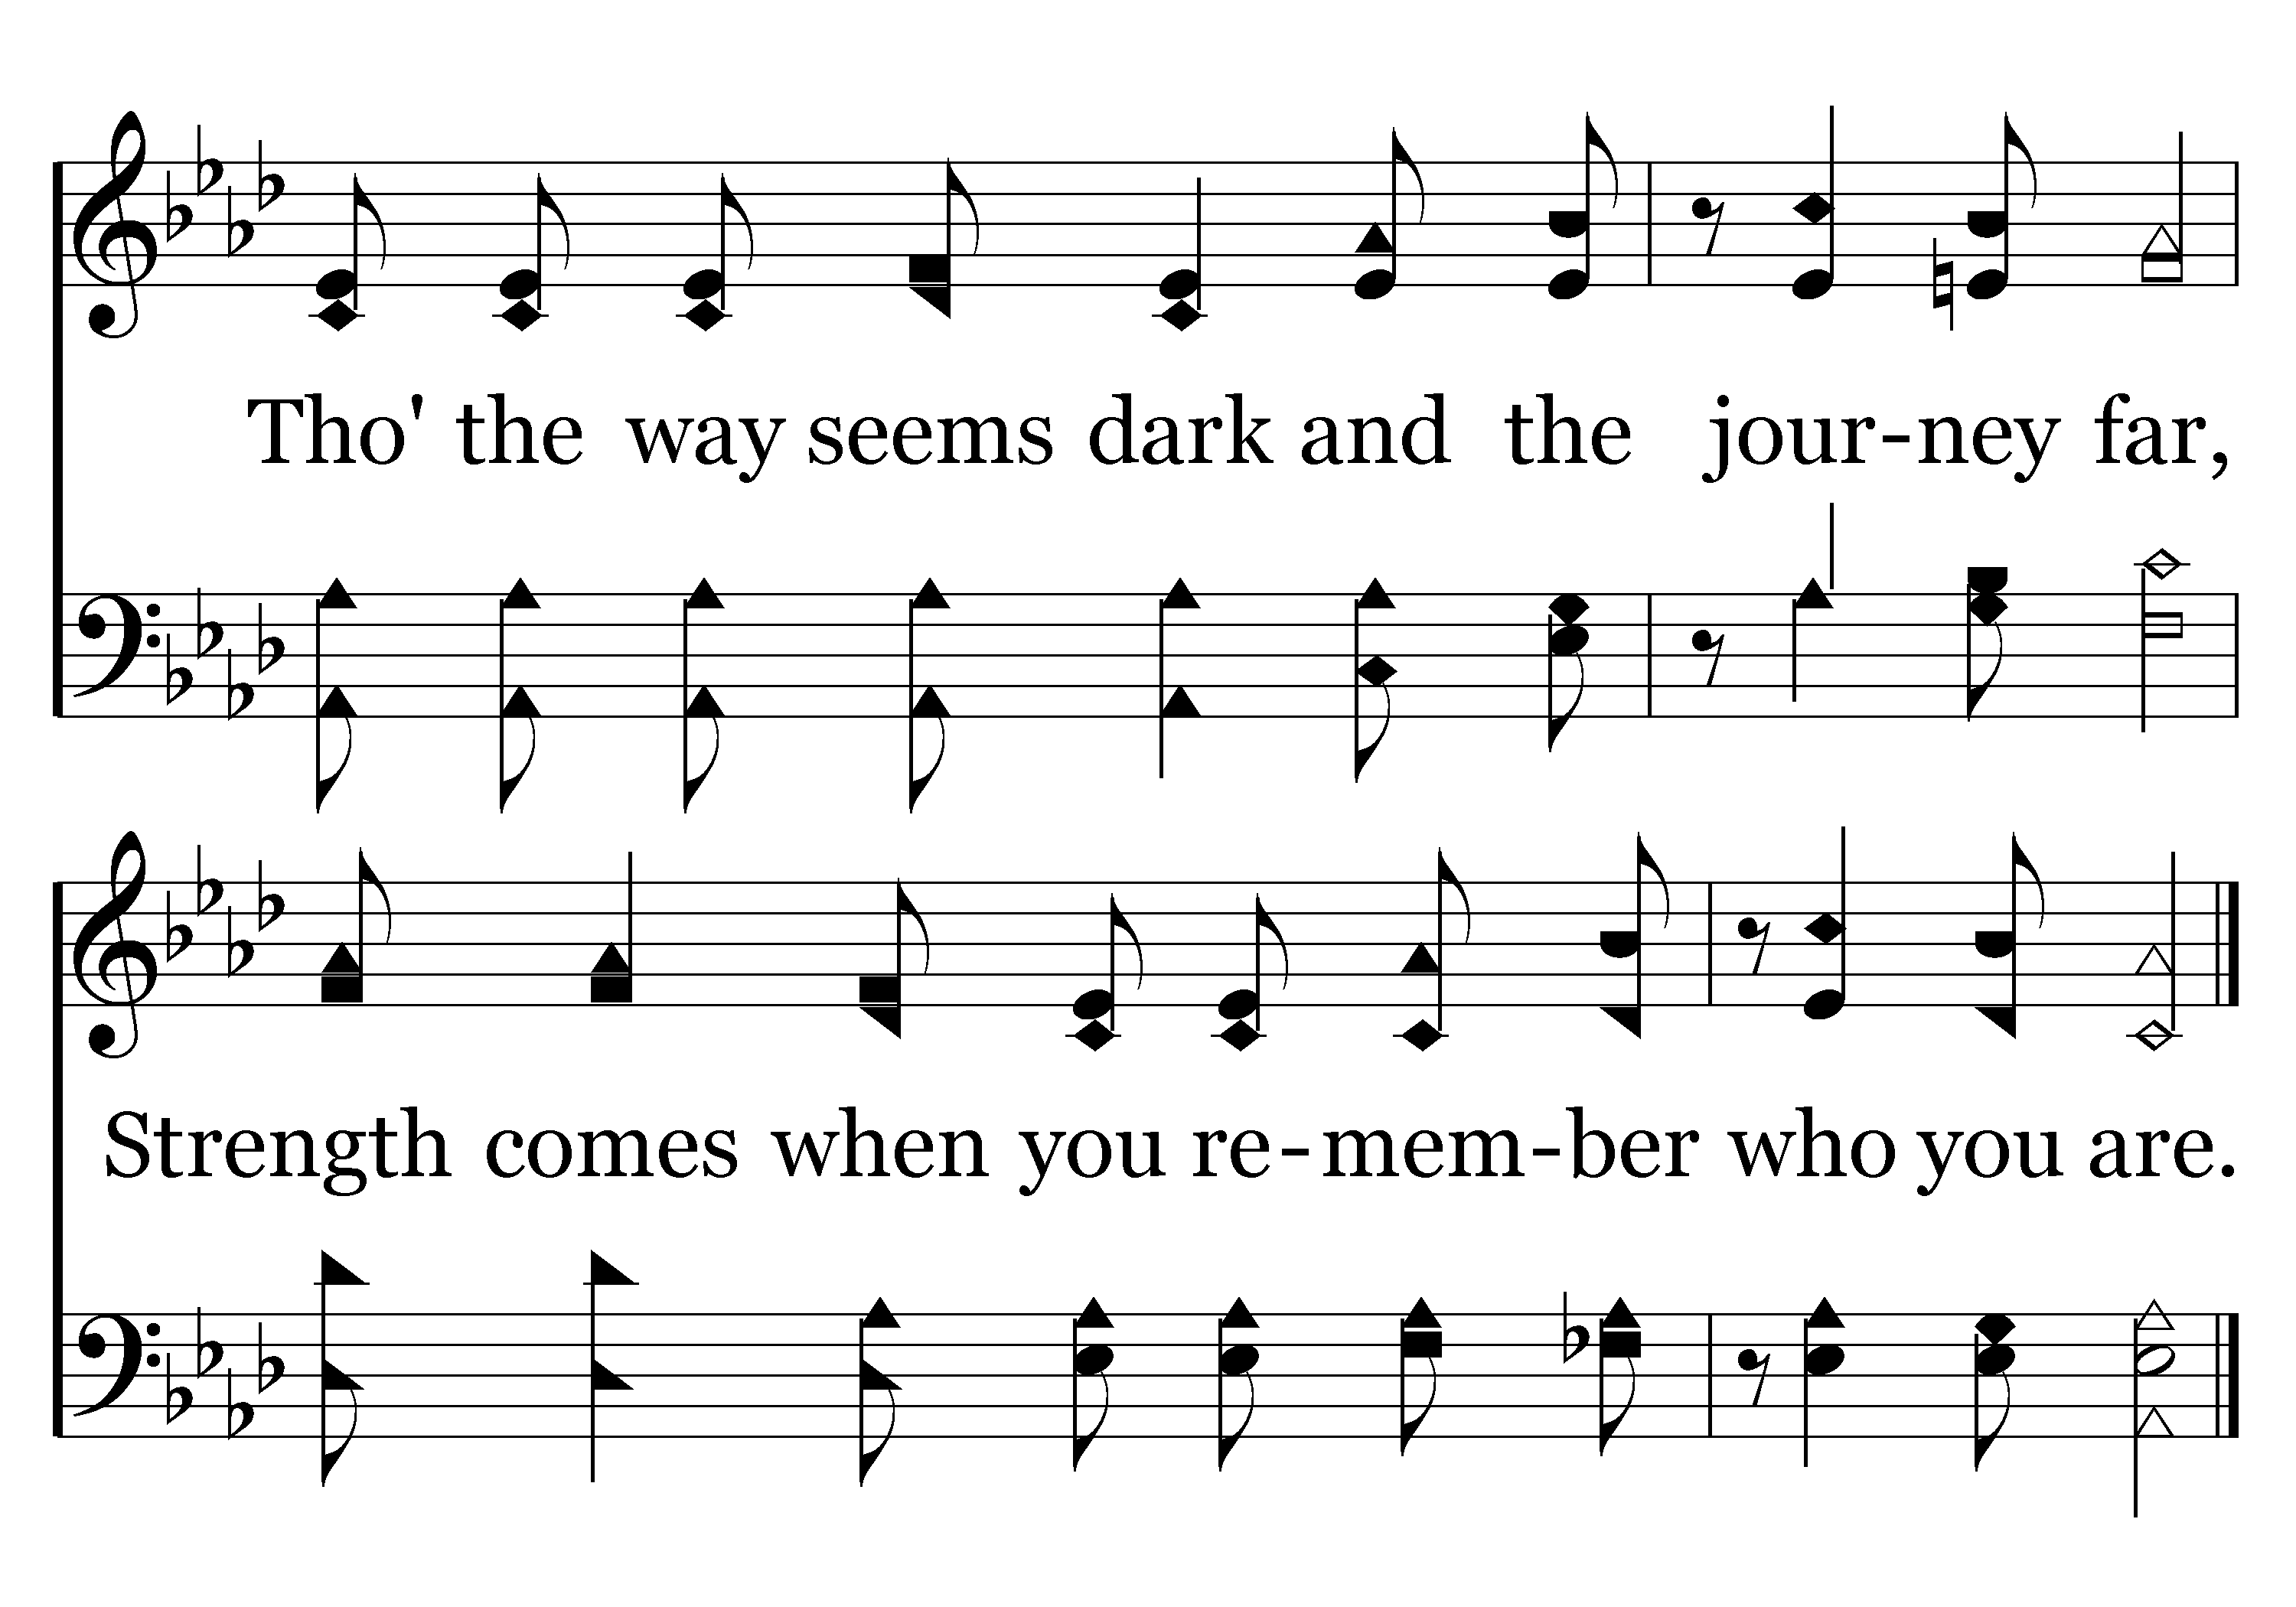
020 - Remember Who You Are - C.2
End of Verse 1

Slide 15
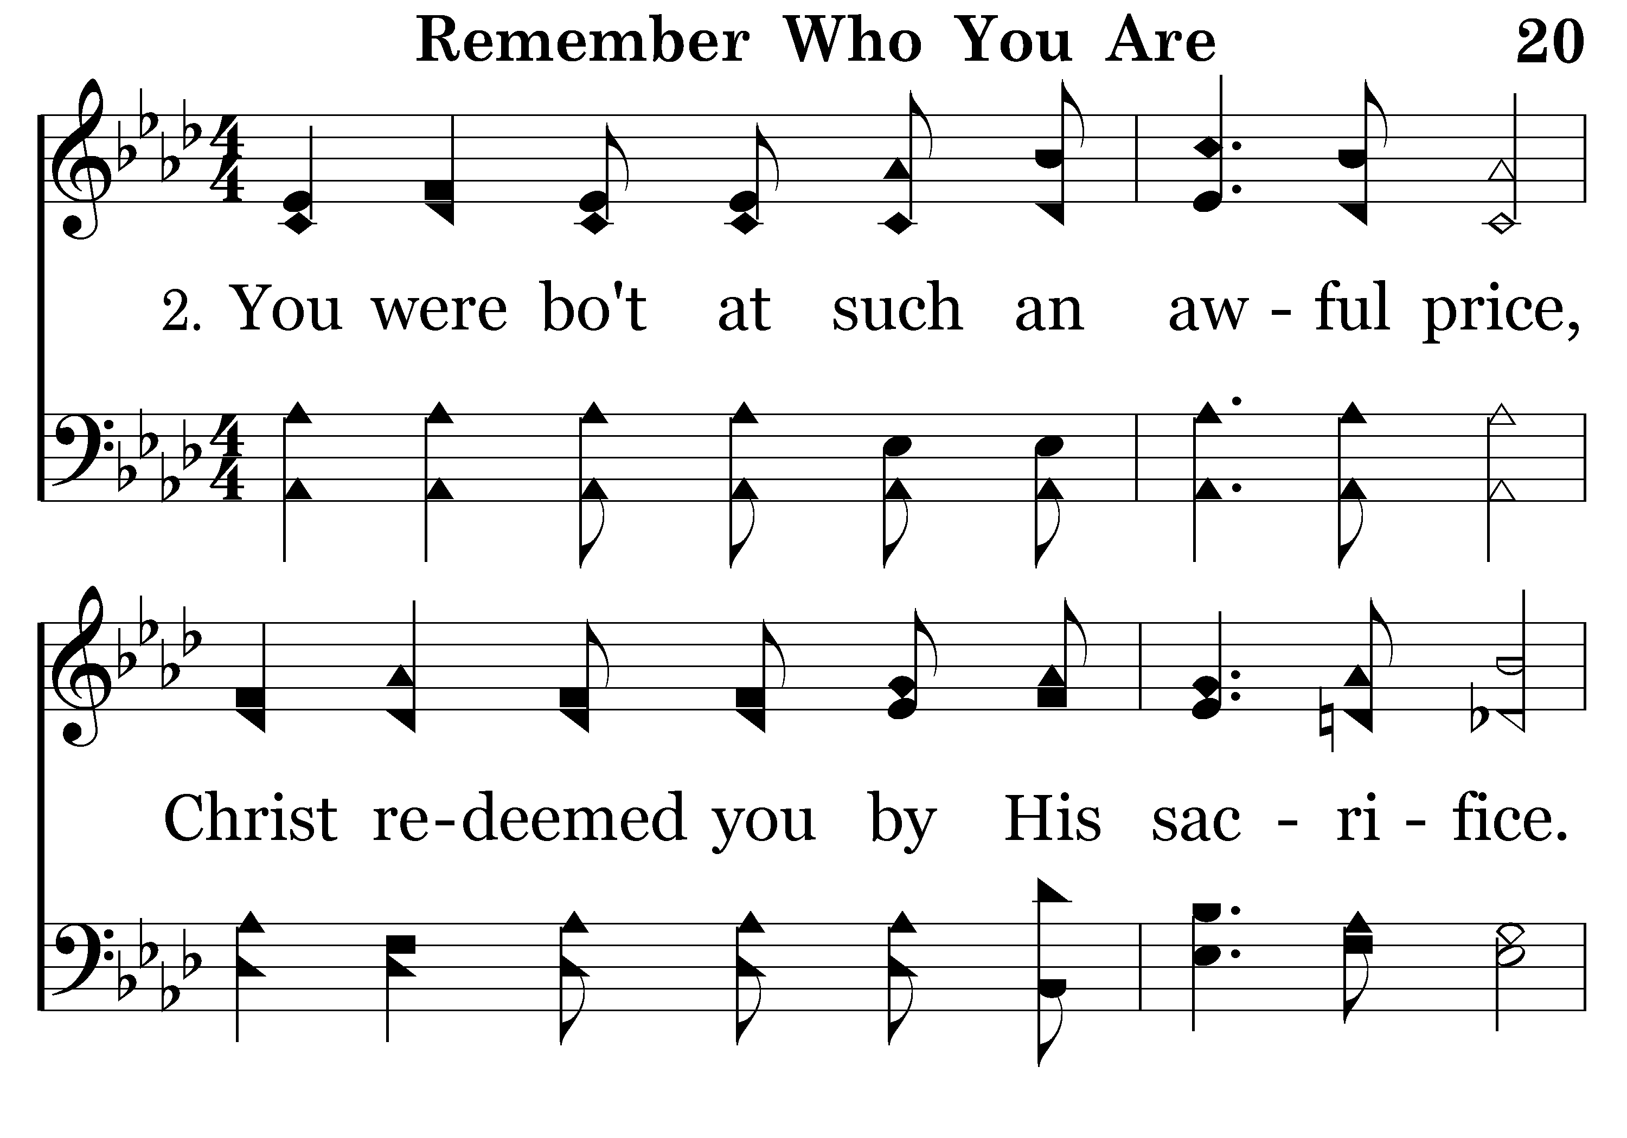
020 - Remember Who You Are - 2.1

Slide 16
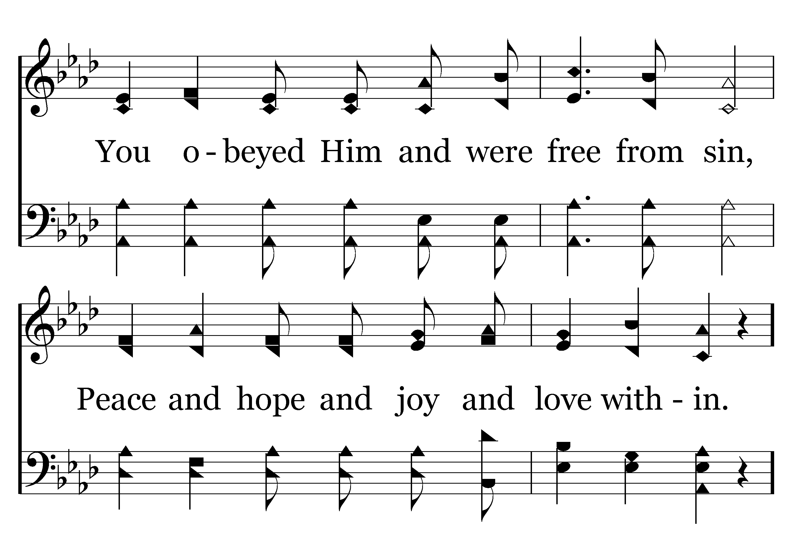
020 - Remember Who You Are - 2.2

Slide 17
020 - Remember Who You Are - C.1

Slide 18
020 - Remember Who You Are - C.2
End of Verse 2

Slide 19
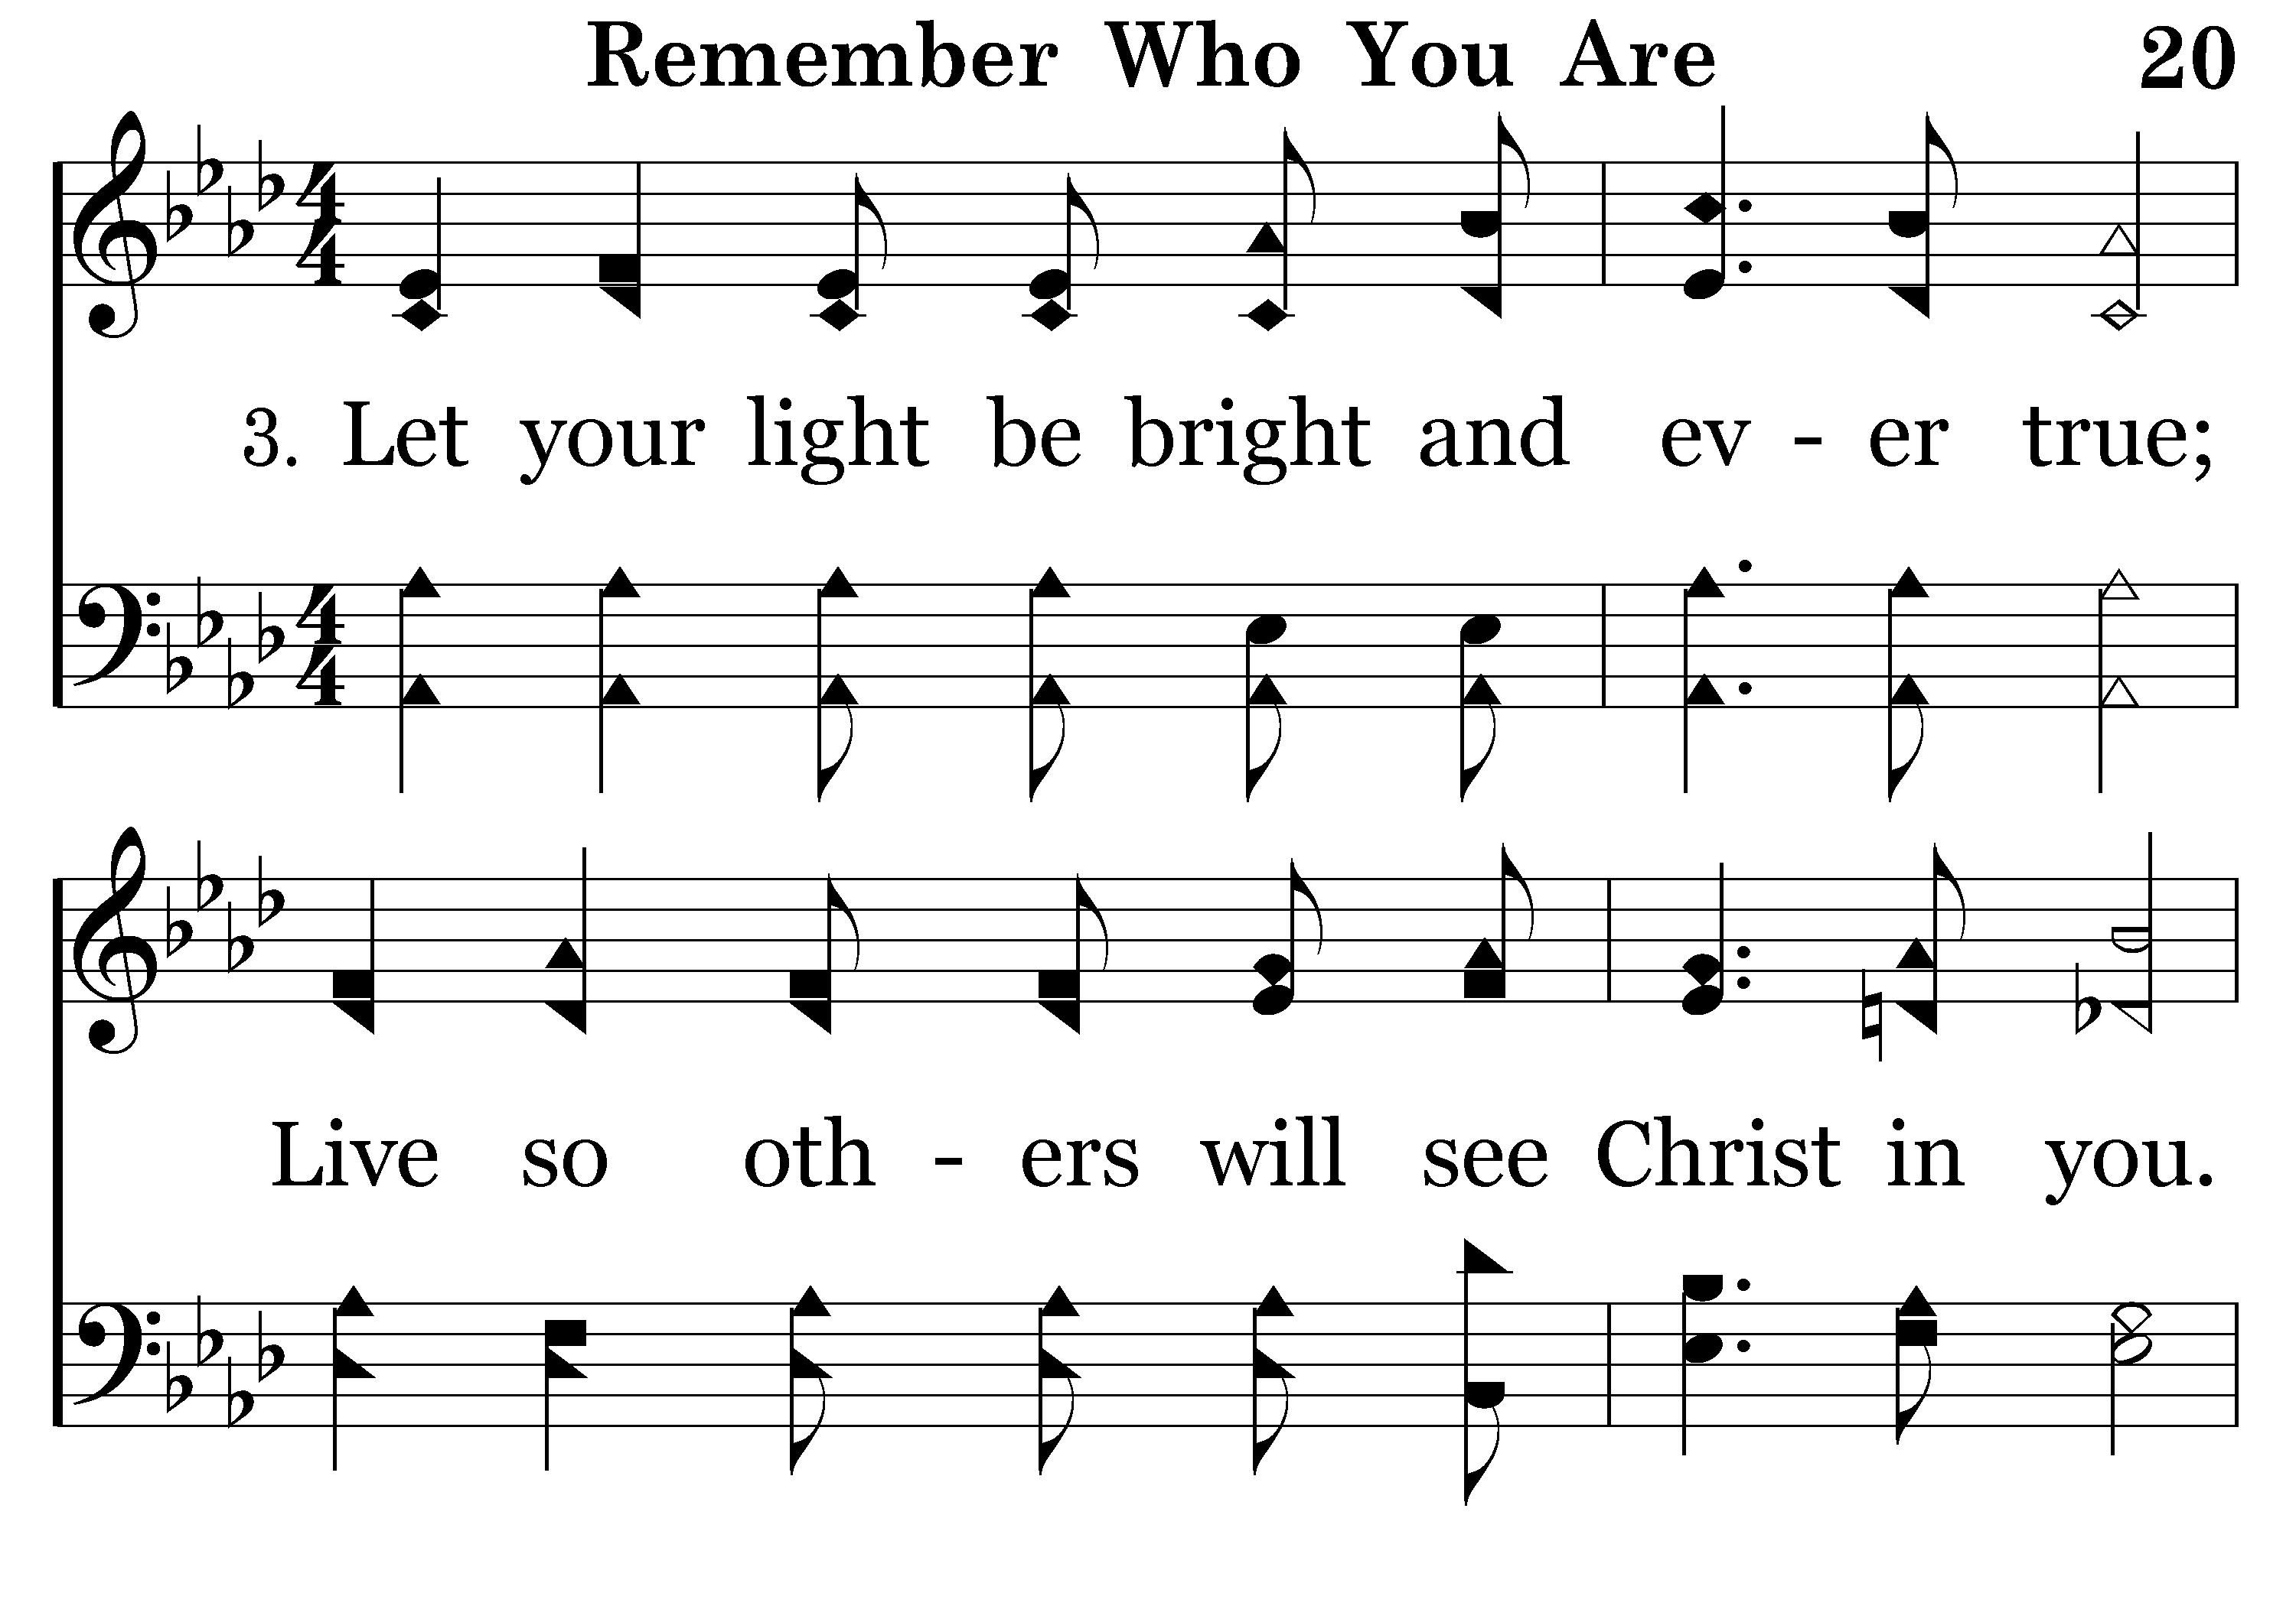
020 - Remember Who You Are - 3.1

Slide 20
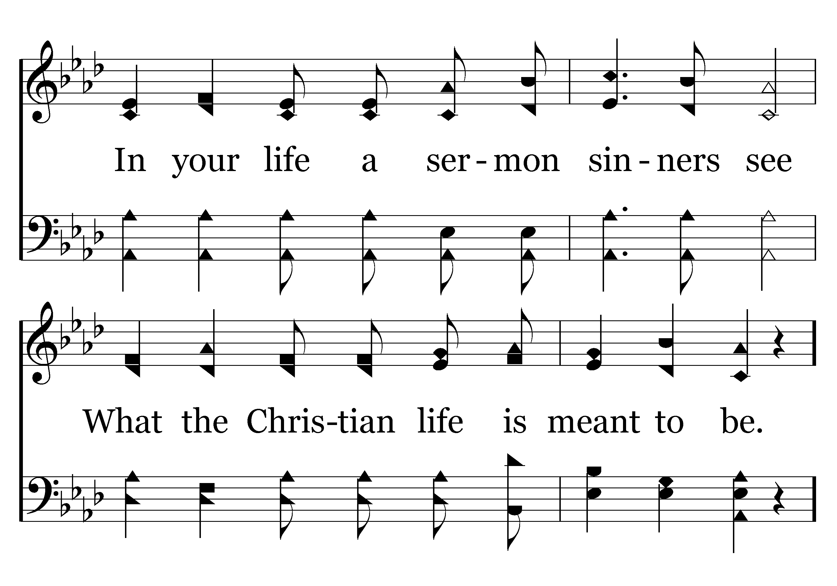
020 - Remember Who You Are - 3.2

Slide 21
020 - Remember Who You Are - C.1

Slide 22
020 - Remember Who You Are - C.2
End of Song

Slide 24
Remember Who You Are
Sons of God
Galatians 4:4-7
  ⁴ But when the fulness of the time was come, God sent forth his Son, made of a woman, made under the law,
  ⁵ To redeem them that were under the law, that we might receive the adoption of sons.
  ⁶ And because ye are sons, God hath sent forth the Spirit of his Son into your hearts, crying, Abba, Father.
  ⁷ Wherefore thou art no more a servant, but a son; and if a son, then an heir of God through Christ.
Notes:
As Christians, we have to remember who we are.
We are…..Sons of God!

Slide 25
Remember Who You Are
Sons of God
1 John 3:1
  ¹ Behold, what manner of love the Father hath bestowed upon us, that we should be called the sons of God: therefore the world knoweth us not, because it knew him not.
John 1:12
  ¹² But as many as received him, to them gave he power to become the sons of God, even to them that believe on his name:

Slide 26
Sons of God
We have an obligation.
1 Peter 1:13-17 NLT
¹³ So prepare your minds for action and exercise self-control. Put all your hope in the gracious salvation that will come to you when Jesus Christ is revealed to the world.
¹⁴ So you must live as God’s obedient children. Don’t slip back into your old ways of living to satisfy your own desires. You didn’t know any better then.

Slide 27
Sons of God
We have an obligation.
1 Peter 1:13-17 NLT
¹⁵ But now you must be holy in everything you do, just as God who chose you is holy.
¹⁶ For the Scriptures say, “You must be holy because I am holy.”
¹⁷ And remember that the heavenly Father to whom you pray has no favorites. He will judge or reward you according to what you do. So you must live in reverent fear of him during your time here as “temporary residents.”

Slide 28
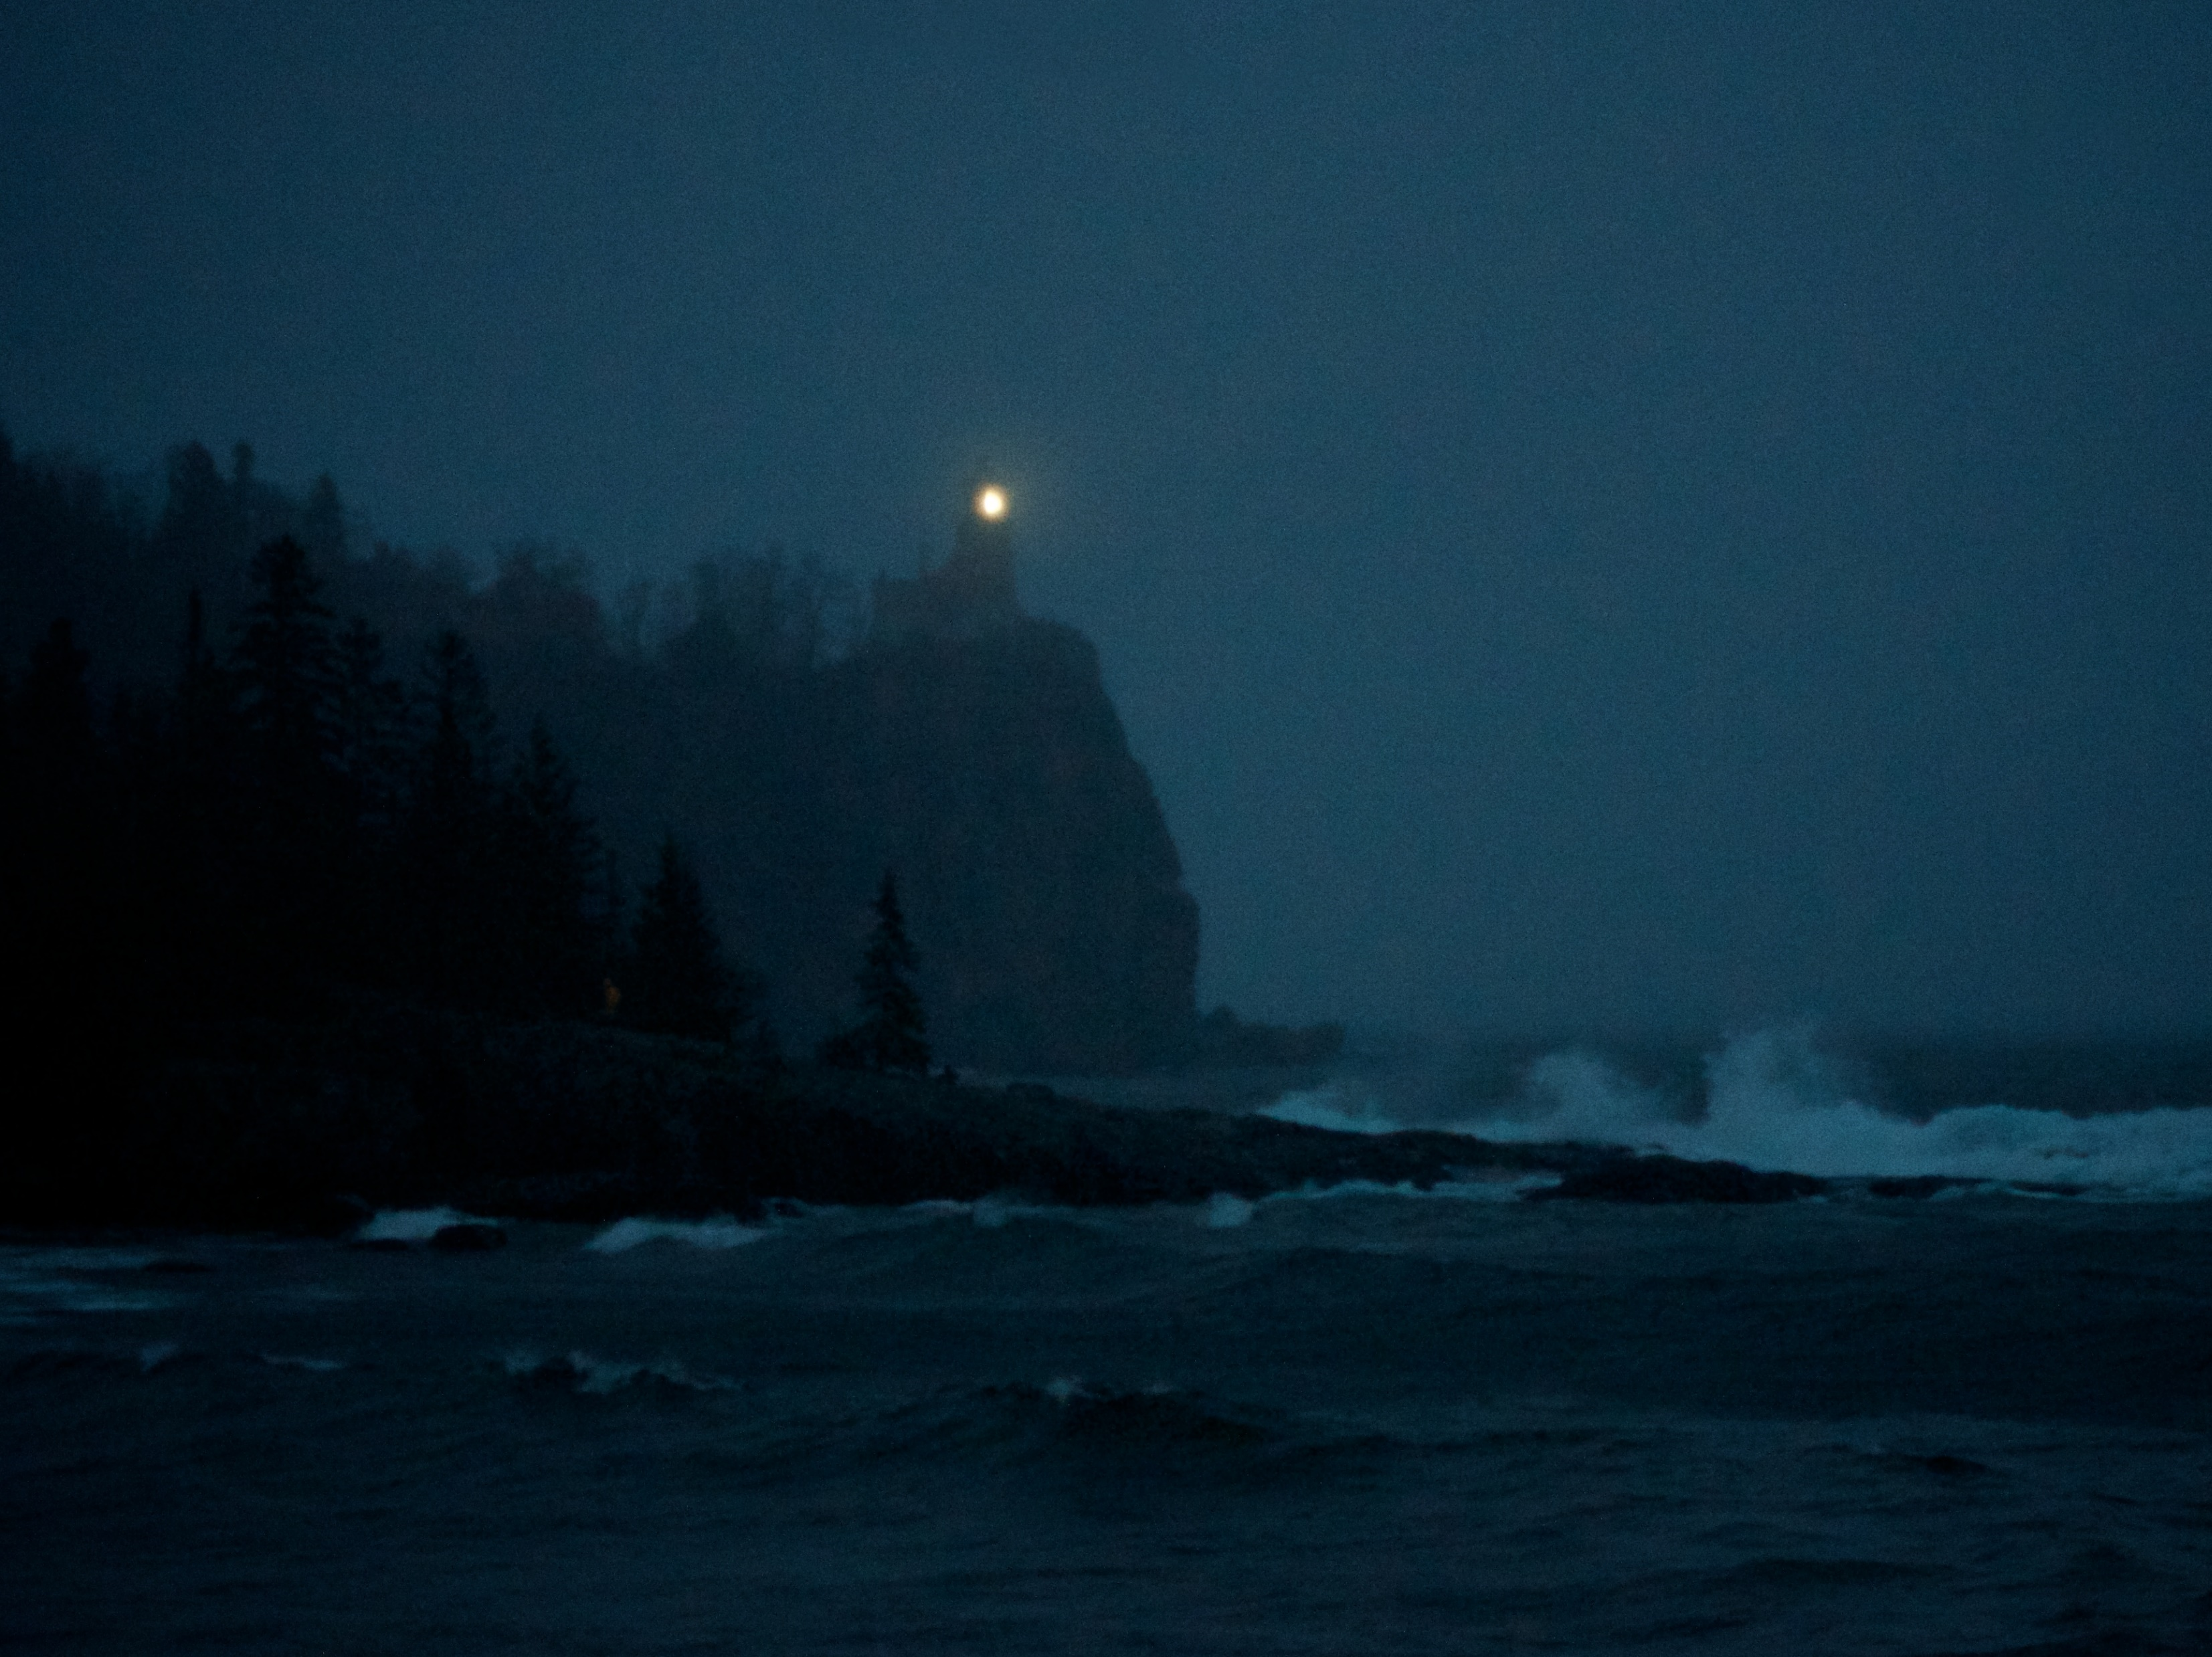
Notes:
The Story Behind…
Let the Lower Lights be Burning
At one of D.L. Moody’s meetings in America he related the story of a shipwreck on a dark and tempestuous night, when not even a star was visible. A ship was approaching the harbor of Cleveland, with a pilot on board. The captain, noticing only one light as they drew near — that from the lighthouse —asked the pilot if he was quite sure that it was Cleveland harbor, as other lights should have been burning at the harbor mouth. The pilot replied that he was quite sure, whereupon the captain enquired:
“Where are the lower lights?” “Gone out, sir,” replied the pilot.
“Can you make the harbor, then?” asked the captain, to which the pilot answered:
“We must, sir, or perish.”
Bravely the old man steered the vessel upon her course toward safety. But alas! In the darkness of the harbor mouth he missed the channel, the ship struck upon many rocks, and in the stormy waters many lives were lost.

Slide 29
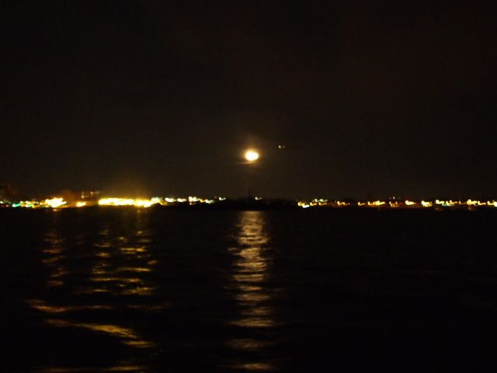
Let the Lower Lights Be Burning
Notes:
Then Moody made his appeal to his audience: “Brothers, the Master will take care of the great lighthouse! Let us keep the lower lights burning!”
Among Moody’s hearers that evening was Mr. Philip P. Bliss, the well-known hymn writer, and the striking story at once suggested to him one of his most popular hymns:
Who are you?
We are the lower lights!

Slide 30
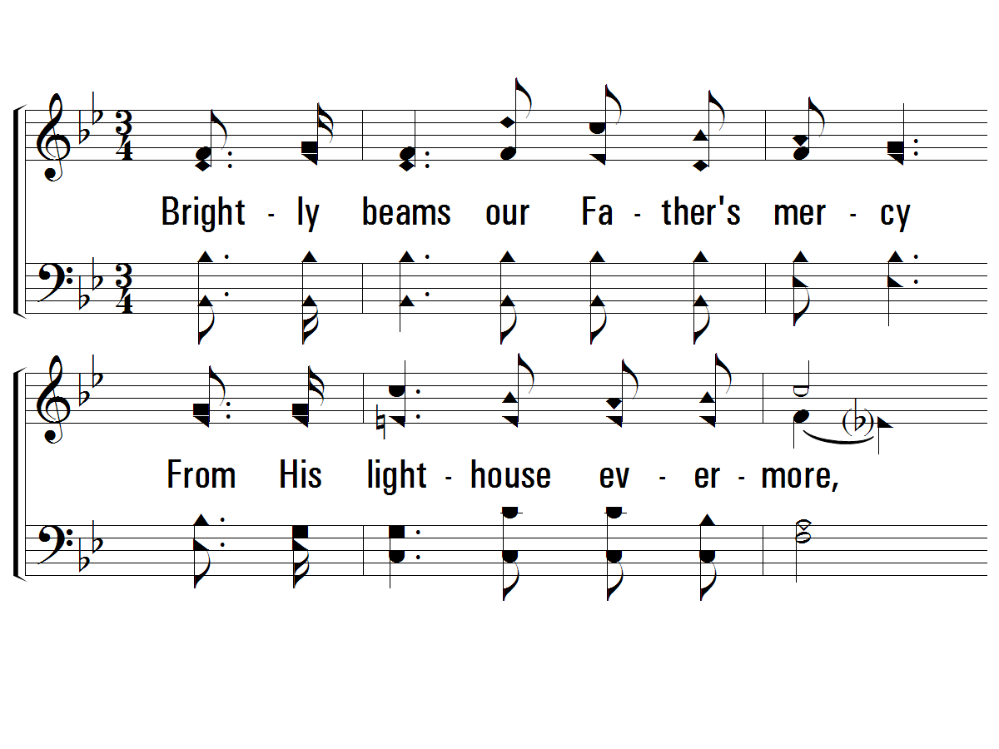
1 – Let the Lower Lights Be Burning
397
1.
Brightly beams our Father's mercy
From His lighthouse evermore,
But to us He gives the keeping
Of the lights along the shore.
Words & Music: Phillip P. Bliss
© 2003 The Paperless Hymnal™

Slide 31
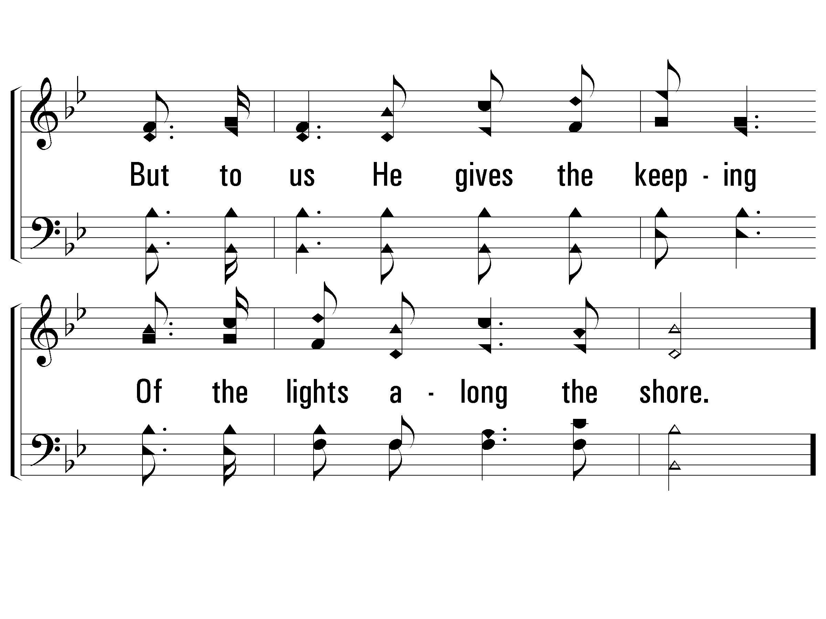
1 – Let the Lower Lights Be Burning
397
© 2003 The Paperless Hymnal™

Slide 32
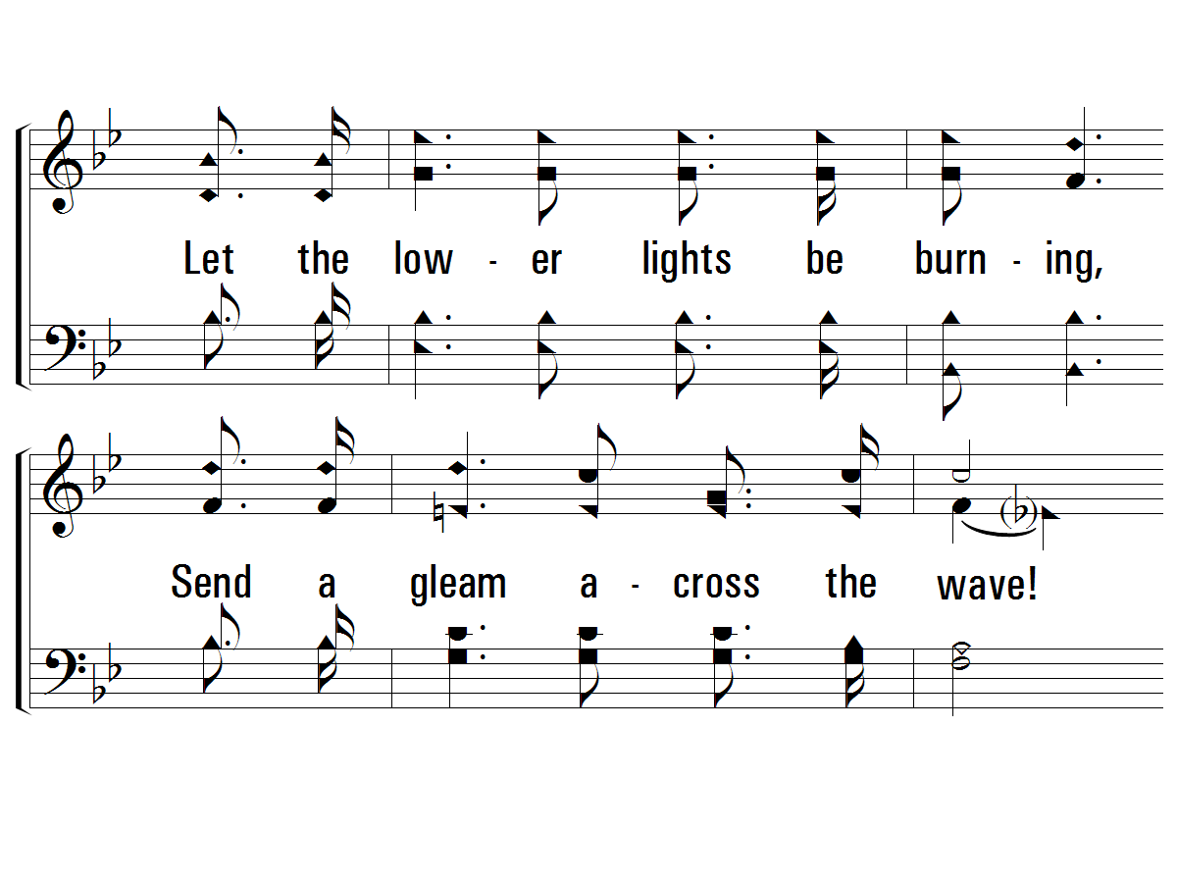
c – Let the Lower Lights Be Burning
397
Let the lower lights be burning,
Send a gleam across the wave!
Some poor fainting, struggling seaman
You may rescue, you may save.
© 2003 The Paperless Hymnal™

Slide 33
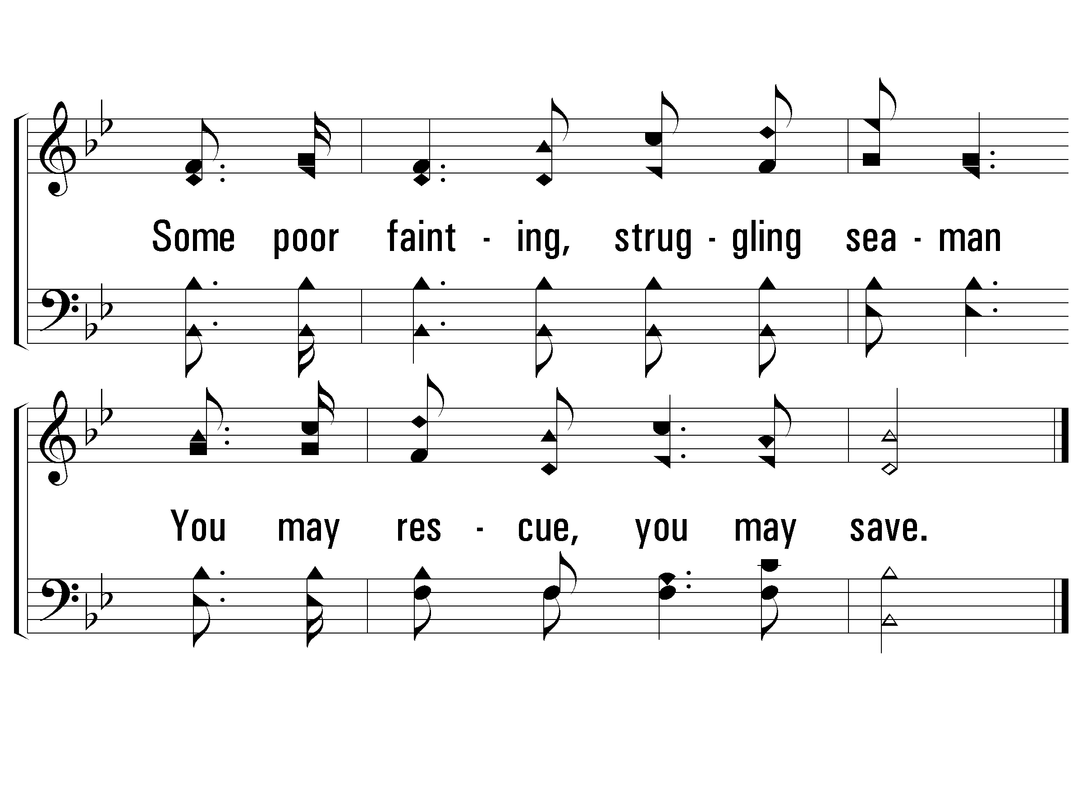
c – Let the Lower Lights Be Burning
397
© 2003 The Paperless Hymnal™

Slide 34
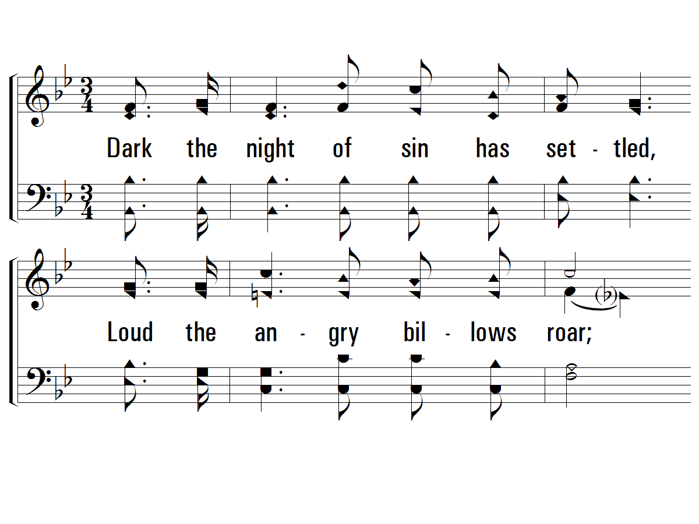
2 – Let the Lower Lights Be Burning
397
2.
Dark the night of sin has settled,
Loud the angry billows roar;
Eager eyes are watching, longing
For the lights along the shore.
Words & Music: Phillip P. Bliss
© 2003 The Paperless Hymnal™

Slide 35
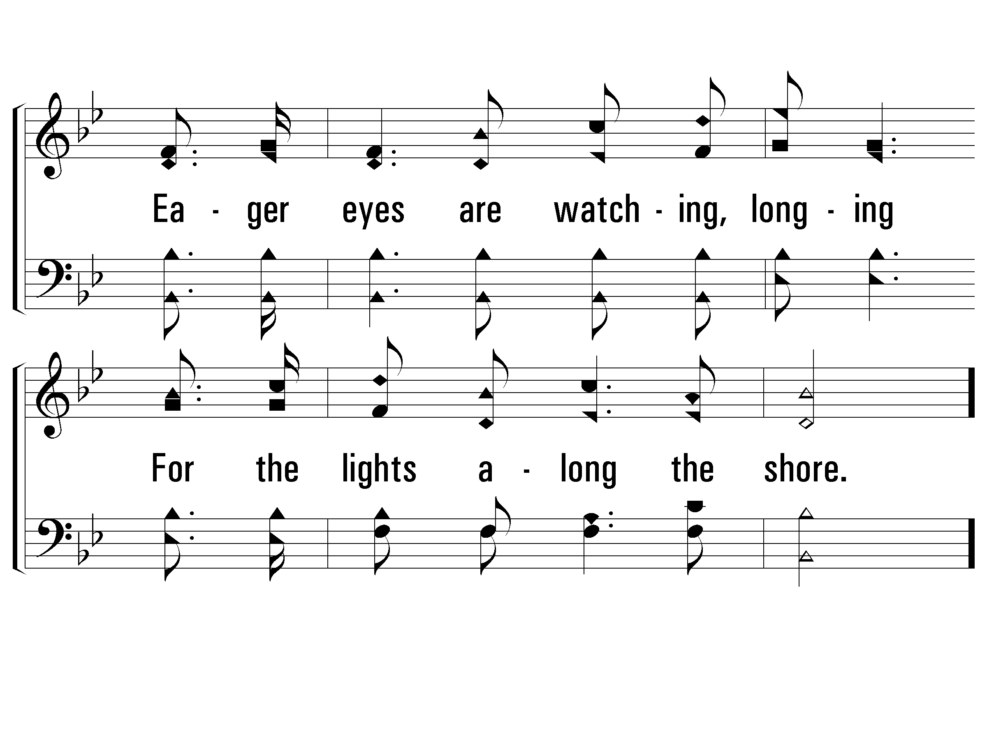
2 – Let the Lower Lights Be Burning
397
© 2003 The Paperless Hymnal™

Slide 36
c – Let the Lower Lights Be Burning
397
Let the lower lights be burning,
Send a gleam across the wave!
Some poor fainting, struggling seaman
You may rescue, you may save.
© 2003 The Paperless Hymnal™

Slide 37
c – Let the Lower Lights Be Burning
397
© 2003 The Paperless Hymnal™

Slide 38
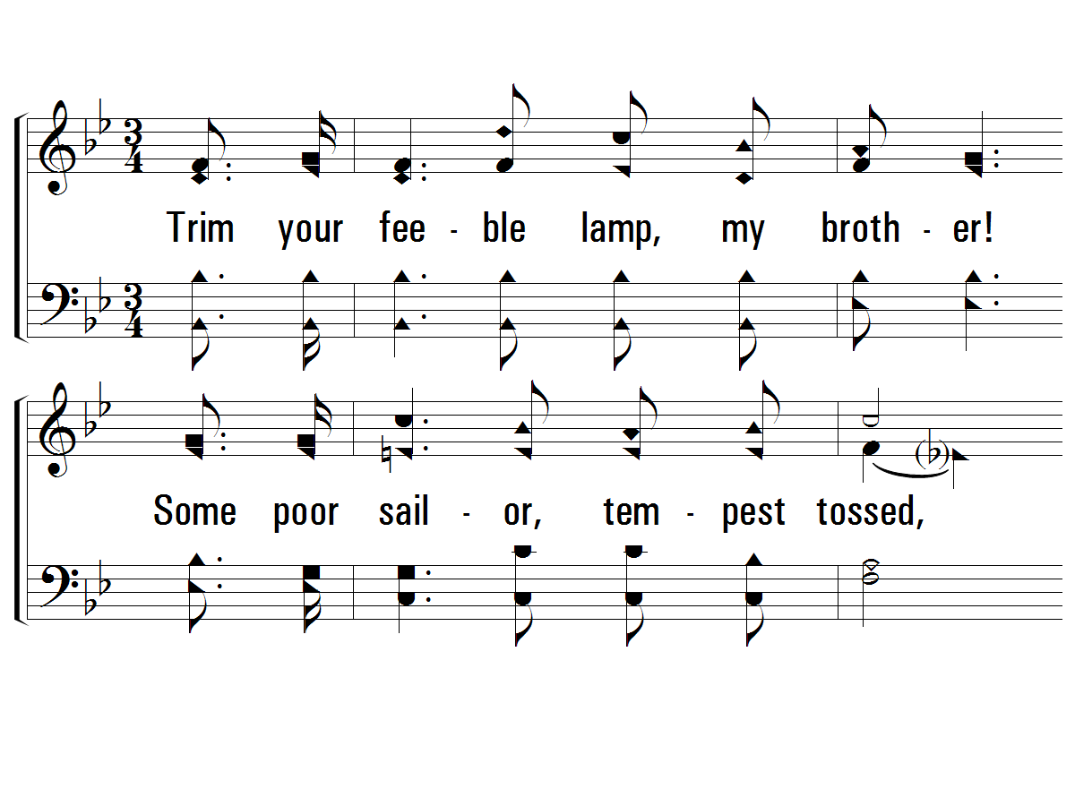
3 – Let the Lower Lights Be Burning
397
3.
Trim your feeble lamp, my brother!
Some poor sailor, tempest tossed,
Trying now to make the harbor,
In the darkness may be lost.
Words & Music: Phillip P. Bliss
© 2003 The Paperless Hymnal™

Slide 39
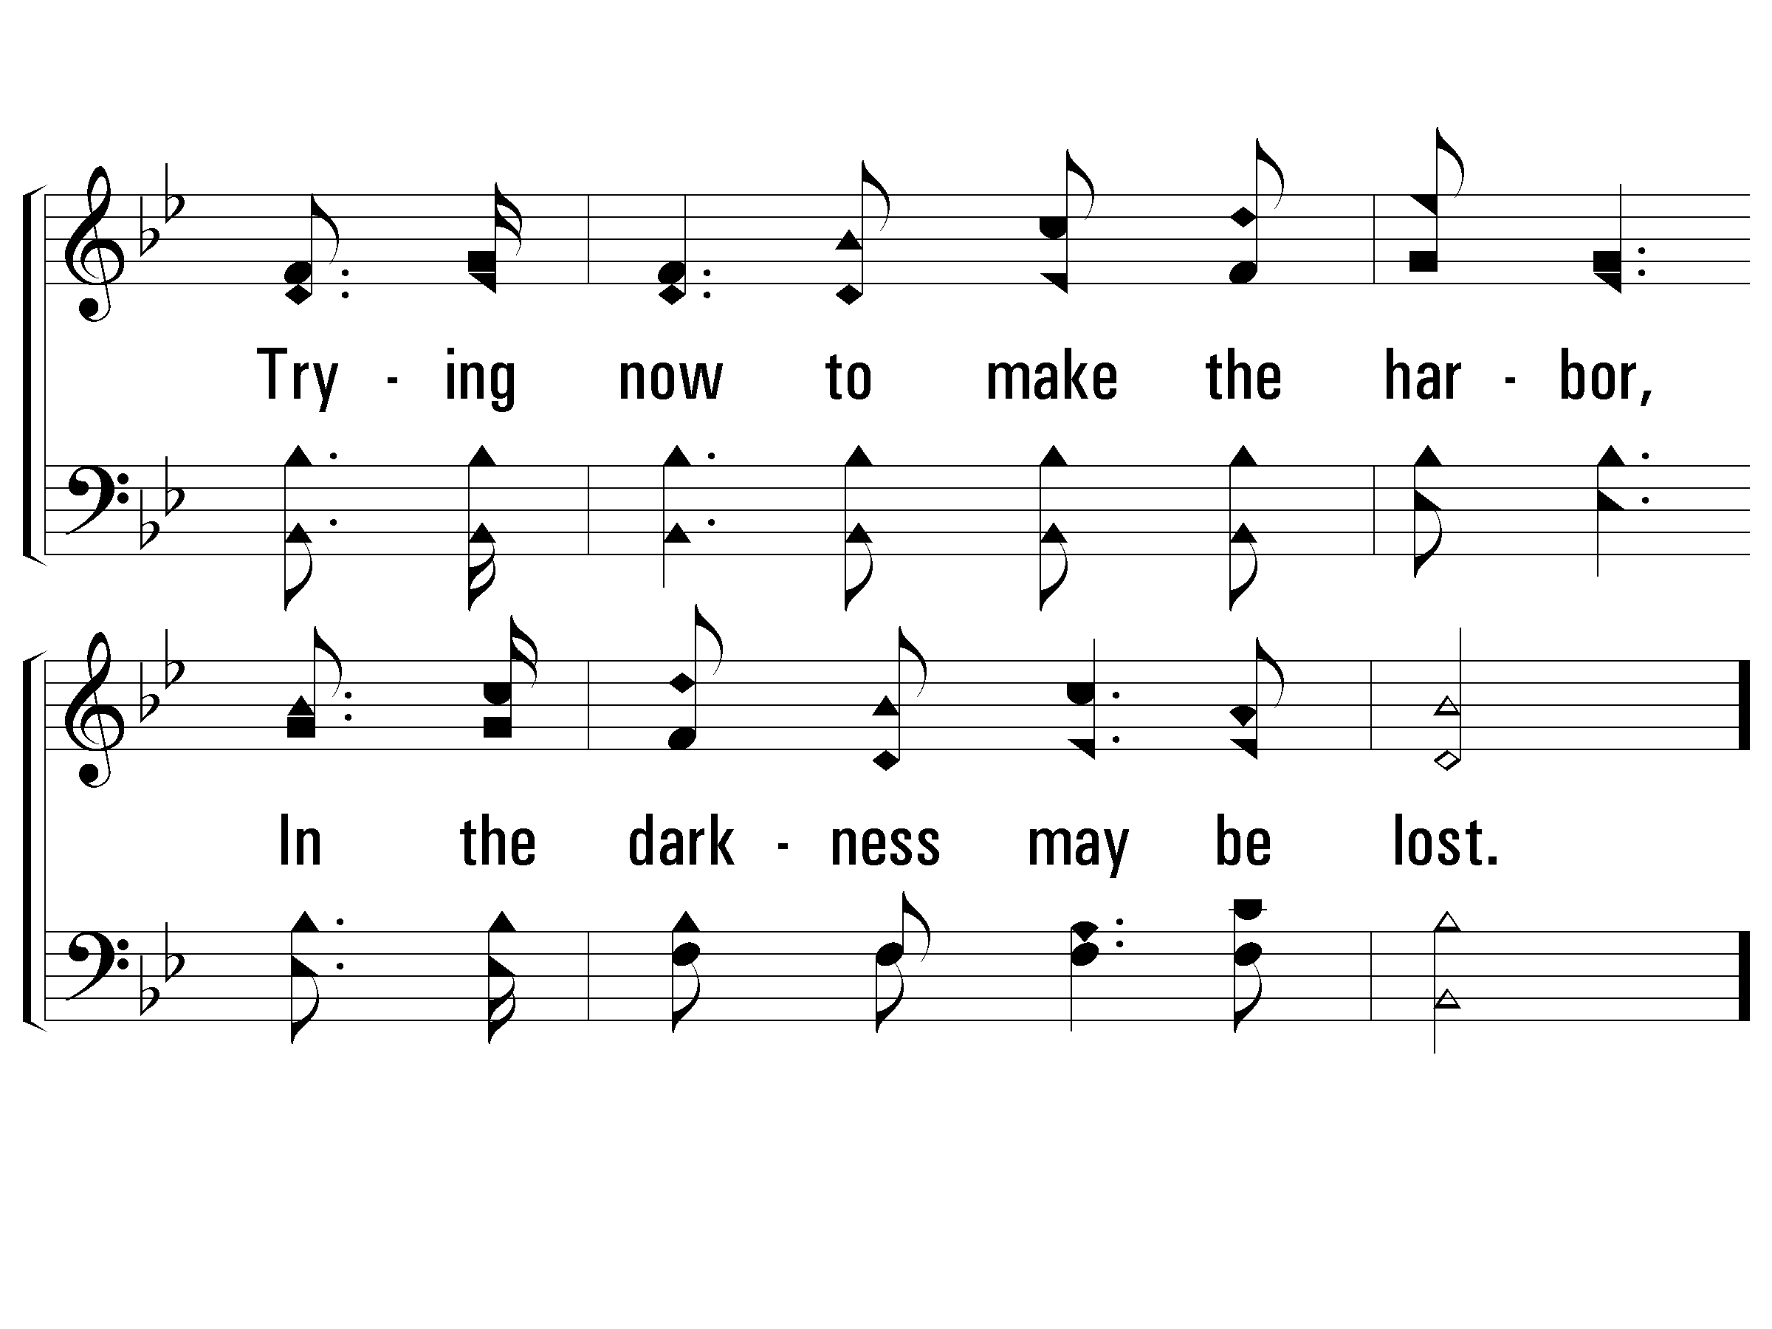
3 – Let the Lower Lights Be Burning
397
© 2003 The Paperless Hymnal™

Slide 40
c – Let the Lower Lights Be Burning
397
Let the lower lights be burning,
Send a gleam across the wave!
Some poor fainting, struggling seaman
You may rescue, you may save.
© 2003 The Paperless Hymnal™

Slide 41
c – Let the Lower Lights Be Burning
397
© 2003 The Paperless Hymnal™

Slide 42
Let the Lower Lights Be Burning
Notes:
Then Moody made his appeal to his audience: “Brothers, the Master will take care of the great lighthouse! Let us keep the lower lights burning!”
Among Moody’s hearers that evening was Mr. Philip P. Bliss, the well-known hymn writer, and the striking story at once suggested to him one of his most popular hymns:
Who are you?
We are the lower lights!

Slide 43
Don’t Let Satan Blow It Out!

Slide 44
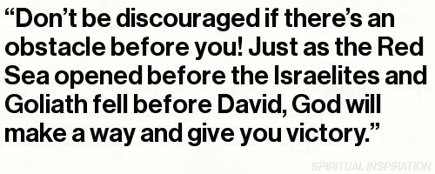

Slide 45
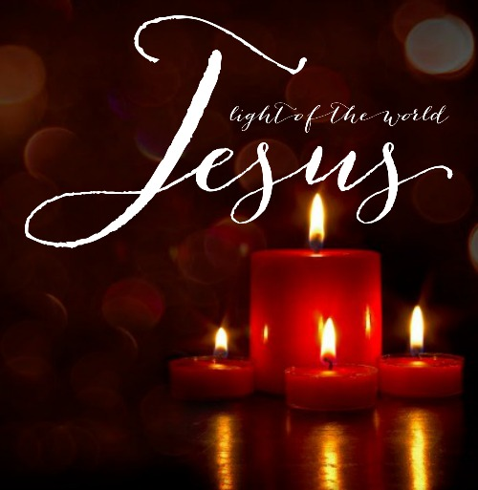
Notes:
The Source of our Light
John 8:12
I am the light of the world. He who follows Me shall not walk in darkness, but have the light of life.”

Slide 46
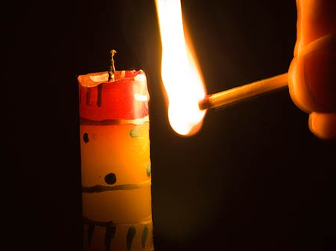
What Lights You?
Notes:
Too many people leave
Too many people quit
Too many people look elsewhere
We get out of something what we put into it!
Are we putting in truth--the fuel that never ends or are we looking for things of this life that is temporary to sustain our faith?

Slide 47
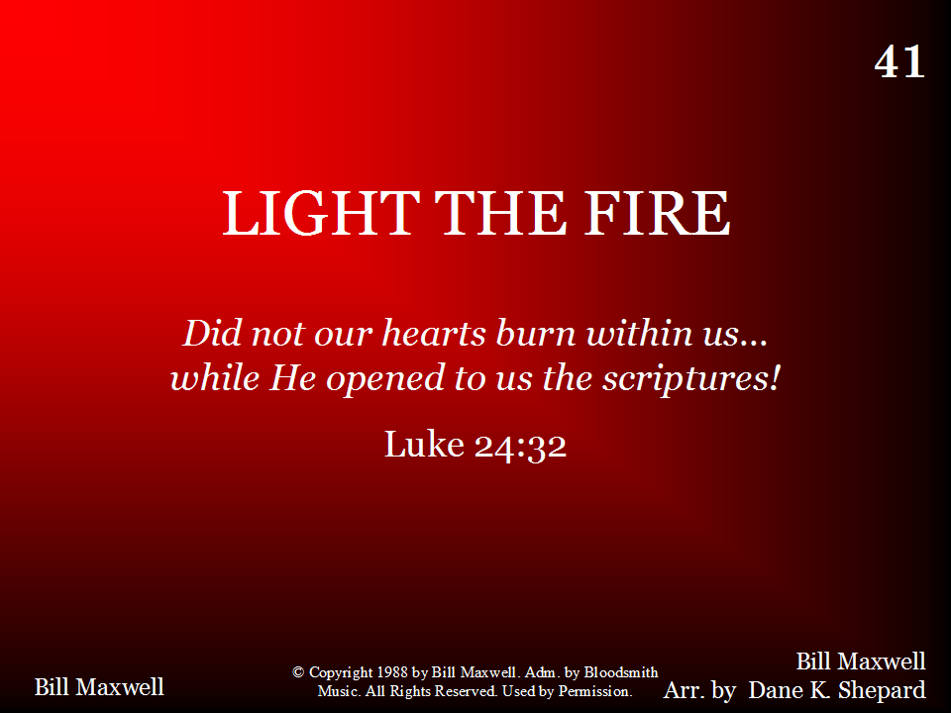
041 - Light The Fire - Title
Notes:
In Luke 24, we find the story concerning 2 of Jesus’ disciples as they appeared to them on the Road to Emmaus after His resurrection.
²⁷ And beginning at Moses and all the prophets, he expounded unto them in all the scriptures the things concerning himself.
²⁹ But they constrained him, saying, Abide with us: for it is toward evening, and the day is far spent. And he went in to tarry with them.
³⁰ And it came to pass, as he sat at meat with them, he took bread, and blessed it, and brake, and gave to them.
³¹ And their eyes were opened, and they knew him; and he vanished out of their sight.
³² And they said one to another, Did not our heart burn within us, while he talked with us by the way, and while he opened to us the scriptures?
The Scriptures point us to our light source—Jesus Christ.

Slide 48
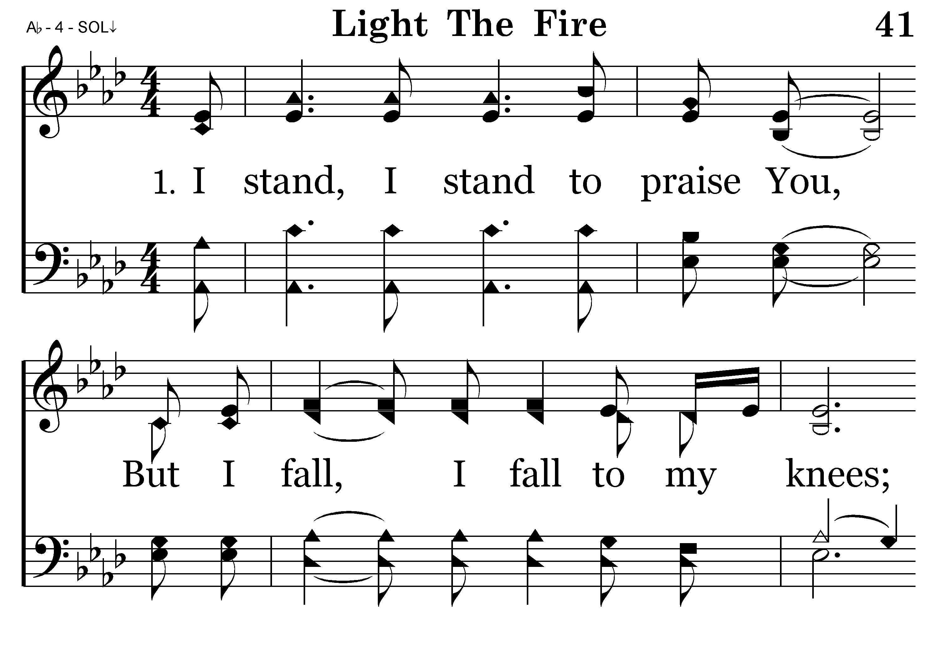
041 - Light The Fire - 1.1

Slide 49
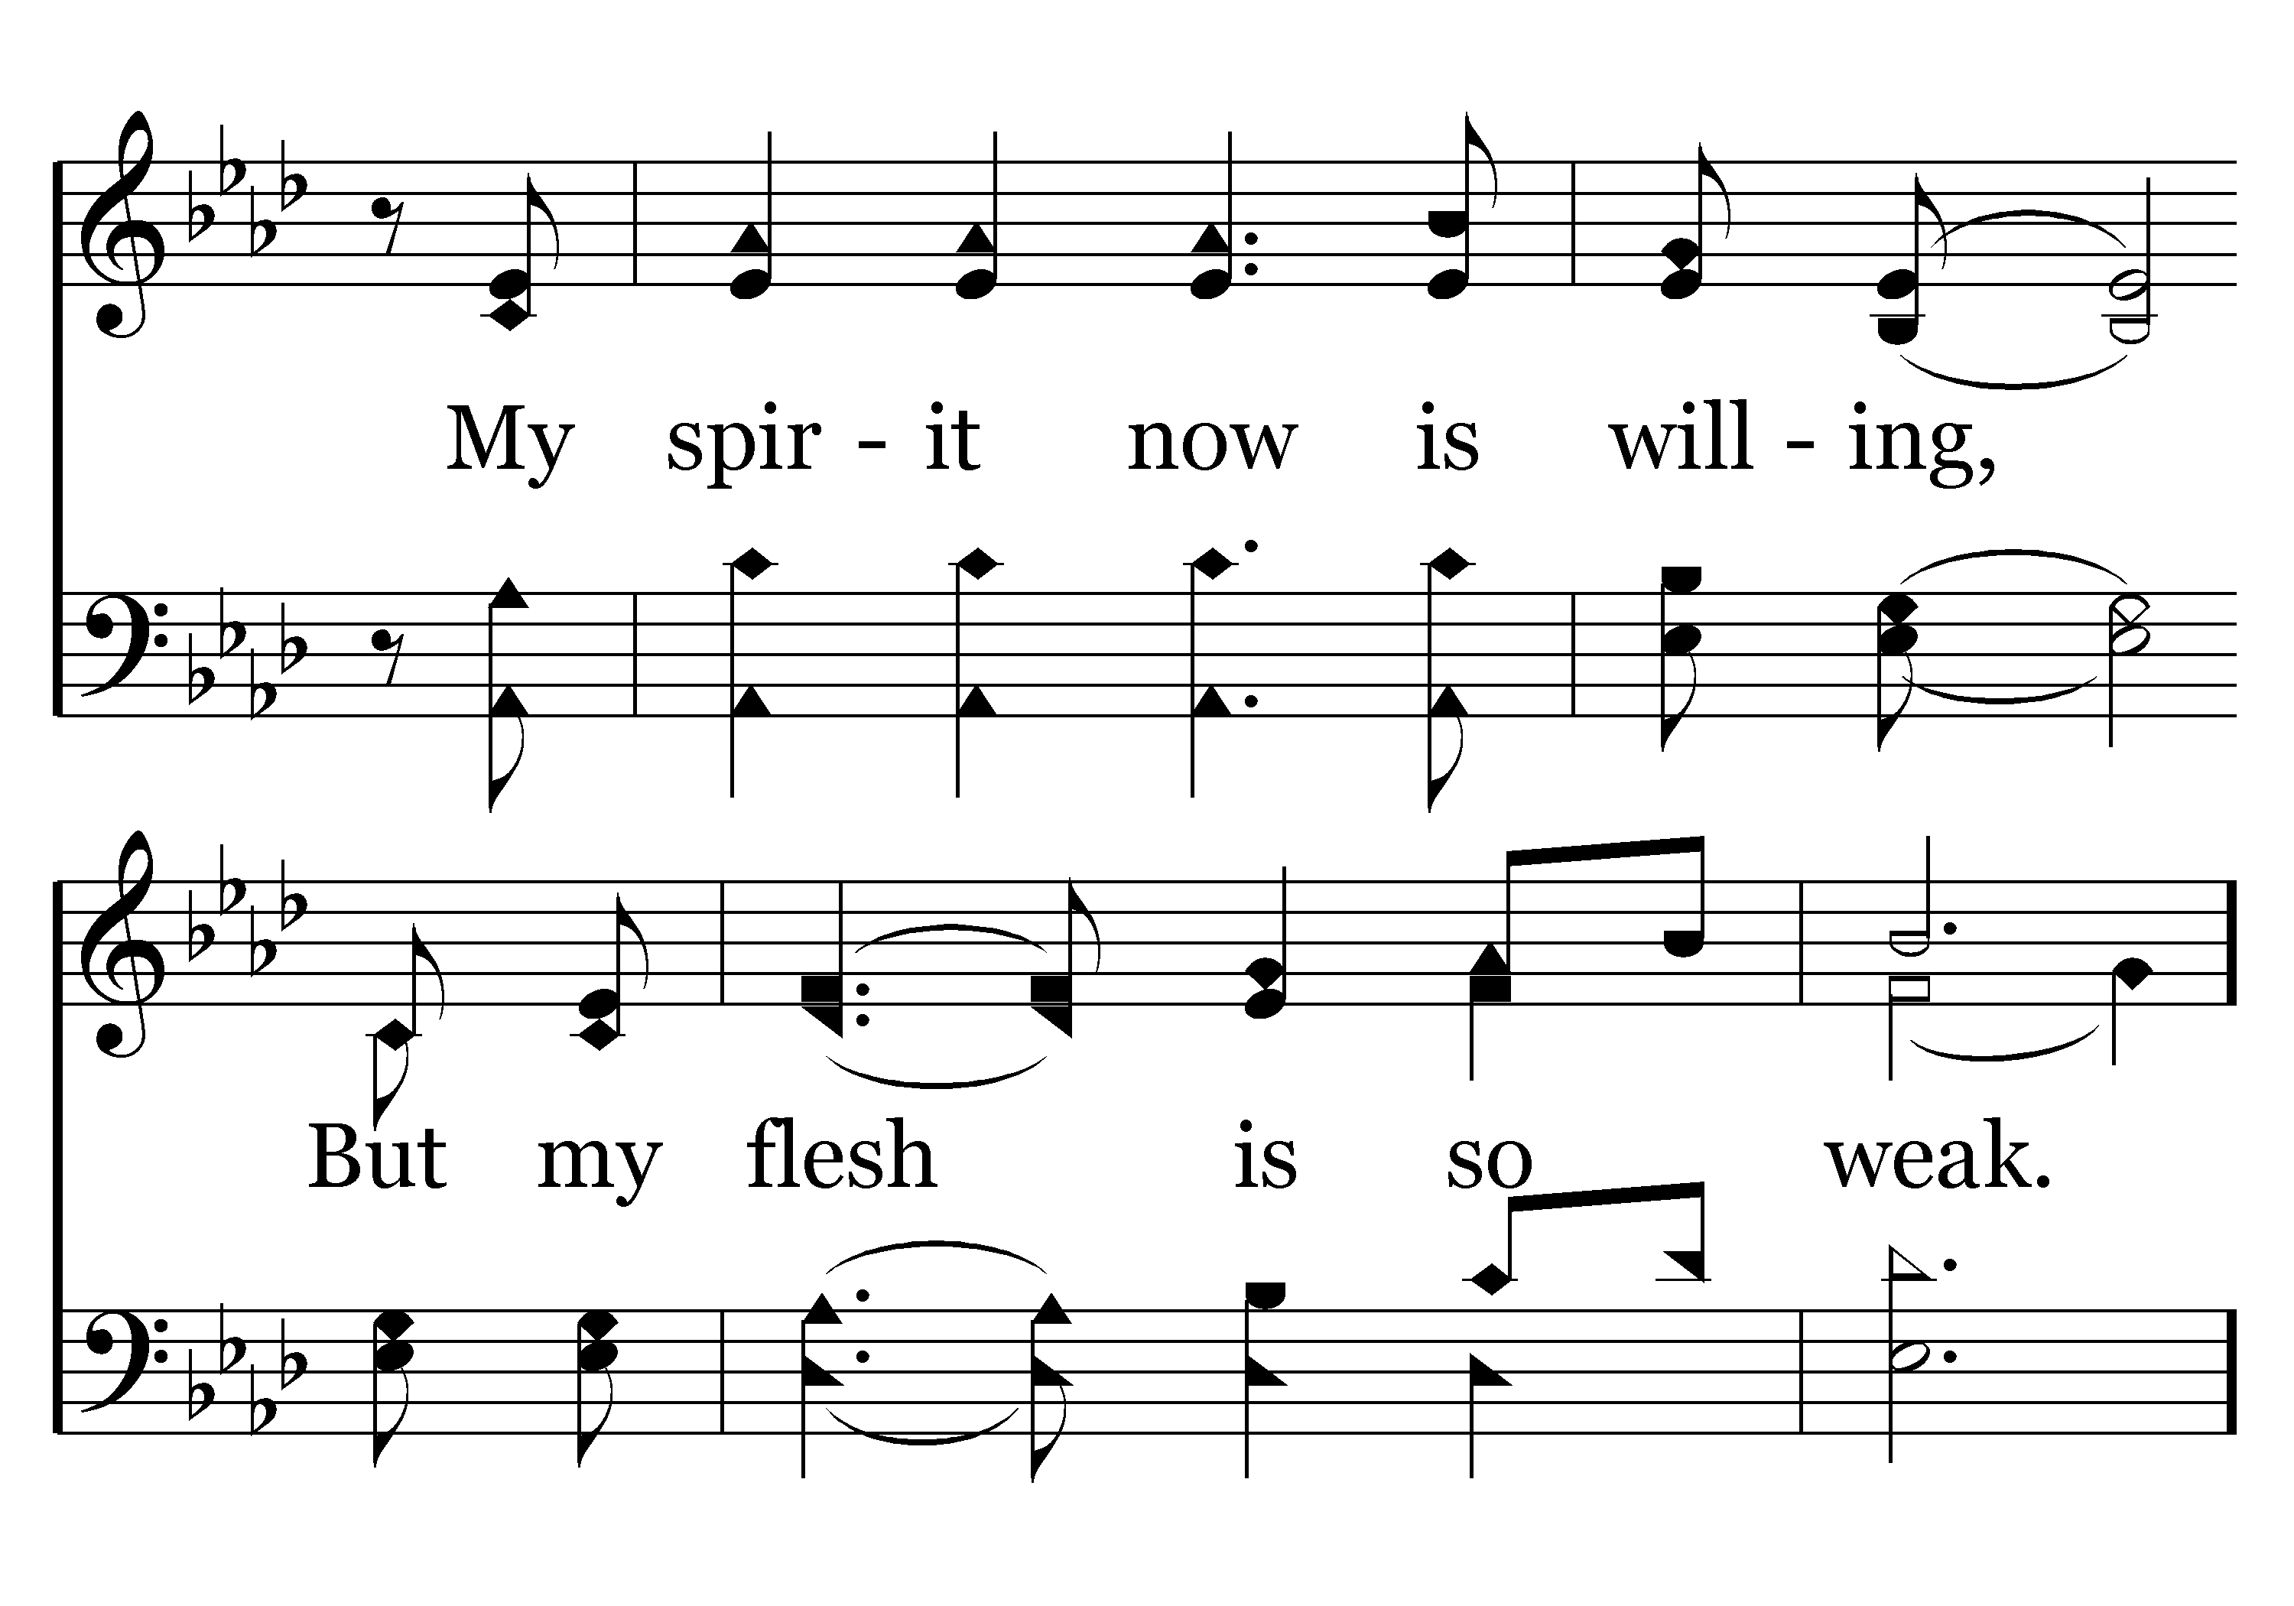
041 - Light The Fire - 1.2

Slide 50
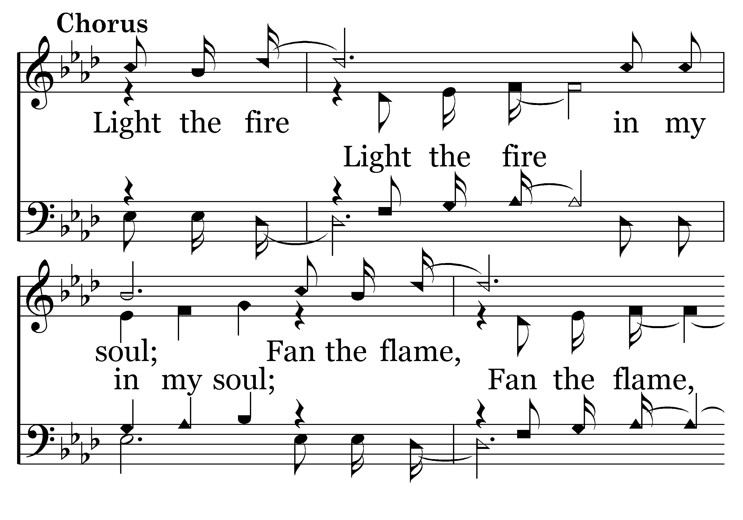
041 - Light The Fire - C.1

Slide 51
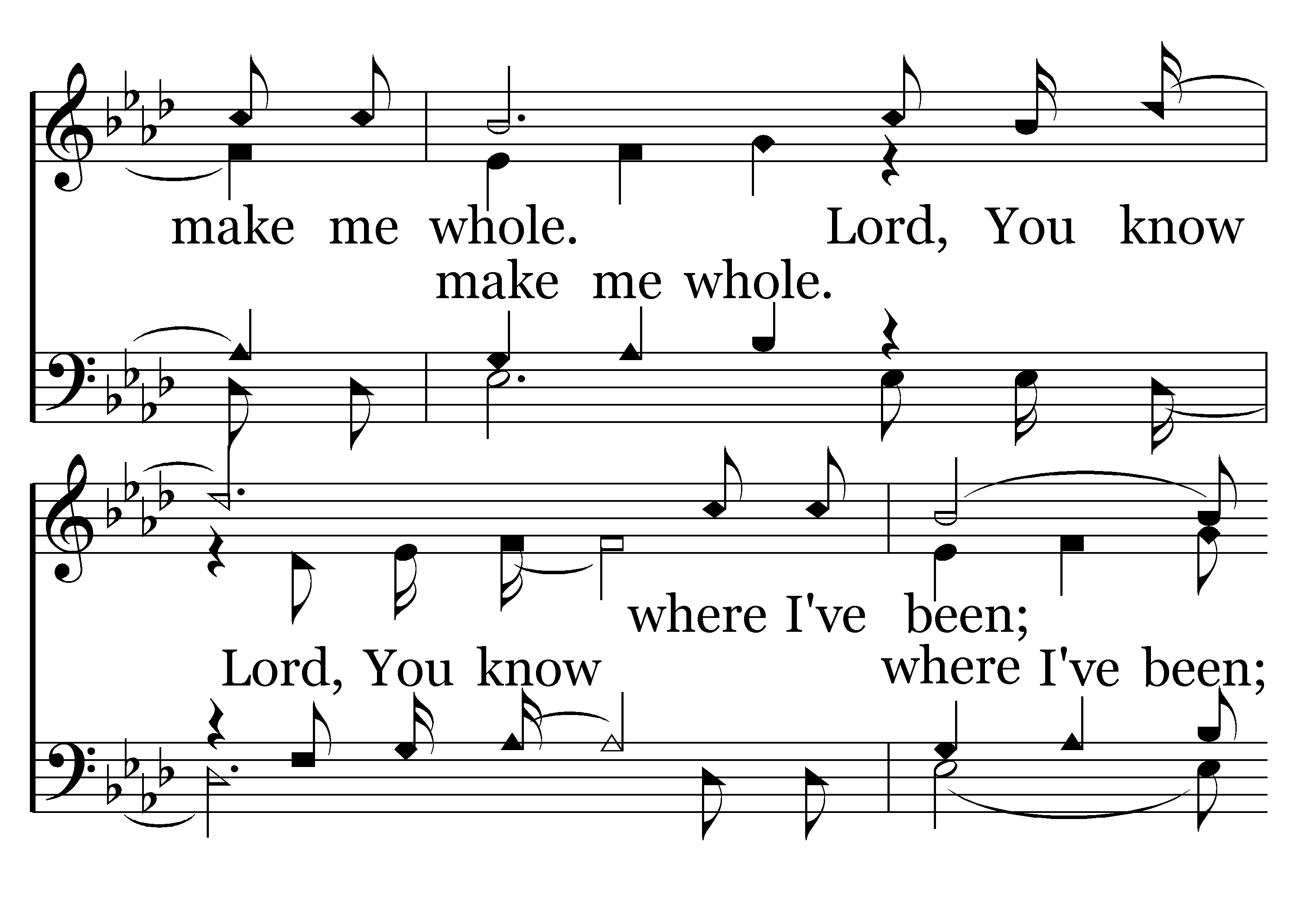
041 - Light The Fire - C.2

Slide 52
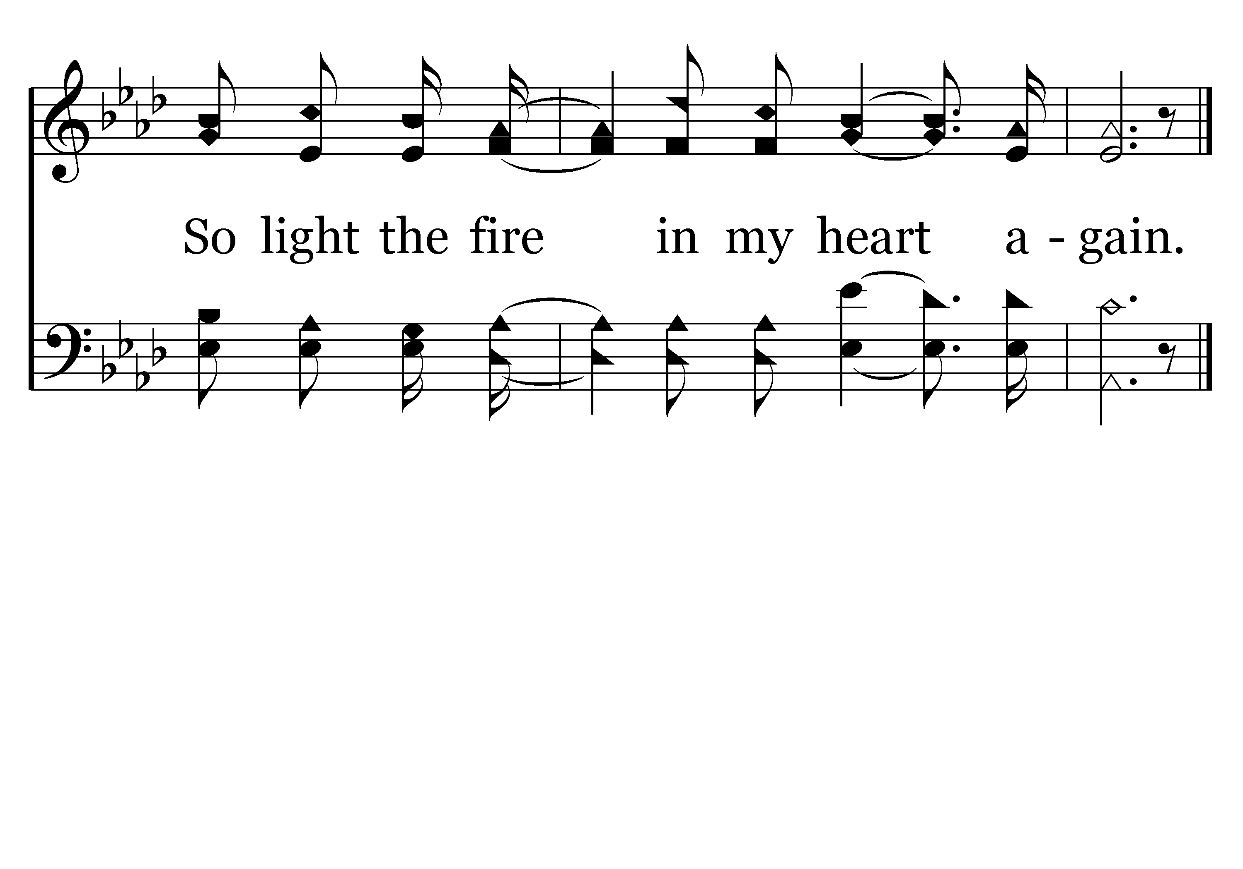
041 - Light The Fire - C.3
End of Verse 1

Slide 53
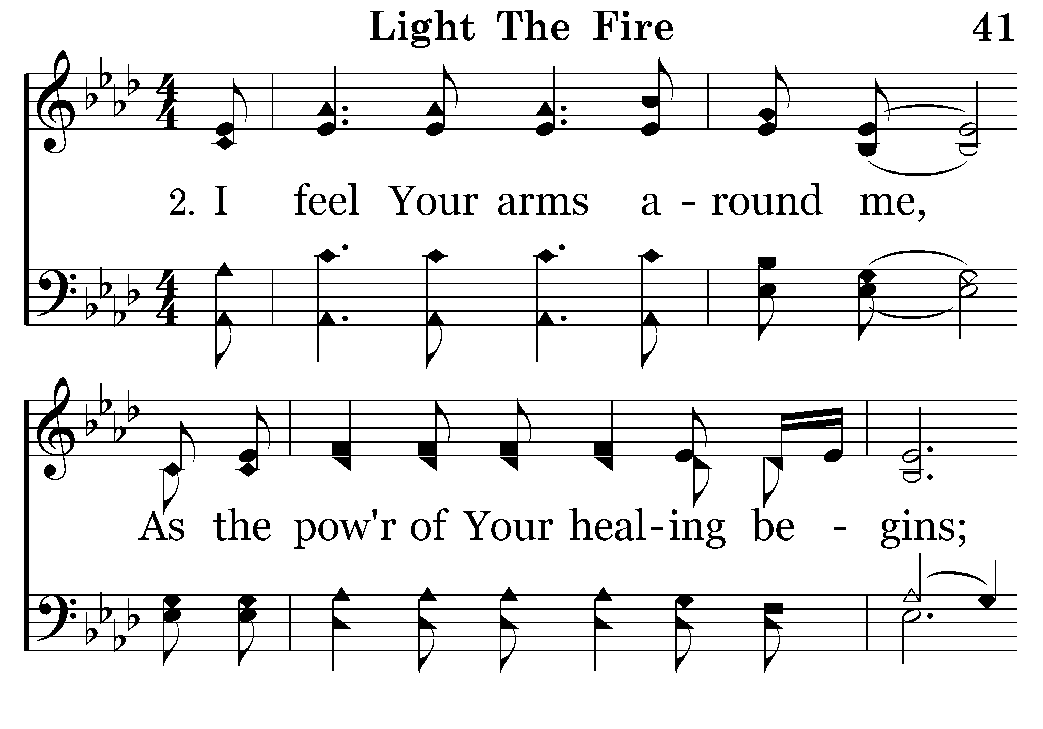
041 - Light The Fire - 2.1

Slide 54
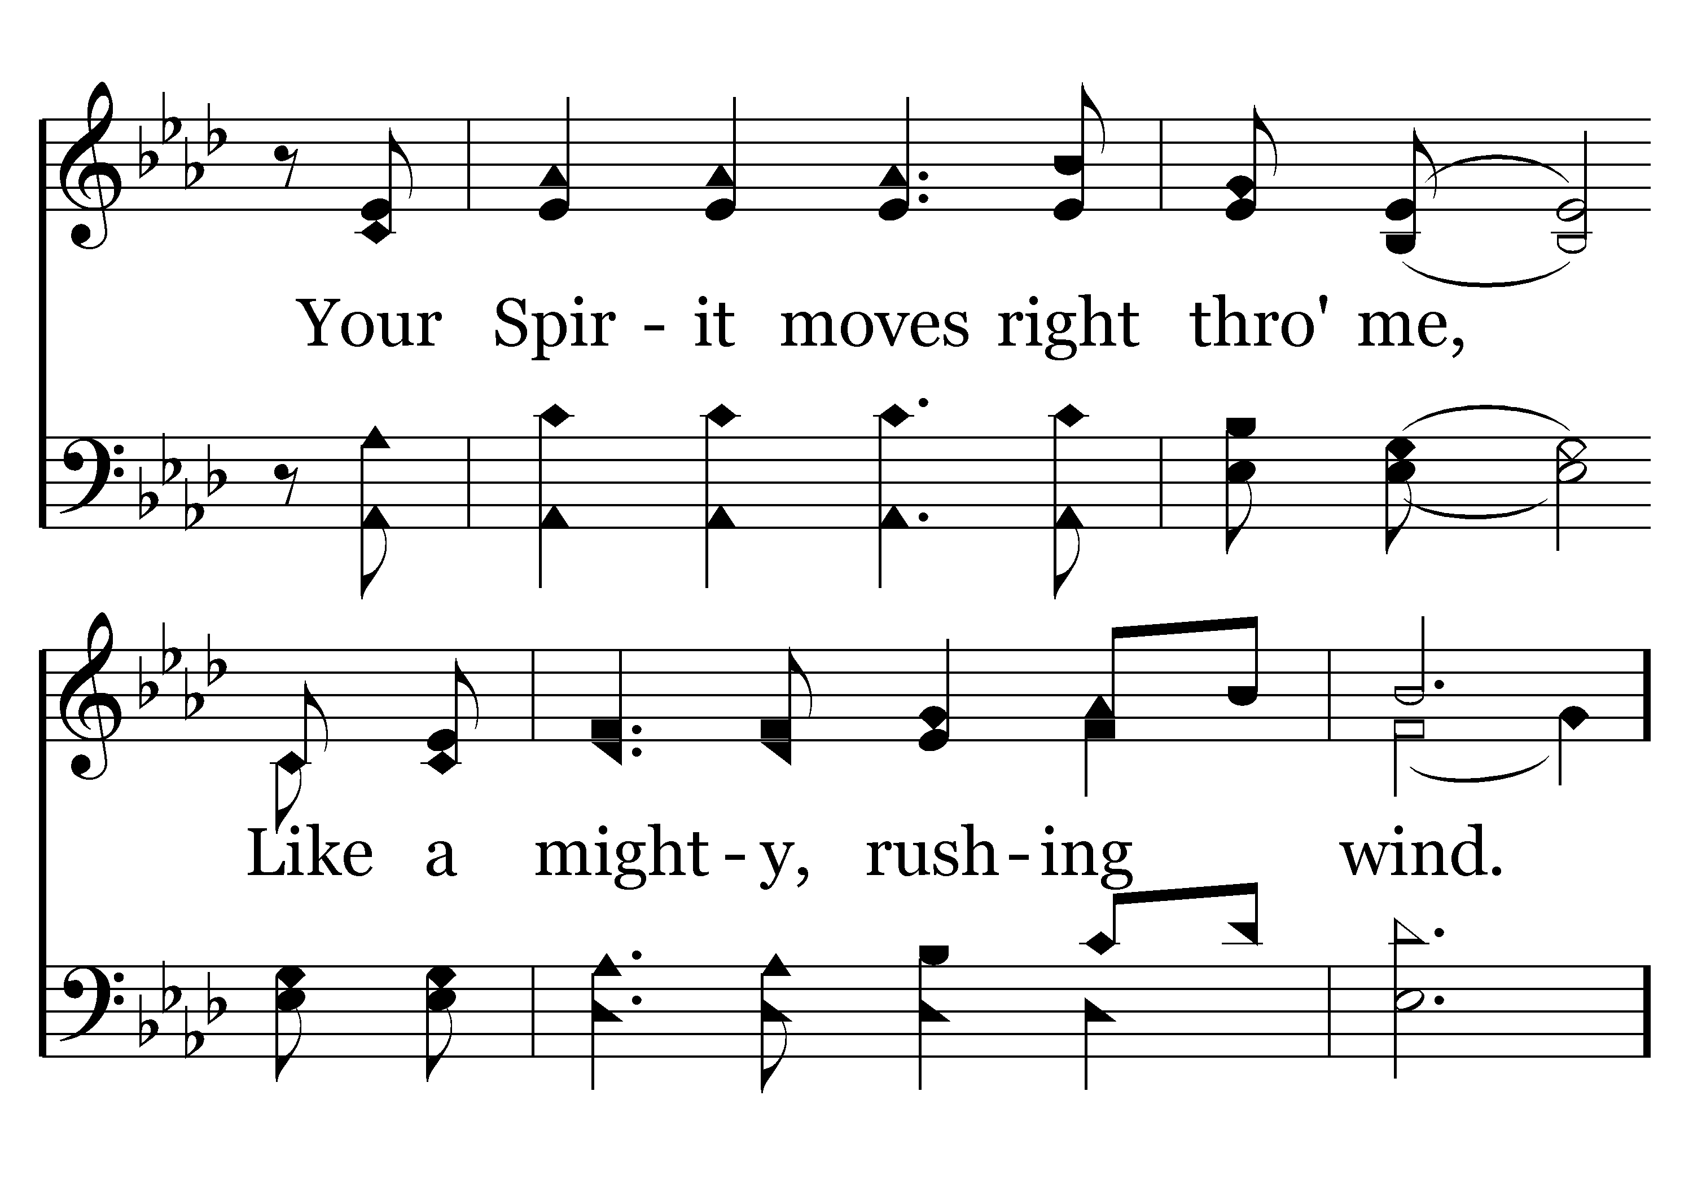
041 - Light The Fire - 2.2

Slide 55
041 - Light The Fire - C.1

Slide 56
041 - Light The Fire - C.2

Slide 57
041 - Light The Fire - C.3
End of Song

Slide 58
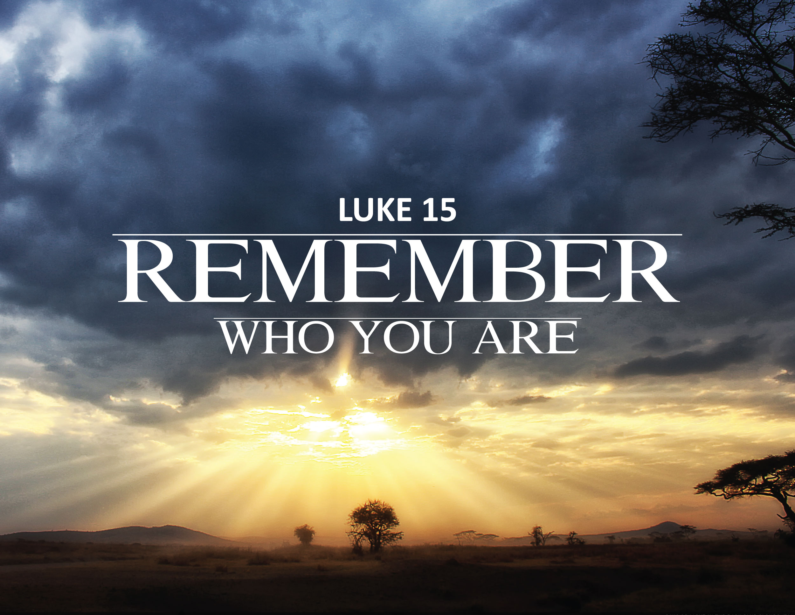
Notes:
Tonight I hope you Remember Who You Are.
In John 6, when the crowds began to leave because they didn’t like what Jesus was saying--they weren’t receiving what they wanted.
Jesus asked his apostles, Will ye also go away? In John 6:68, Peter answered “Lord, to whom shall we go? Thou has the words of eternal life.
Remember who you are!
Remember you are the sons of God!
Remember you are the light of the world!
Remember you are the lower lights!
Remember the source of your light!

Slide 59
The Light of the World
Sons of God
Lower Lights
Source of Light is Jesus!

Slide 60
Notes:
Are you a child of Jesus? Have you obeyed the Gospel of Christ? Have you had your sins washed away?
If not, do so tonight!
If you are a child of Jesus and have forgotten who you are or have forgotten whom you serve, make the necessary corrections tonight.
Come as we stand and sing.

