Slide 1

Neither is there salvation in any other: for there is none other name under Heaven,given among men whereby
We must be saved. Acts 4:12\

Slide 2
^{Acts 4:8-13} Then Peter, filled with the Holy Ghost, said unto them, Ye rulers of the people, and elders of Israel,⁹ If we this day be examined of the good deed done to the impotent man, by what means he is made whole;¹⁰ Be it known unto you all, and to all the people of Israel, that by the name of Jesus Christ of Nazareth, whom ye crucified, whom God raised from the dead, even by him doth this man stand here before you whole. 11 This is the stone which was set at nought of you builders, which is become the head of the corner.¹² Neither is there salvation in any other: for there is none other name under heaven given among men, whereby we must be saved.¹³ Now when they saw the boldness of Peter and John, and perceived that they were unlearned and ignorant men, they marvelled; and they took knowledge of them, that they had been with Jesus.

Slide 3
Acts 4:8-13
“There is salvation in no one else, for there is no other name under heaven given among mortals by which we must be saved.”
Peter is not only saying that Jesus saves but he is saying clearly
that only Jesus saves.

Slide 4
The single most important topic known to mankind.
Man’s Salvation
In our lesson today, we want
To examine what the Bible says about
Salvation:
What It Is And Why We Need It!

Slide 5
Back to the Bible where we find
The Pattern
1) The Purpose of Salvation
2) The Place of Salvation
3) The Plan of Salvation

Slide 6
We are interested today in each one of us being
Able to understand
1. Why Salvation is necessary: The Purpose of Salvation
2. Where Salvation is located: The Place of Salvation
3. How to Obtain Salvation: The Plan of Salvation

Slide 7
#1 The Purpose of Salvation
To Redeem Man To God
1. Sin entered into the world . Gen. 2:16-17
Gen. 2:16-17 “And the LORD God commanded the man, saying, Of every tree of the garden thou mayest freely eat: But of the tree of the knowledge of good and evil, thou shalt not eat of it: for in the day that thou eatest thereof thou shalt surely die.”

Slide 8
2. Sin separates man from God. Isa. 59:1-2
Isaiah 59:1-2 “Behold, the LORD’S hand is not shortened, that it cannot save; neither his ear heavy, that it cannot hear: But your iniquities have separated between you and your God, and your sins have hid his face from you, that he will not hear.”

Slide 9
3. All have sinned. Rom. 3:23; I John 1:8-10
4. All of us who have sinned are deserving of death.
Rom. 6:23; James 1:15
We sinners NEED Redemption.
..Rom. 7:24 ““O wretched man that I am! Who shall deliver me from the body of this death?”
We cannot find Redemption through:
a) Riches. Psalm 49:6,7 “They that trust in their wealth, and boast themselves in the multitude of their riches; none of them can by any means redeem his brother, nor give to God a ransom for him.”

Slide 10
b. We cannot find redemption through the blood
Of animal sacrifices. Heb. 10:4 “For it is not possible that the blood of bulls and of goats should take away sins.”
c. We cannot find Redemption through our own works.
Eph. 2:9 “Not of works, lest any man should boast.”
d. We cannot find Redemption through man’s works, or
Invention or man’s devising. Jerm. 10:23 “O LORD, I know that the way of man is not in himself: it is not in man that walketh to direct his steps.”

Slide 11
It is Jesus Christ who came to REDEEM man. He was willing
To be made a blood sacrifice of himself for our Redemption.
1. The Place of the Redeemed. In Christ. Rom. 3:24
“Being justified freely by his grace through the redemption that is in Christ Jesus:” –
2. The People who are Redeemed. Titus 2:14 “Who gave himself for us, that he might redeem us from all iniquity, and purify unto himself a peculiar people, zealous of good works.”
3. The Propitiation for the Redeemed. Heb. 9:12 “Neither by the blood of goats and calves, but by his own blood he entered in once into the holy place, having obtained eternal redemption for us.”

Slide 12
4. The Price of our Redemption. I Pet. 1:18 “Forasmuch as ye know that ye were not redeemed with corruptible things, as silver and gold, from your vain conversation received by tradition from your fathers; But with the precious blood of Christ, as of a lamb without blemish and without spot:”
The PURPOSE OF SALVATION: To bring about the
Reconcilation between God and Man through Jesus
Christ our Lord

Slide 13
THE PLACE OF SALVATION
Salvation is only in the name of Christ. Acts 4:12
cf. Acts 4:6
We are saved by Him. He has all authority. Matt. 28:18
John 14:6
When one is saved, one is “in Christ”

Slide 14
#2 The Place of Our Salvation
Salvation is ONLY IN THE NAME OF JESUS CHRIST.
Acts 4:12 Neither is there salvation in any other: for
There is none other name under Heaven given among
Men, whereby we must be saved.”

Slide 15
1. There is no condemnation for those in Christ.
1. Rom. 8:1 There is therefore now no condemnation to them which are in Christ Jesus, who walk not after the flesh, but after the Spirit.
2. Redemption is in Christ. Rom. 3:24 ²⁴ Being justified freely by his grace through the redemption that is in Christ Jesus:
3. The Love of God is in Christ. Rom. 8:39 ³⁹ Nor height, nor depth, nor any other creature, shall be able to separate us from the love of God, which is in Christ Jesus our Lord.
4. The one body is in Christ. Rom. 12:5 ⁵ So we, being many, are one body in Christ, and every one members one of another.

Slide 16
5. Sanctification and sainthood are in Christ. I Cor. 1:2² Unto the church of God which is at Corinth, to them that are sanctified in Christ Jesus, called to be saints, with all that in every place call upon the name of Jesus Christ our Lord, both their's and our's:
6. We always triumph in Christ. 2 Cor. 2:14 “Now thanks be unto God, which always causeth us to triumph in Christ,”
7. We are new creatures in Christ. 2 Cor. 5:17 2 Corinthians 5:17 “Therefore if any man be in Christ, he is a new creature: old things are passed away; behold, all things are become new.”
8. Reconciliation with God is in Christ. 2 Cor. 5:19 To
Wit ,that God was in Christ, reconciling the world unto himself,
Not imputing their trespasses unto them; and hath commited
Unto us the word of reconciliation

Slide 17
9. Christian liberty is in Christ. Gal. 2:4⁴ And that because of false brethren unawares brought in, who came in privily to spy out our liberty which we have in Christ Jesus, that they might bring us into bondage:
10.God’s power is in Christ. Eph. 1:19-20 ¹⁹ And what is the exceeding greatness of his power to us-ward who believe, according to the working of his mighty power,²⁰ Which he wrought in Christ, when he raised him from the dead, and set him at his own right hand in the heavenly places
11.God’s eternal purpose is made known in Christ. Eh. 3:11 ¹¹ According to the eternal purpose which he purposed in Christ Jesus our Lord:
12. Rejoicing is in Christ. Phil. 3:3 For we are the circumcision, which worship God in the spirit, and rejoice in Christ Jesus, and have no confidence in the flesh.

Slide 18
13. Grace is in Christ. 2 Tim. 2:1 Thou therefore, my son, be strong in the grace that is in Christ Jesus
14. Salvation is in Christ. 2 Tim. 2:10 Therefore I endure all things for the elect's sakes, that they may also obtain the salvation which is in Christ Jesus with eternal glory.
15. All spiritual blessings are in Christ. Eph. 1:3 ³ Blessed be the God and Father of our Lord Jesus Christ, who hath blessed us with all spiritual blessings in heavenly places in Christ:

Slide 19
When you are in Christ, you are in the one body,
The church.
1. Rom. 12:5 ⁵ So we, being many, are one body in Christ, and every one members one of another
2. Eph. 1:22-23 ²² And hath put all things under his feet, and gave him to be the head over all things to the church,
²³ Which is his body, the fulness of him that filleth all in all.
3. Eph. 5:23 ²³ For the husband is the head of the wife, even as Christ is the head of the church: and he is the saviour of the body.

Slide 20
Col. 1:18 And he is the head of the body, the church: who is the beginning, the firstborn from the dead; that in all things he might have the preeminence.
I Cor. 12:12 ¹² For as the body is one, and hath many members, and all the members of that one body, being many, are one body: so also is Christ
Acts 2:47 ⁴⁷ Praising God, and having favour with all the people. And the Lord added to the church daily such as should be saved.

Slide 21
The Purpose of Salvation
The Place of Salvation
And now….
The Plan of salvation.

Slide 22
#3 The Plan
of Salvation

Slide 23
What is God’s plan of salvation?

Slide 24
The Plan of Salvation.
Salvation is in Christ,
how does one
Get into Christ?.

Slide 25
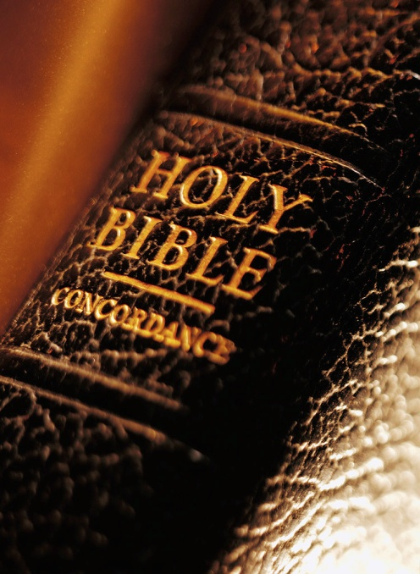
Hear
Notes:
Hear the Word of God

Slide 26
Romans 10:17
faith
So then _______ cometh by hearing, and _hearing by the word of God.

Slide 27
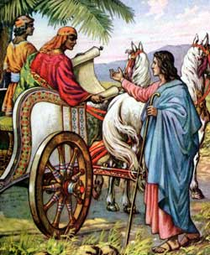
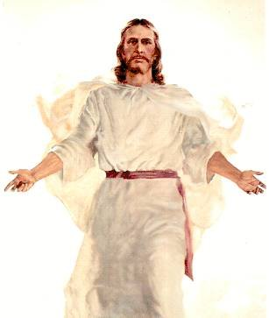
Believe
Notes:
Believe that Jesus is the Son of God.

Slide 28
John 8:24
believe
…. for if ye __________ not that I am he, ye shall ______ in your sins.
die

Slide 29

Repent
Notes:
Turn around our life. Change and follow after Jesus.

Slide 30
Acts 2:38
Then Peter said unto them, _______, and be baptized every one of you in the name of Jesus Christ for the ___________ of sins, and ye shall receive the gift of the Holy Ghost.
Repent
remission

Slide 31
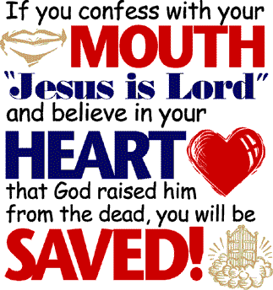
Confess

Slide 32
Matthew 10:32-33
³² Whosoever therefore shall confess me before men, him will I _________ also before my Father which is in heaven.
³³ But whosoever shall deny me before men, him will I also deny before my Father which is in heaven.
confess

Slide 33
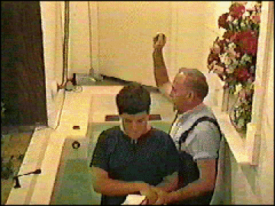
Be Baptized

Slide 34
Galatians 3:27
For as many of you as have been baptized
into Christ have put on Christ.

Slide 35

Remain Faithful

Slide 36
Revelation 2:10
….be thou________ unto death, and I will give thee a crown of life.
faithful

Slide 37
Are you Saved today?

Slide 38
Peter is not only saying that Jesus saves but he is saying clearly
that only Jesus saves. Acts 4:12

