Slide 1
The Cost of Sin

Slide 2

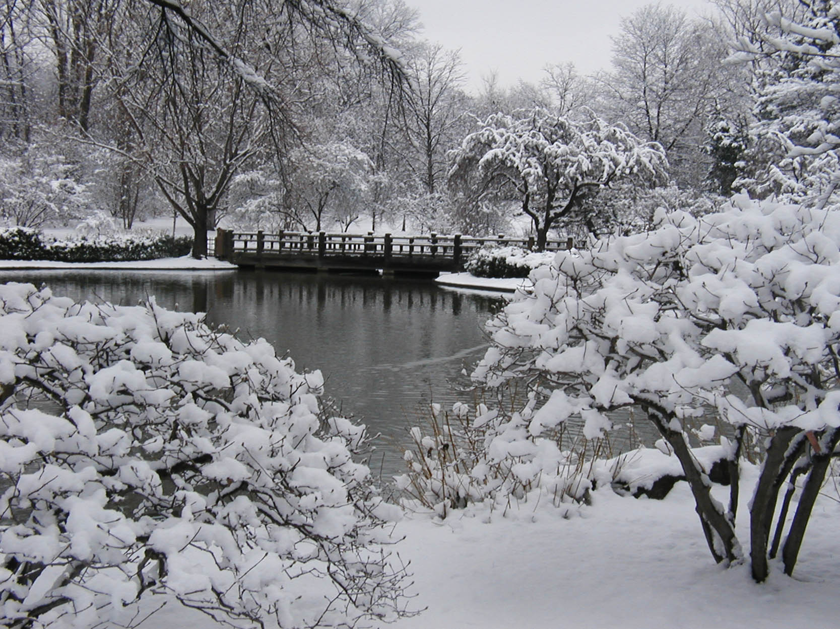

Slide 3
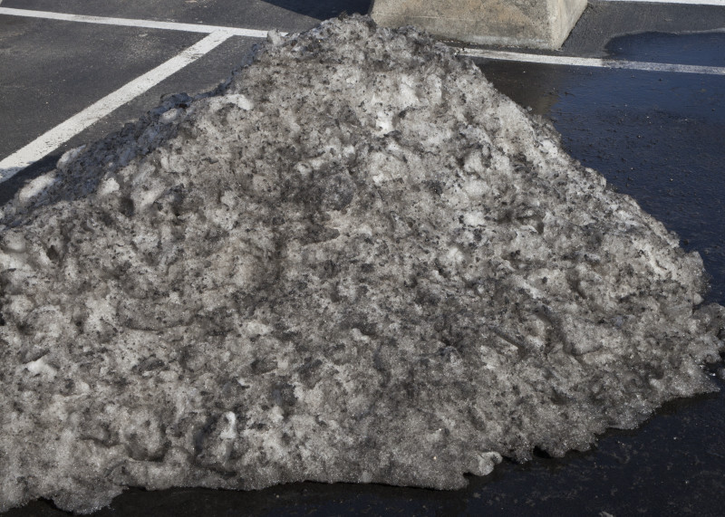


Slide 4
The First Sin
Adam and Eve
  Genesis 2:25
    “And they were both naked, the man and his wife, and were not ashamed.”
      Adam and Eve were not ashamed because they were innocent and free of sin, just like children
  Genesis 3:1-21
    6. “So when the woman saw that the tree was good for food, that it was pleasant to the eyes, and a tree desirable to make one wise, she took of its fruit and ate. She also gave to her husband with her, and he ate.
    7. Then the eyes of both of them were opened, and they knew that they were naked.”
After giving in to sin, Adam and Eve are no longer innocent

Slide 5
Other Examples of Sin
David and Bathsheba
  II Samuel 11:1-27
Judas
  Matthew 26:14-16; 47-56; 27:3-5
    14. “Then one of the twelve, called Judas Iscariot, went to the chief priests
    15. and said, ‘What are you willing to give me if I deliver Him to you?’ And they counted out to him thirty pieces of silver.
    16. So from that time he sought opportunity to betray Him.”
David and Judas had a choice to make, but gave in to sin

Slide 6
What are the Consequences of Sin?
Adam and Eve
  Banished from the garden
Judas
  Hung himself
Our possible consequences
  Lose family/friends
  Hurt others (emotionally and/or physically)
  Arrested
  Die
  Lose our soul

Slide 7
How to Beat Sin
Recognize sin
  2 Timothy 4:2b
Stay away from sin
  Matthew 5:29-30
  1 Corinthians 15:33
Build a strong foundation
  Matthew 7:24-27
  Luke 6:47-49
  Matthew 16:18
Live for Godly things, not worldly things
  Matthew 6:19-21 & 24
  1 Timothy 6:10

Slide 8
How to Beat Sin
Live by Jesus’ example
  Matthew 4:1-11; Luke 4:1-13
  Matthew 5:48
Be fearful of God
  Matthew 7:13-14
  Matthew 10:28
  Luke 13:22-30
  2 Corinthians 5:10

Slide 9
God’s Plan of Salvation
Hear
  Acts 18:8
Believe
  John 3:16; Mark 16:16; Acts 16:31
Confess
  Matthew 10:32-33; Romans 10:9-10
Repent
  Matthew 4:17; Acts 2:38; Luke 13:3; Acts 8:22
Be Baptized
  Mark 16:14-20; John 3:3, 5-8; Romans 6:4; I Peter 3:21; Acts 2:38
Live a Faithful Life
  Revelation 2:10

