Slide 1


Slide 2
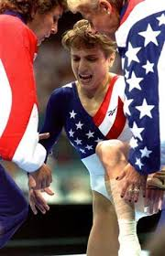
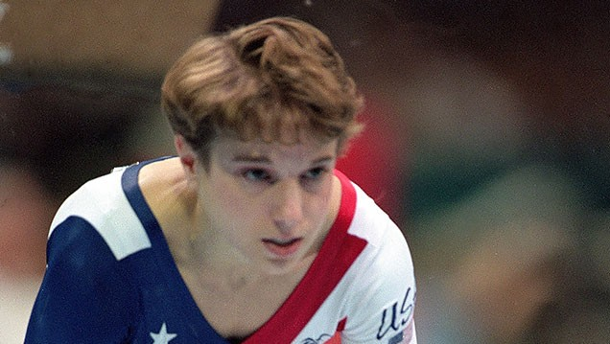
Atlanta 1996: The Magnificent Seven

Slide 3
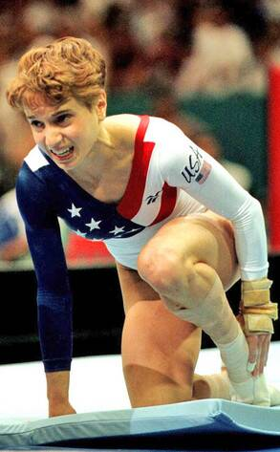
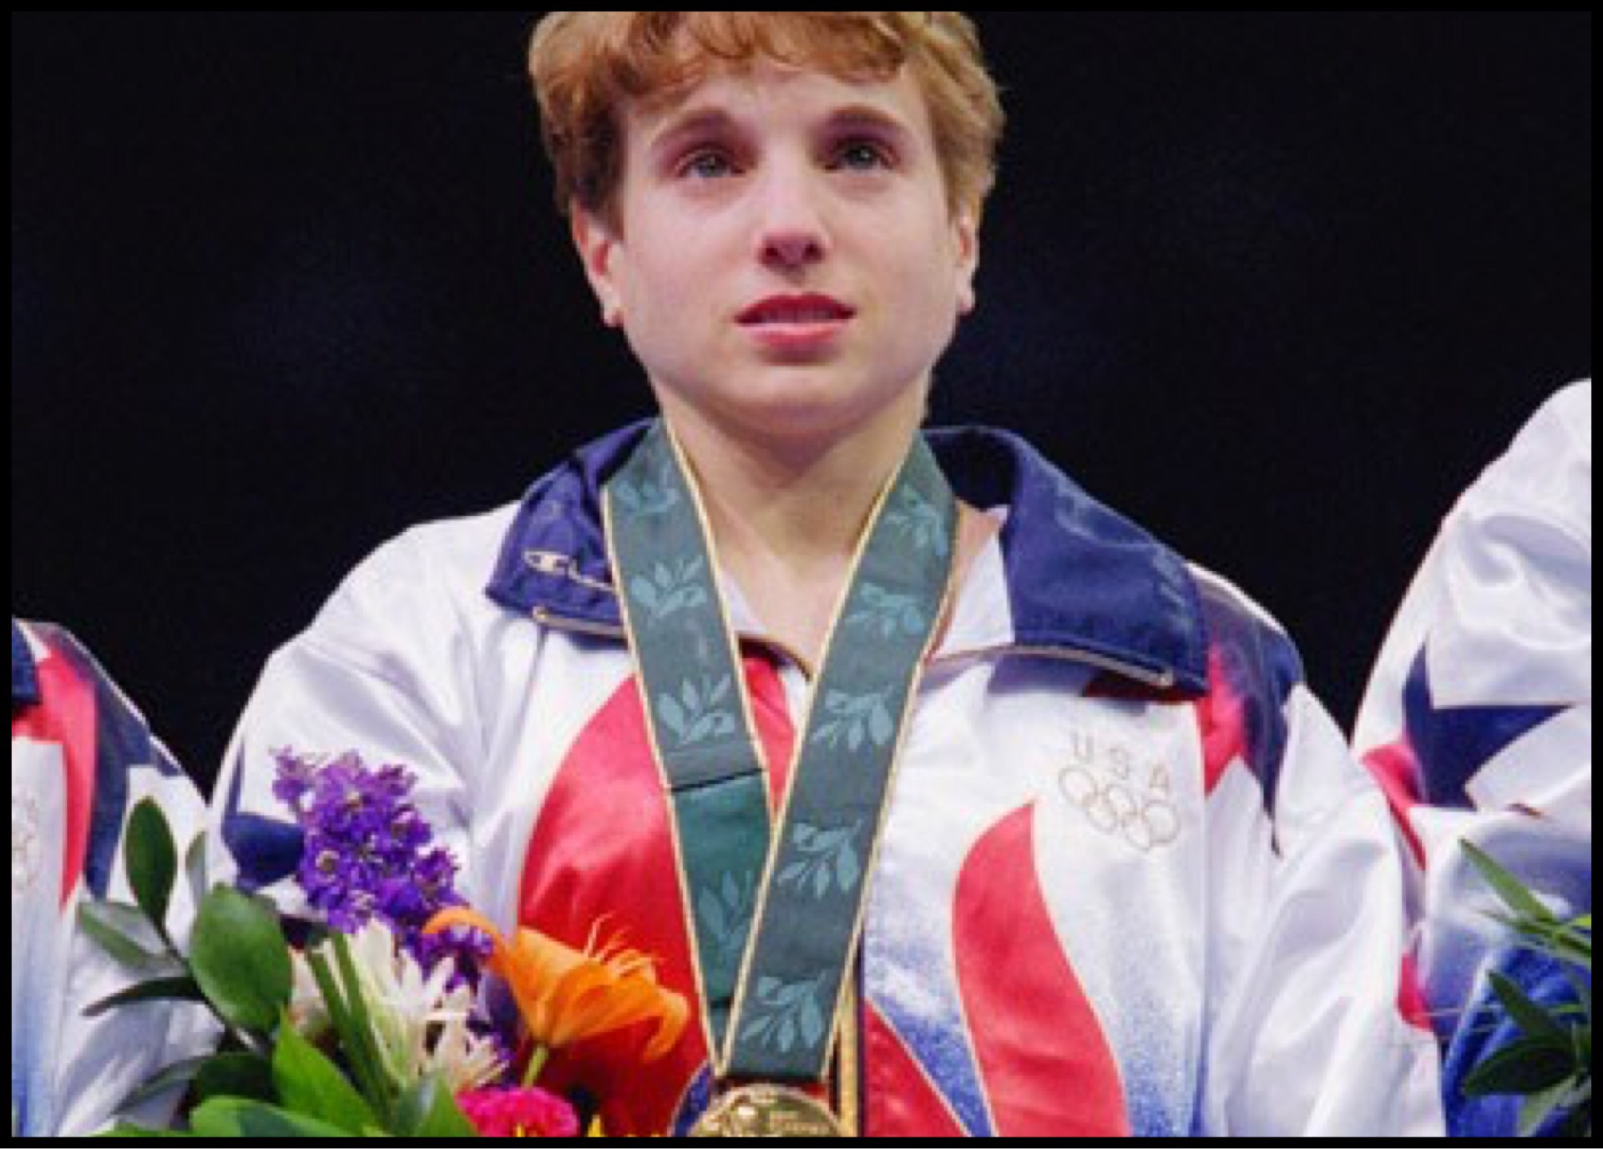
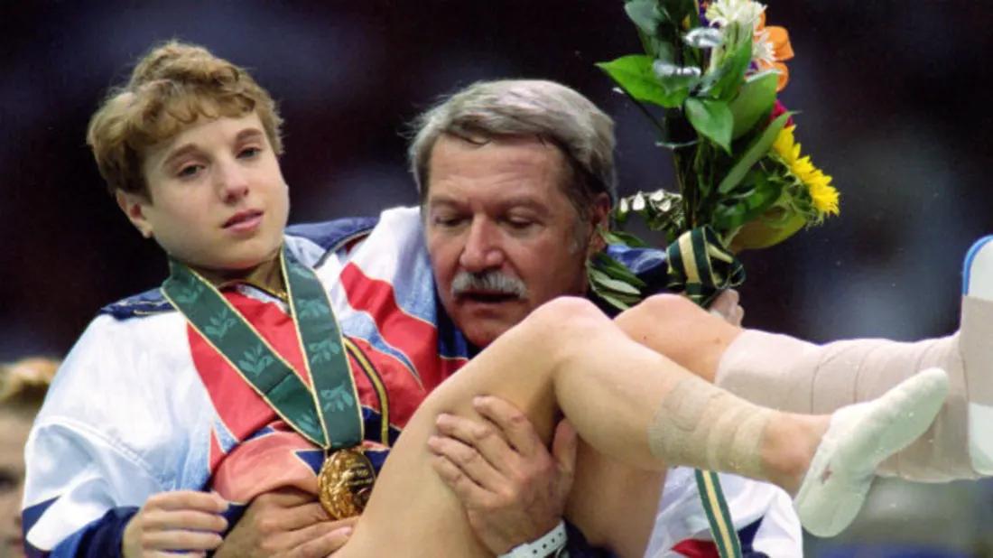

Slide 4
We love stories like that
Because we love to glimpse Excellence.

Slide 5
Hebrews 11:1-4
Now faith is the substance of things hoped for, the evidence of things not seen. For by it the elders obtained a good testimony. By faith we understand that the worlds were framed by the word of God, so that the things which are seen were not made of things which are visible. By faith Abel offered to God a more excellent sacrifice than Cain, through which he obtained witness that he was righteous, God testifying of his gifts; and through it he being dead still speaks. - NKJV

Slide 6
Something More Excellent
Hebrews 11:4

Slide 7
We live in a world of good enough
A son honors his father, and a servant his master. Then if I am a father, where is My honor? And if I am a master, where is My respect?’ says the Lord of hosts to you, O priests who despise My name. But you say, ‘How have we despised Your name?’ You are presenting defiled food upon My altar. But you say, ‘How have we defiled You?’ In that you say, ‘The table of the Lord is to be despised.’ But when you present the blind for sacrifice, is it not evil? And when you present the lame and sick, is it not evil? Why not offer it to your governor? Would he be pleased with you? Or would he receive you kindly?” says the Lord of hosts. Malachi 1:6-8

Slide 8
Was their sacrifice good enough?
Oh that there were one among you who would shut the gates, that you might not uselessly kindle fire on My altar! I am not pleased with you,” says the Lord of hosts, “nor will I accept an offering from you. Malachi 1: 10
Therefore I urge you, brethren, by the mercies of God, to present your bodies a living and holy sacrifice, acceptable to God, which is your spiritual service of worship. And do not be conformed to this world, but be transformed by the renewing of your mind, so that you may prove what the will of God is, that which is good and acceptable and perfect. Romans 12:1-2

Slide 9

What is excellence?

Slide 10
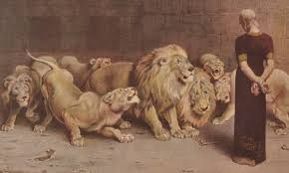
Daniel was willing to stand up.
Now when Daniel knew that the document was signed, he entered his house (now in his roof chamber he had windows open toward Jerusalem); and he continued kneeling on his knees three times a day, praying and giving thanks before his God, as he had been doing previously. Daniel 6:10

Slide 11
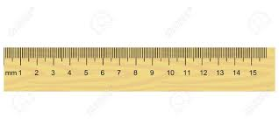
How do we measure up?
For I am not ashamed of the gospel, for it is the power of God for salvation to everyone who believes, to the Jew first and also to the Greek. For in it the righteousness of God is revealed from faith to faith; as it is written, “But the righteous man shall live by faith.” Romans 1:16-17
Are we willing to stand up?

Slide 12
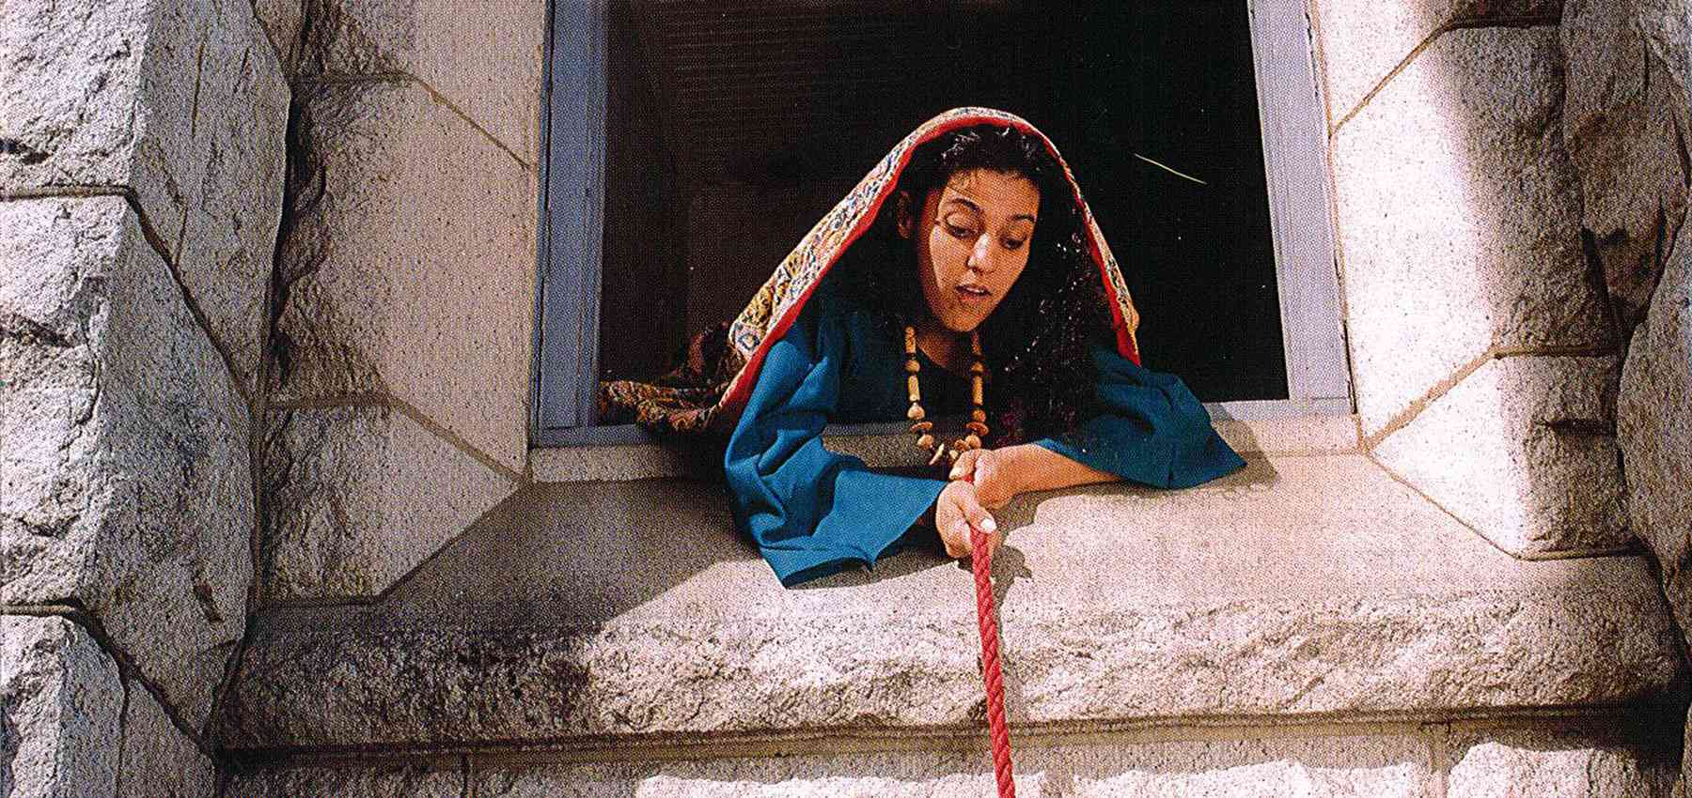
Rahab was willing to stand out.
By faith the walls of Jericho fell down after they had been encircled for seven days. By faith Rahab the harlot did not perish along with those who were disobedient, after she had welcomed the spies in peace. Hebrews 11: 30-31
Rahab was willing to stand out.

Slide 13
How do we measure up?
Therefore I urge you, brethren, by the mercies of God, to present your bodies a living and holy sacrifice, acceptable to God, which is your spiritual service of worship. And do not be conformed to this world, but be transformed by the renewing of your mind, so that you may prove what the will of God is, that which is good and acceptable and perfect. Romans 12:1-2
Are we willing to be different?

Slide 14
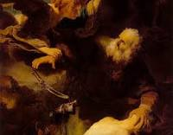
Abraham was willing to sacrifice
By faith Abraham, when he was called, obeyed by going out to a place which he was to receive for an inheritance; and he went out, not knowing where he was going. Hebrews 11: 8
By faith Abraham, when he was tested, offered up Isaac, and he who had received the promises was offering up his only begotten son; Hebrews 11:17

Slide 15
How do we measure up?
Through Him then, let us continually offer up a sacrifice of praise to God, that is, the fruit of lips that give thanks to His name. And do not neglect doing good and sharing, for with such sacrifices God is pleased. Hebrews 13:15-16
What have you sacrificed for God?

Slide 16
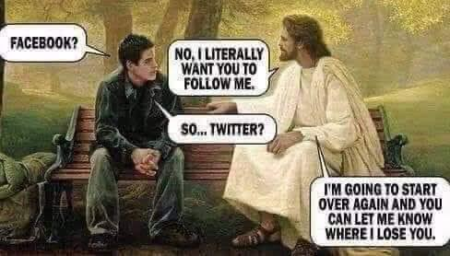

Slide 17
Our path to spiritual excellence?
“Yet even now,” declares the Lord, Return to Me with all your heart, And with fasting, weeping and mourning; and rend your heart and not your garments.” Now return to the Lord your God, For He is gracious and compassionate, Slow to anger, abounding in lovingkindness and relenting of evil. Joel 2:12-13
For You do not delight in sacrifice, otherwise I would give it; You are not pleased with burnt offering. The sacrifices of God are a broken spirit; A broken and a contrite heart, O God, You will not despise. Psalms 51:16-17

Slide 18
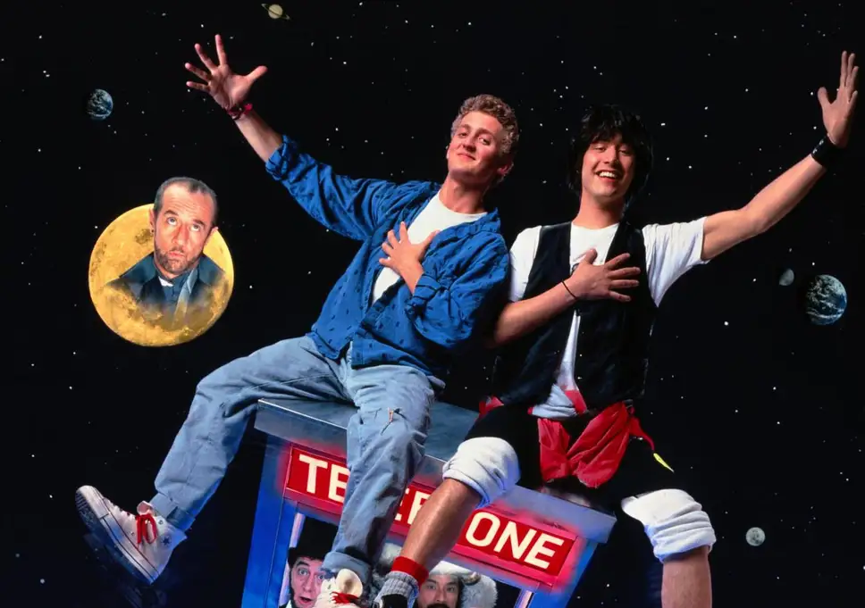

Slide 19
Something more excellent
Have this attitude in yourselves which was also in Christ Jesus, who, although He existed in the form of God, did not regard equality with God a thing to be grasped, but emptied Himself, taking the form of a bond-servant, and being made in the likeness of men. Being found in appearance as a man, He humbled Himself by becoming obedient to the point of death, even death on a cross. For this reason also, God highly exalted Him, and bestowed on Him the name which is above every name, Philippians 2:5-9

Slide 20

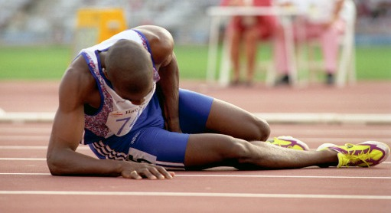
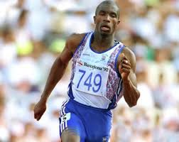
1992 Summer Olympics

Slide 21
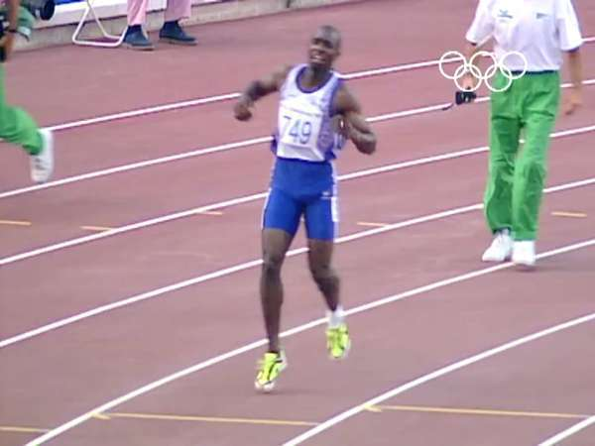
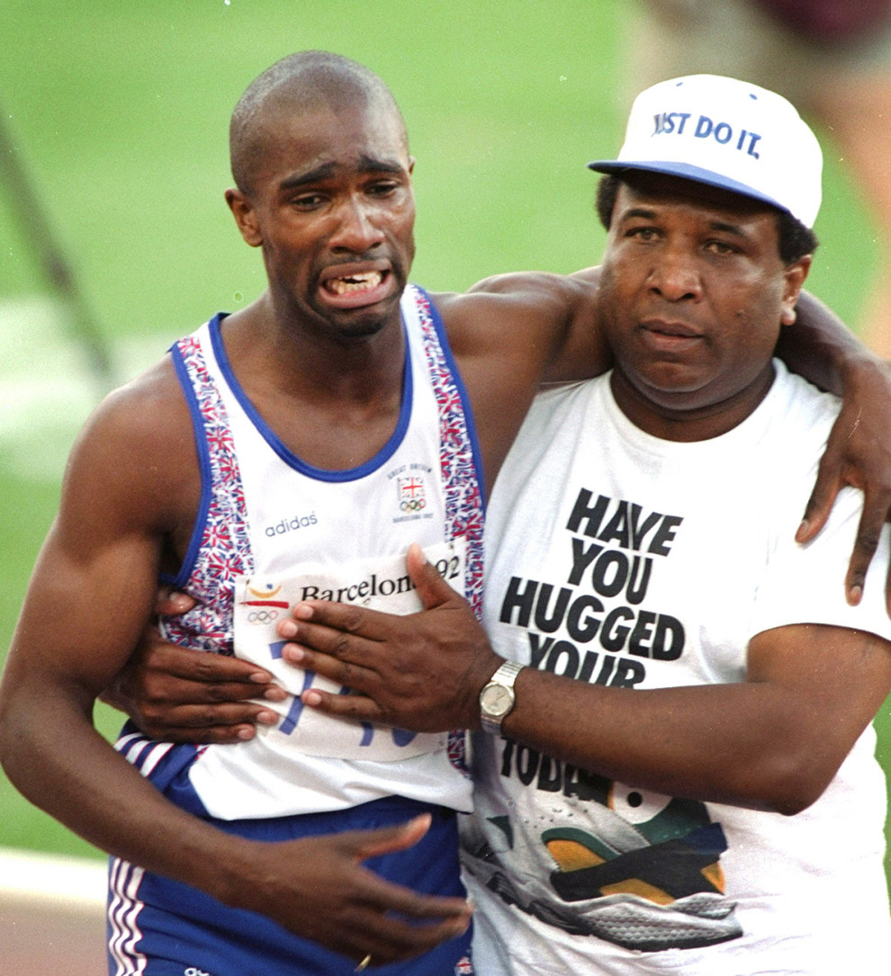


Slide 22
While we were weak and needed it...
For when we were yet without strength, in due time Christ died for the ungodly. For scarcely for a righteous man will one die: yet peradventure for a good man some would even dare to die. But God commendeth his love toward us, in that, while we were yet sinners, Christ died for us. Much more then, being now justified by his blood, we shall be saved from wrath through him. Romans 5:6-9
While we could not fathom excellence Christ showed us what excellence was so that we might glimpse it and strive to live in it.

