Slide 1
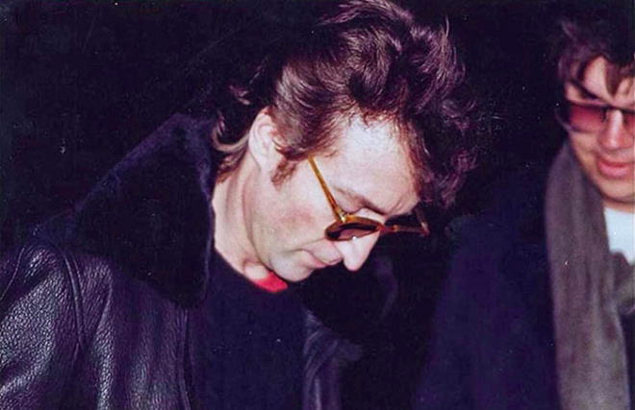
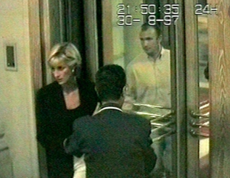
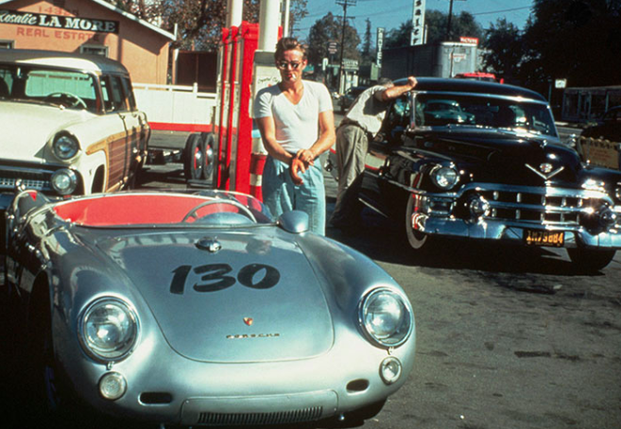
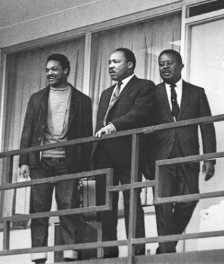
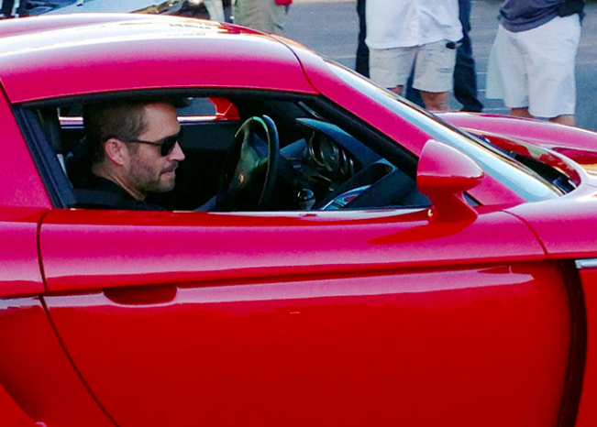
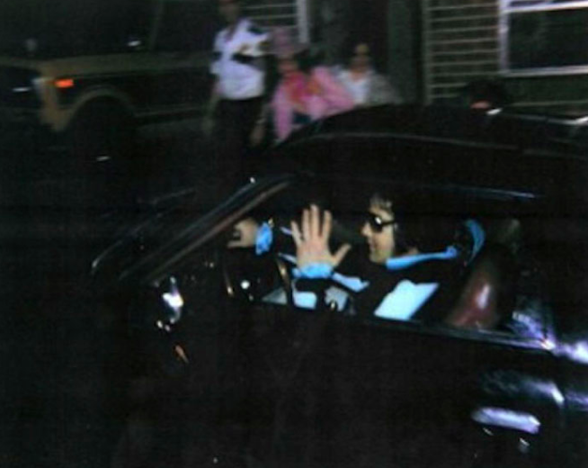
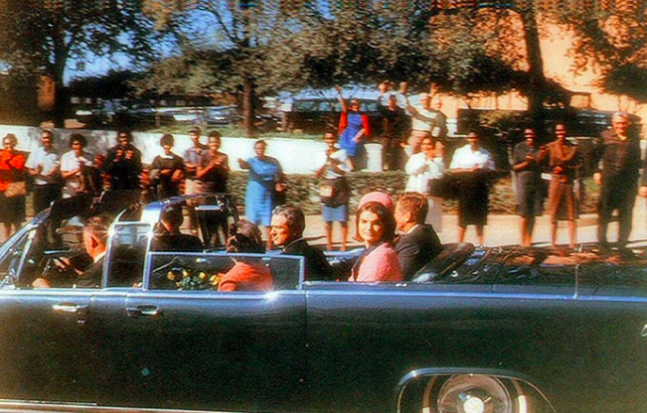

Slide 2
What do these pictures All have in common?

Slide 3
These are the last known pictures taken of these people.
Notes:
The man who shot John Lennon, Mark David Chapman, is captured getting an autograph from the Beatles star. After signing the album for him, Lennon asked, "Is this all you want?" Chapman smiled and nodded in agreement. Four hours later, as Lennon was returning to his residence from a recording studio, Chapman dropped onto one knee and fired five bullets into Lennon's back from close range. Lennon was pronounced dead on arrival at the hospital soon after.
This photo of James Dean at a gas station was taken the day that he died. Dean was a keen driver and loved race cars. He died when he crashed the Porsche in this photo, swerving to avoid an oncoming car, on September 30, 1955. Curiously, when Dean introduced himself to British actor Alec Guinness during an encounter in Hollywood, he asked him to take a look at the car. Guinness thought the car appeared "sinister" and told Dean: "If you get in that car, you will be found dead in it by this time next week." This happened on September 23, 1955, seven days before Dean's death.
This picture shows Martin Luther King Jr. standing with other civil rights leaders on the balcony of the Lorraine Motel in Memphis, Tennessee, on April 3rd, 1968. A day later he was assassinated in approximately the same place by James Earl Ray, although there are many conspiracy theories surrounding the assassination.
This is Princess Dianna as she was leaving the Ritz in Paris….moments later, she died in a car accident.
This is Paul Walker… moments later, he was killed in that car after crashing.
This is the picture of John F. Kennedy right before he was assassinated.
This photo of Elvis Presley was taken at Graceland in the early hours of August 16th, 1977 having just visited the dentist. Later that day Presley had a heart attack and died

Slide 4
What if this was YOUR last picture?

Slide 5
James 4:14

Slide 6
Our Spiritual bucket list

Slide 7
Have You used Your talents?
Matthew 25:14-30
I Peter 4:10-11
I Corinthians 12:7-11
Romans 12:6-8

Slide 8
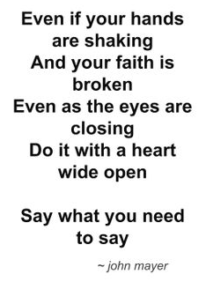
Have you left things undone?
Matthew 18:15-17
Colossians 3:13
Luke 17:3
James 5:16

Slide 9
Are You Leaving a legacy?
Matthew 5:14-16
Galatians 2:20
2 Timothy 2:15
“Ask God to use you. Ask Him to show you how you can be a blessing everywhere you go. Keep honoring Him so that others can see Him through you.” ― Germany Kent

Slide 10
Have you Spread the gospel?
Mark 15:15
1 Peter 3:15
Matthew 28:18-20

Slide 11
Are you spiritually ready?
Hear Romans 10:17
Believe Mark 16: 15-16, Romans 10:9
Repent Luke 13:3, Luke 15:7, Acts 2:38
Confess Romans 10:9, 1 John 1: 8-9
Be Baptized Mark 16: 15-16, Acts 2:38
Live a faithful life Ephesians 2:8

Slide 12
What if this was YOUR last picture?

Slide 14
Are you spiritually ready?
Hear Romans 10:17
Believe Mark 16: 15-16, Romans 10:9
Repent Luke 13:3, Luke 15:7, Acts 2:38
Confess Romans 10:9, 1 John 1: 8-9
Be Baptized Mark 16: 15-16, Acts 2:38
Live a faithful life Ephesians 2:8

