Slide 1
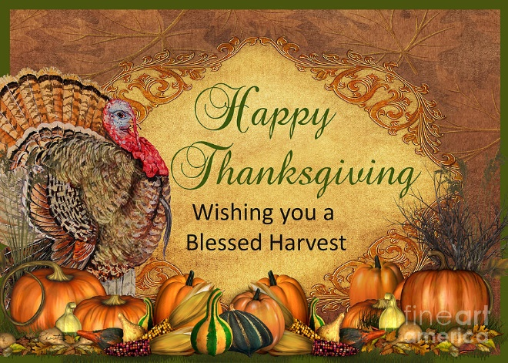
Happy Thanksgiving, O’Neal. May God bless you all.
Love, Guy and Ann McDaniel Nov. 19, 2017

Slide 2
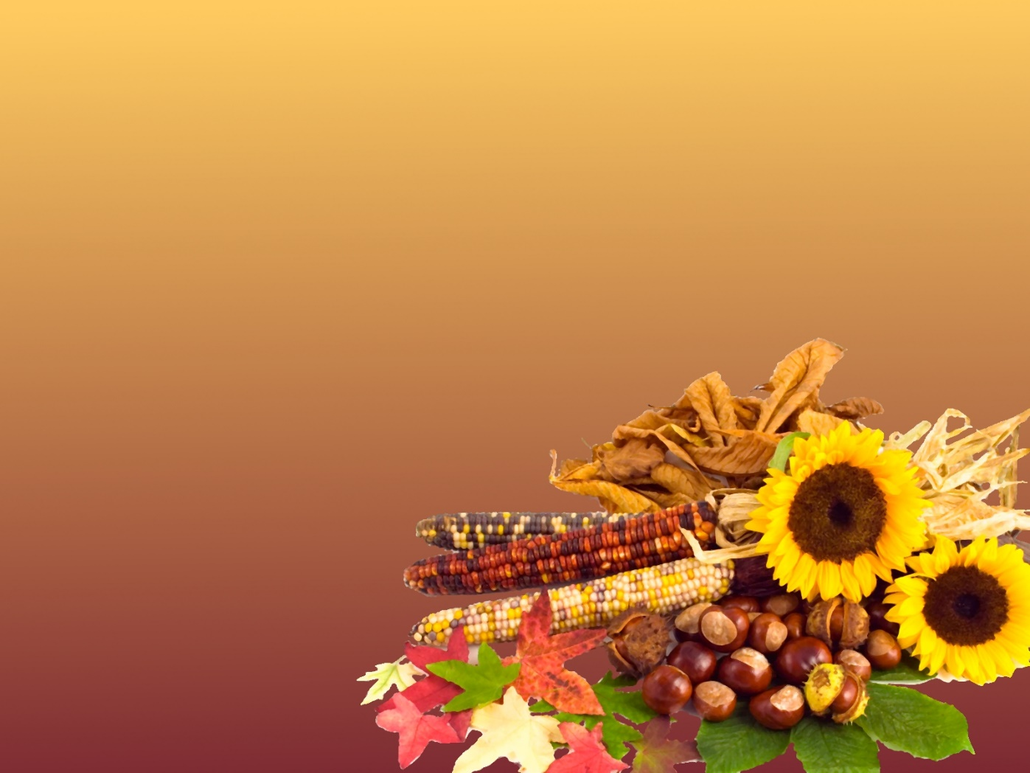
The Early Settlers had
Plenty of Water Fowl
Many turkeys
Much Venison
Lots of Fish like cod and bass
Indian Corn from which they made meal
They wrote back to England of how
prosperous this new
land was!

Slide 3
Latter:
In 1623, they were in a drought and prayed for
Rain and received one and they established a
True “Thanksgiving Day”.
By 1700’s almost every colony had established a
“Thanksgiving Day” to celebrate God’s manifold
Blessings.

Slide 4
A Special Day To Give Thanks
It is a North American Holiday
It started as a form of Harvest Festival
1st record was San Augustine Florida September 8th 1565.
Best known recorded event was at Plymouth Plantation in 1621
Celebrated 2nd Monday in October – Canada
4th Thursday in United States

Slide 5
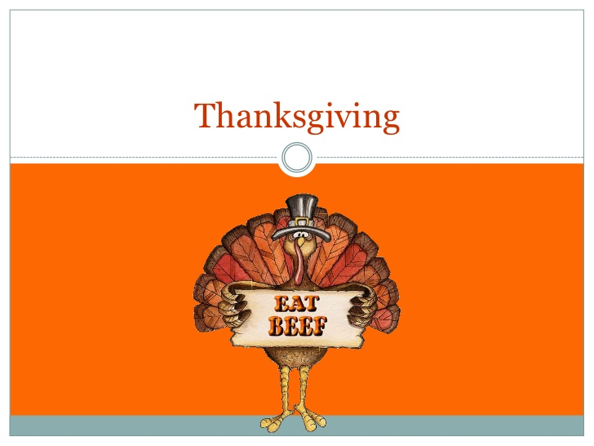

Slide 6
(Hens
On
Vacation)

Slide 7
Have we forgotten the
Importance of giving thanks to
God ‘every day’?

Slide 8
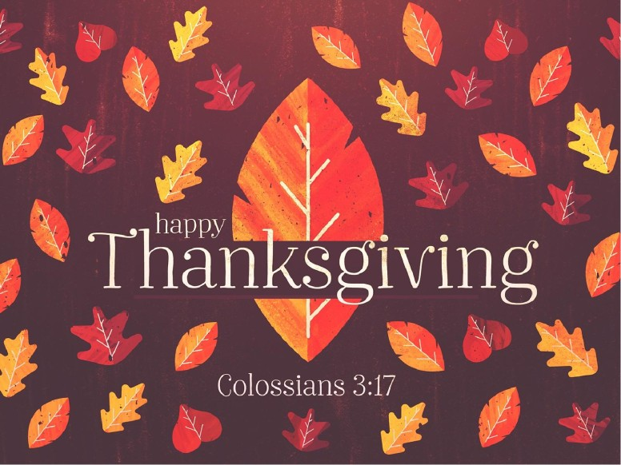

Slide 9
Col. 3:17 And whatsoever ye do in word or deed,
do all in the name of the Lord Jesus,
giving thanks to God and the Father by him

Slide 10
Psalm 100:4 Be Thankful Unto God

Slide 11
Psalm 100
1 Make a joyful noise unto the Lord, all ye lands.
² Serve the Lord with gladness: come before his presence with singing.
³ Know ye that the Lord he is God: it is he that hath made us, and not we ourselves; we are his people, and the sheep of his pasture.
⁴ Enter into his gates with thanksgiving, and into his courts with praise: be thankful unto him, and bless his name.
⁵ For the Lord is good; his mercy is everlasting; and his truth endureth to all generations.

Slide 12
And

Slide 13
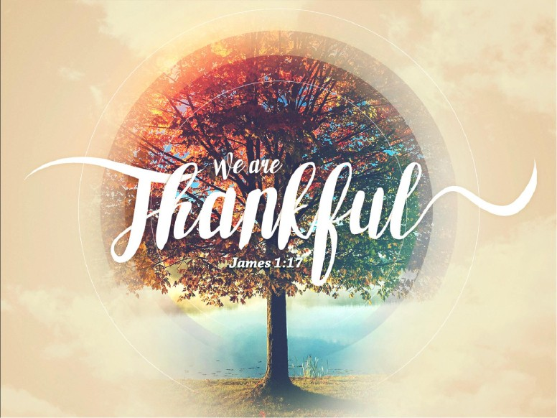

Slide 14
Why? James tells us why!!
James 1:17 ¹⁷ Every good gift and every perfect gift
is from above, and cometh down from the
Father of lights, with whom is no variableness,
neither shadow of turning.

Slide 15
And

Slide 16
Do Not Forget All His Benefits

Slide 17
Psalm 103:1 Bless the Lord, O my soul: and all that is within me, bless his holy name.
² Bless the Lord, O my soul, and forget not all his benefits:
³ Who forgiveth all thine iniquities; who healeth all thy diseases;
⁴ Who redeemeth thy life from destruction; who crowneth thee with lovingkindness and tender mercies;
⁵ Who satisfieth thy mouth with good things; so that thy youth is renewed like the eagle's.
⁶ The Lord executeth righteousness and judgment for all that are oppressed.⁷ He made known his ways unto Moses, his acts unto the children of Israel.⁸ The Lord is merciful and gracious, slow to anger, and plenteous in mercy.

Slide 18
⁹ He will not always chide: neither will he keep his anger for ever.¹⁰ He hath not dealt with us after our sins; nor rewarded us according to our iniquities.¹¹ For as the heaven is high above the earth, so great is his mercy toward them that fear him.¹² As far as the east is from the west, so far hath he removed our transgressions from us.
¹³ Like as a father pitieth his children, so the Lord pitieth them that fear him.¹⁴ For he knoweth our frame; he remembereth that we are dust.
¹⁵ As for man, his days are as grass: as a flower of the field, so he flourisheth.
¹⁶ For the wind passeth over it, and it is gone; and the place thereof shall know it no more

Slide 19
¹⁷ But the mercy of the Lord is from everlasting to everlasting upon them that fear him, and his righteousness unto children's children;
¹⁸ To such as keep his covenant, and to those that remember his commandments to do them.
¹⁹ The Lord hath prepared his throne in the heavens; and his kingdom ruleth over all.
²⁰ Bless the Lord, ye his angels, that excel in strength, that do his commandments, hearkening unto the voice of his word.
²¹ Bless ye the Lord, all ye his hosts; ye ministers of his, that do his pleasure.
²² Bless the Lord, all his works in all places of his dominion: bless the Lord, O my soul.

Slide 20
Choose God
1.Joshua did. Joshua 24:14,15
2.Joseph did. Gen. 39:9
3.Jonah did. Jonah 2:9
4. Jesus did. Heb. 5:8-9

Slide 21
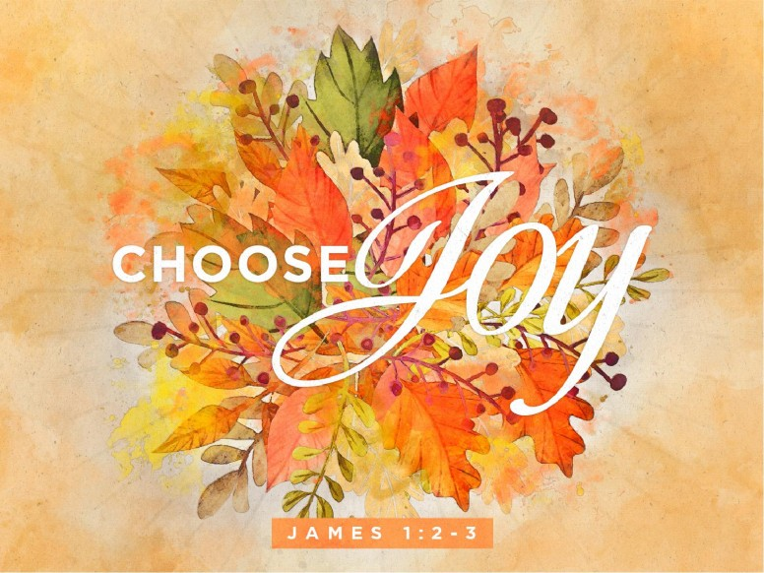

Slide 22
James 1:2-3
My brethren, count it all joy when ye fall into divers temptations;
³ Knowing this, that the trying of your faith worketh patience.

Slide 23


Slide 24


Slide 25
^{Col. 3:15-16}
¹⁵ And let the peace of God rule in your hearts, to the which also ye are called in one body; and be ye thankful.
¹⁶ Let the word of Christ dwell in you richly in all wisdom; teaching and admonishing one another in psalms and hymns and spiritual songs, singing with grace in your hearts to the Lord

Slide 26
God is looking for
a Heart of Thanksgiving!

Slide 27
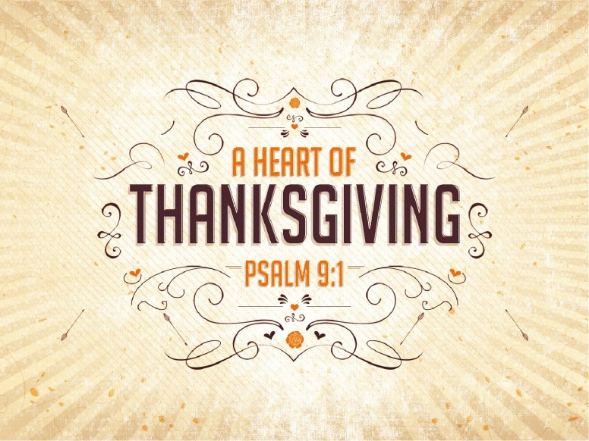

Slide 28
Psalm 9:1
I will praise thee, O Lord, with my whole heart;
I will shew forth all thy marvellous works.

Slide 29
Psalm 69:30 I will praise the name of God with a song, and will magnify him with thanksgiving.
Psalm 95:2 Let us come before his presence with thanksgiving, and make a joyful noise unto him with psalms.

Slide 30
Jonah 2:9 But I will sacrifice unto thee with the voice of thanksgiving; I will pay that that I have vowed. Salvation is of the LORD.
2 Cor. 4:15 For all things are for your sakes, that the abundant grace might through the thanksgiving of many redound to the glory of God.
2 Cor. 9:11 Being enriched in every thing to all bountifulness, which causeth through us thanksgiving to God.

Slide 31
Phil. 4:6 Be careful for nothing; but in every thing by prayer and supplication with thanksgiving let your requests be made known unto God.
Col. 2:7 Rooted and built up in him, and stablished in the faith, as ye have been taught, abounding therein with thanksgiving.
Col.4:2 Continue in prayer, and watch in the same with thanksgiving

Slide 32
I Tim. 4:4 For every creature of God is good,
and nothing to be refused,
if it be received with thanksgiving:
Rev. 7:12 Saying, Amen: Blessing, and glory, and wisdom, and thanksgiving, and honour, and power, and might, be unto our God for ever and ever. Amen.

Slide 33
Do we forget to be thankful?
I Chron. 16:34 “Oh, give thanks to the Lord, for He is good!”
I Chron. 16:8 Oh, give thanks to the Lord! Call upon His Name, Make known His deeds among
the peoples!

Slide 34
Yes, Today, we often forget to be thankful.
Psalm 79:13 So we, your people and sheep of your
Pasture, will give You thanks forever; We will show
Forth Your praise to all generations..
Ps.107:8-9 O, that men would give thanks to the
Lord for His goodness, And for His wonderful works
To the children of men! For He satisfies the longing
Soul, And fills the hungry soul with goodness.

Slide 35
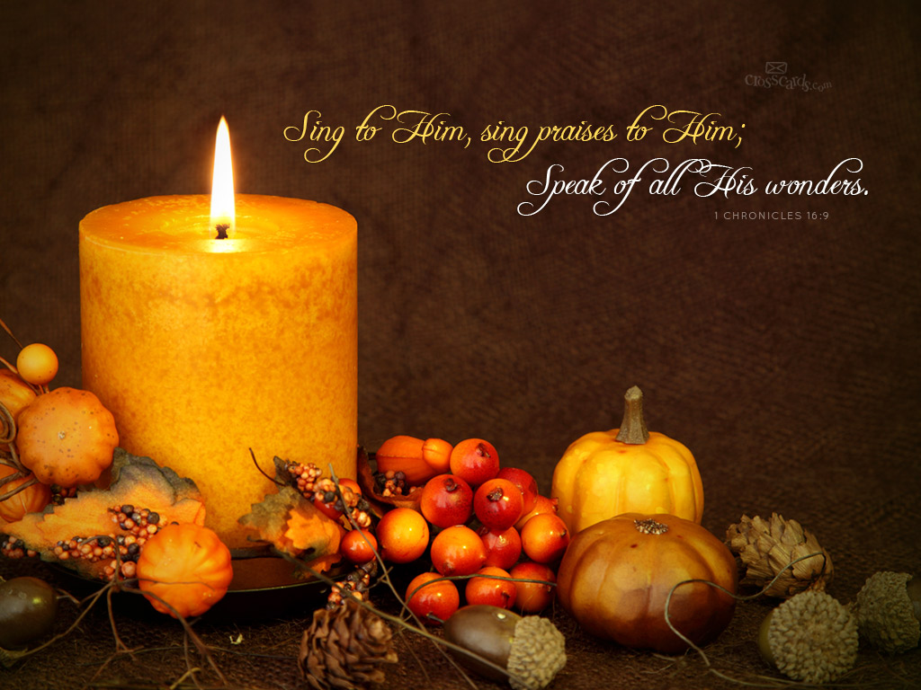
Praise God Forever

Slide 36
Psalm 34:8
⁸ O taste and see that the Lord is good: blessed is the man that trusteth in him.

Slide 37
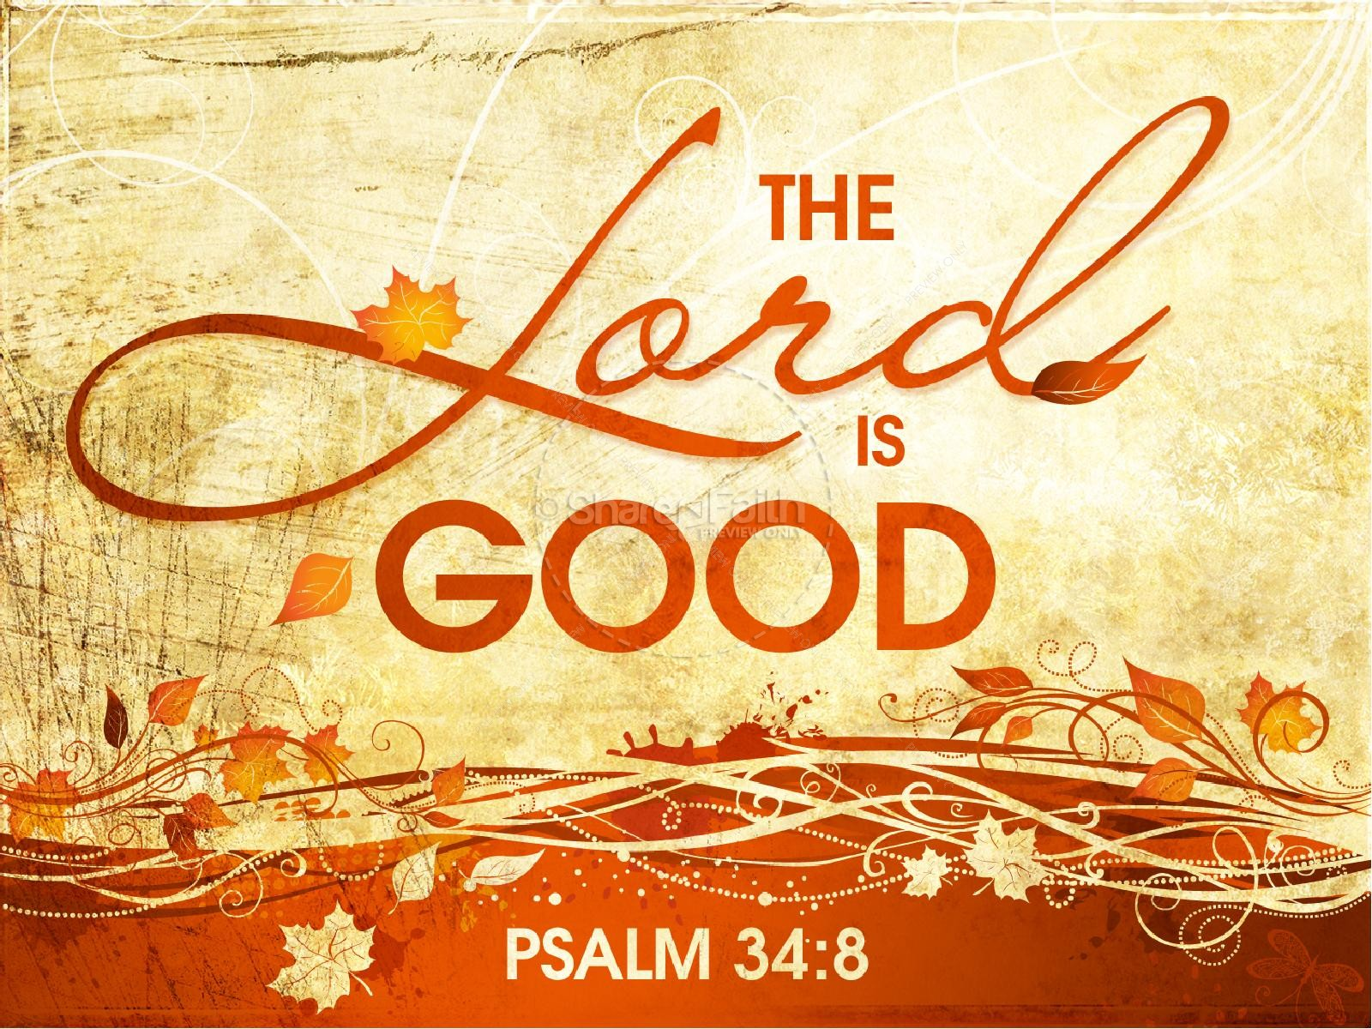
“God Is So Good”
O’Neal
Church of Christ

Slide 38
And

Slide 39
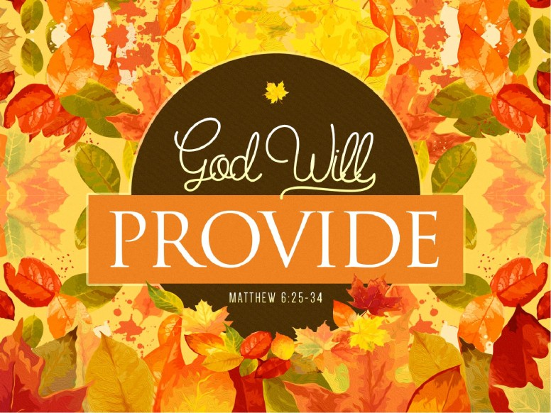

Slide 40
Matt. 6:25-34
²⁵ Therefore I say unto you, Take no thought for your life, what ye shall eat, or what ye shall drink; nor yet for your body, what ye shall put on. Is not the life more than meat, and the body than raiment?
²⁶ Behold the fowls of the air: for they sow not, neither do they reap, nor gather into barns; yet your heavenly Father feedeth them. Are ye not much better than they?
²⁷ Which of you by taking thought can add one cubit unto his stature?
²⁸ And why take ye thought for raiment? Consider the lilies of the field, how they grow; they toil not, neither do they spin:
²⁹ And yet I say unto you, That even Solomon in all his glory was not arrayed like one of these.

Slide 41
³⁰ Wherefore, if God so clothe the grass of the field, which to day is, and to morrow is cast into the oven, shall he not much more clothe you, O ye of little faith?
³¹ Therefore take no thought, saying, What shall we eat? or, What shall we drink? or, Wherewithal shall we be clothed?
³² (For after all these things do the Gentiles seek:) for your heavenly Father knoweth that ye have need of all these things.
³³ But seek ye first the kingdom of God, and his righteousness; and all these things shall be added unto you.
³⁴ Take therefore no thought for the morrow: for the morrow shall take thought for the things of itself. Sufficient unto the day is the evil thereof

Slide 42
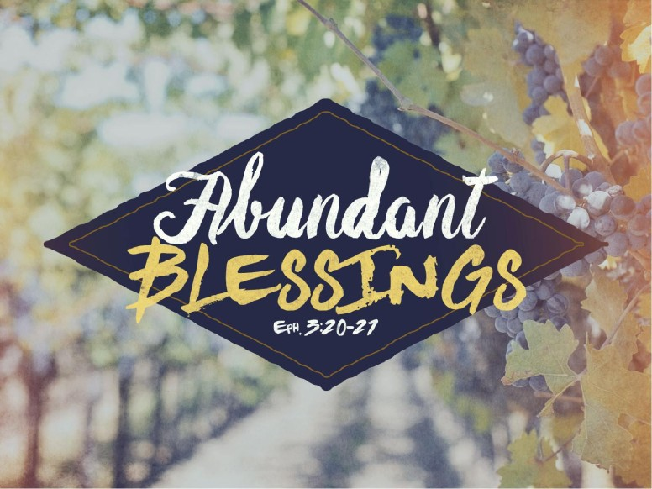

Slide 43
^{Eph. 3:20-21}
²⁰ Now unto him that is able to do exceeding abundantly above all that we ask or think, according to the power that worketh in us,
²¹ Unto him be glory in the church by Christ Jesus throughout all ages, world without end. Amen.

Slide 44
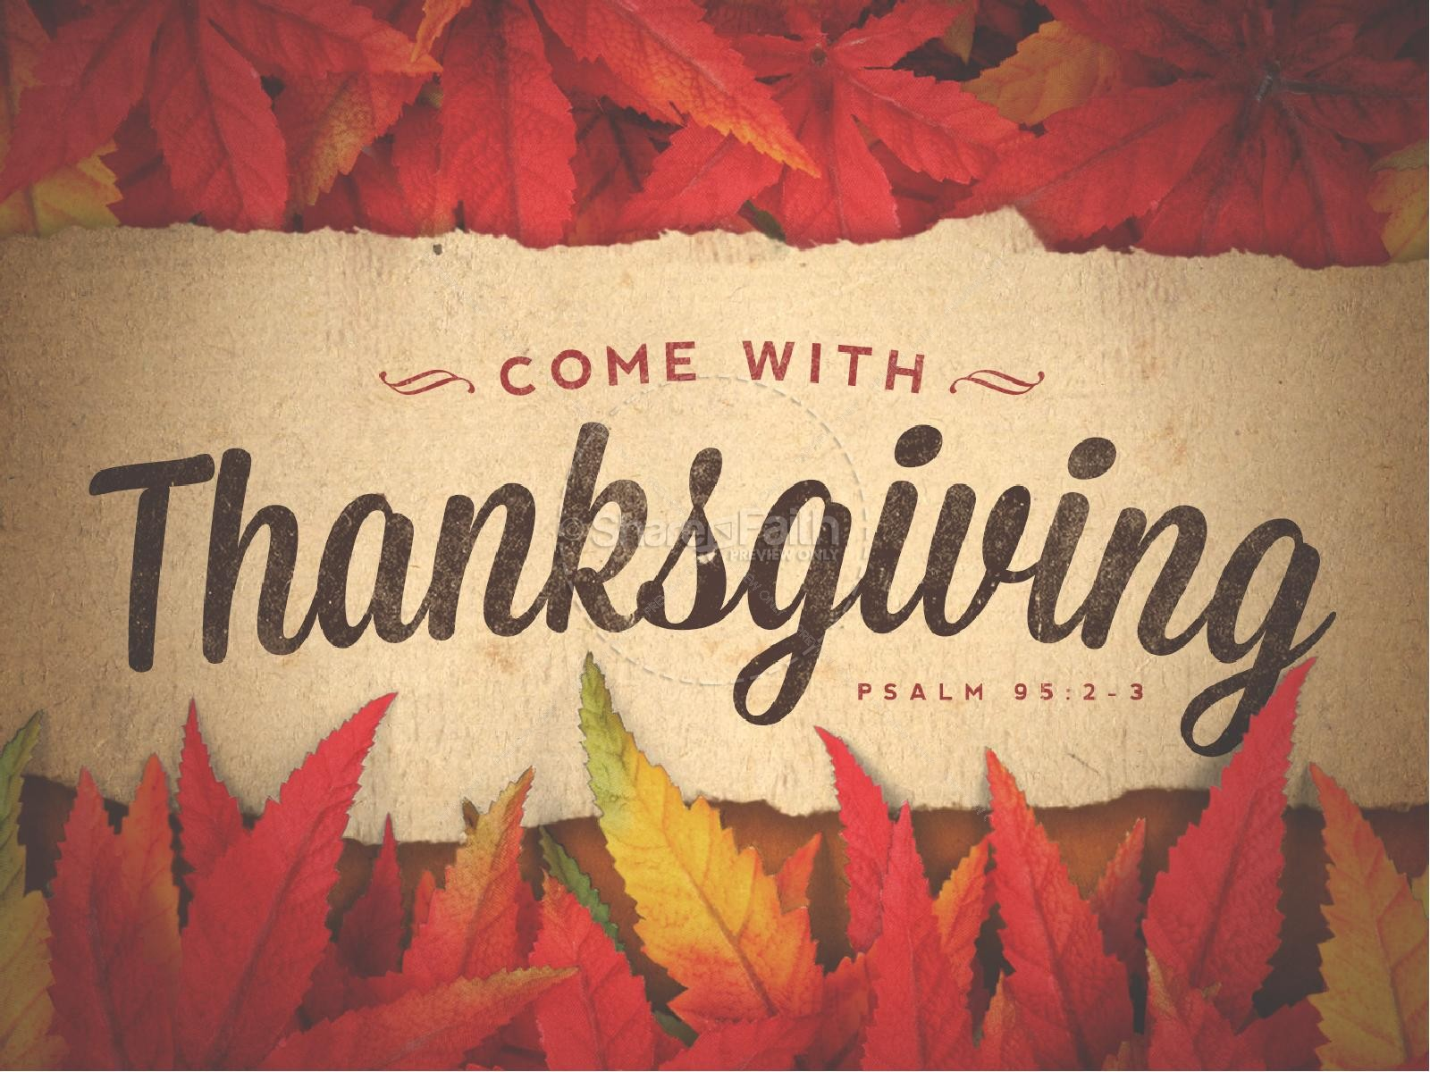

Slide 45
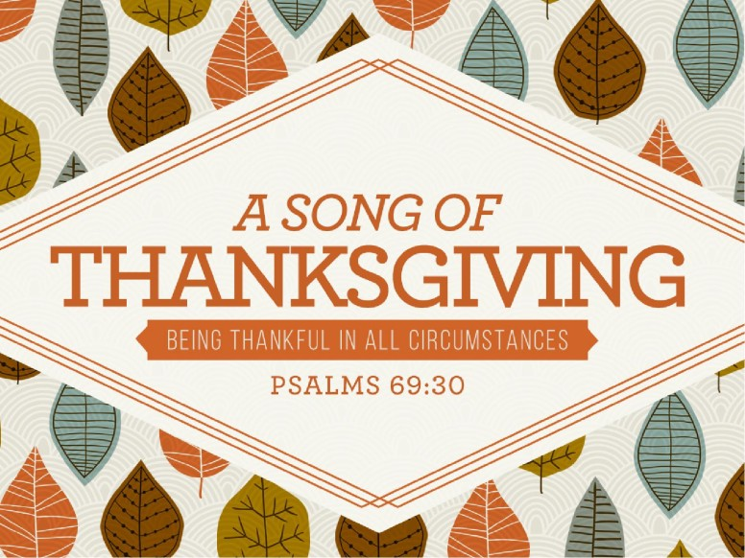

Slide 46
Psalm 69:30
³⁰ I will praise the name of God with a song, and will magnify him with thanksgiving
Praising God in all circumstances!

Slide 47
Thanks
“When this life is over, you are going
To receive the ultimate reward in
Eternity.” Thank you. David
“Thank you for supporting us in
Our trials.” ($30,000 sent from the church
Treasury here to 3 different churches
Of Christ for poor saints as a result of the floods)
And $5,000 sent to one church
From individuals.)

Slide 48
Rom. 16:3-4 Greet Priscilla and Aquila, my fellow workers in
Christ Jesus, ⁴ who risked their own necks for my life,
to whom not only I give thanks, but also all the
churches of the Gentiles.
2 Cor.2:14-16 Now thanks be to God who always leads us in triumph in Christ, and through us diffuses the fragrance of His knowledge in every place. ¹⁵ For we are to God the fragrance of Christ among those who are being saved and among those who are perishing. ¹⁶ To the one we are the aroma of death leading to death, and to the other the aroma of life leading to life. And who is sufficient for these things?

Slide 49
For What should we be thankful?
2 Corinthians 9:10-15 Now may^{[a]} He who supplies seed to the sower, and bread for food, supply and multiply the seed you have sown and increase the fruits of your righteousness, while you are enriched in everything for all liberality, which causes thanksgiving through us to God.For the administration of this service not only supplies the needs of the saints, but also is abounding through many thanksgivings to God, while, through the proof of this ministry, they glorify God for the obedience of your confession to the gospel of Christ, and for your liberal sharing with them and all men, ¹⁴ and by their prayer for you, who long for you because of the exceeding grace of God in you. ¹⁵ Thanks be to God for His indescribable gift!

Slide 50
I Tim. 4:4 For every creature of God is good,
and nothing to be refused,
if it be received with thanksgiving:
Rev. 7:12 Saying, Amen: Blessing, and glory, and wisdom, and thanksgiving, and honour, and power, and might, be unto our God for ever and ever. Amen.

Slide 51


Slide 52
Your Physical Blessings
Count your blessings,
name them one by one.

Slide 53
your eyes (‘some cannot see”) Lady in Shelbyville
your ears (‘some cannot hear’) Little baby who hears
for the first time)
your mouth (Bob O.)
your ability to feed yourself and taste what you eat
your legs/your arms/ (shoulder unable to work as it did)
your ability to breathe (some have COPD)
your ability to cry -- release stress and sorrow
your ability to lift with your hands and arms.. Carry your
own food..

Slide 54
Blessings:
Your husband/wife
Your children: Sons/Daughters
Your parents: Mothers/Fathers
Your grandparents/ Nanny/Pepaw
Your friends: People who know you and still love you!
Your fellow workers:
Your neighbors
Your spiritual brothers/sisters in Christ ()Christians!

Slide 55
Your Spiritual Blessings

Slide 56
1. A loving God, the Father.(Eph.4:4-6;Heb. 13:5,6; Prov. 3:5,6)
2. Jesus Christ, our Saviour (Rom. 5:8,9; Acts 4:12;Heb5:8,9)
3. The Holy Spirit of God. (John 16:13; John 14:26; Acts 2:38)
4. The Bible, the Word of God. (2 Tim.3:16,17; Heb. 4:12;)
5. The Gospel. (Rom. 1:16; Mark 16:15,16;
6. God’s Plan of Salvation. (H. B. R. C. B) ..I Pet. 3:21;
7. The Church ( I Tim.1:15; Eph. 1:22,23; Col. 1:18; Acts 2:47)
8. Promise of God to be with us in life. (Matt. 11:28-30; Mtt.28:18-20)
9. Promise of God to be with us in death. (Psalm 23:1-4; Psalm 116:15

Slide 57
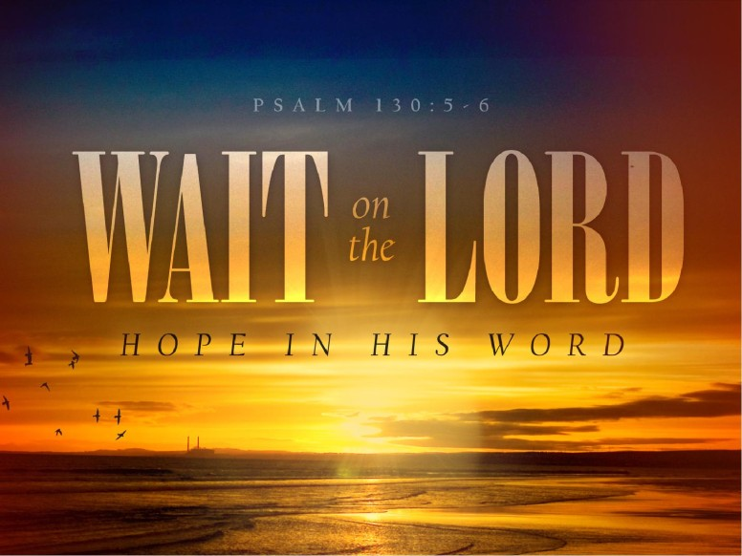

Slide 58
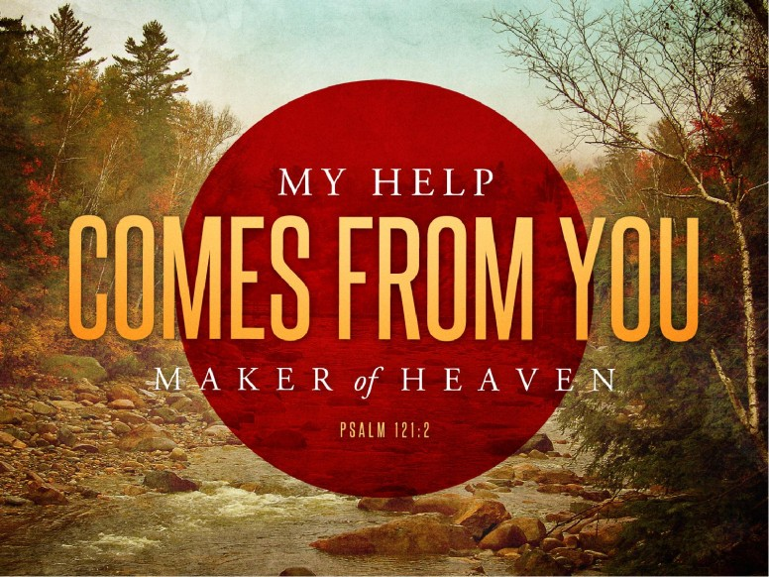

Slide 59


Slide 60


Slide 61
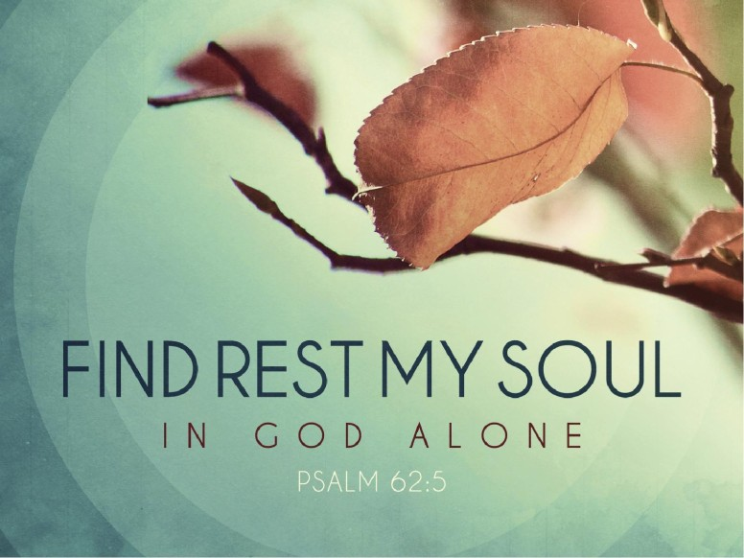

Slide 62


Slide 63
I Tim. 4:4 For every creature of God is good,
and nothing to be refused,
if it be received with thanksgiving:
Rev. 7:12 Saying, Amen: Blessing, and glory, and wisdom, and thanksgiving, and honour, and power, and might, be unto our God for ever and ever. Amen.

Slide 64
Do we forget to be thankful?
I Chron. 16:34 “Oh, give thanks to the Lord, for He is good!”
I Chron. 16:8 Oh, give thanks to the Lord! Call upon His Name, Make known His deeds among
the peoples!

Slide 65
Yes, Today, we often forget to be thankful.
Psalm 79:13 So we, your people and sheep of your
Pasture, will give You thanks forever; We will show
Forth Your praise to all generations..
Ps.107:8-9 O, that men would give thanks to the
Lord for His goodness, And for His wonderful works
To the children of men! For He satisfies the longing
Soul, And fills the hungry soul with goodness.

Slide 66
For What Should We Be Thankful?

Slide 67
Why should we give thanks to God?
Psalm 107:1
O give thanks unto the Lord, for he is good:
for his mercy endureth for ever.
Sing: “God Is So Good”

Slide 68
To whom shall we give thanks?
Psalm 75:1 “We give thanks to you,
O God, we give thanks!”
For what should we give thanks?
I Thess. 5:18 “..in everything give
thanks; for this is the
Will of God in
Christ Jesus for you.”

Slide 69
From Whence cometh every good gift and
every perfect gift?
James 1:17
¹⁷ Every good gift and every perfect gift is from above, and cometh down from the Father of lights, with whom is no variableness, neither
shadow of turning.
“Count your blessings…name them one
by one…

Slide 70
1. A loving God, the Father.(Eph.4:4-6;Heb. 13:5,6; Prov. 3:5,6)
2. Jesus Christ, our Saviour (Rom. 5:8,9; Acts 4:12;Heb5:8,9)
3. The Holy Spirit of God. (John 16:13; John 14:26; Acts 2:38)
4. The Bible, the Word of God. (2 Tim.3:16,17; Heb. 4:12;)
5. The Gospel. (Rom. 1:16; Mark 16:15,16;
6. God’s Plan of Salvation. (H. B. R. C. B) ..I Pet. 3:21;
7. The Church ( I Tim.1:15; Eph. 1:22,23; Col. 1:18; Acts 2:47)
8. Promise of God to be with us in life. (Matt. 11:28-30; Mtt.28:18-20)
9. Promise of God to be with us in death. (Psalm 23:1-4; Psalm 116:15

Slide 71
Thanks
“When this life is over, you are going
To receive the ultimate reward in
Eternity.” Thank you. David
“Thank you for supporting us in
Our trials.” ($30,000 sent from the church
Treasury here to 3 different churches
Of Christ for poor saints as a result of the floods)
And $5,000 sent to one church
From individuals.)

Slide 72
How thankful should we be?
2 Timothy 3:2-5 For men will be lovers of themselves, lovers of money, boasters, proud, blasphemers, disobedient to parents, unthankful, unholy, ³ unloving, unforgiving, slanderers, without self-control, brutal, despisers of good, ⁴ traitors, headstrong, haughty, lovers of pleasure rather than lovers of God, ⁵ having a form of godliness but denying its power. And from such people turn away!

Slide 73
How Thankful Should we be?
Ephesians 5:3-4
³ But fornication and all uncleanness or covetousness,
let it not even be named among you, as is fitting for saints;
⁴ neither filthiness, nor foolish talking, nor coarse jesting, which are not fitting,
but rather giving of thanks.

Slide 76
A Special Day To Give Thanks
It is a North American Holiday
It started as a form of Harvest Festival
1st record was San Augustine Florida September 8th 1565.
Best known recorded event was at Plymouth Plantation in 1621
Celebrated 2nd Monday in October – Canada
4th Thursday in United States

Slide 77
Through whom shall we give thanks unto God?
Col.3:17 “And whatever you do in word or deed, do
All in the name of the Lord Jesus, giving thanks to God
The Father through Him.”
Heb. 13:15 “Therefore by Him let us continually offer
The sacrifice of praise to God, that is the fruit of our
Lips, giving thanks to His name.”

Slide 78
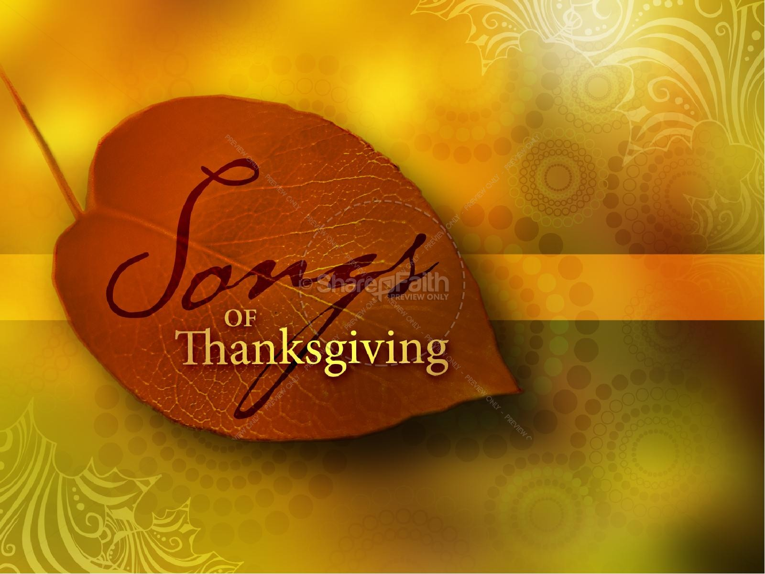

Slide 82
Psalm 95:1-

Slide 85
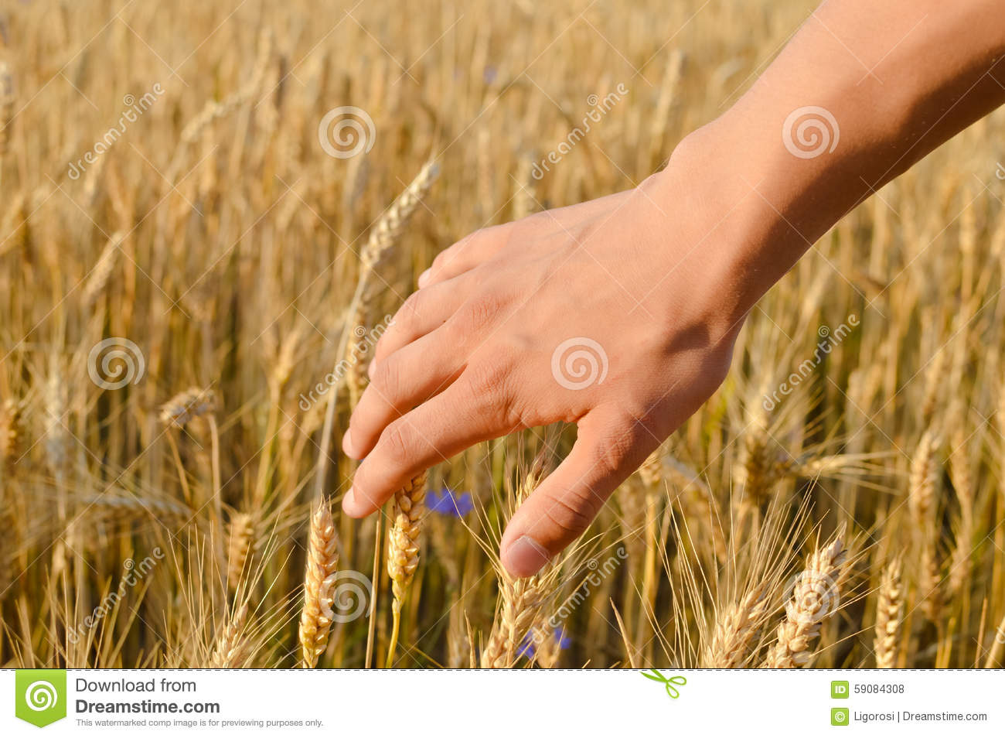

Slide 86
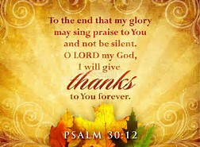

Slide 87


Slide 88


Slide 89
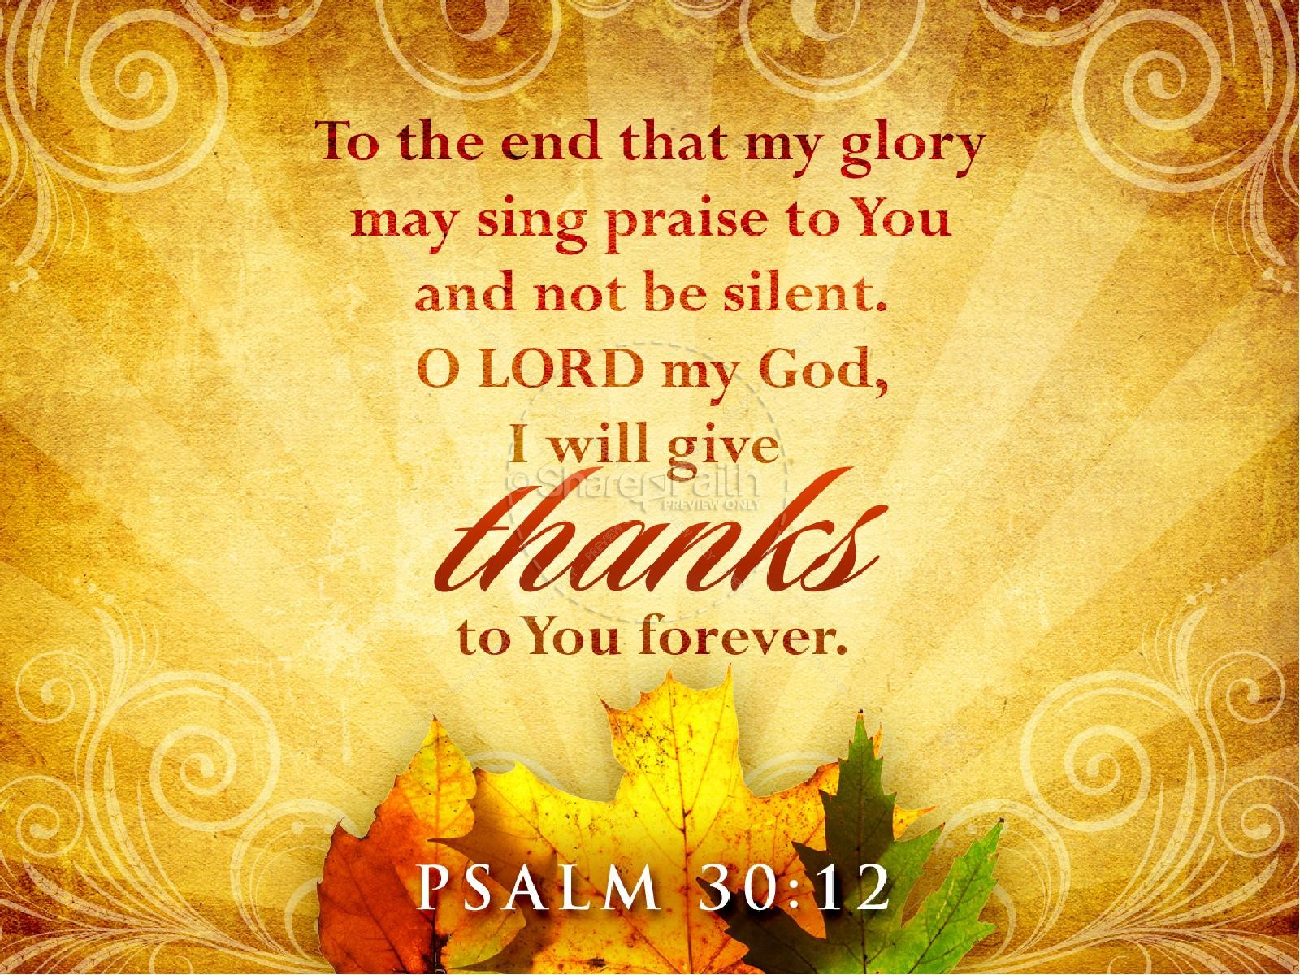

Slide 90
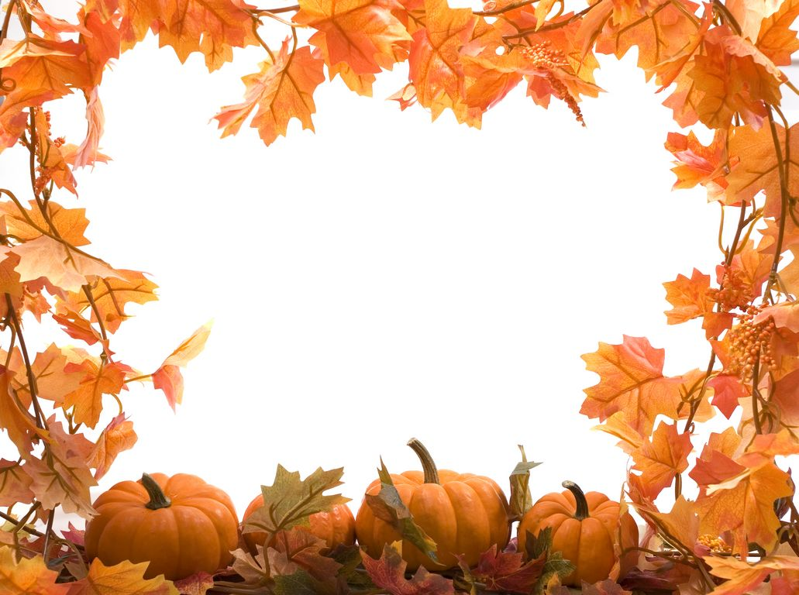
Thanksgiving In Alabama Nov. 23, 2017
Eph. 5:20 “Giving thanks always for all things
To God the Father in the name of our Lord
Jesus Christ.”

Slide 91
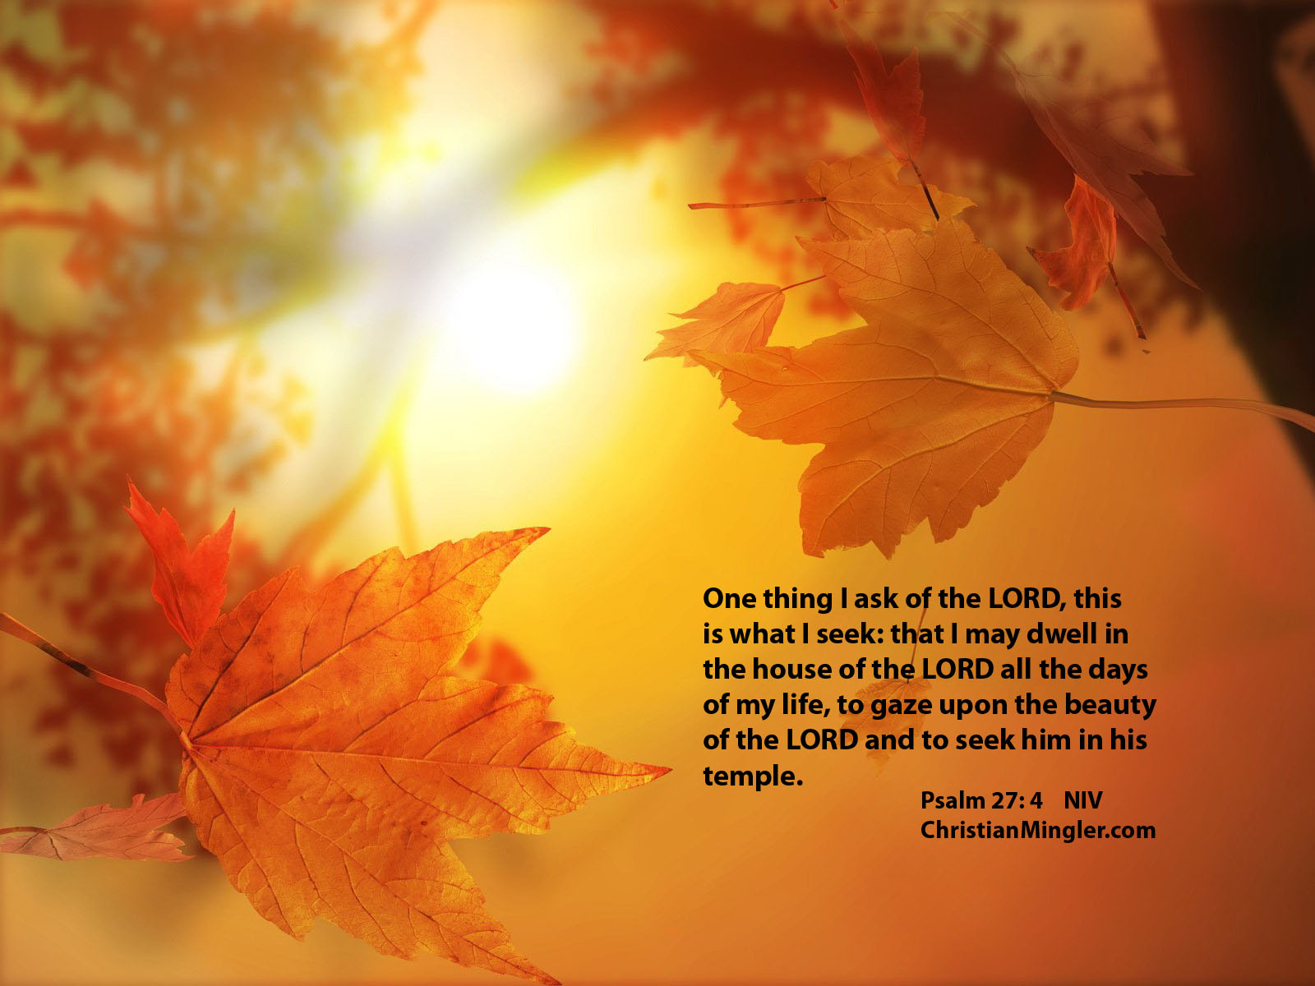

Slide 92
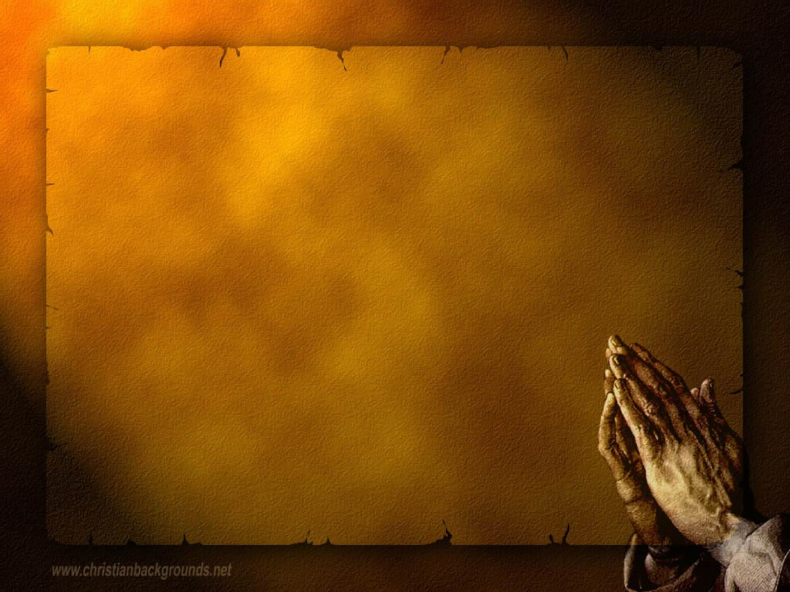

Slide 93
Squirrel gathering nuts

Slide 94
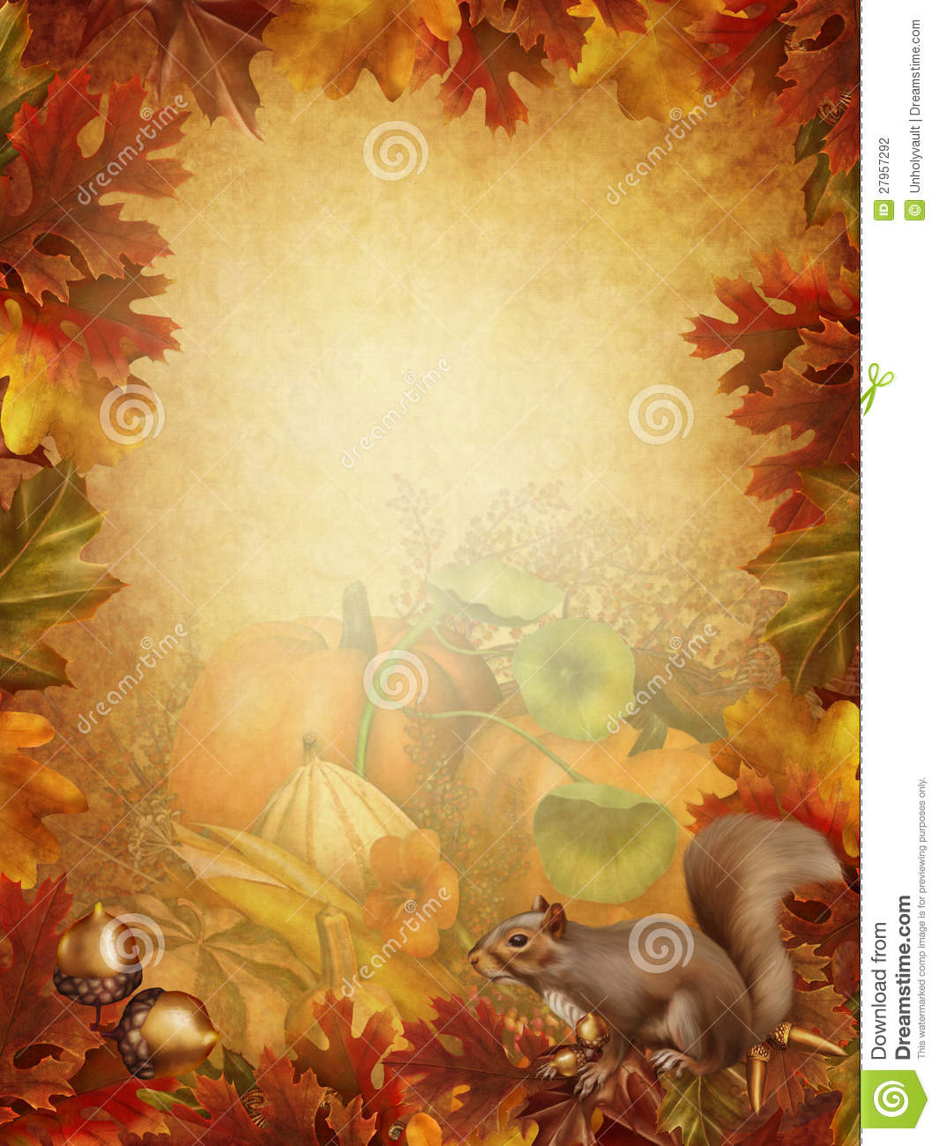

Slide 96
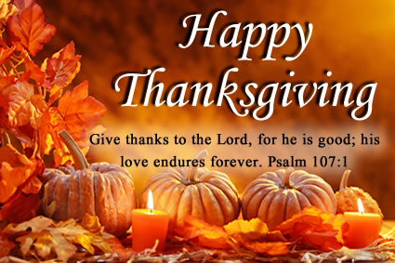

Slide 97
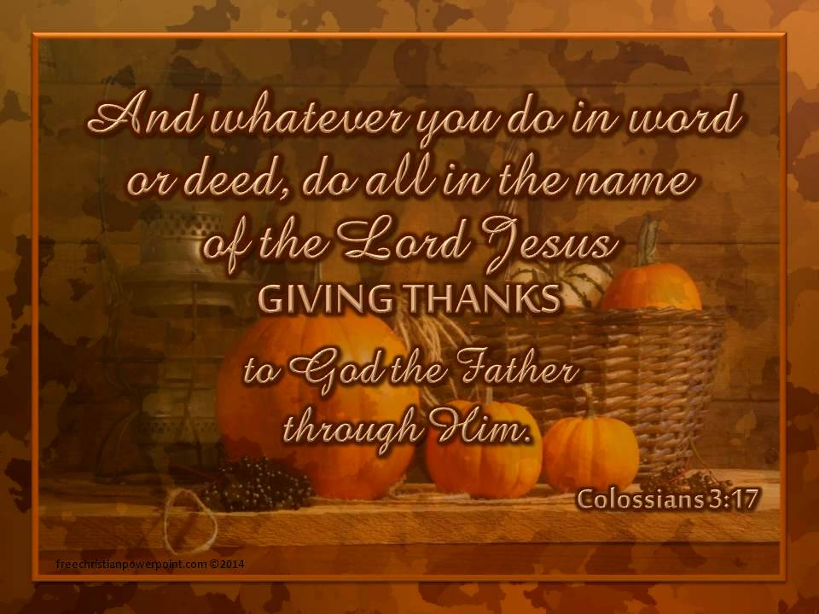

Slide 99
Give Thanks to God First…For His Being our God.
Give thanks to God for Jesus Christ, His Son,and our Saviour
Give thanksto God for the Holy Spirit..for His guidance to give
us this Inspired Word of God.
Give thanks to God for His Church, which he prophesied would
be set up. Joel 2:28; Daniel 2;
Give thanks to God for the Gospel, God’s plan to saveman.
Give thanks to God for the preaching of the truth…to setmen free
Give thanks to God for all his blessings. James1:17

Slide 100
Give thanks for our Elders/Deacons/Preachers/ and all members
Give thanks to God for families…Our Husbands/wives/children/
grandchildren/ great grand children…
Give thanks for America..USA
Give thanks for Worship, the priviledge we have to worship God
in Spirit and in truth.
Give thanks for ‘Showers of Blessings”.

Slide 101
In Everything …give thanks..

Slide 102
There shall be showers of blessings…

Slide 104
How can we ‘give thanks unto God?”
^{Psalm 30: 12} To the end that my glory may sing
praise to thee, and not be silent. O Lord my God,
I will give thanks unto thee for ever.
Praise Him, Praise Him….

