Slide 1
The Death of a Christian

Slide 2
Obituary
On behalf of the family, I want to say “Thank you” for all your acts of kindness—your prayers, visits, food, beautiful flowers, phone calls, messages, and especially your presence here today. It means so much to the family--all the love you have shown to them during this time of sorrow.
We have gathered here today to remember….
Notes:
I would proceed to say the name of the person, how old they were, when and where they were born and I would read the list of surviving family members and members of the family who preceded the individual in death.

Slide 3
Ecclesiastes 3
1 To every thing there is a season, and a time to every purpose under the heaven:
2 A time to be born, and a time to die; a time to plant, and a time to pluck up that which is planted;
3 A time to kill, and a time to heal; a time to break down, and a time to build up;
4 A time to weep, and a time to laugh; a time to mourn, and a time to dance;
5 A time to cast away stones, and a time to gather stones together; a time to embrace, and a time to refrain from embracing;
6 A time to get, and a time to lose; a time to keep, and a time to cast away;
7 A time to rend, and a time to sew; a time to keep silence, and a time to speak;
8 A time to love, and a time to hate; a time of war, and a time of peace.
Notes:
I would explain to the audience how Solomon reminds us that there is a time for everything—Death being one of them.
I would say a few words about the person. I would share memories from the surviving family members, I would share my personal memories, I try to give comforting memories to the family, and remind them to hold on to their memories.

Slide 4
James 4:13-14
13 Go to now, ye that say, Today or tomorrow we will go into such a city, and continue there a year, and buy and sell, and get gain:
14 Whereas ye know not what shall be on the morrow. For what is your life? It is even a vapour, that appeareth for a little time, and then vanisheth away.
Notes:
In my eulogy, I would share with everyone that life is brief. There are no guarantees of tomorrow. I would remind everyone that Death is something we will all have to face.

Slide 5
1 Peter 1:24
24 For all flesh is as grass, and all the glory of man as the flower of grass. The grass withereth, and the flower thereof falleth away:
Notes:
We aren’t guaranteed a tomorrow.

Slide 6
Hebrews 9:27
“And as it is appointed unto men once to die, but after this the judgment:”
Notes:
Death is an appointment that we all must take.
I would remind the family and those in attendance to number our days.

Slide 7
Psalms 90:12
12 So teach us to number our days, that we may apply our hearts unto wisdom.
Notes:
And if the person was a faithful Christian, I could talk about their faithfulness to the Lord. I could talk about how the person was willing to serve the Lord all the days of their life. I could talk about how they loved the Lord and how His light shined through them. I could talk about the humility in his/her life. I could talk about how the person put Christ above all things and how that person put on Christ and shared Christ with others.
If the Christian had been a lady, I could talk about how she loved her husband and cared for her children. I could read of the virtuous woman in Proverbs 31. I could talk about the wonderful example she set before her family. If the Christian was a man, I could talk about how much he loved his wife and kids and provided for them. I could talk about his forgiving heart and his love for the Lord.

Slide 8
Quote from James Luna
We don’t know what tomorrow holds, but we know who holds tomorrow.
Notes:
I would talk about how death reminds us just how truly short life is.

Slide 9
John 14:1-4
"Do not let your hearts be troubled. Trust in God; trust also in me. In my Father’s house are many rooms; if it were not so, I would have told you. I am going there to prepare a place for you. And if I go and prepare a place for you, I will come back and take you to be with me that you also may be where I am. You know the way to the place where I am going." (NIV)
Notes:
I would remind everyone of the promise of Jesus in John 14.
What place is He preparing?

Slide 10
HEAVEN
Notes:
Jesus promises us that He has went ahead of us and is preparing a place for us in Heaven. This is not just any place, but Jesus says we have a place in God’s house in Heaven. What a wonderful thought. When we leave this life, we get to live with God. We get to walk side by side with Jesus and enjoy the benefits of Heaven.
Heaven will surely be worth it all!
How exciting it will be for God to welcome those who are His home!

Slide 11
Matthew 11:28-30
Jesus said, “Come unto me, all ye that labour and are heavy laden, and I will give you rest. Take my yoke upon you and learn of me; for I am meek and lowly in heart: and ye shall find rest unto your souls. For my yoke is easy and my burden is light.”
Notes:
I would remind everyone of the comfort and rest we have being in Jesus.

Slide 12
2 Timothy 1:12
"I know whom I have believed, and am persuaded that He is able to keep what I have committed to Him until that day."
Notes:
I would remind everyone of Paul’s confidence in his salvation because he believed in the promises of Jesus.

Slide 13
Philippians 1:21-24
21 For to me to live is Christ, and to die is gain.
22 But if I live in the flesh, this is the fruit of my labour: yet what I shall choose I wot not.
23 For I am in a strait betwixt two, having a desire to depart, and to be with Christ; which is far better:
24 Nevertheless to abide in the flesh is more needful for you.
Notes:
I would remind everyone of Paul’s assurance that dying in Christ was far better than living this life.
Paul knew of the inheritance he was going to gain by death.

Slide 14
2 Timothy 4:8
8 Henceforth there is laid up for me a crown of righteousness, which the Lord, the righteous judge, shall give me at that day: and not to me only, but unto all them also that love his appearing.
Notes:
We, as Christians, can have that same assurance and that same confidence as Paul.

Slide 15
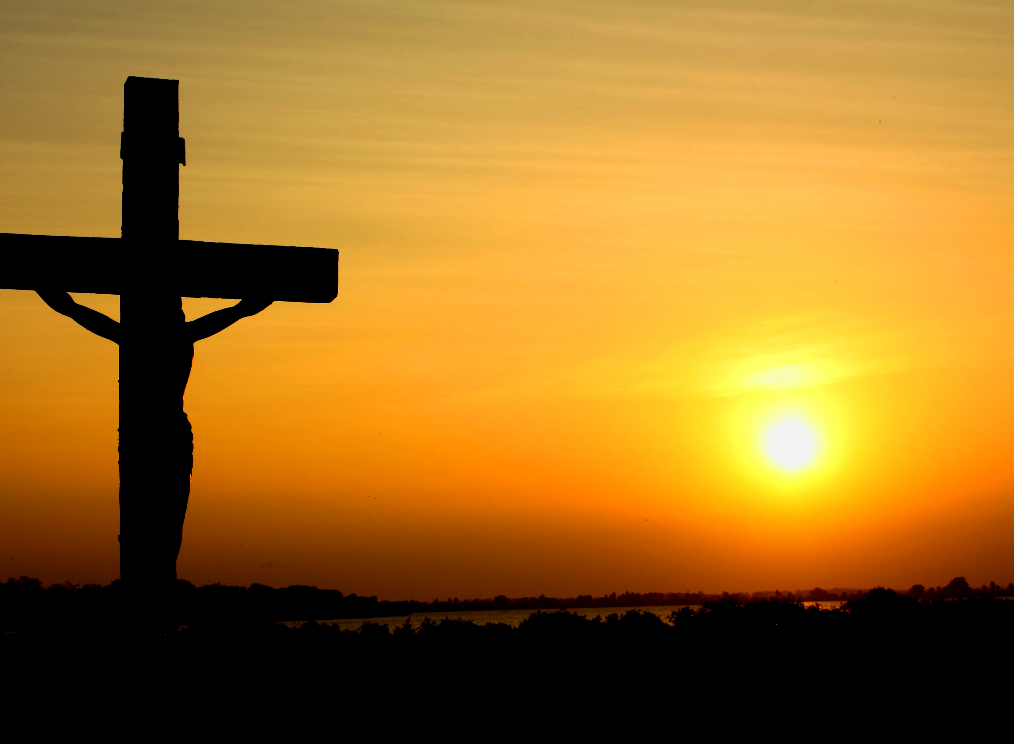
Notes:
Because of Jesus’ sacrifice, in the event of the death of a Christian, he/she will gain an inheritance like no other.

Slide 16
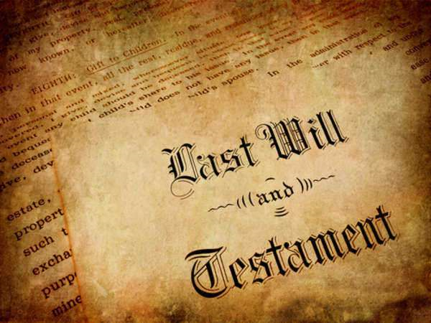
Notes:
No amount of earthly possessions that can be given away in a Last Will & Testament will compare to the inheritance found in Jesus Christ.

Slide 17
1 Peter 1:3-5
Blessed be the God and Father of our Lord Jesus Christ, which according to his abundant mercy hath begotten us again unto a lively hope by the resurrection of Jesus Christ from the dead,
To an inheritance incorruptible, and undefiled, and that fadeth not away, reserved in heaven for you,
Who are kept by the power of God through faith unto salvation ready to be revealed in the last time.
Notes:
Listen to what Peter said….

Slide 18
What will our inheritance look like?

Slide 19
Incorruptible
Notes:
It is not subject to death, decay, or corruption. There is no seed of death in it. It will endure forever in perfect condition

Slide 20
Undefiled
Notes:
It is not susceptible to being spoiled, stained, or made impure by sin. It is free from anything that would weaken or contaminate it. It is in its own nature pure, holy, and perfect.

Slide 21
Unfading
Notes:
On earth, everything is subject to fading, to gradually disappearing or dying. “The grass withers, and the flower falls off” (1 Peter 1:24). Our inheritance in Christ is not of this world. Colors will never lose their brightness. Light will never become dim. Everything will retain its freshness, vigor, strength, and health – permanently.

Slide 22
Reserved
Notes:
It is already prepared (Matthew 25:34). It is being kept secure in Heaven, where “thieves do not break in or steal” (Matthew 6:20). It is being kept specially for you.

Slide 23
WE HAVE AN inheritance
Notes:
Peter revealed that we are born again to an inheritance.
How can we have an inheritance? Because, in Christ, we have become heirs of God's endless fortunes.
How can we possibly be heirs of God? Because, in Christ, we have become God's own children.
Isn’t that incredible?
How great it is to serve a God who is preparing a place for us!
When you think about that inheritance, what’s the only thing that God doesn’t have there?

Slide 24
YOU

Slide 25
1 Corinthians 15:51-54
51 Behold, I shew you a mystery; We shall not all sleep, but we shall all be changed,
52 In a moment, in the twinkling of an eye, at the last trump: for the trumpet shall sound, and the dead shall be raised incorruptible, and we shall be changed.
53 For this corruptible must put on incorruption, and this mortal must put on immortality.
54 So when this corruptible shall have put on incorruption, and this mortal shall have put on immortality, then shall be brought to pass the saying that is written, Death is swallowed up in victory.
Notes:
At Christ’s return, you will receive a new, glorified body like His.

Slide 26
What kind of heirs are we?
Notes:
Going to heaven is not the natural result of simply having lived. It involves a choice.
When Jesus taught concerning the foolish virgins (Matt. 25:1-13), he was trying to impress upon our minds that everybody who anticipates going to heaven isn't going to go there.
The foolish virgins were not foolish because they were immoral, they were virgins.
They were not foolish because they were in the wrong company, they were with the wise.
They were foolish because they had a vain expectation of seeing the bridegroom. They had not been willing to prepare for him. They counted on others to have their preparation for them. Finally it was too late. They were on the outside looking in, as the door was shut.
To go to heaven takes time, prayer, thought, planning, discipline and perseverance.

Slide 27
What Will Heaven
Be Like?

Slide 28
Revelation 21
1 And I saw a new heaven and a new earth: for the first heaven and the first earth were passed away; and there was no more sea.
2 And I John saw the holy city, new Jerusalem, coming down from God out of heaven, prepared as a bride adorned for her husband.
3 And I heard a great voice out of heaven saying, Behold, the tabernacle of God is with men, and he will dwell with them, and they shall be his people, and God himself shall be with them, and be their God.
Notes:
At Christ’s return, you will receive a new, glorified body like His.

Slide 29
Revelation 21
4 And God shall wipe away all tears from their eyes; and there shall be no more death, neither sorrow, nor crying, neither shall there be any more pain: for the former things are passed away.
5 And he that sat upon the throne said, Behold, I make all things new. And he said unto me, Write: for these words are true and faithful.
6 And he said unto me, It is done. I am Alpha and Omega, the beginning and the end. I will give unto him that is athirst of the fountain of the water of life freely.
Notes:
At Christ’s return, you will receive a new, glorified body like His.

Slide 30
Revelation 21
7 He that overcometh shall inherit all things; and I will be his God, and he shall be my son.
8 But the fearful, and unbelieving, and the abominable, and murderers, and whoremongers, and sorcerers, and idolaters, and all liars, shall have their part in the lake which burneth with fire and brimstone: which is the second death.
Notes:
At Christ’s return, you will receive a new, glorified body like His.

Slide 31
Revelation 21
21 And the twelve gates were twelve pearls: every several gate was of one pearl: and the street of the city was pure gold, as it were transparent glass.
22 And I saw no temple therein: for the Lord God Almighty and the Lamb are the temple of it.
23 And the city had no need of the sun, neither of the moon, to shine in it: for the glory of God did lighten it, and the Lamb is the light thereof.
Notes:
At Christ’s return, you will receive a new, glorified body like His.

Slide 32
Revelation 21
24 And the nations of them which are saved shall walk in the light of it: and the kings of the earth do bring their glory and honour into it.
25 And the gates of it shall not be shut at all by day: for there shall be no night there.
26 And they shall bring the glory and honour of the nations into it.
27 And there shall in no wise enter into it any thing that defileth, neither whatsoever worketh abomination, or maketh a lie: but they which are written in the Lamb's book of life.
Notes:
At Christ’s return, you will receive a new, glorified body like His.

Slide 33
HEAVEN
Notes:
Is your name in the book of life?
Will you receive God’s glorious inheritance?
If not, become a Christian tonight by believing on Jesus, changing your life, confessing his sweet name, and be buried with him in baptism to walk a new life---to gain a new life—to gain an incorruptible inheritance!
If you are a Christian and you have become defiled with sin, make your life right tonight!
Will HEAVEN be your home?
Make your salvation certain tonight as we stand and sing!

