Slide 1
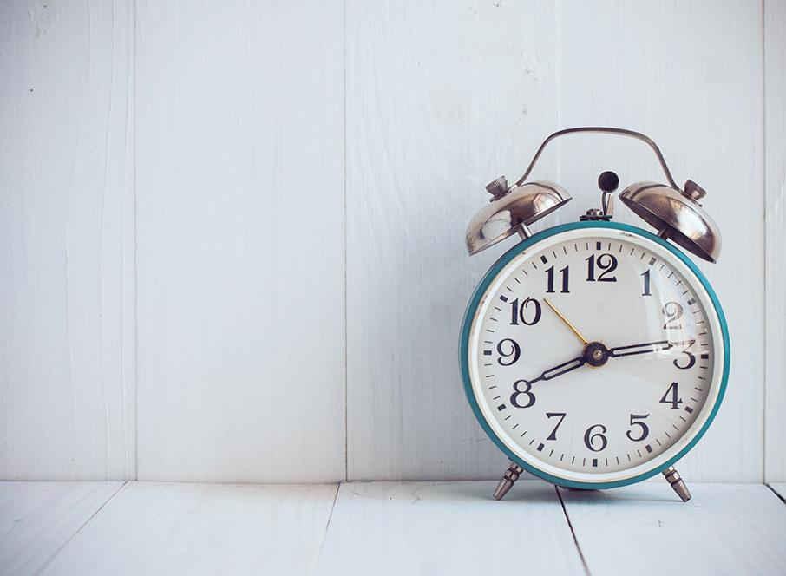
Time & Tardiness
T
2

Slide 2
Introduction
SOME DO NOT TAKE IT SERIOUSLY...
"The trouble with being punctual is that nobody's there to appreciate it."
"I am a believer in punctuality, though it makes me very lonely."
"Laugh and the world laughs with you, be prompt and you dine alone."
R
5
2

Slide 3
Introduction
YET OTHERS VALUE IT HIGHLY...
"Promptitude is not only a duty, but is also a part of good manners; it is favorable to fortune, reputation, influence, and usefulness.”
One might wonder whether punctuality is really all that important.
How about for the Christian, is it a sin to be habitually late for one's appointments?
E
24
3

Slide 4
Introduction
A
15
Is there a lack of appreciation regarding punctuality, especially as it relates to arriving on time for worship services?
Not the occasional lateness due to unforeseen or unavoidable circumstances.
But the habitual practice of being late due to a lack of concern for being on time.
Is there a need for concern regarding the lack of punctuality?
Does it has a negative effect on the spiritual growth and health of a congregation?
4

Slide 5
The Example of our Father
E
22
God was/is never late!
We read His Word and see…
Or
“then the Lord” appears 163 times in the Bible.
Joshua 5:2 At that time the Lord said to Joshua…
Deuteronomy 10:8 At that time the Lord separated (did)…
5

Slide 6
The Example of our Father
God was/is never late!
He sent forth Jesus at just the right time.
Galatians 4:4 But when the set time had fully come, God sent his Son, born of a woman, born under the law, 5 to redeem those under the law, that we might receive adoption to sonship.
E
14
6

Slide 7
The Example of our Father
God was/is never late!
Then He sent the star to guide the wise men.
Matthew 2:2 After Jesus was born in Bethlehem in Judea, during the time of King Herod, Magi from the east came to Jerusalem 2 and asked, “Where is the one who has been born king of the Jews? We saw his star when it rose and have come to worship him.”
I
21
7

Slide 8
The Example of our Savior
U
16
Jesus lived by a schedule.
He knew His time…
Even to the exact hour and moment.
John 7:6 Then Jesus said to them, “My time has not yet come, but your time is always ready.
John 12:27 “Now My soul is troubled, and what shall I say? ‘Father, save Me from this hour’? But for this purpose I came to this hour. 28 Father, glorify Your name.”
8

Slide 9
The Troubles of Tardiness
Tardiness is mistreatment of others.
Lack of punctuality is a theft of someone else's time.
Especially as an employee who is late for work. (see employee warning letter)
S
6
9

Slide 10
The Troubles of Tardiness
H
3
Tardiness is a lack of respect for others.
If we honor others better than ourselves, we will make it a point to be on time when meeting with them.
Most wouldn’t be late for an appointment with someone whom they want to honor. (President)
Philippians 2:3 Let nothing be done through selfish ambition or conceit, but in lowliness of mind let each esteem others better than himself. 4 Let each of you look out not only for his own interests, but also for the interests of others.
10

Slide 11
The Troubles of Tardiness
Tardiness is a lack of respect for others.
But even as friends (or brethren), where we have agreed to meet at a set time.
10AM, 1045AM, 5PM, 7PM.
Romans 12:10 Be kindly affectionate to one another with brotherly love, in honor giving preference to one another; 11 not lagging in diligence, fervent in spirit, serving the Lord;
T
1
11

Slide 13
7:29
Wednesday

Slide 14
7:30
Wednesday

Slide 15
The Troubles of Tardiness
Tardiness is a lack of respect for others.
We wouldn’t be tardy for other events, would we?
Matthew 18:20 For where two or three are gathered together in My name, I am there in the midst of them.”
U
18
15

Slide 16
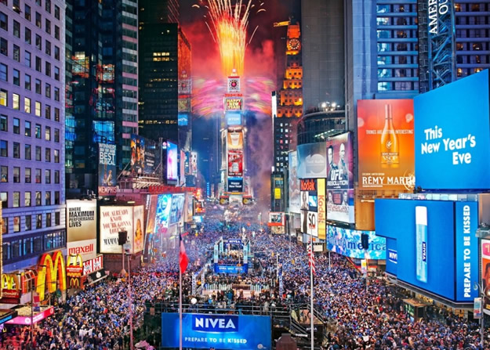
At midnight TONIGHT…
O
9
16

Slide 17
The Troubles of Tardiness
F
19
What about the impact on visitors?
Who often allow more time to find the location and arrive early.
It’s an opportunity for us to welcome them and briefly visit with them.
But if we are late…
What must they think when there are no teachers to welcome their children?
We will be a distraction late.
The visitors may be likely to leave quickly. Often the only time we have to visit with them is before the services.
Y
13
17

Slide 18
The Troubles of Tardiness
O
17
Tardiness is a violation of the “Golden Rule”.
How do you value your time?
Are you not bothered when others are late in meeting you?
Matthew 7:12 So in everything, do to others what you would have them do to you, for this sums up the Law and the Prophets.
18

Slide 19
The Troubles of Tardiness
Tardiness is a violation of the “Golden Rule”.
Suppose you were teaching a class, and half the class was consistently late?
How would that make you feel about your efforts?
Not only during class, but the time spent in preparation?
T
20
19

Slide 20
The Troubles of Tardiness
M
23
Tardiness is a violation of the “Greatest Commandment”.
Mark 12:29 Jesus answered him, “The first of all the commandments is: ‘Hear, O Israel, the Lord our God, the Lord is one. 30 And you shall love the Lord your God with all your heart, with all your soul, with all your mind, and with all your strength.’ This is the first commandment. 31 And the second, like it, is this: ‘You shall love your neighbor as yourself.’ There is no other commandment greater than these.”
20

Slide 21
The Troubles of Tardiness
B
4
S
11
When we are late for these meetings to worship God or to learn of God, it may be indicative God is not really as important as whatever causes us to be late, be it our bodily rest, our meals, our recreation, our chores, etc. We are, of course, not saying that all lateness for the appointed means would fall into this sin. But if we are habitually late for the means, we must really examine our attitude towards the Lord. One who is generally on time for other appointments but is usually late for worship or prayer is probably experiencing severe backsliding. One who is generally late for all appointments is probably also suffering some form of tardiness in the soul. No one who genuinely loves Christ can be late for an appointment with Him without feeling shame and embarrassment." - Pilgrim Covenant Church web site
21

Slide 22
The Troubles of Tardiness
E
10
Tardiness is a violation of the “Fruit of the Spirit”.
Faithfulness is shown by dependability.
Does tardiness show self control?
Galatians 5:22 But the fruit of the Spirit is love, joy, peace, longsuffering, kindness, goodness, faithfulness, 23 gentleness, self-control. Against such there is no law. 24 And those who are Christ’s have crucified the flesh with its passions and desires. 25 If we live in the Spirit, let us also walk in the Spirit.
22

Slide 23
The Troubles of Tardiness
Tardiness results in missed opportunities
Think of the missed opportunities when we are late to services of the church.
The opportunity to visit with brethren and visitors (as discussed).
The opportunity to hear some point, some truth, that was presented prior to arriving late.
The opportunity to be of service should there be a last minute need. (fill in or put out chairs)
K
12
23

Slide 24
Conclusion
M
7
Practicing Punctuality in 2018 will make us better servants.
Providing service to our visitors through meeting them before as well as after.
Providing service to our brethren by edifying them through your prompt presence.
Providing service to our Lord by honoring Him with your punctual arrival.
24

Slide 25
Conclusion
Our Lord was on a schedule, and He kept it!
Maybe we need to practice punctuality in 2018.
MAKE THE BEST USE OF YOUR TIME!
Puzzle Answer
Ephesians 5:15 ESV Look carefully then how you walk, not as unwise but as wise, 16 making the best use of the time, because the days are evil. 17 Therefore do not be foolish, but understand what the will of the Lord is.
25

