Slide 2
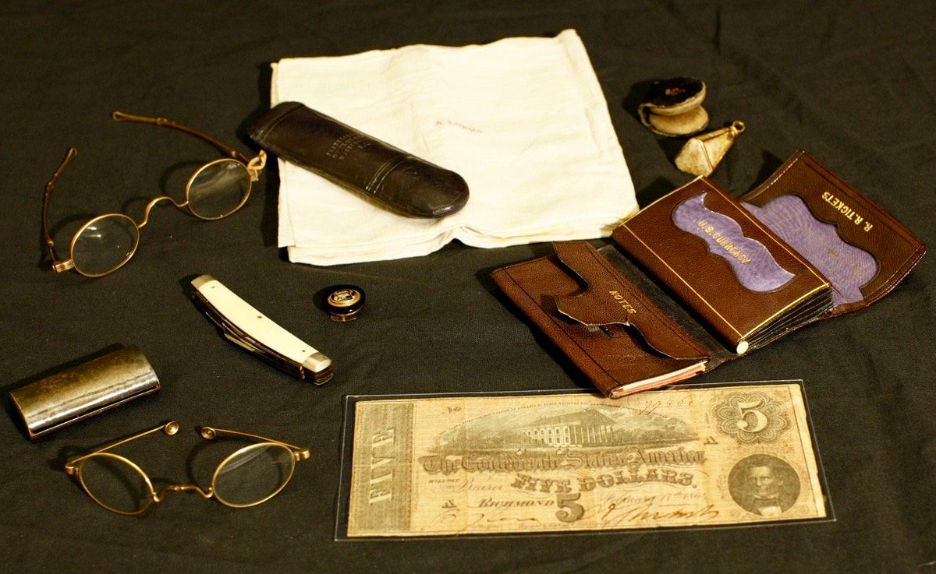

Slide 3
What's in your pockets?
1 Thessalonians 1:1-5

Slide 4
1 Thessalonians 1: 1-5 (NKJV)
1 Paul, Silvanus, and Timothy, To the church of the Thessalonians in God the Father and the Lord Jesus Christ: Grace to you and peace from God our Father and the Lord Jesus Christ.
2 We give thanks to God always for you all, making mention of you in our prayers, 3 remembering without ceasing your work of faith, labor of love, and patience of hope in our Lord Jesus Christ in the sight of our God and Father, 4 knowing, beloved brethren, your election by God. 5 For our gospel did not come to you in word only, but also in power, and in the Holy Spirit and in much assurance, as you know what kind of men we were among you for your sake.

Slide 5
work of faith
James 2:20 & 26 (NKJV)
20 But do you want to know, O foolish man, that faith without works is dead?
26 For as the body without the spirit is dead, so faith without works is dead also.

Slide 6
work of faith
2 Thessalonians 1:3 (NKJV)
3 We are bound to thank God always for you, brethren, as it is fitting, because your faith grows exceedingly, and the love of every one of you all abounds toward each other

Slide 7
work of faith
Romans 10:17 (NKJV)
17 So then faith comes by hearing, and hearing by the word of God.

Slide 8
work of faith
John 20:30-31 (NKJV)
30 And truly Jesus did many other signs in the presence of His disciples, which are not written in this book; 31 but these are written that you may believe that Jesus is the Christ, the Son of God, and that believing you may have life in His name.

Slide 9
labor of love
1 John 3:18 (NKJV)
18 My little children, let us not love in word or in tongue, but in deed and in truth.

Slide 10
labor of love
1 Thessalonians 4:9-10 (NKJV)
9 But concerning brotherly love you have no need that I should write to you, for you yourselves are taught by God to love one another; 10 and indeed you do so toward all the brethren who are in all Macedonia. But we urge you, brethren, that you increase more and more;

Slide 11
labor of love
John 13:34-35 (NKJV)
34 A new commandment I give to you, that you love one another; as I have loved you, that you also love one another. 35 By this all will know that you are My disciples, if you have love for one another.”

Slide 12
labor of love
1 John 3:18-19 (NKJV)
18 My little children, let us not love in word or in tongue, but in deed and in truth. 19 And by this we know that we are of the truth, and shall assure our hearts before Him.

Slide 13
patience of hope
Romans 8:25 (NKJV)
25 But if we hope for what we do not see, we eagerly wait for it with perseverance.

Slide 14
patience of hope
1 Thessalonians 5:8 (NKJV)
8 But let us who are of the day be sober, putting on the breastplate of faith and love, and as a helmet the hope of salvation.

Slide 15
patience of hope
1 Peter 3:15 (NKJV)
15 But sanctify the Lord God in your hearts, and always be ready to give a defense to everyone who asks you a reason for the hope that is in you, with meekness and fear;

Slide 16
patience of hope
1 John 2:17 (NKJV)
17 And the world is passing away, and the lust of it; but he who does the will of God abides forever.

Slide 17
Who needs it?
Colossians 1:4-5 (NKJV)
4 since we heard of your faith in Christ Jesus and of your love for all the saints; 5 because of the hope which is laid up for you in heaven, of which you heard before in the word of the truth of the gospel

Slide 18
Who needs it?
1 Corinthians 13:13 (NKJV)
13 And now abide faith, hope, love, these three; but the greatest of these is love

Slide 19
1 Thessalonians 50-51 ad
1 Corinthians 55-56 ad
Colossians 62-63 ad

