Slide 2
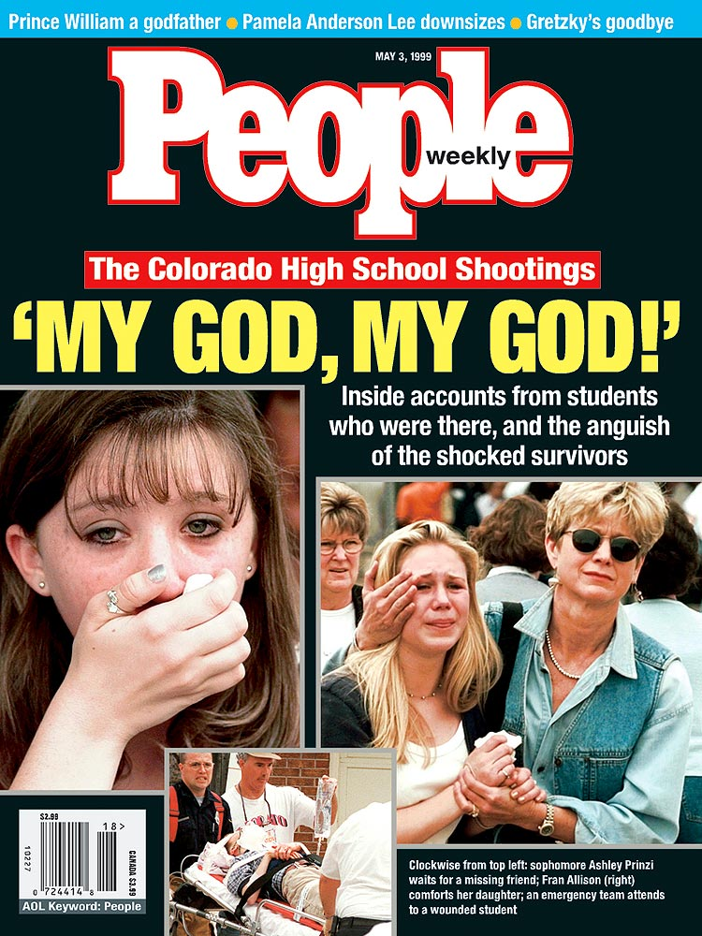
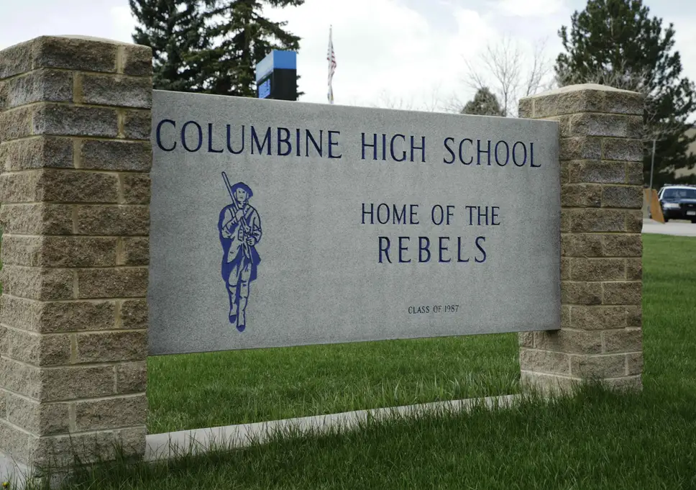
April 20th 1999

Slide 3
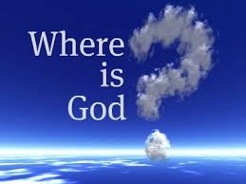
Where is God?
Psalm 139:7-12

Slide 4
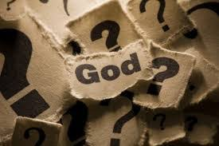
We often question where is God...
“I think it’s a natural question to ask ourselves. And I think it’s ok to ask, Where is God when something like this happens? Or perhaps why does God allow things like to happen? We are hurting and sad… And we just ask, God why?”

Slide 5
Psalms 42:3
My tears have been my food day and night, While they say to me all day long, “Where is your God?”

Slide 6
The simple answer...God is everywhere.
Where can I go from Your Spirit? Or where can I flee from Your presence? If I ascend to heaven, You are there; If I make my bed in Sheol, behold, You are there. If I take the wings of the dawn, If I dwell in the remotest part of the sea, Even there Your hand will lead me, And Your right hand will lay hold of me. If I say, “Surely the darkness will overwhelm me, And the light around me will be night,” Even the darkness is not dark to You, And the night is as bright as the day. Darkness and light are alike to You. Psalms 139:7-12

Slide 7
But...Doesn’t a question that important...
Deserve an answer more complex?

Slide 8
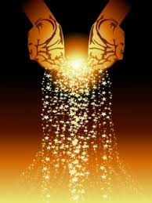
Or perhaps the question is wrong...
“Because of the multitude of oppressions they cry out; They cry for help because of the arm of the mighty. “But no one says, ‘Where is God my Maker,
Who gives songs in the night, Job 35:9-10

Slide 9
Where is God when I am all alone?
So Ahab sent a message among all the sons of Israel and brought the prophets together at Mount Carmel. Elijah came near to all the people and said, “How long will you hesitate between two opinions? If the Lord is God, follow Him; but if Baal, follow him.” But the people did not answer him a word. Then Elijah said to the people, “I alone am left a prophet of the Lord, but Baal’s prophets are 450 men. I Kings 18:20-22

Slide 10
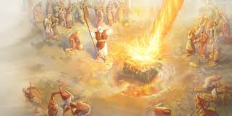
I alone am left...
Then he came there to a cave and lodged there; and behold, the word of the Lord came to him, and He said to him, “What are you doing here, Elijah?” He said, “I have been very zealous for the Lord, the God of hosts; for the sons of Israel have forsaken Your covenant, torn down Your altars and killed Your prophets with the sword. And I alone am left; and they seek my life, to take it away.” I Kings 19:9-10

Slide 11
God’s answer
So He said, “Go forth and stand on the mountain before the Lord.” And behold, the Lord was passing by! And a great and strong wind was rending the mountains and breaking in pieces the rocks before the Lord; but the Lord was not in the wind. And after the wind an earthquake, but the Lord was not in the earthquake. After the earthquake a fire, but the Lord was not in the fire; and after the fire a still small voice. When Elijah heard it, he wrapped his face in his mantle and went out and stood in the entrance of the cave. I Kings 19: 11-13

Slide 12
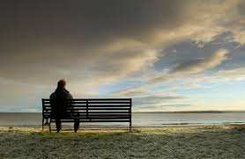
Where is God when I am alone?
God is there with you.
Where can I go from Your Spirit? Or where can I flee from Your presence?
Psalms 139

Slide 13
Where is God when I feel hopeless?
The word of the Lord came to Jonah the son of Amittai saying, “Arise, go to Nineveh the great city and cry against it, for their wickedness has come up before Me.” But Jonah rose up to flee to Tarshish from the presence of the Lord. Jonah 1:1-2
So they said to him, “What should we do to you that the sea may become calm for us?”—for the sea was becoming increasingly stormy. He said to them, “Pick me up and throw me into the sea. Then the sea will become calm for you… 11-12
And the Lord appointed a great fish to swallow Jonah, and Jonah was in the stomach of the fish three days and three nights. 17

Slide 14
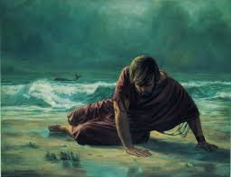
Is there a more hopeless person ?
I called out of my distress to the Lord, And He answered me. I cried for help from the depth of Sheol; You heard my voice. “For You had cast me into the deep, Into the heart of the seas, And the current engulfed me. All Your breakers and billows passed over me. “So I said, ‘I have been expelled from Your sight. Nevertheless I will look again toward Your holy temple.’ “Water encompassed me to the point of death. The great deep engulfed me, Weeds were wrapped around my head. Jonah 2:1-5

Slide 15
God’s answer...
“While I was fainting away, I remembered the Lord, And my prayer came to You, Into Your holy temple. Jonah 2:7
Then the Lord commanded the fish, and it vomited Jonah up onto the dry land. Vs. 10

Slide 16
Where is God when I feel hopeless?
God is everywhere all around.
If I ascend to heaven, You are there; If I make my bed in Sheol, behold, You are there. Psalms 139

Slide 17
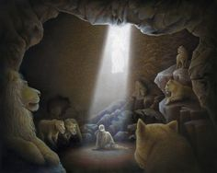
Where is God when I am afraid?
Now when Daniel knew that the document was signed, he entered his house (now in his roof chamber he had windows open toward Jerusalem); and he continued kneeling on his knees three times a day, praying and giving thanks before his God, as he had been doing previously. Then these men came by agreement and found Daniel making petition and supplication before his God. Daniel 6:10-11

Slide 18
God’s answer?
Then the king gave orders, and Daniel was brought in and cast into the lions’ den. The king spoke and said to Daniel, “Your God whom you constantly serve will Himself deliver you.” Daniel 6:16
Then the king arose at dawn, at the break of day, and went in haste to the lions’ den. When he had come near the den to Daniel, he cried out with a troubled voice. The king spoke and said to Daniel, “Daniel, servant of the living God, has your God, whom you constantly serve, been able to deliver you from the lions?” Daniel 6:19-20

Slide 19
Where is God when I am afraid?
God is alive.
You are there. If I take the wings of the dawn, If I dwell in the remotest part of the sea, Even there Your hand will lead me, And Your right hand will lay hold of me.

Slide 20
Where is God when we feel overwhelmed?
Now the heart of the king of Aram was enraged over this thing; and he called his servants and said to them, “Will you tell me which of us is for the king of Israel?” One of his servants said, “No, my lord, O king; but Elisha, the prophet who is in Israel, tells the king of Israel the words that you speak in your bedroom.” II Kings 6:11-12
Now when the attendant of the man of God had risen early and gone out, behold, an army with horses and chariots was circling the city. And his servant said to him, “Alas, my master! What shall we do?” II Kings 6:15

Slide 21
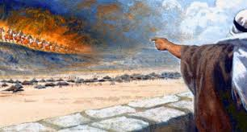
God’s answer...
So he answered, “Do not fear, for those who are with us are more than those who are with them.” Then Elisha prayed and said, “O Lord, I pray, open his eyes that he may see.” And the Lord opened the servant’s eyes and he saw; and behold, the mountain was full of horses and chariots of fire all around Elisha. When they came down to him, Elisha prayed to the Lord and said, “Strike this people with blindness, I pray.” So He struck them with blindness according to the word of Elisha. II Kings 6:16-18

Slide 22
Where is God when I feel overwhelmed?
God is there in the dark.
“Surely the darkness will overwhelm me, And the light around me will be night,” Even the darkness is not dark to You, And the night is as bright as the day… Psalms 139

Slide 23
Maybe a simple answer is enough...
Where can I go from Your Spirit? Or where can I flee from Your presence? If I ascend to heaven, You are there; If I make my bed in Sheol, behold, You are there. If I take the wings of the dawn, If I dwell in the remotest part of the sea, Even there Your hand will lead me, And Your right hand will lay hold of me. If I say, “Surely the darkness will overwhelm me, And the light around me will be night,” Even the darkness is not dark to You, And the night is as bright as the day.Darkness and light are alike to You. Psalms 139:7-12

Slide 24
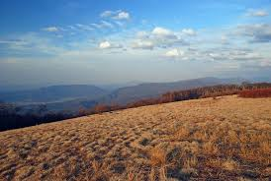
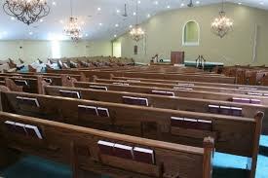
God is everywhere!
He is always there!

Slide 25
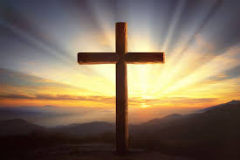
Where is God when I suffer?
Then they brought Him to the place Golgotha, which is translated, Place of a Skull. They tried to give Him wine mixed with myrrh; but He did not take it. And they crucified Him, and divided up His garments among themselves, casting [g]lots for them to decide what each man should take. It was the third hour when they crucified Him. 26 The inscription of the charge against Him read, “THE KING OF THE JEWS.” They crucified two robbers with Him, one on His right and one on His left. - Mark 22:27

Slide 26
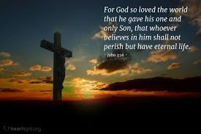

Slide 27
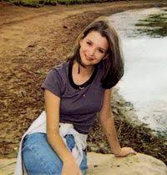
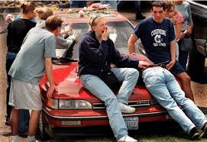

Slide 28
Where is God when I suffer?
God is right there suffering with you.
In all their affliction He was afflicted,
And the angel of His presence saved them… Isaiah 63:9

