Slide 2
1964

Slide 3
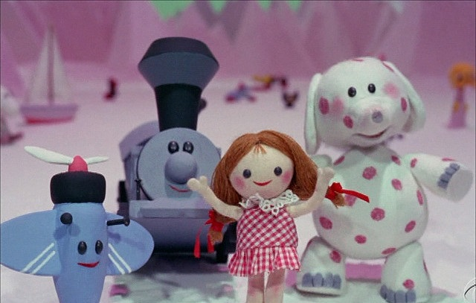

Slide 4
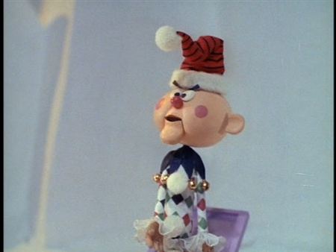
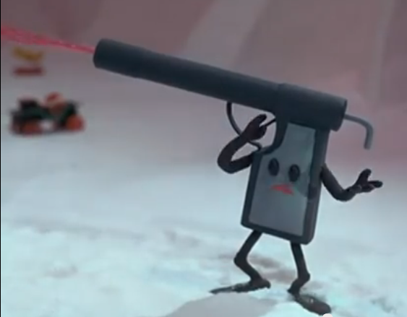
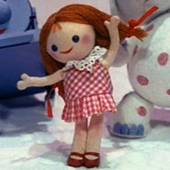
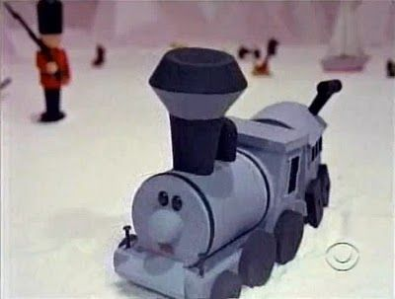
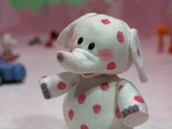

Slide 5
We are a group of misfit toys.
I find then the principle that evil is present in me, the one who wants to do good. For I joyfully concur with the law of God in the inner man, but I see a different law in the members of my body, waging war against the law of my mind and making me a prisoner of the law of sin which is in my members. Wretched man that I am! Who will set me free from the body of this death? Thanks be to God through Jesus Christ our Lord! So then, on the one hand I myself with my mind am serving the law of God, but on the other, with my flesh the law of sin. Romans 7: 21-25

Slide 6
Why am I such a misfit?

Slide 7
I am a misfit because I have sinned.
for all have sinned and fall short of the glory of God, being justified as a gift by His grace through the redemption which is in Christ Jesus -Romans 3:23-24

Slide 8
I am a misfit because grace is the only thing that justifies me. .
But when the kindness of God our Savior and His love for mankind appeared, He saved us, not on the basis of deeds which we have done in righteousness, but according to His mercy, by the washing of regeneration and renewing by the Holy Spirit, whom He poured out upon us richly through Jesus Christ our Savior, so that being justified by His grace we would be made heirs according to the hope of eternal life. Titus 3:4-8

Slide 9
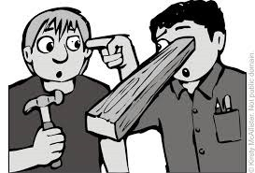
Don’t judge?!?!?
Do not judge so that you will not be judged. For in the way you judge, you will be judged; and by your standard of measure, it will be measured to you. Why do you look at the speck that is in your brother’s eye, but do not notice the log that is in your own eye? Or how can you say to your brother, ‘Let me take the speck out of your eye,’ and behold, the log is in your own eye? You hypocrite, first take the log out of your own eye, and then you will see clearly to take the speck out of your brother’s eye. Matthew 7: 1-5

Slide 10
Judge on actions.
Woe to you, scribes and Pharisees, hypocrites! For you tithe mint and dill and cummin, and have neglected the weightier provisions of the law: justice and mercy and faithfulness; but these are the things you should have done without neglecting the others. -Matthew 23:23

Slide 11
I am a misfit because of the way I judge.

Slide 12
I am a misfit because I am incomplete.
“There is a God-shaped vacuum in the heart of each man which cannot be satisfied by any created thing but only by God the Creator, made known through Jesus Christ.” - Pascal

Slide 13
Philippians 3:12-14, 20-21
Not that I have already obtained it or have already become perfect, but I press on so that I may lay hold of that for which also I was laid hold of by Christ Jesus. Brethren, I do not regard myself as having laid hold of it yet; but one thing I do: forgetting what lies behind and reaching forward to what lies ahead, I press on toward the goal…
For our citizenship is in heaven, from which also we eagerly wait for a Savior, the Lord Jesus Christ; who will transform the body of our humble state into conformity with the body of His glory, by the exertion of the power that He has even to subject all things to Himself.

Slide 14
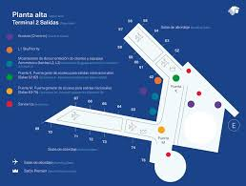
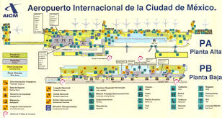
Mexico City Airport

Slide 15
I am a misfit because I am different than the world.
… Do you not know that your body is a temple of the Holy Spirit who is in you, whom you have from God, and that you are not your own? For you have been bought with a price: therefore glorify God in your body.
I Corinthians 6: 19-20
For he who was called in the Lord while a slave, is the Lord’s freedman; likewise he who was called while free, is Christ’s slave. You were bought with a price; do not become slaves of men.
I Corinthians 7: 22-23

Slide 16
Do you ever forget your place?
Then the Pharisees went and plotted together how they might trap Him in what He said. And they *sent their disciples to Him, along with the Herodians, saying, “Teacher, we know that You are truthful and teach the way of God in truth, and defer to no one; for You are not partial to any. Tell us then, what do You think? Is it lawful to give a poll-tax to Caesar, or not?” But Jesus perceived their malice, and said, “Why are you testing Me, you hypocrites? Show Me the coin used for the poll-tax.” And they brought Him a denarius. And He *said to them, “Whose likeness and inscription is this?” They *said to Him, “Caesar’s.” Then He *said to them, “Then render to Caesar the things that are Caesar’s; and to God the things that are God’s.” And hearing this, they were amazed, and leaving Him, they went away. Matthew 22:15-22

Slide 18
I am a misfit because I don’t want to fit in!
But you are a chosen race, a royal priesthood, a holy nation, a people for God’s own possession, so that you may proclaim the excellencies of Him who has called you out of darkness into His marvelous light; for you once were not a people, but now you are the people of God; you had not received mercy, but now you have received mercy. Beloved, I urge you as aliens and strangers to abstain from fleshly lusts which wage war against the soul….
I Peters 2: 9-12

Slide 19
A Great Evangelistic Tool
I think it works better than radio, better than auto-dialers, better than showings of Jule Miller filmstrips, better than mailing out a bulletin, better than Dial-a-bible-reading, better than debates, better than cable tv. What is it? It’s brethren not being conformed to the world. If a church is made up of people who understand 184 current and past issues (or more) correctly, but their lives do not show superior conduct, servitude, and holiness, don’t expect an auto dialer, computer, printer, broadcast antenna, or cable outlet to compensate for the failure. When church members think like the world, dress like the world; talk like the world; and chase money and status symbols like the world, it is the world that is winning them, not the other way around.

Slide 20
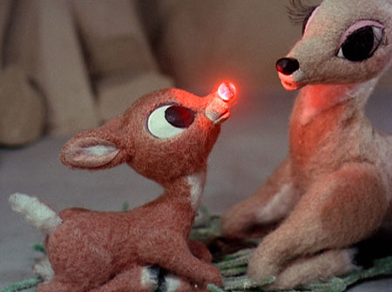
A Great Evangelistic Tool
When church members are selfish, egotistical, arrogant, and shallow, then they are not in a position to help the world to a higher plane. If our families are splitting up, our children are dropping out, and our homes are very little different from our neighbors then our “light” gets rather difficult to notice. We are not called simply to know some things different from the world - we are called to rise above the world, and to “be holy”. And when people become that kind of light, it creates a great evangelistic tool. And it will far exceed the effect of debates, radio, tv, and mail outs. - by Scott Smelser

Slide 21
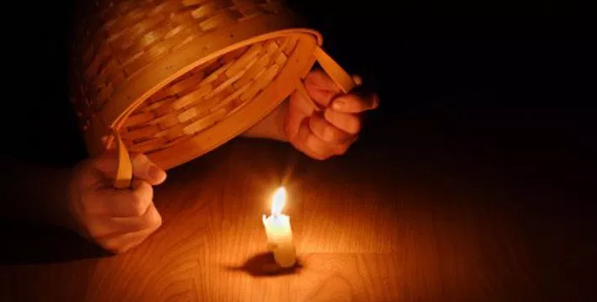
Hide it under a bushel…. NO!

Slide 22
We are doing our jobs if we don’t fit in.
“If the world hates you, you know that it has hated Me before it hated you. If you were of the world, the world would love its own; but because you are not of the world, but I chose you out of the world, because of this the world hates you. John 15: 18-19

Slide 23
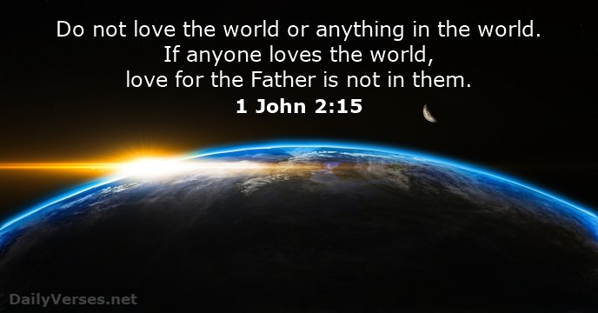

Slide 24
I am proud to be a misfit…
...coming to Him as to a living stone which has been rejected by men, but is choice and precious in the sight of God, you also, as living stones, are being built up as a spiritual house for a holy priesthood, to offer up spiritual sacrifices acceptable to God through Jesus Christ. For this is contained in Scripture: “Behold, I lay in Zion a choice stone, a precious cornerstone, And he who believes in Him will not be disappointed.” I Peter 2: 4-6

Slide 26
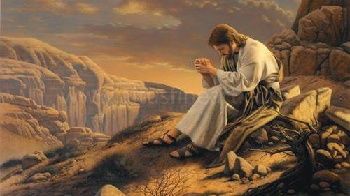
Jesus prayed for you.
I have given them Your word; and the world has hated them, because they are not of the world, even as I am not of the world. I do not ask You to take them out of the world, but to keep them from the evil one. They are not of the world, even as I am not of the world. John 17: 14-16

Slide 27
Never forget that you are loved beyond belief.
For God so loved the world...John 3:16

Slide 28
Dear God, Help us at O’Neal…to be a people That BELONG to You and
seek to practice what You teach us in Your word.
In Jesus name. Amen

