Slide 1
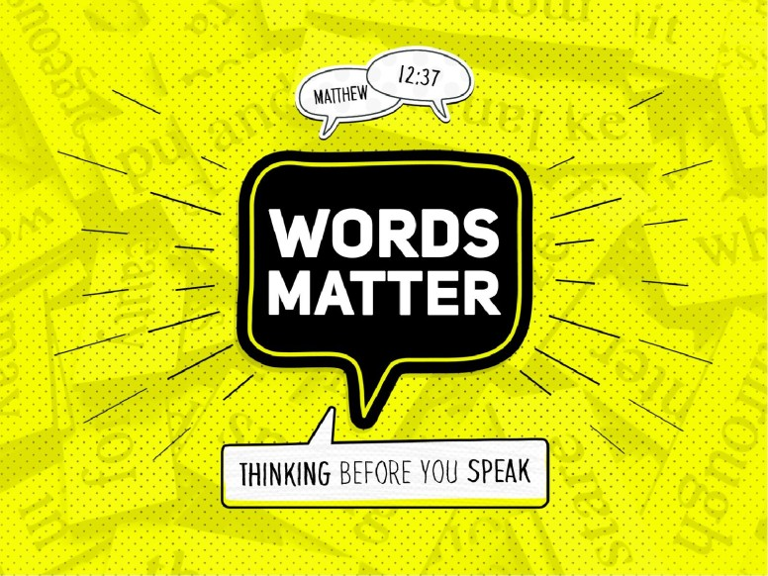

Slide 2
Words Matter
GOD’S WORDS MATTER
CONCERNING Salvation:
Mark 16:15-16
Concerning the Church
Matt. 16:18
Concerning Life…
Phil.l:27

Slide 3
Words of Others Matter
WORDS OF OTHERS MATTER
Parents to children …Eph. 6:1-2
Listen to your parents
Promise you make when you are married.
Do you take this man/woman///? I Do…
..till death do you part. Matt. 19:9

Slide 4
Our Words matter
What we say: Tell the truth..John 8:32
Words that speak..
Example: Ananias and Sapphira Acts 5
Jesus: Let your Yes be Yes and your No be No
Be careful “how “ you say…

Slide 5
So much is said in the Bible about “words”
God’s Words are so important. We need to read
And study and obey every word of God.
The words of others have a great influence upon
Us.
Our words.. words that you and I speak. So often,
If only we would ‘think’ before we speak, we would
make sure we are saying the truth, and saying it in
a way that is acceptable unto God.

Slide 6
Matt. 12:36-37 KJV
³⁶ But I say unto you, That every idle word that men shall speak, they shall give account thereof in the day of judgment.
³⁷ For by thy words thou shalt be justified, and by thy words thou shalt be condemned.
Matthew 12:36-37 (NKJV)
³⁶ But I say to you that for every idle word men may speak, they will give account of it in the day of judgment. ³⁷ For by your words you will be justified, and by your words you will be condemned.”

Slide 7
Bible Example:
Acts 5:1-11 But a certain man named Ananias, with Sapphira his wife, sold a possession,² And kept back part of the price, his wife also being privy to it, and brought a certain part, and laid it at the apostles' feet.³ But Peter said, Ananias, why hath Satan filled thine heart to lie to the Holy Ghost, and to keep back part of the price of the land?⁴ Whiles it remained, was it not thine own? and after it was sold, was it not in thine own power? why hast thou conceived this thing in thine heart? thou hast not lied unto men, but unto God.⁵ And Ananias hearing these words fell down, and gave up the ghost: and great fear came on all them that heard these things.⁶ And the young men arose, wound him up, and carried him out, and buried him

Slide 8
⁷ And it was about the space of three hours after, when his wife, not knowing what was done, came in.
⁸ And Peter answered unto her, Tell me whether ye sold the land for so much? And she said, Yea, for so much.
⁹ Then Peter said unto her, How is it that ye have agreed together to tempt the Spirit of the Lord? behold, the feet of them which have buried thy husband are at the door, and shall carry thee out.
¹⁰ Then fell she down straightway at his feet, and yielded up the ghost: and the young men came in, and found her dead, and, carrying her forth, buried her by her husband.
¹¹ And great fear came upon all the church, and upon as many as heard these things.

Slide 9
Speech is one of the greatest endowments of humanity; and the greater the gift, the greater the sin of perverting it to unworthy purposes.
It would be impossible to sum up all the sins of mankind in the area of sinful speech. It must appear even to casual thought of it that words, as used by millions, constitute the bulk of human shame and wickedness.
James said, "If any stumbleth not in word, the same is a perfect man, able to bridle the whole body also" (James 3:2).

Slide 10
Beyond everything else, man should watch what he says.
One's words can justify when they confess Christ,
or teach the truth, or serve to make peace,
bestow a blessing, or give encouragement;
but on the other hand, when words
condemn, cast a reflection, subvert the truth, utter profanity, vulgarity, hatred, or malice, or any one of a million other evil things - then such words bring the condemnation of those who speak them.” James Burton Coffman

Slide 11
In the outset of this sermon,
we should remember:

Slide 12
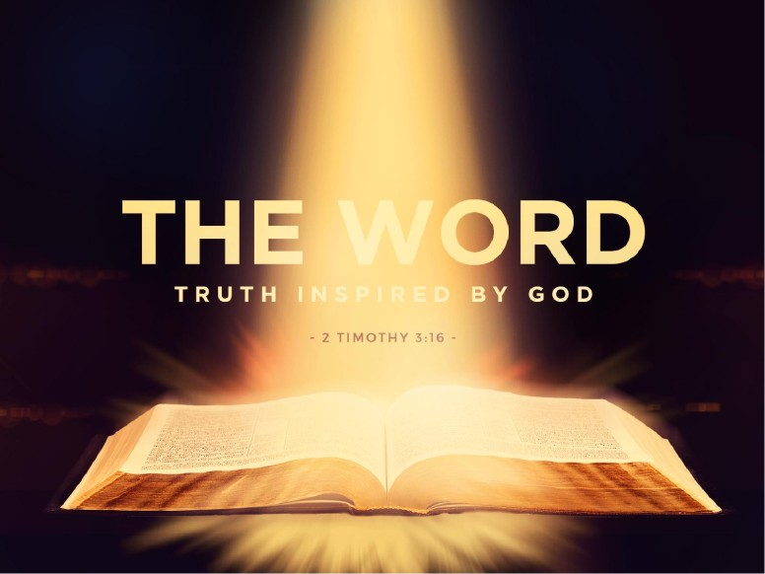

Slide 13
Psalm 19:14 Let the words of my mouth
And the meditation of my heart
Be acceptable in thy sight,
O Lord, my strength and my redeemer.
This prayer has been the favorite of many God
Fearing people.
1. The outward word
2. The inward meditation

Slide 14
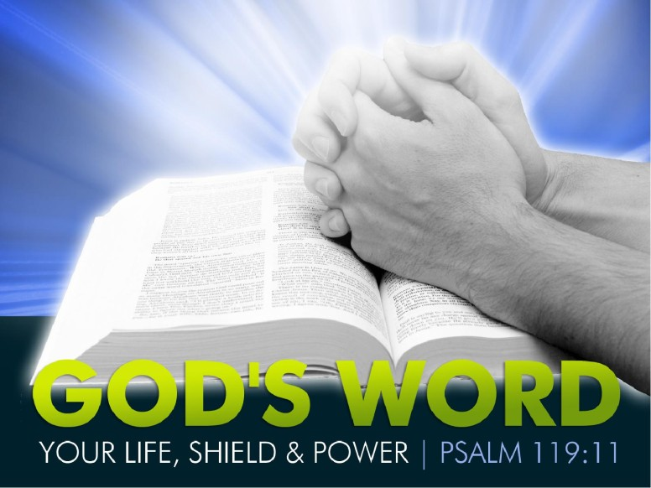
Thy word have I hid in mine heart, that I might not sin against thee.

Slide 15
We live life by ideas,
and words are the pieces of which ideas are built.
Consider:
Words can poison, words can heal.
Words start and fight wars but words can make peace. Words lead men to do great good and great harm.
Nelson Mandela wrote “It is never my custom to use words lightly. If 27 years in prison have done anything to us, it was to use the silence of solitude to make us understand how precious words are and how real speech is in its impact on the way people live and die

Slide 16
There are certain phrases that when honestly spoken have the power to transform the life of those who repeat them.
This is certainly true in the scripture.
The words you say and the words you hear carry a lot of weight—more than you might think!

Slide 17
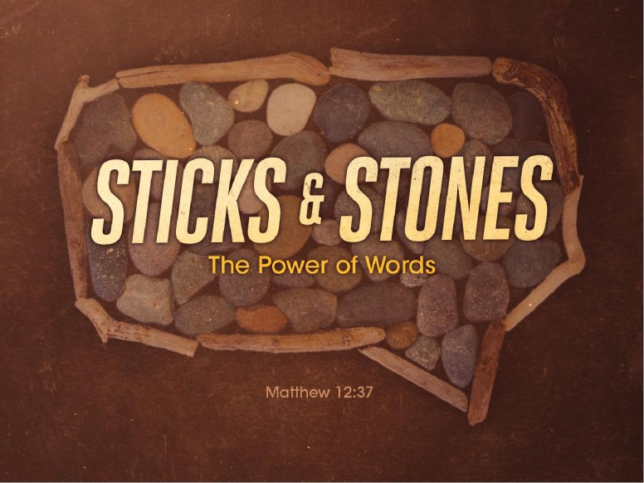

Slide 18
We will be justified or condemned because of the words Of our mouths.
a)Lies in words
b)Cruel judgment in words
c)Unkindness in words
d)Harsh words
e)Despictable words
f)Damnable words

Slide 19
Never forget what Jesus said: Matt. 12:37
New International Version
For by your words you will be acquitted,
and by your words you will be condemned."

Slide 20
Words Matter

Slide 21
Playing Scramble with my 93 year old sister:

Slide 22
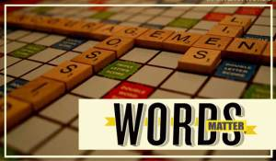

Slide 23
Words Matter
God’s Words Matter
And
So do our Words matter
The Words we speak are to be :
a)Acceptable to God
b)Acceptable to Men
c)Acceptable to ourselves

Slide 24
Angry Words
Angry words! O let them never,
From the tongue unbridled slip,
May the heart's best impulse ever,
Check them ere they soil the lip.
Love one another thus saith the Savior,
Children obey the Father's blest command,
Love each other, love each other,
'Tis the Father's blest command.

Slide 25
Love is much too pure and holy,
Friendship is too sacred far,
For a moment's reckless folly,
Thus to desolate and mar.
Love one another thus saith the Savior,
Children obey the Father's blest command,
Love each other, love each other,
'Tis the Father's blest command.

Slide 26
Angry words are lightly spoken,
Bitterest thoughts are rashly stirred,
Brightest links of life are broken,
By a single angry word.
Love one another thus saith the Savior,
Children obey the Father's blest command,
Love each other, love each other,
'Tis the Father's blest command.

Slide 27
Contrast of words in the Bible:
Words of Mischief: Words of Comfort
Prov. 24:2 ² For their heart studieth destruction, and their lips talk of mischief.
Change - - - - To
Curse words - Pure words
Filthy words - Clean words
Bad words - Good words
Uncaring words- Sympathic words
Hatred words - Loving words
Cruel words - Comforting words
Words of Comfort…I Thess. 4:18 Wherefore comfort one another
with these words.

Slide 28
Here is a good practice for living when it comes to what you will say or refrain from saying. We can form an acrostic from the word THINK.
We should THINK before we speak of another.
T - Is it True?
H - Will it Help?
I - Is it Inspiring?
N - Is it Necessary?
K - Is it Kind?

Slide 29
The Bible is full of scripture that will help us
To be speaking words that matter!

Slide 30
Prov. 15:1 A soft answer turneth away wrath: but grievous words stir up anger
Proverbs 15:23 A man hath joy by the answer of his mouth: and a word spoken in due season, how good is it!
Prov. 25:11 A word fitly spoken is like apples of gold in pictures of silver

Slide 31
Proverbs 23:12 Apply thine heart unto instruction, and thine ears to the words of knowledge
Proverbs 21:23 Whoso keepeth his mouth and his tongue keepeth his soul from troubles
Prov. 23:16 Yea, my reins shall rejoice, when thy lips speak right things

Slide 32
Look what God says about a man whose
Ways please God:
Prov. 16:7 When a man's ways please the Lord, he maketh even his enemies to be at peace with him

Slide 33
This morning, let’s ask a few questions???
Have your words ever hurt anyone else?
Have your words ever caused someone to turn away from Christ?
Have your words put someone else down to the point that you have stifled their self esteem and confidence?
Have you been wounded by words?
Have you been hurt by constant abusive language?

Slide 35
Proverbs 12:18 (NIV)
¹⁸ The words of the reckless pierce like swords,
but the tongue of the wise brings healing.

Slide 36
Eph. 4:29
Do not let any unwholesome talk come out of your mouths, but only what is helpful for building others up according to their needs, that it may benefit those who listen.

Slide 37
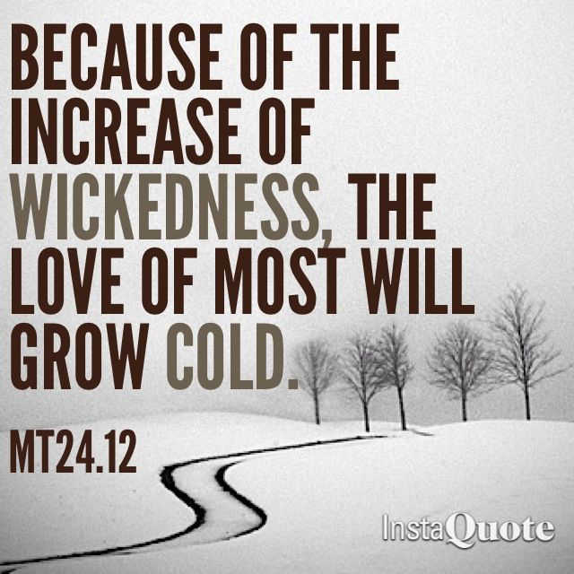

Slide 38
Isaiah 40:31 ³¹ But they that wait upon the Lord shall renew their strength; they shall mount up with wings as eagles; they shall run, and not be weary; and they shall walk, and not faint.

Slide 39
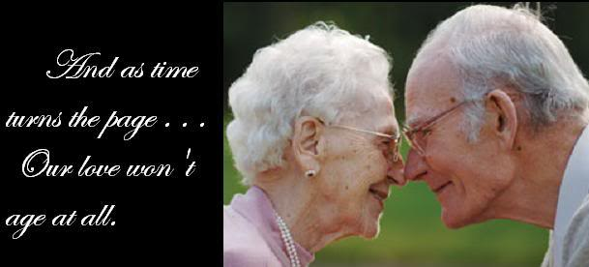
Words Matter!

Slide 40
Are you a Christian?
Hear the word of God .. Rom.10:17
Believe the Lord… John 8:24
Repent… Acts 17:30-31
Confess Christ .. Matt. 10:32,33
Be baptized.. I Pet.3:21
Live faithfully. Rev.2:10
Are you an Erring Christian..? Come home.. James 5:19; 5:16

