Slide 1
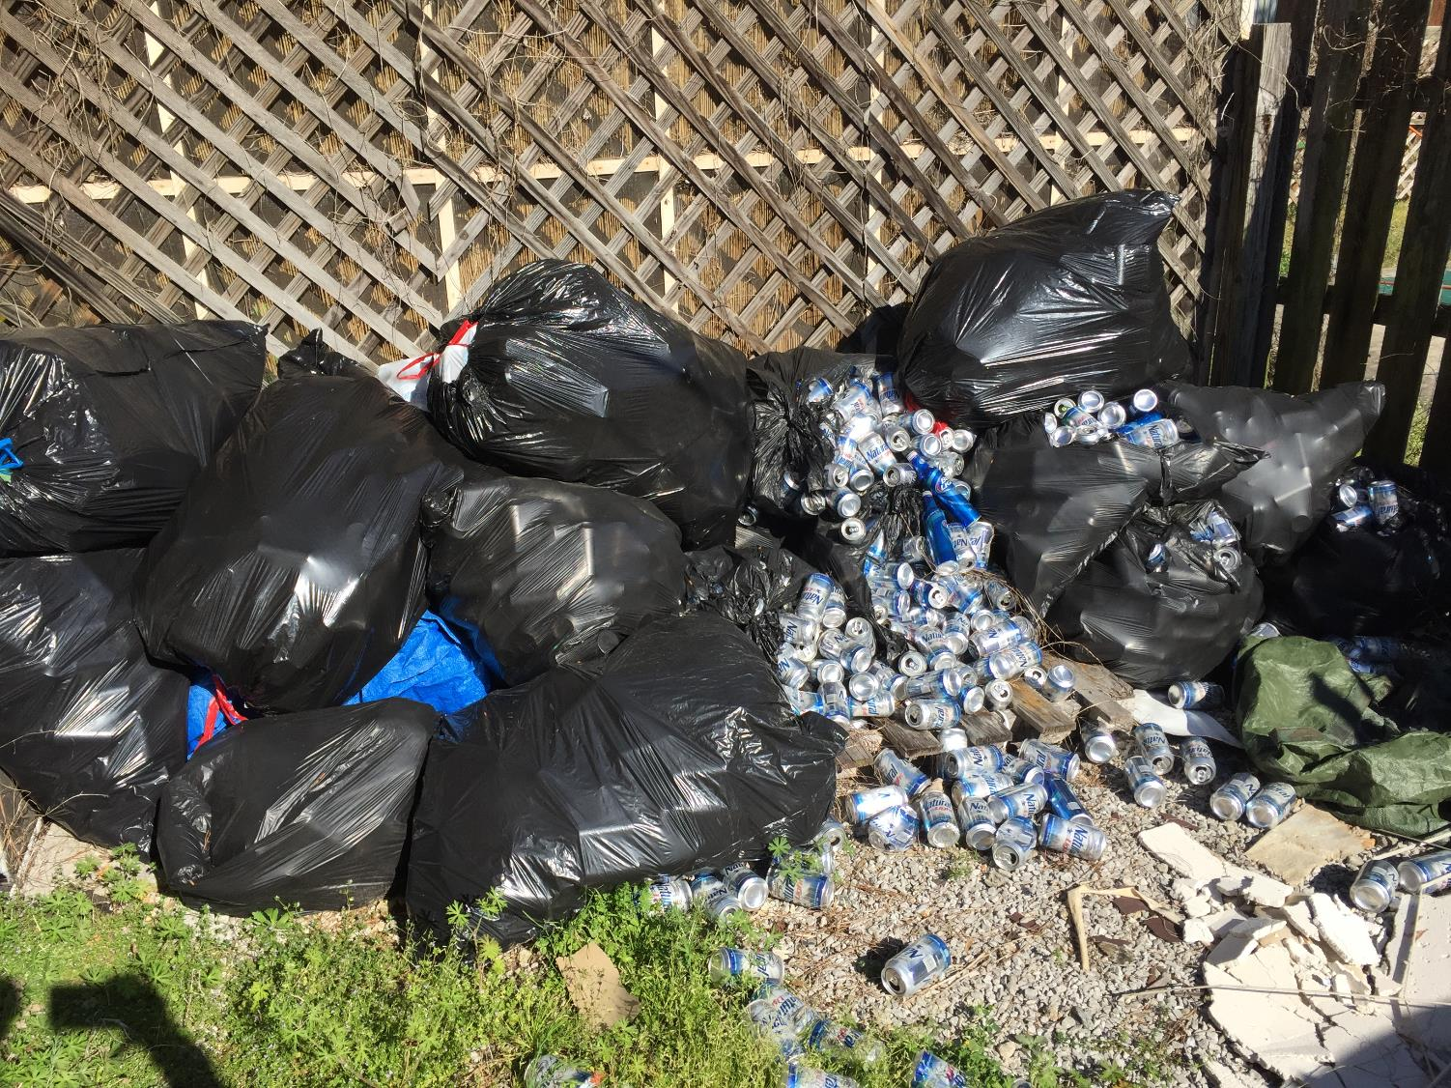

Slide 2
B
H
A
B
I
T
S
D
&
G
O
I
N
T
E
N
T
I
O
N
S
D

Slide 3
Bad Habits, Sinful Habits
Addiction –drugs, tobacco, alcohol, pills
Pornography
Gambling
Profanity
Lying, gossiping, hateful speech
To much time online/phone/TV
Wasteful overspending, theft and greed
Anything that “we just can’t stop,” from addictions to destructive attitudes.

Slide 4
Bad Habits, Sinful Habits
We must see that bad habits are spiritual issues.
We should want to change a habit, not only because it’s embarrassing, expensive, unhealthy, or makes us feel guilty, but because it is a transgression of God's Law.
When we struggle with a particular sin, we want to say that “we can’t” or “it’s just too hard to stop.”
1 Corinthians 10:13 No temptation has overtaken you but such as is common to man; and God is faithful, who will not allow you to be tempted beyond what you are able.

Slide 5
Bad Habits, Sinful Habits
It's hard to get thru the day without________!
The pull of temptation can be so strong!
Society will try to justify the way we are and say that we shouldn’t go against what comes naturally to us.
Proverbs 4:14 Do not enter the path of the wicked
And do not proceed in the way of evil men. 15 Avoid it, do not pass by it; Turn away from it and pass on. 16 For they cannot sleep unless they do evil.

Slide 6
Bad Habits, Sinful Habits
Society will tell us that morality is relative and that there is no set definition of right and wrong.
We who believe that the Bible is the inspired Word of God know that there is a definite law that we must follow!
So how can we use God’s Word to kick those bad habits?
Proverbs 16:25 There is a way which seems right to a man,
But its end is the way of death.

Slide 7
Kicking the Habit > Prayer
#1: Prayer – ask God for help
Don't overlook the power of prayer!
If your spirit is willing but your flesh is weak, ask God for help. (see the model prayer)
Matthew 26:41 Keep watching and praying that you may not enter into temptation; the spirit is willing, but the flesh is weak.
Matthew 6:13 And do not lead us into temptation, but deliver us from evil.

Slide 8
Kicking the Habit > Accountability
#2: Surround yourself with good people
The opposite is also true: good company corrects bad habits.
John 8 – Surround yourself with the kind of people that will encourage you to go and sin no more, not the people that want to cast the first stone. We need to CAREFULLY select our friends.
1 Corinthians 15:33 Do not be deceived: “Bad company corrupts good morals.”

Slide 9
Kicking the Habit > Acknowledge
#3: Admit you have a problem
(We need prayer and good friends no matter what!)
Sin loves secrecy!
But every deed will be known anyway…
James 5:16 Therefore, confess your sins to one another, and pray for one another so that you may be healed.
Ecclesiastes 12:14 For God will bring every act to judgment, everything which is hidden, whether it is good or evil.

Slide 10
Kicking the Habit > Repent
#4: Replace Evil with Good
Biblical change is not just turning away from sin; it is turning toward righteousness. (see Eph. 4)
Good habits replace sinful ones!
25 Therefore, laying aside falsehood, speak truth each one of you with his neighbor, for we are members of one another.
28 He who steals must steal no longer; but rather he must labor, performing with his own hands what is good,
29 Let no unwholesome word proceed from your mouth, but only such a word as is good for edification

Slide 11
Kicking the Habit > Tackle the Trigger
#5: Make Bad Habits Impossible
You may fail because sin is so accessible!
Look for ways to make sinning inconvenient.
Matthew 5:29 If your right eye makes you stumble, tear it out and throw it from you, 30 If your right hand makes you stumble, cut it off and throw it from you;
Acts 19:18 Many also of those who had believed kept coming, confessing and disclosing their practices. 19 And many of those who practiced magic brought their books together and began burning them in the sight of everyone;

Slide 12
Kicking the Habit > Focus on Today
#6: Take One Day at a Time
“What do I need to do to get thru today?”
Don't despair! Don’t think about how hard it will be to break the habit, but rather take one day at a time. Don't worry about tomorrow.
Matthew 6:34 “So do not worry about tomorrow; for tomorrow will care for itself. Each day has enough trouble of its own.

Slide 13
Bad Habits & Good Intentions
Both seen in Matthew 21
Good intentions can be no better than bad habits!
Matthew 21:28 (Jesus speaking in a parable) “But what do you think? A man had two sons, and he came to the first and said, ‘Son, go work today in the vineyard.’ 29 And he answered, ‘I will not’; but afterward he regretted it and went. 30 The man came to the second and said the same thing; and he answered, ‘I will, sir’; but he did not go. 31 Which of the two did the will of his father?” They said, “The first.”

Slide 14
But what are good intentions?
Acts 26:10 And this is just what I did in Jerusalem; not only did I lock up many of the saints in prisons, having received authority from the chief priests, but also when they were being put to death I cast my vote against them. 11 And as I punished them often in all the synagogues, I tried to force them to blaspheme; and being furiously enraged at them, I kept pursuing them even to foreign cities.
Paul said he did a lot of terrible things…

Slide 15
But what are good intentions?
But his intentions were good!
Good intentions can be a misunderstanding!
Acts 23:1 Paul, looking intently at the Council, said, “Brethren, I have lived my life with a perfectly good conscience before God up to this day.”

Slide 16
But what are good intentions?
Proverbs 16:1-3 The plans of the heart belong to man, But the answer of the tongue is from the Lord. All the ways of a man are clean in his own sight, But the Lord weighs the motives. Commit your works to the Lord And your plans will be established.
Good intentions can be plans & motives with no commitment!

Slide 17
We may have good intentions…
Intend to obey the Gospel…
Intend to be a better Christian (grow spiritually)…
Acts 24:25 But as he was discussing righteousness, self-control and the judgment to come, Felix became frightened and said, “Go away for the present, and when I find time I will summon you.”
Hebrews 5:12 For though by this time you ought to be teachers, you have need again for someone to teach you the elementary principles of the oracles of God, and you have come to need milk and not solid food.

Slide 18
Committed until completed
Luke 14:28 For which one of you, when he wants to build a tower, does not first sit down and calculate the cost to see if he has enough to complete it? 29 Otherwise, when he has laid a foundation and is not able to finish, all who observe it begin to ridicule him, 30 saying, ‘This man began to build and was not able to finish.’
Good intentions might motivate you to start something, but commitment will help you finish it.

Slide 19
You’ve heard the saying,
“the road to Hell…”
“Is paved with good intentions.”
I want to _________ someday.
Sin changes the heart that stays in it.
Hebrews 3:12 Take care, brethren, that there not be in any one of you an evil, unbelieving heart that falls away from the living God. 13 But encourage one another day after day, as long as it is still called “Today,” so that none of you will be hardened by the deceitfulness of sin.

Slide 20
We need to make changes now
We will all appear before God.
We will be judged based on what we do, not what we intend to do.
2 Corinthians 5:10 For we must all appear before the judgment seat of Christ, so that each one may be recompensed for his deeds in the body, according to what he has done, whether good or bad.

Slide 21
Get on the right path
Matthew 7:13 “Enter through the narrow gate; for the gate is wide and the way is broad that leads to destruction, and there are many who enter through it.
If the road to hell is paved with good intentions…
Then the path to Heaven is paved with God’s Will.
Matthew 7:21 “Not everyone who says to Me, ‘Lord, Lord,’ will enter the kingdom of heaven, but he who does the will of My Father who is in heaven will enter.

Slide 22
Conclusion
That sinful habit that you love…
It doesn't love you back.
And intending to quit a bad habit…
Isn't the same as quitting a bad habit.
Mark 8:36 For what does it profit a man to gain the whole world, and forfeit his soul? 37 For what will a man give in exchange for his soul?

Slide 23
Conclusion
Sinful habits bring the question…
Have you died to sin?
WE SHOULD!
Romans 6:1 What shall we say then? Are we to continue in sin so that grace may increase? 2 May it never be! How shall we who died to sin still live in it?
Romans 6:11 Even so consider yourselves to be dead to sin, but alive to God in Christ Jesus.

